Slide 1
Chapter 2: Operating-System Structures

Slide 2
Operating System Services
One set of operating-system services provides functions that are helpful to the user:
  User interface - Almost all operating systems have a user interface (UI)
    Varies between Command-Line (CLI), Graphics User Interface (GUI), Batch
  Program execution - The system must be able to load a program into memory and to run that program, end execution, either normally or abnormally (indicating error)
  I/O operations - A running program may require I/O, which may involve a file or an I/O device
  File-system manipulation - The file system is of particular interest. Obviously, programs need to read and write files and directories, create and delete them, search them, list file Information, permission management.

Slide 3

A View of Operating System Services

Slide 4
Operating System Services (Cont)
One set of operating-system services provides functions that are helpful to the user (Cont):
  Communications – Processes may exchange information, on the same computer or between computers over a network
    Communications may be via shared memory or through message passing (packets moved by the OS)
  Error detection – OS needs to be constantly aware of possible errors
    May occur in the CPU and memory hardware, in I/O devices, in user program
    For each type of error, OS should take the appropriate action to ensure correct and consistent computing
    Debugging facilities can greatly enhance the user’s and programmer’s abilities to efficiently use the system

Slide 5
Operating System Services (Cont)
Another set of OS functions exists for ensuring the efficient operation of the system itself via resource sharing
  Resource allocation - When multiple users or multiple jobs running concurrently, resources must be allocated to each of them
    Many types of resources - Some (such as CPU cycles, main memory, and file storage) may have special allocation code, others (such as I/O devices) may have general request and release code
  Accounting - To keep track of which users use how much and what kinds of computer resources
  Protection and security - The owners of information stored in a multiuser or networked computer system may want to control use of that information, concurrent processes should not interfere with each other
    Protection involves ensuring that all access to system resources is controlled
    Security of the system from outsiders requires user authentication, extends to defending external I/O devices from invalid access attempts
    If a system is to be protected and secure, precautions must be instituted throughout it. A chain is only as strong as its weakest link.

Slide 6
User Operating System Interface - CLI
Command Line Interface (CLI) or command interpreter allows direct command entry
    Sometimes implemented in kernel, sometimes by systems program
    Sometimes multiple flavors implemented – shells
    Primarily fetches a command from user and executes it
      Sometimes commands built-in, sometimes just names of programs
        If the latter, adding new features doesn’t require shell modification

Slide 7
User Operating System Interface - GUI
User-friendly desktop metaphor interface
  Usually mouse, keyboard, and monitor
  Icons represent files, programs, actions, etc
  Various mouse buttons over objects in the interface cause various actions (provide information, options, execute function, open directory (known as a folder)
  Invented at Xerox PARC
Many systems now include both CLI and GUI interfaces
  Microsoft Windows is GUI with CLI “command” shell
  Apple Mac OS X as “Aqua” GUI interface with UNIX kernel underneath and shells available
  Solaris is CLI with optional GUI interfaces (Java Desktop, KDE)

Slide 8
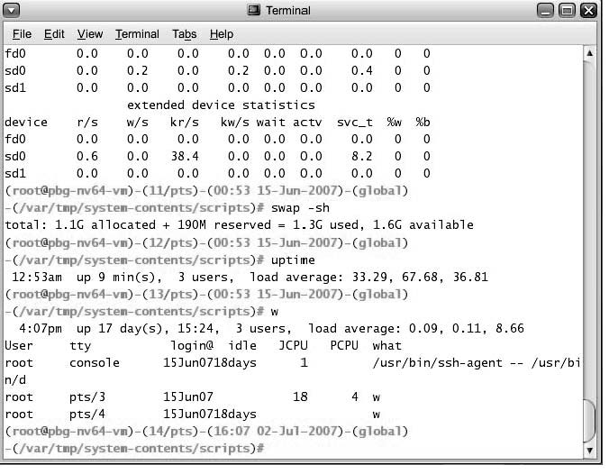
Bourne Shell Command Interpreter

Slide 9

The Mac OS X GUI

Slide 10
System Calls
Programming interface to the services provided by the OS
Typically written in a high-level language (C or C++)
Mostly accessed by programs via a high-level Application Program Interface (API) rather than direct system call use
Three most common APIs are Win32 API for Windows, POSIX API for POSIX-based systems (including virtually all versions of UNIX, Linux, and Mac OS X), and Java API for the Java virtual machine (JVM)
Why use APIs rather than system calls?
(Note that the system-call names used throughout this text are generic)

Slide 11

Example of System Calls
System call sequence to copy the contents of one file to another file

Slide 12

Example of Standard API
Consider the ReadFile() function in the
Win32 API—a function for reading from a file
A description of the parameters passed to ReadFile()
  HANDLE file—the file to be read
  LPVOID buffer—a buffer where the data will be read into and written from
  DWORD bytesToRead—the number of bytes to be read into the buffer
  LPDWORD bytesRead—the number of bytes read during the last read
  LPOVERLAPPED ovl—indicates if overlapped I/O is being used

Slide 13
System Call Implementation
Typically, a number associated with each system call
  System-call interface maintains a table indexed according to these numbers
The system call interface invokes intended system call in OS kernel and returns status of the system call and any return values
The caller need know nothing about how the system call is implemented
  Just needs to obey API and understand what OS will do as a result call
  Most details of OS interface hidden from programmer by API
    Managed by run-time support library (set of functions built into libraries included with compiler)

Slide 14

API – System Call – OS Relationship

Slide 15

Standard C Library Example
C program invoking printf() library call, which calls write() system call

Slide 16
System Call Parameter Passing
Often, more information is required than simply identity of desired system call
  Exact type and amount of information vary according to OS and call
Three general methods used to pass parameters to the OS
  Simplest: pass the parameters in registers
    In some cases, may be more parameters than registers
  Parameters stored in a block, or table, in memory, and address of block passed as a parameter in a register
    This approach taken by Linux and Solaris
  Parameters placed, or pushed, onto the stack by the program and popped off the stack by the operating system
  Block and stack methods do not limit the number or length of parameters being passed

Slide 17
Types of System Calls
Process control
File management
Device management
Information maintenance
Communications
Protection

Slide 18

Examples of Windows and Unix System Calls

Slide 19
OS organization types
Kernel based systems
Microkernel-based systems
Virtual machines

Slide 20
Kernel based systems
Traditional organization of Unix systems
Kernel-space
  Sensitive stuff, controlled only by the OS
  Provides the file system, CPU scheduling, memory management, and other operating-system functions;
    a large number of functions for one level
  An error in the kernel can crash the OS
User-space
  Applications programs
  Whatever they do, they cannot bring down the OS

Slide 21

Traditional UNIX System Structure

Slide 22
Microkernels
Idea: make the kernel small
  Moves as much from the kernel into “user” space
  Communication takes place between user modules using message passing
(Claimed) benefits:
  Easier to extend a microkernel
  Easier to port the operating system to new architectures
  More reliable (less code is running in kernel mode)
  More secure
Detriments:
  Performance overhead of user space to kernel space communication

Slide 23
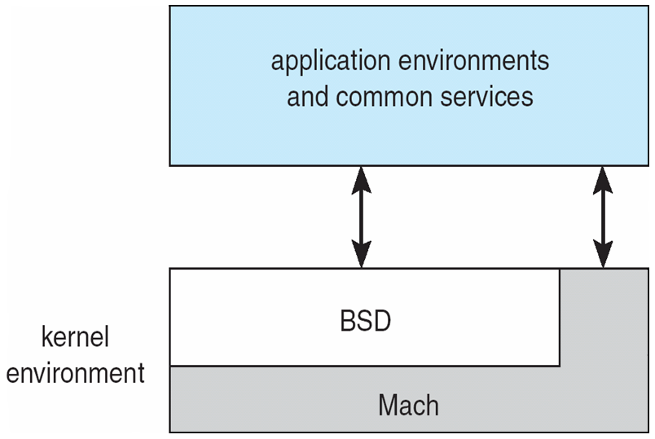
Mac OS X Structure

Slide 24
Kernel modules
Most modern operating systems implement kernel modules
  Uses object-oriented approach
  Each core component is separate
  Each talks to the others over known interfaces
  Each is loadable as needed within the kernel

Slide 25
Virtual Machines
A virtual machine: treats hardware and the operating system kernel as though they were all hardware
A virtual machine provides an interface identical to the underlying bare hardware
The operating system host creates the illusion that a process has its own processor and (virtual memory)
Each guest provided with a (virtual) copy of underlying computer

Slide 26
Virtual Machines History and Benefits
First appeared commercially in IBM mainframes in 1972
Fundamentally, multiple execution environments (different operating systems) can share the same hardware
Protect from each other
Some sharing of file can be permitted, controlled
Commutate with each other, other physical systems via networking
Useful for development, testing
Consolidation of many low-resource use systems onto fewer busier systems
“Open Virtual Machine Format”, standard format of virtual machines, allows a VM to run within many different virtual machine (host) platforms

Slide 27

Virtual Machines (Cont)
(a) Nonvirtual machine (b) virtual machine
Non-virtual Machine
Virtual Machine

Slide 28
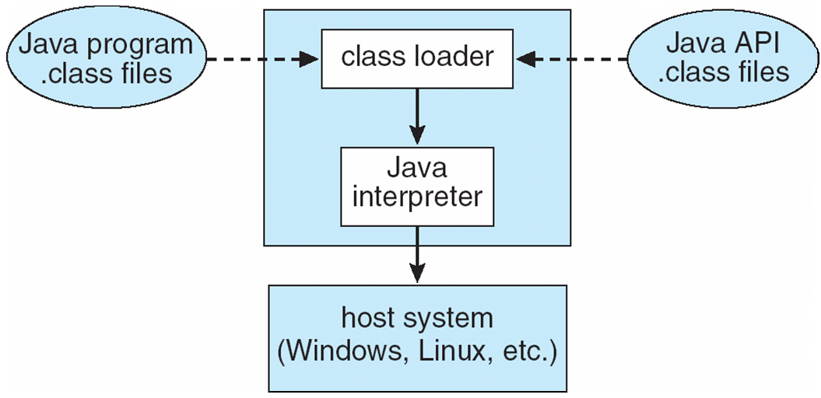
The Java Virtual Machine

Slide 29
End of Chapter 2

