Slide 1
Canny Algorithm, Part One
So, the main difference between Canny Part One and Sobel is
the smoothener (Canny uses a Gaussian Sobel uses the four one’s.
To write code for canny, we will start with marrh.c and do these steps.
-- Marrh.c uses flexible size masks (which we need), we will keep
this part of the code.
-- Marrh.c uses second derivatives, whereas we need only first derivatives
(we need first x- and y- derivatives), so we will change the equation
in the marrh.c line to be the first x-derivative.
-- Then, because we need two derivatives, we will double up on that line,
i.e., make a copy of it to compute the y-derivative, finally ending
up with two masks (xmask and ymask).

Slide 2
Canny Algorithm, Part One
-- Then use the convolution code from marrh but remember to double up on it, to get two outputs.
-- Then delete the code in marrh that is below the convolution code.
-- Then bring in the sqrt (of squares) code from sobel. This will compute the
magnitude, will scale it for output, and will print it out.
-- At this point, you are done with Canny part One, and your code should
produce output very similar to the Sobel magnitude image.

Slide 3
Canny Part Two
Also called Non-maximaSuppression

Slide 5
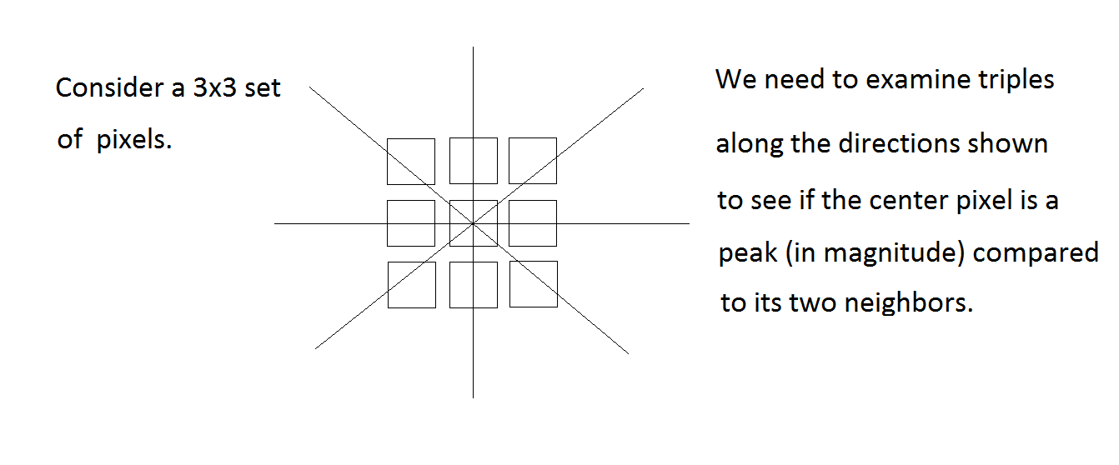

Slide 6
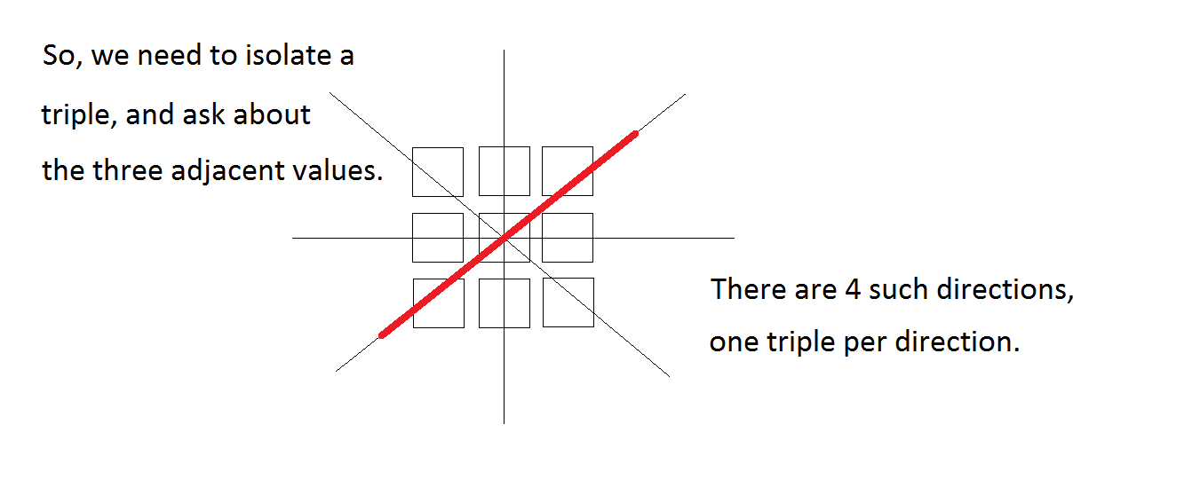

Slide 7
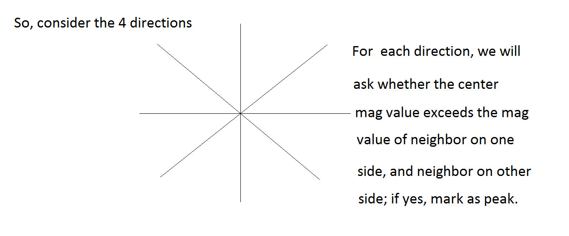

Slide 8
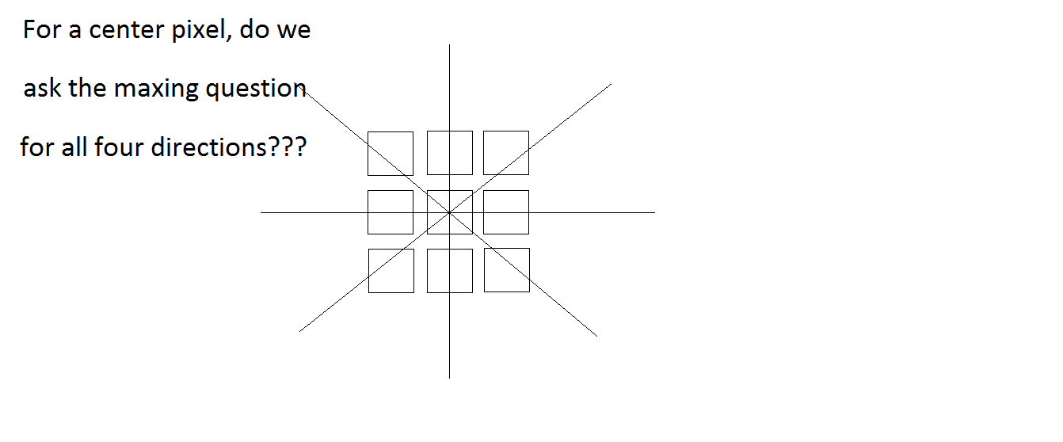

Slide 9
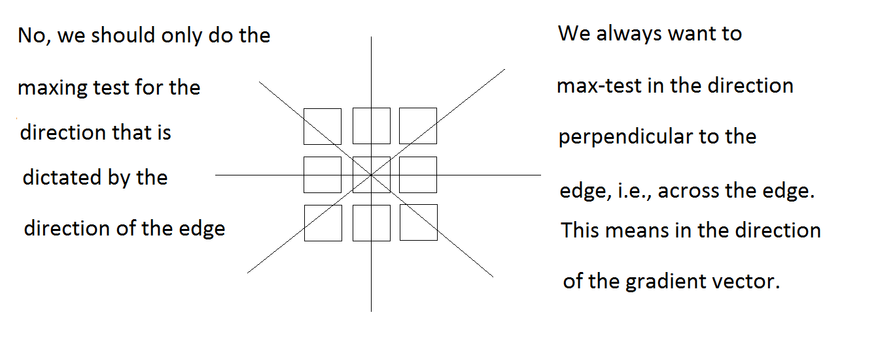

Slide 10
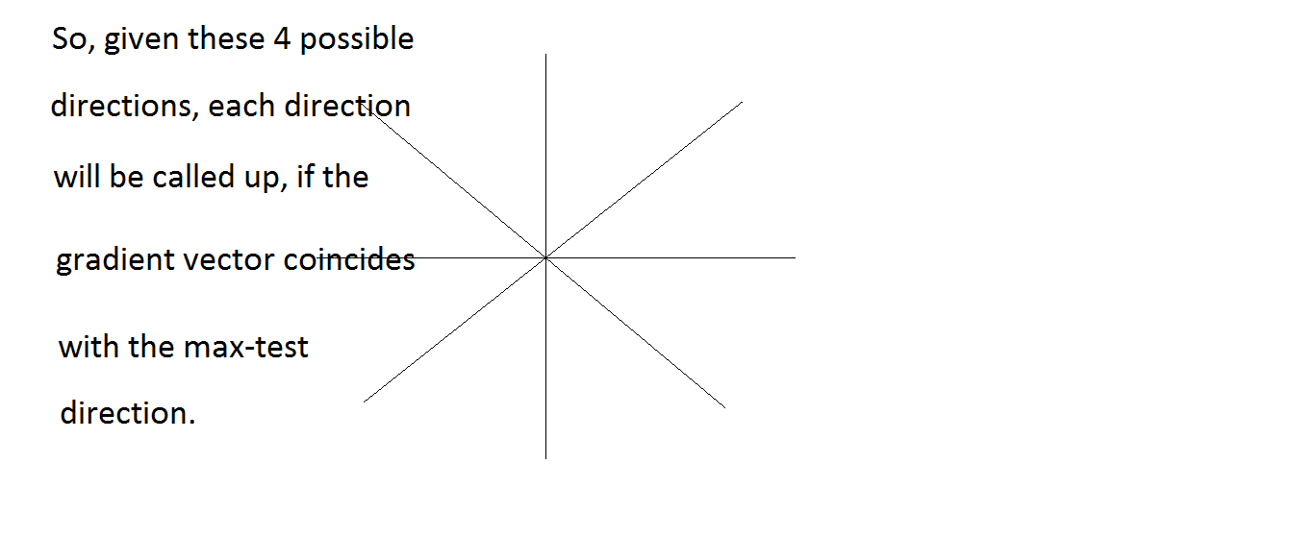

Slide 11
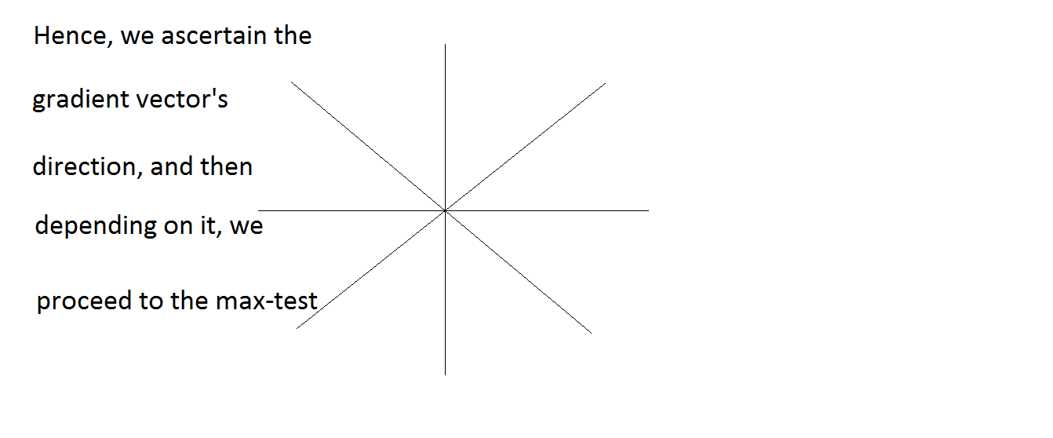

Slide 12
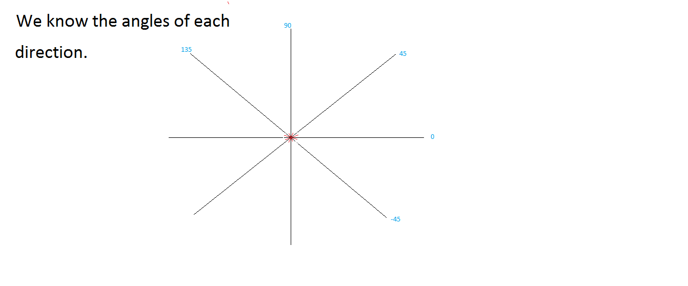

Slide 13
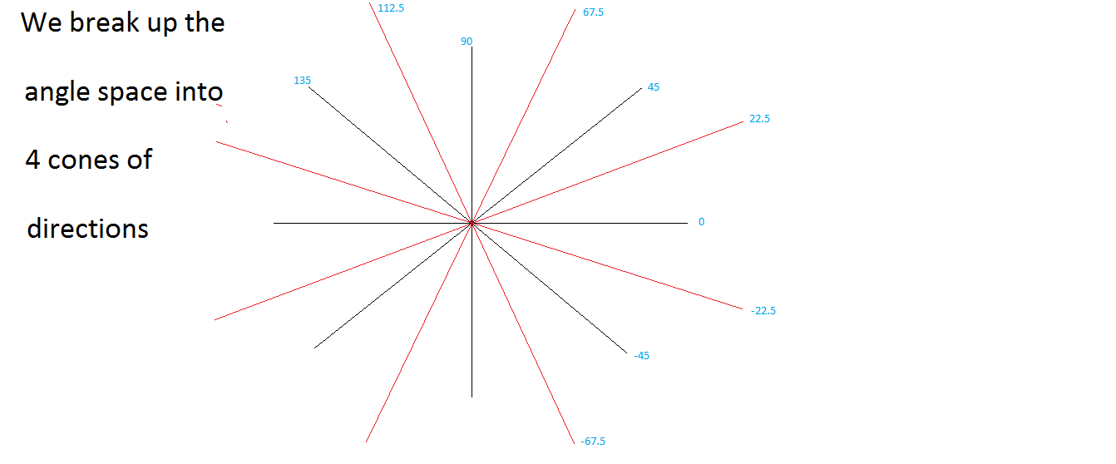

Slide 14
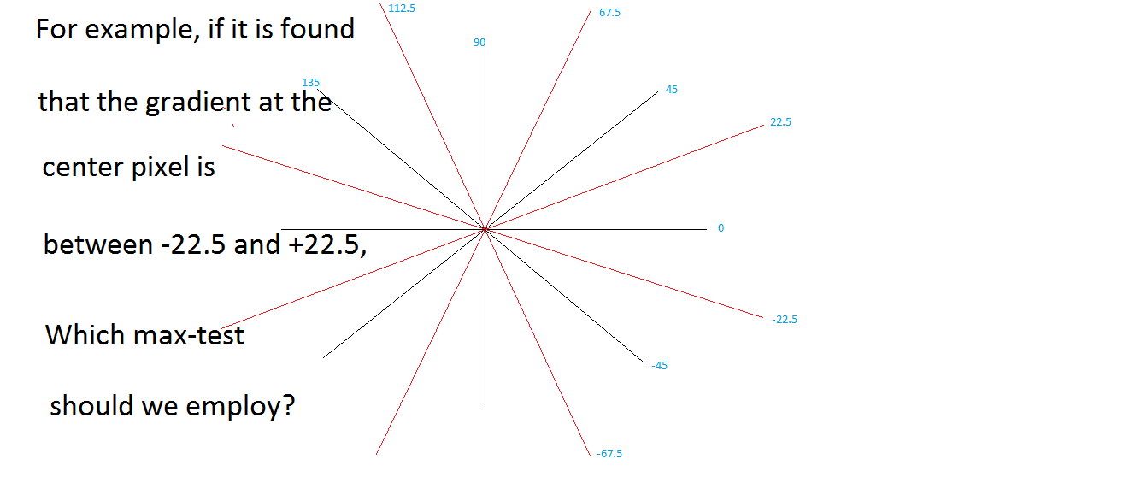

Slide 16
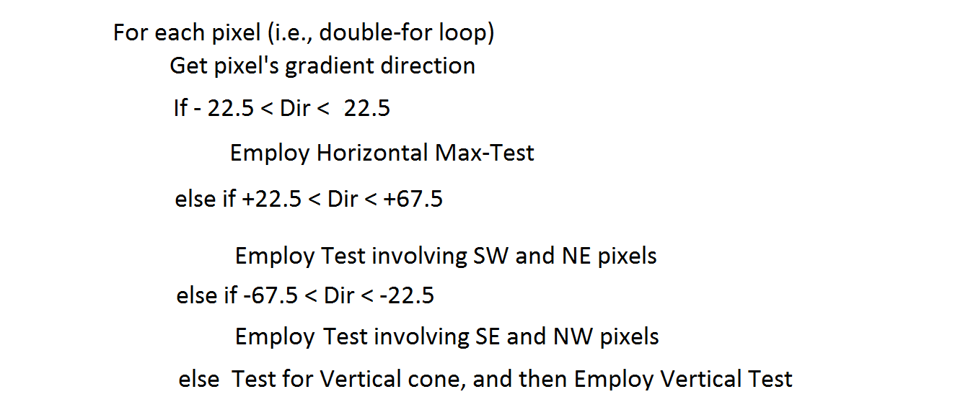

Slide 17
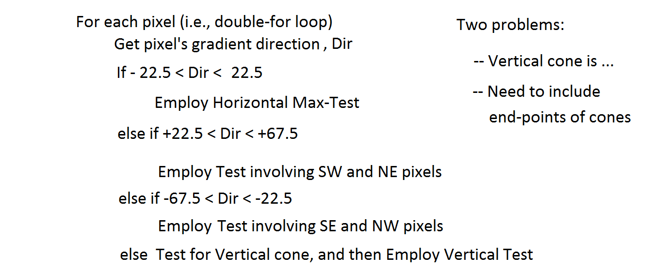

Slide 18
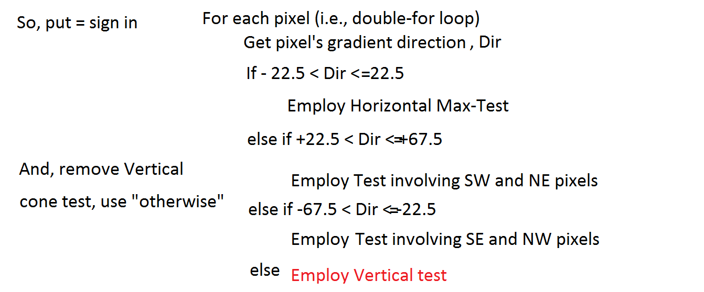

Slide 19
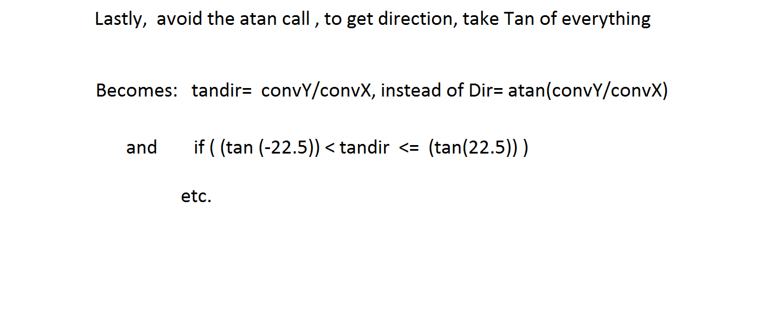

Slide 20
Actual code for Peaks
for(i=MR;i<256-MR;i++){
for(j=MR;j<256-MR;j++){
if((xconv[i][j]) == 0.0) {
xconv[i][j] = .00001;
}
slope = yconv[i][j]/xconv[i][j];
if( (slope <= .4142)&&(slope > -.4142)){
if((mag[i][j] > mag[i][j-1])&&(mag[i][j] > mag[i][j+1])){
cand[i][j] = 255;
}
}
else if( (slope <= 2.4142)&&(slope > .4142)){
if((mag[i][j] > mag[i-1][j-1])&&(mag[i][j] > mag[i+1][j+1])){
cand[i][j] = 255;
}
}
else if( (slope <= -.4142)&&(slope > -2.4142)){
if((mag[i][j] > mag[i+1][j-1])&&(mag[i][j] > mag[i-1][j+1])){
cand[i][j] = 255;
}
}else{
if((mag[i][j] > mag[i-1][j])&&(mag[i][j] > mag[i+1][j])){
cand[i][j] = 255;
}
}
}
}

Slide 21
Hysteresis (Double) Threshold

