Slide 1
01 / ARCHITECTURE
An agent connects the tools to the conversation.
Owned job
Result IDs
Researcher
Agent worker
Visual reply
Next.js + Keycloak
OpenShell / Codex CLI
Saved, typed React cards
Review context
Reference query
Meterless H-MEM
Scientific tools
Zetaris
Recall saved reviews
and their sources
Measure expression.
Score cell types.
Retrieve the versioned
marker reference
PostgreSQL: owned experiments, queued turns, results, reviews and memory history
CELLORAS / TECHNICAL COMPANION
01
Notes:
The browser authenticates through Keycloak. PostgreSQL stores owner-scoped jobs. The worker runs the server-side OpenShell/Codex agent, validates typed tool requests and saves canonical results. Scientific tools retrieve the reference through Zetaris and measure the count matrix outside the model. H-MEM supplies reviewed decisions as context at turn start. The model explains and recommends, and returns typed card/result IDs. The browser resolves only completed owned results. The diagram groups services by responsibility; it does not imply H-MEM is an external server or Zetaris runs the count matrix.
Sources:
https://github.com/mpckkk/2026_GenAI/blob/celloras.com/infra/agent/worker.mjs
https://github.com/mpckkk/2026_GenAI/blob/celloras.com/app/services/analysis-tools.mjs
https://github.com/mpckkk/2026_GenAI/blob/celloras.com/app/services/agent-response.mjs
https://github.com/mpckkk/2026_GenAI/blob/celloras.com/docs/architecture.md

Slide 2
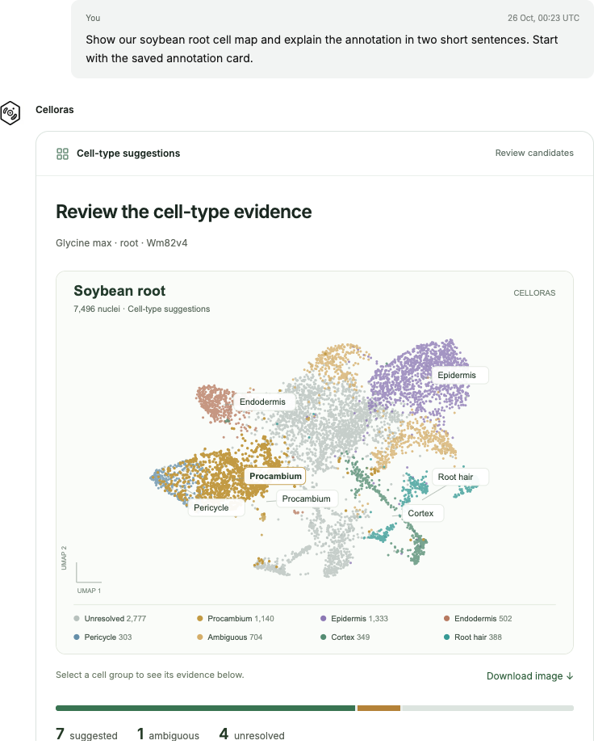
02 / THE RESEARCHER SEES THIS
A visual answer, with evidence to inspect.
The agent proposes
cell types and
explains why.
Its reply can contain the same
interactive map and evidence
cards used across Celloras.
You can challenge the result,
review its sources, and save
a correction in the conversation.
CELLORAS / TECHNICAL COMPANION
02
Notes:
This is an actual authenticated agent conversation captured from celloras.com on 26 October 2026. No reply text, analysis result or map was fabricated. The agent was asked to show the saved annotation card and briefly explain it. It uses the existing React annotation card with computed cell-type suggestions and unresolved groups. Captured content is a cropped viewport of that actual turn. The underlying annotation was completed on 25 October. The screenshot shows the product interaction, not a fresh independent accuracy evaluation.
Sources:
https://github.com/mpckkk/2026_GenAI/blob/celloras.com/docs/demo.md
https://github.com/mpckkk/2026_GenAI/blob/celloras.com/app/(workspace)/app/annotation-card.tsx
https://github.com/mpckkk/2026_GenAI/blob/celloras.com/app/core/agent-response.schema.json

Slide 3
03 / DATA SOURCES
Each source answers a different part of the question.
MEASURED CELLS
Your H5AD / published root demo
Celloras agent
7,496 nuclei, RNA counts, original UMAP
MARKER REFERENCE
Compare measured activity
with compatible marker evidence.
Explain candidates and uncertainty.
Published Table S2 via Zetaris
42 associations, 41 genes, 9 root cell types
RESEARCH CONTEXT
Curated papers and guide
3 sources, 68 searchable passages
Saved reviews enter separately
through Meterless H-MEM.
Next connections: SoyBase mapping, live orthology and compatible nodule reference panels.
CELLORAS / TECHNICAL COMPANION
03
Notes:
This separates measured data, marker associations, literature context and researcher interpretation. GSE270392 and soybean-atlas.com describe the same underlying published atlas and are not independent confirmation. The numeric panel includes associations originally supported by Arabidopsis orthology, with that provenance retained, but Celloras does not currently perform live ortholog mapping. The root/nodule paper is in the literature collection; its gene build is not automatically transferred to the Wm82v4 panel. Guide ingestion is abstract-only. H5AD uploads now enter an owned inspection/import queue and retain the original counts and UMAP. The public uploaded-file workflow passed on 26 October. SoyBase and broader nodule annotation remain planned, not active reference adapters. All count-matrix data stays numeric rather than being embedded as text.
Sources:
https://github.com/mpckkk/2026_GenAI/blob/celloras.com/data/datasets/gse270392-root-rna-v1.json
https://github.com/mpckkk/2026_GenAI/blob/celloras.com/data/references/soybean-annotation-v1.json
https://github.com/mpckkk/2026_GenAI/blob/celloras.com/data/literature/soybean-v1.json
https://github.com/mpckkk/2026_GenAI/blob/celloras.com/docs/literature.md

Slide 4
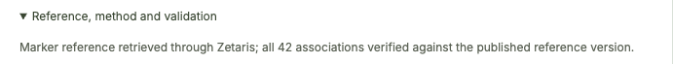
04 / ZETARIS
Zetaris supplies the reference used for annotation.
A real, read-only SQL connection
SELECT record_index, record_json, content_sha256
FROM CELLORAS.marker_reference_v1
WHERE reference_id = <pinned reference>
ORDER BY record_index
42
associations verified
1 Retrieve all 42 associations.
2 Verify their order, count and content hash.
3 Save a query receipt with the result.
41 genes · 9 root cell types
Annotation stops if verification fails.
CELLORAS / TECHNICAL COMPANION
04
Notes:
Official Zetaris hackathon self-hosted stack 2.4.3.1 runs on the Linux server in a separate Compose project. The app uses a dedicated SELECT-only account and private network API. CELLORAS.marker_reference_v1 is a Lightning filestore table over a mounted JSON array. The actual adapter runs fixed operator-owned SQL through /api/v1.0/query/sql/start, validates the pinned full canonical content SHA, closes the query cursor and saves a non-secret delivery receipt. The model cannot supply SQL. One pinned table is demonstrated, not multi-source federation or matrix ingestion. Public annotation run af2c9005-6be1-4f7c-baf4-dede8d06155c has query receipt f7fbb611-05df-4f96-83c8-efe2e60e8d32. SQL on the slide uses an explanatory placeholder for the pinned reference id.
Sources:
https://github.com/mpckkk/2026_GenAI/blob/celloras.com/app/adapters/zetaris-reference.mjs
https://github.com/mpckkk/2026_GenAI/blob/celloras.com/docs/sponsor-explanation.md
https://github.com/mpckkk/2026_GenAI/blob/celloras.com/docs/configuration.md

Slide 5
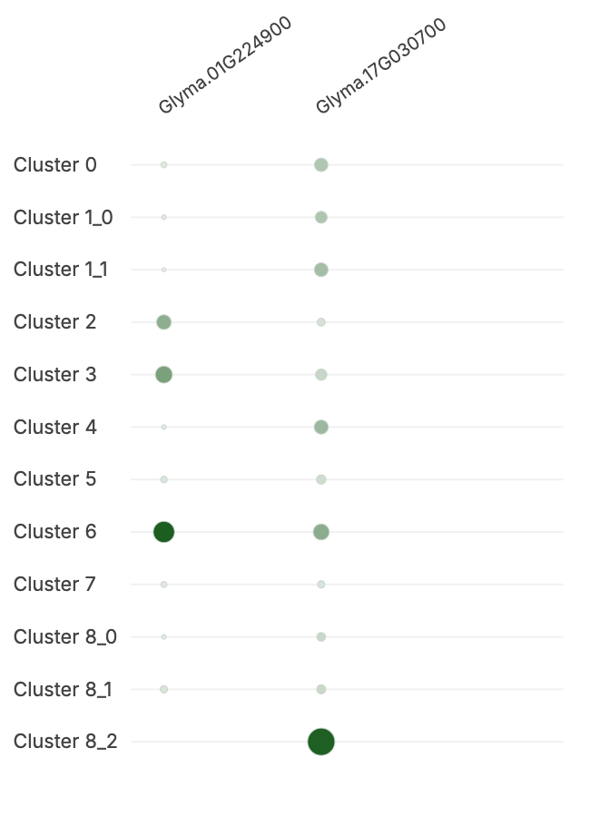
05 / ANNOTATION
The candidate comes from measured gene activity.
Example: group 6, 388 nuclei
01
Normalise raw counts
log1p(count / cell total × 10,000)
02
Compare each group
Mean expression, detection and group-versus-rest
03
Score compatible markers
Across-group z-scores and published gene sets
04
Return a candidate
Root hair, supported by two measured genes
7 suggested groups / 1 ambiguous / 4 unresolved
CELLORAS / TECHNICAL COMPANION
05
Notes:
The deterministic engine consumes compatible species, tissue and Wm82v4 data, never source cell labels. Means include zeros. It calculates across-group gene z-scores and divides the sum for available genes by each cell type reference gene count. Supporting genes must meet detection >=0.1, cluster-rest mean log delta >=0.1, and z>=0.5. A candidate requires at least two supporting genes, >=50% reference availability and score>=0.5. A competitor within 0.25 makes the result ambiguous. Group 6 is supported by Glyma.01G224900 and Glyma.17G030700. 2,952 independent base-R numerical comparisons passed within 1e-10. This checks implementation arithmetic, not general biological accuracy. The source-label comparison uses the same study; no independent benchmark has been demonstrated. The 25-nucleus group 8_2 disagreement remains visible. The dot plot is an actual stored analysis.
Sources:
https://github.com/mpckkk/2026_GenAI/blob/celloras.com/docs/annotation-method.md
https://github.com/mpckkk/2026_GenAI/blob/celloras.com/app/adapters/annotation-engine.mjs
https://github.com/mpckkk/2026_GenAI/blob/celloras.com/app/adapters/scientific-data.mjs

Slide 6
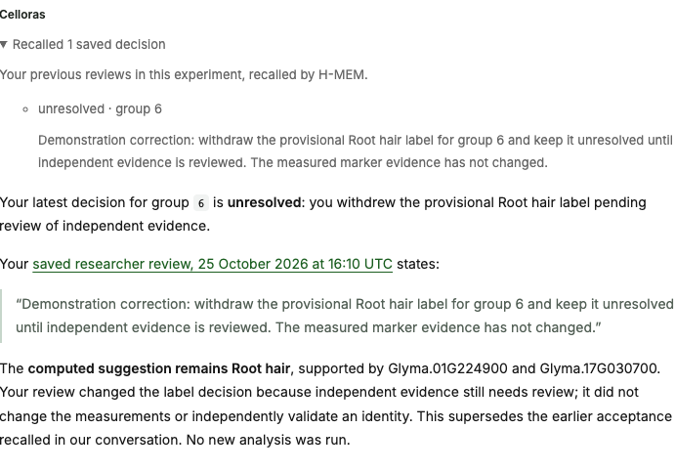
06 / METERLESS H-MEM
The next answer remembers the reviewed decision.
Saved review
Root hair, provisional
Corrected review
Unresolved pending independent evidence
Next agent turn
Recall the latest review and cite its source
The correction changes the saved decision. The computed evidence stays intact.
CELLORAS / TECHNICAL COMPANION
06
Notes:
Meterless official H-MEM reference revision 1742dec56a66e58eef9dda2d2b865823758ca8cd is vendored with its license and reproducible runtime. On an owned turn, Celloras synchronises explicit saved reviews, superseding only the same annotation-run/cluster or marker-entry target. The reference hashed embeddings and hybrid retrieval rank relevant records; exact named-group selection is application logic. Up to five memories reach the model with canonical source links. PostgreSQL retains the engine snapshot and append-only ledger. Memory is not paper retrieval or biological validation. Automatic mining, dreaming and semantic conflict resolution are disabled. All 13 upstream conformance checks passed; a real public review beyond 31 newer notes was recalled, and correction/account-isolation checks passed. Screenshot records the 25 October demonstration correction.
Sources:
https://github.com/mpckkk/2026_GenAI/blob/celloras.com/app/adapters/research-memory.mjs
https://github.com/mpckkk/2026_GenAI/blob/celloras.com/third_party/meterless-hmem/README.md
https://github.com/mpckkk/2026_GenAI/blob/celloras.com/docs/sponsor-explanation.md
https://github.com/mpckkk/2026_GenAI/blob/celloras.com/docs/verification.md

Slide 7
07 / STORAGE AND BOUNDARIES
Different data needs different storage.
Data | Where it lives | How the agent uses it
RNA counts and UMAP | Verified sparse files | Runs numerical tools on the matrix
Published marker genes | Zetaris reference table | Retrieves a checked reference version
Papers and guide | Curated passage files | Searches text and returns source links
Experiments and results | PostgreSQL | Reads only the authenticated project
Reviewed decisions | H-MEM + PostgreSQL | Recalls relevant decisions with receipts
Typed tool requests. Owned result IDs. Immutable saved results. No model-written SQL.
CELLORAS / TECHNICAL COMPANION
07
Notes:
Keycloak handles login and credentials. The app enforces ownership before project/data/model/memory operations. Agent output must satisfy a JSON schema; cards reference canonical owned records, never arbitrary model-written HTML or fabricated chart payloads. The worker limits scientific tools to four per turn and saves JSON activity events with run identifiers. Failed/cancelled turns cannot expose completed result endpoints. H5AD uploads use checksummed 8 MiB chunks, PostgreSQL queue state and a bounded Python importer. The imported bundle is immutable and private to the owned experiment; the app and agent mount it read-only. The count matrix stays in numeric files, not a vector database. Curated literature currently uses lexical search, while H-MEM uses its reference hashed-embedding retrieval only for explicit reviews. NeMo Files and an NVIDIA observability dashboard are not active.
Sources:
https://github.com/mpckkk/2026_GenAI/blob/celloras.com/app/services/analysis-tools.mjs
https://github.com/mpckkk/2026_GenAI/blob/celloras.com/app/services/agent-response.mjs
https://github.com/mpckkk/2026_GenAI/blob/celloras.com/app/core/agent-response.schema.json
https://github.com/mpckkk/2026_GenAI/blob/celloras.com/infra/agent/worker.mjs
https://github.com/mpckkk/2026_GenAI/blob/celloras.com/app/adapters/research-memory.mjs

Slide 8
08 / DEMO EVIDENCE
One workflow makes the judging criteria visible.
Criterion | What the video shows | Proof already recorded
Demo / 15 points | Cell map, marker evidence, review, recall | Public H5AD workflow, 26 Oct
Product & UX / 10 points | Clickable map and evidence cards in chat | Desktop and mobile browser checks
Sponsor tech / 10 points | Zetaris provenance + H-MEM review recall | Real SQL receipt and sourced memory
NVIDIA OpenShell runs the CLI agent on the server.
The required pair is Zetaris + a Meterless Engine. Cursor and NVIDIA are optional.
CELLORAS / TECHNICAL COMPANION
08
Notes:
The points are copied from the user-provided judging screenshot: Demo 15, Product & UX 10, Sponsor Tech 10. These are rubric weights, not awarded scores or an inferred complete rubric. The user supplied updated submission instructions requiring only Zetaris and a Meterless Engine in a working feature, with Cursor and NVIDIA optional. Celloras uses Zetaris, Meterless H-MEM and NVIDIA OpenShell. It does not claim Cursor usage, a working Nemotron call or an NVIDIA observability dashboard. The 26 October uploaded-file acceptance used the same project for H5AD upload, annotation, a real reference receipt, supporting gene plot, an illustrative saved review and H-MEM recall. The separate 25 October prepared workflow also proved correction recall. The current video is still to be recorded. The prepared workflow script resumes saved verified turns; replay is not a new benchmark or fresh inference for every step.
Sources:
https://github.com/mpckkk/2026_GenAI/blob/celloras.com/docs/demo.md
https://github.com/mpckkk/2026_GenAI/blob/celloras.com/docs/sponsor-explanation.md
https://github.com/mpckkk/2026_GenAI/blob/celloras.com/docs/verification.md

Slide 9
09 / CURRENT STAGE
From uploaded counts to a reviewed cell map.
Working in the public demo
Next scientific work
H5AD upload and data checks
Interactive map and annotation
Live Zetaris marker reference
Meterless H-MEM review recall
Independent biological validation
Broader marker coverage
Gene-build and ortholog mapping
Other tissues and plants
One actual uploaded dataset, one agent conversation, both required sponsors.
Demo input: 7,496 soybean root nuclei. Original counts, groups and UMAP preserved.
CELLORAS / TECHNICAL COMPANION
09
Notes:
Public upload workflow accepted on 26 October 2026, source release e153cf8. The real browser downloaded the verified 28,919,346-byte sample, uploaded and inspected it, explicitly selected raw counts/groups/UMAP and imported all 7,496 nuclei and 40,127 genes. The OpenShell/Codex agent annotated the owned dataset, returned its 7,496-cell map, compared two measured genes, and recalled a saved illustrative review through Meterless H-MEM. Annotation run f21b6943-c980-454b-8870-643773341ae9 retains Zetaris request e37392b3-f96d-4ee6-82e9-73fe75b301a2. The sample is a transparent lossless H5AD conversion of the published GSE270392 root RDS, not an author-deposited H5AD or raw sequencing reads. Native SOTA Root.scRNA.h5ad has normalized noninteger values and SoyZH13 IDs and is unsuitable for this Wm82v4 raw-count workflow. Limits include existing groups/UMAP and compatible soybean-root reference identifiers; no FASTQ processing, QC, new clustering, new embedding, automatic cross-build mapping or independent biological accuracy benchmark is claimed. The 4 GiB upload ceiling has not been load-tested. Broader local MicroVM freeform tests have shown intermittent execution failures, separate from this passing public Linux workflow. The video remains to be recorded.
Sources:
https://github.com/mpckkk/2026_GenAI/blob/celloras.com/docs/verification.md
https://github.com/mpckkk/2026_GenAI/blob/celloras.com/docs/h5ad-source.md
https://github.com/mpckkk/2026_GenAI/blob/celloras.com/docs/configuration.md
https://celloras.com/app/projects/fd21eefc-6a63-4c06-89fd-007ed138c77f

