Slide 1
Understanding the Effect of Certain Socioeconomic Factors on Mental Health Outcomes
Medha Pappula & Kade Yen

Slide 2
Project Goal
Mental health => leading global concern
Individuals with lower socioeconomic status => exhibits higher rates of mental disorders and vice versa for higher socioeconomic status individuals
Leads to our question:
What specific socioeconomic factors among adults in the United States have a profound impact on mental health severity?

Slide 3
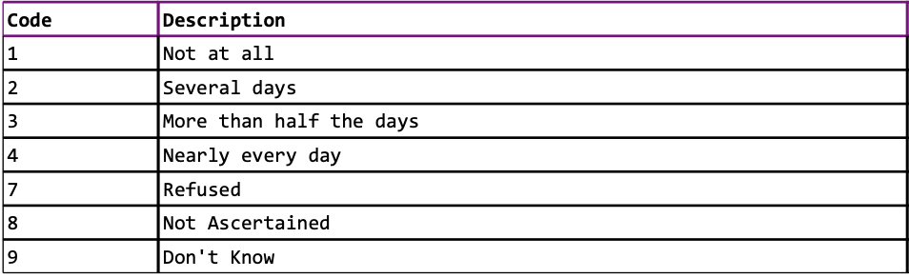
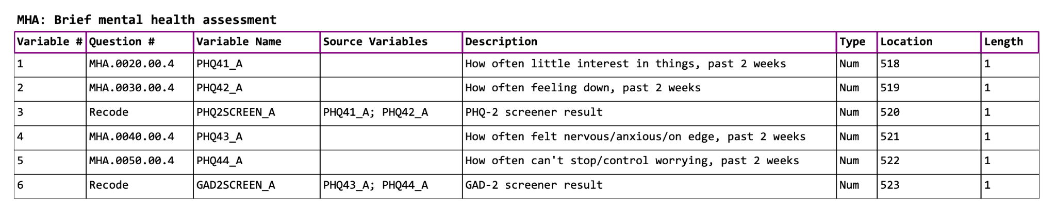
Dataset Description
https://www.cdc.gov/nchs/nhis/2023nhis.htm
29522 instances
647 attributes
Class Label
Combines PHQ41_A, PHQ42_A, PHQ44_A, and PHQ44_A attributes

Slide 4
Pre-Processing
Removal of all attributes with >70% missing because:
Lack of information - little value
Curse of dimensionality - increases complexity of model with little improvement
Leads to overfitting
We removed these by deleting the attribute all together.

Slide 5
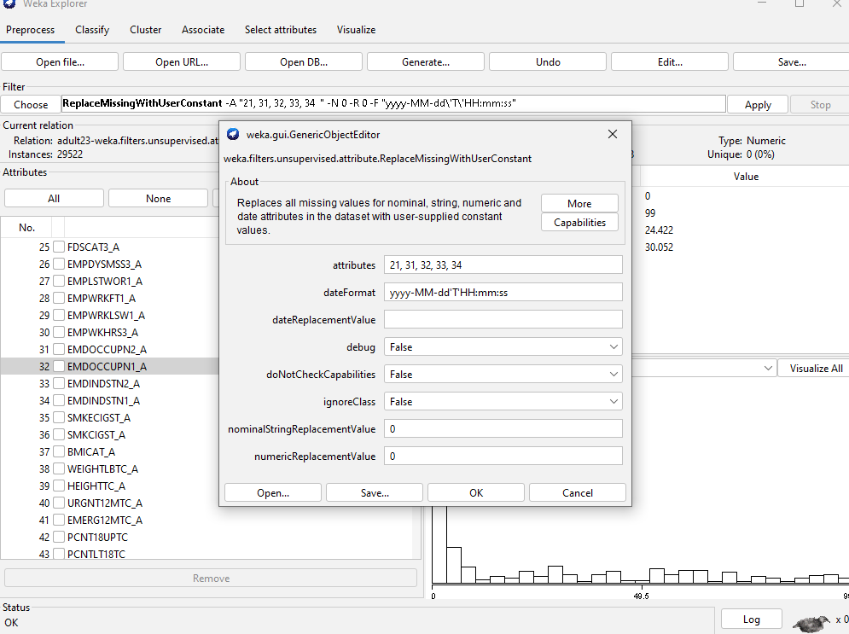
Pre-Processing - Continued
Filling in default values within the attribute because:
Not everyone willing to answer questions
Refusal to answer
Participants don’t know if they have or don’t have
Replaced default value using Weka’s
ReplaceMissingWithUserConstant

Slide 6
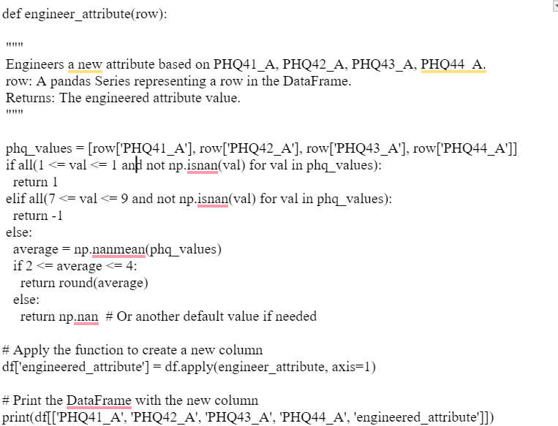
Pre-Processing - Continued
Engineering the class attribute involved combining the 4 previously mentioned into a class variable. This was completed using a python script.
Overall left with 336 attributes.

Slide 7
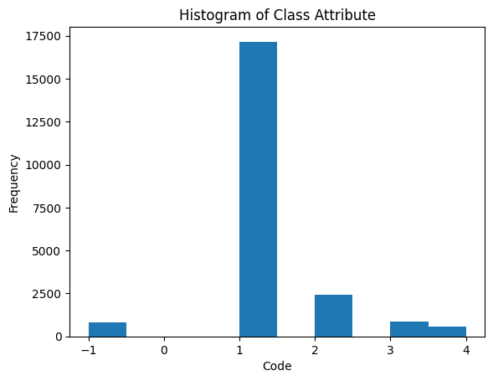
Spread of Class Variable

Slide 8
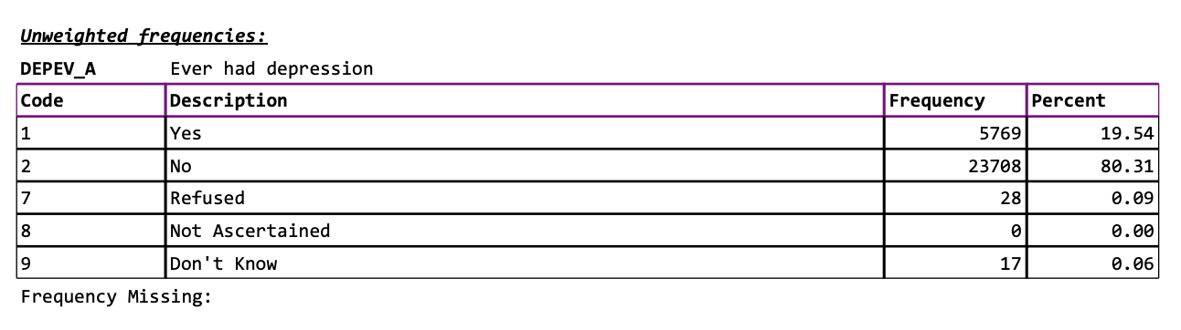
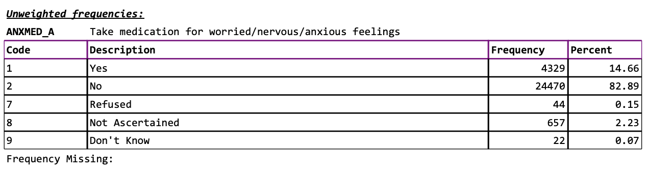
Manual Attribute Removal
Removed all attributes related to mental health or explicitly mentioned depression/anxiety

Slide 9
Training / Validation / Testing Dataset
Completed using Python sklearn’s train_test_split function. Used stratified sampling
Train/test: 70%
Validation: 30%
from sklearn.model_selection import train_test_split X_train, X_test, y_train, y_test = train_test_split(X, y, test_size=0.2, random_state=42, stratify=y)

Slide 10
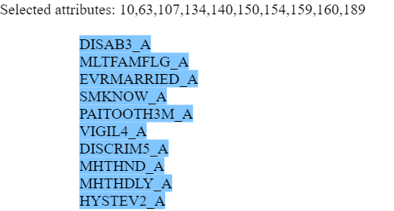
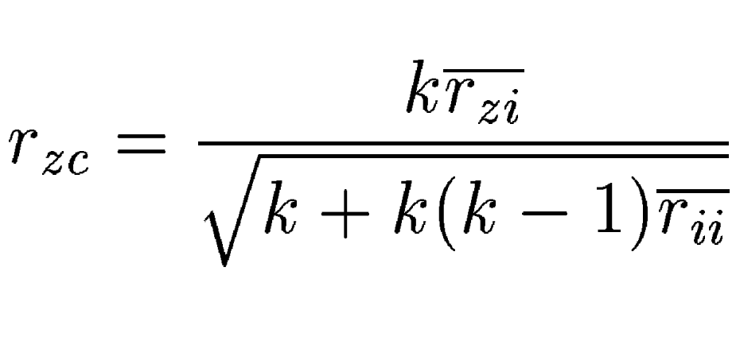
Attribute Selection Algorithms
CfsSubsetEval with BestFirst
Good subset of features contains features highly correlated with the target class but uncorrelated with each other.
Best First
Forward Selection: Empty set of features and add features incrementally
Backward Elimination: Start will all features and remove one by one
Bidirectional Search: Combine both forward and backward elimination

Slide 11
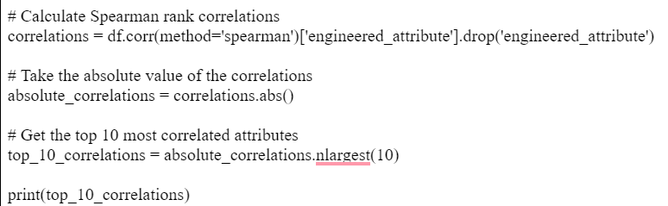
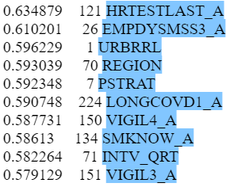
Attribute Selection Algorithms - Continued
Handpicked
Calculating the Spearman rank correlation index of each attribute in relation to the class “engineered attribute”.
Taking the absolute value of the correlation coefficients
Take the top 10, around a threshold of 0.6 on both the positive and negative end.

Slide 12
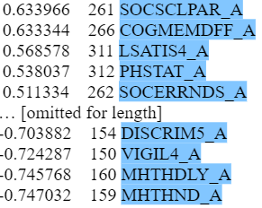
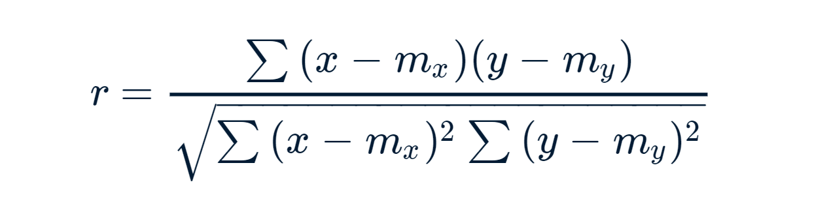
Attribute Selection Algorithms - Continued
CorrelationAttributeEval with Ranker
CorrelationAttributeEval evaluates attributes based on their correlation with the class label.
Measures the relationship between each feature and target class.
Uses the Pearson correlation.

Slide 13
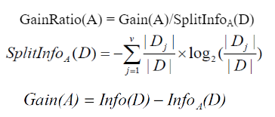
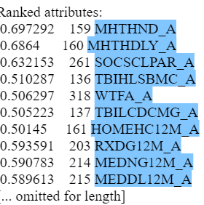


Attribute Selection Algorithms - Continued
GainRatioAttributeEval with Ranker

Slide 14
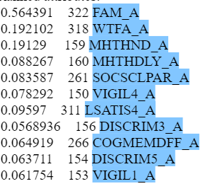
Attribute Selection Algorithms - Continued
SymmetricUncertAttributeEval
SymmetricUncertAttributeEval is an attribute evaluator based on the concept of Symmetrical Uncertainty (SU)
Entropy is a measure of the uncertainty or randomness in data.
Symmetrical uncertainty is a normalized form
of information gain, designed to remove biases
towards attributes with many values.

Slide 15
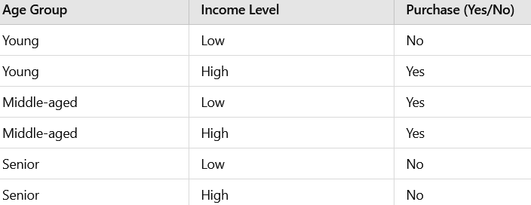
Model Selection
Decision Tables
Decision tables are concise visual representations of which actions to perform based on a given dataset.
Each row responds to a combination of feature values,
Rules which are the specific values/conditions in which the decision is made
This model is good for interpretation and creates rules that might be valuable for analysis.
Not suitable for continuous variables and may be impractical for complex models.

Slide 16
Model Selection - Continued
J48:
This classifier is a subset of existing decision tree algorithms.
It is an open-source Java implementation of the C4.5 decision tree algorithm.
Uses a recursive process to build the tree.
Uses information gain to measure how much a feature reduces the uncertainty for the class label.
J48 is great for larger datasets as well as handling both categorical and continuous variables.
Prone to overfitting and bias towards certain features due to the use of gain ratios.

Slide 17
Model Selection - Continued
Bagging:
Bagging involves training multiple models independently on different subsets of the data.
The data will be randomly sampled an n amount of times with replacement.
The model will train it on each of the data samples which create predictions.
Models' predictions will be combined through simple averaging to make an overall prediction.
Bagging can reduce variance and improve stability because it trains on multiple different models with different subsets of data.
Increased computation because requires training of multiple
models as well as not being useful for low variance models.

Slide 18
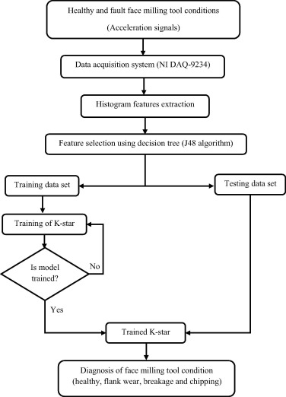
Model Selection - Continued
KStar
Stores all the training data and makes predictions only when a new instance is classified.
Makes decisions based on distances between new instances and the stored training data.
Instances that are closer to the new instance have more influence and more weight on final prediction.
K star is good for complex distributions of data as well as categorical and continuous data.
Complex and may be slow for large datasets as well as being memory intensive because it saves all the training instances.

Slide 19
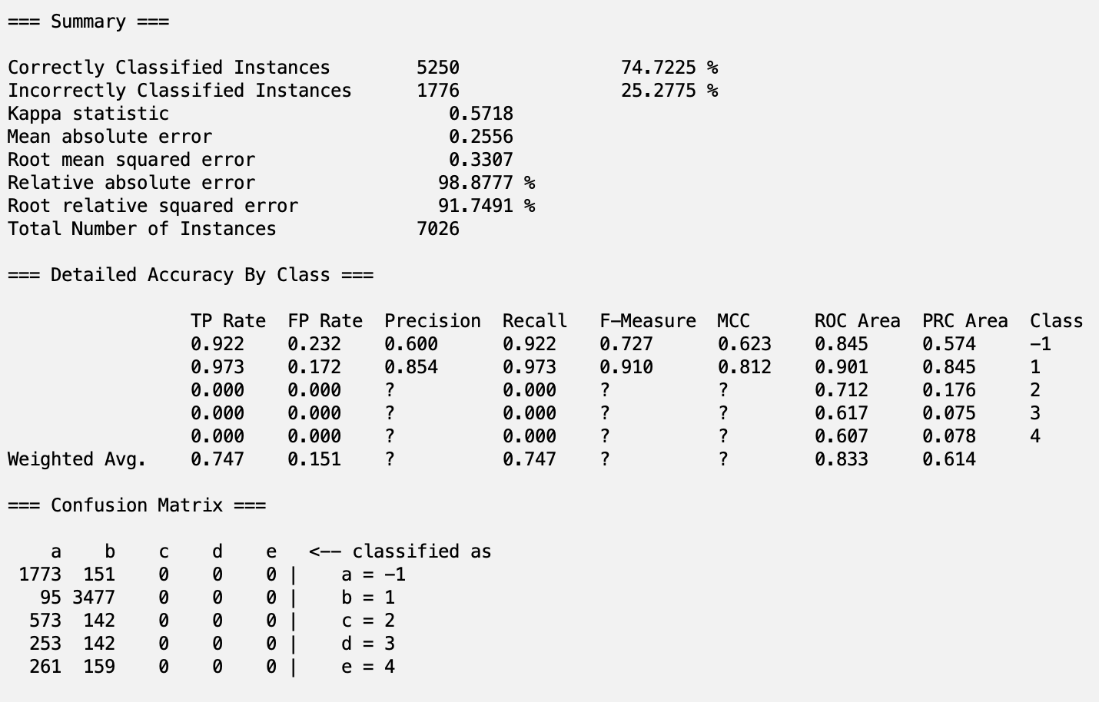
Why Not Others? (AdaBoostM1)

Slide 20
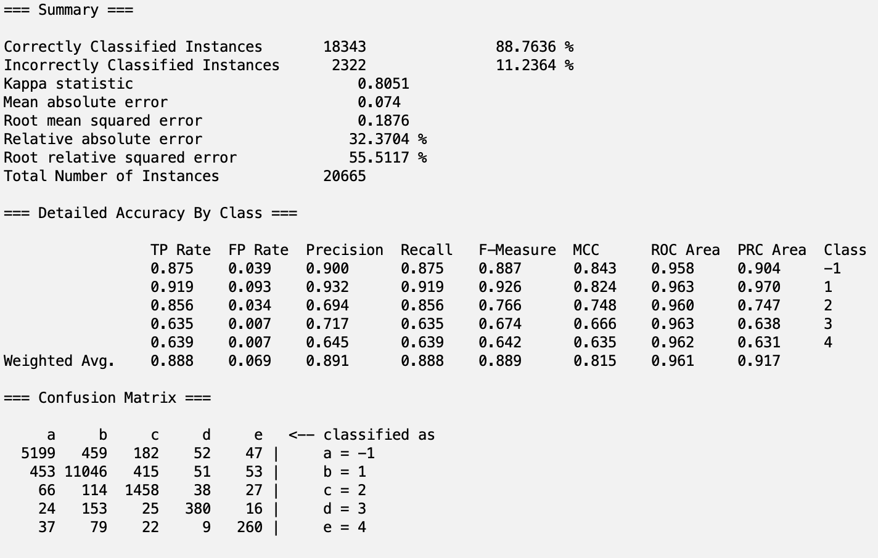
Example Statistics

Slide 21
Summary of Accuracies
 | Model Type
Attribute Group | Decision Table | J48 | Bagging | KStar | Averages
cfsEVAL | 88.7636 | 88.9475 | 88.6422 | 86.0233 | 88.09415
reliefEVAL | 88.0444 | 88.0159 | 86.2226 | 75.6618 | 84.486175
corrEVAL | 85.8098 | 86.4098 | 85.8098 | 82.3086 | 85.0845
gainEVAL | 88.6991 | 85.8098 | 85.8098 | 85.3829 | 86.4254
symmEVAL | 88.9268 | 89.4677 | 86.2226 | 85.454 | 87.517775
Averages | 88.04874 | 87.73014 | 86.5414 | 82.96612

Slide 22
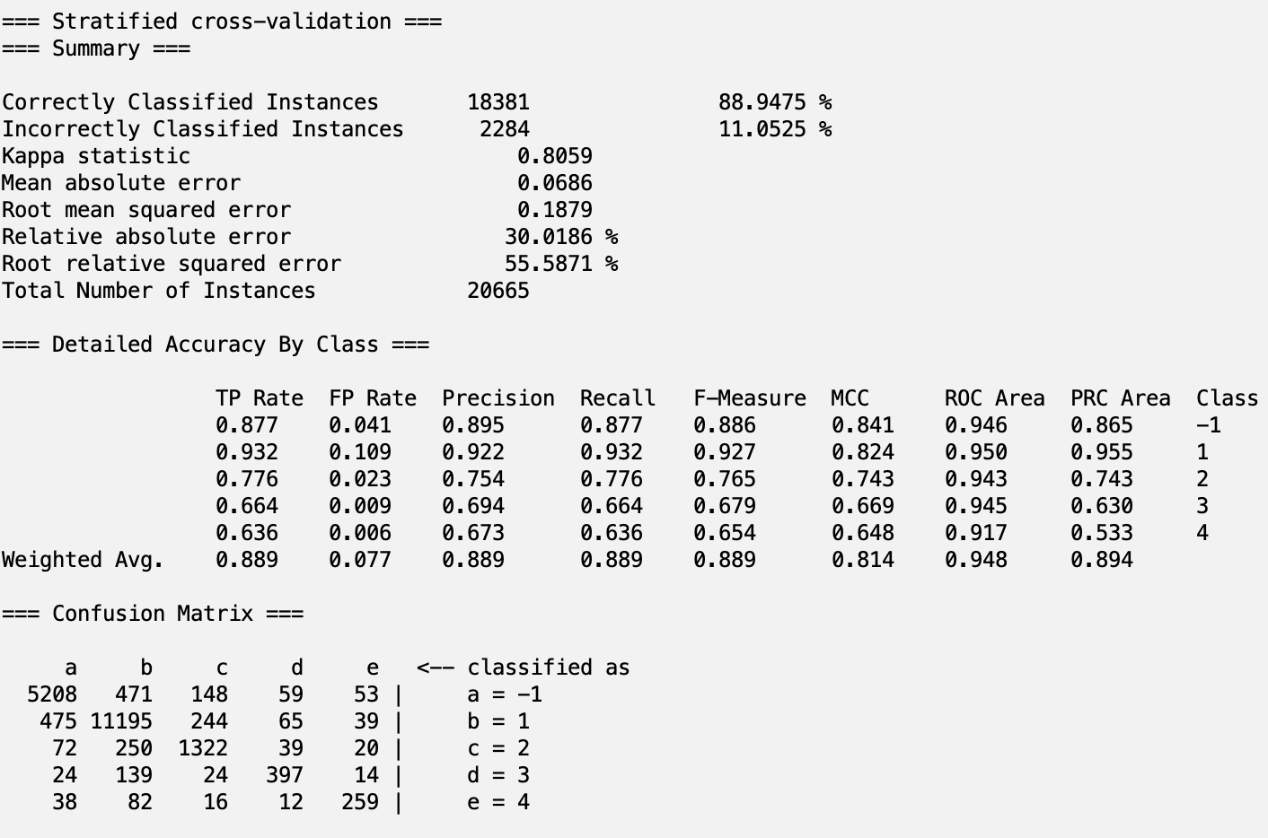
cfsEVAL
Decision Table
J48

Slide 23
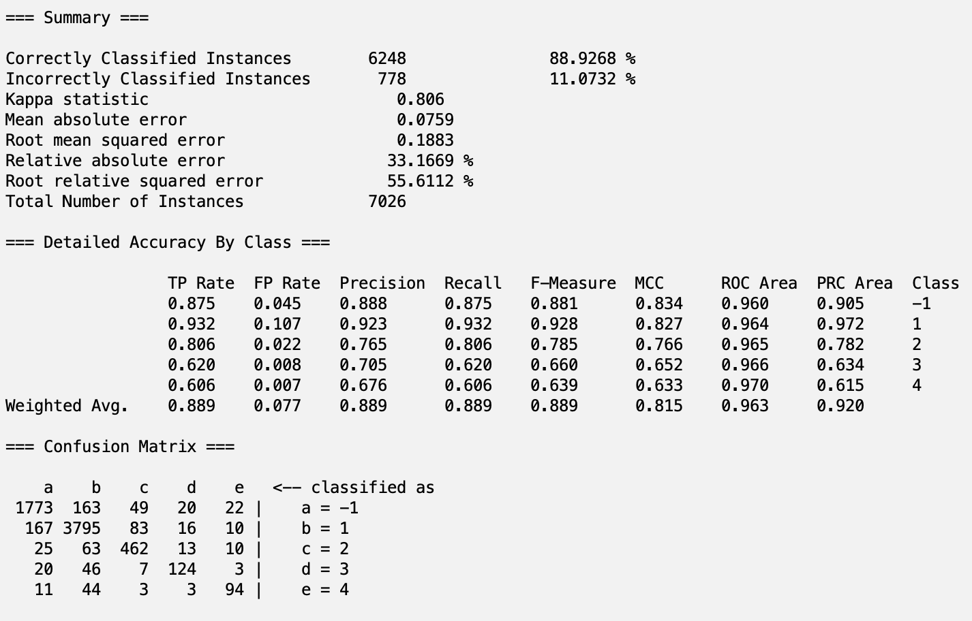

symmEVAL
Decision Table
J48

Slide 24
Winner - symmEVAL with J48

Slide 25
Recreating Our Model
Access preprocessed adult23_train+test.csv
Tranform to Nominal datatypes
Go to the “Select Attributes” tab and choose the correct class “engineered_attribute”
Select SymmetricUncertAttributeEval (Symmetric Uncertainty Attribute Evaluation Selection) as the Attribute Evaluator, and Ranker as the Search Method
Hit Start and wait for the program to finish
Take note of top 11 (threshold 0.55) features; keep the index values for these features
Go back to the Preprocess tab and click Remove other attributes except this
Click on the Classify tab and click “Percentage Split” under Test Options, write 70%
Select the J48 model under trees
Click start and wait for it to complete

Slide 26
So, which features are important?
cfsEVAL | reliefEVAL | corrEVAL | gainEVAL | symmEVAL
DISAB3_A MLTFAMFLG_A EVRMARRIED_A SMKNOW_A PAITOOTH3M_A VIGIL4_A DISCRIM5_A MHTHND_A MHTHDLY_A HYSTEV | HRTESTLAST_A EMPDYSMSS3_A URBRRL REGION PSTRAT LONGCOVD1_A VIGIL4_A SMKNOW_A INTV_QRT VIGIL3_A | SOCSCLPAR_A COGMEMDFF_A LSATIS4_A PHSTAT_A SOCERRNDS_A DISCRIM5_A VIGIL4_A MHTHDLY_A MHTHND_A | MHTHND_A MHTHDLY_A SOCSCLPAR_A TBIHLSBMC_A WTFA_A FAM_A TBILCDCMG_A HOMEHC12M_A RXDG12M_A MEDNG12M_A MEDDL12M_A | FAM_A WTFA_A MHTHND_A MHTHDLY_A SOCSCLPAR_A VIGIL4_A LSATIS4_A DISCRIM3_A COGMEMDFF_A DISCRIM5_A VIGIL1_A

Slide 27
Delay Due to Cost
Attribute | Description
MHTHND_A | Needed counseling, therapy but did not get it due to cost, past 12 months
MHTHDLY_A | Delayed counseling, therapy due to cost, past 12 months
MEDNG12M_A | Needed medical care but did not get it due to cost, past 12 months
MEDDL12M_A | Delayed medical care due to cost, past 12 months

Slide 28
Health
Attribute | Description
DISAB3_A | The Washington Group Short Set Composite Disability Indicator
SMKNOW_A | Now smoke cigarettes
PAITOOTH3M_A | Toothache or jaw pain
HRTESTLAST_A | A How long since hearing test
LONGCOVD1_A | Had COVID-19 symptoms for 3 or more months
SMKNOW_A | Now smoke cigarettes
PHSTAT_A | General health status
TBIHLSBMC_A | Headache, sensitivities, balance problems or mood change, past 12 months
WTFA_A | Weight - Final Annual

Slide 29
Personal Specifics
Attribute | Description
VIGIL4_A | Avoid certain situations and places
DISCRIM5_A | You are threatened or harassed
VIGIL3_A | Watch what you say and how you say it
SOCSCLPAR_A | Language socially
COGMEMDFF_A | Difficulty remembering/concentrating
SOCERRNDS_A | Difficulty doing errands alone
TBILCDCMG_A | A Lost consciousness, dazed or confused, or had gap in memory, past 12 months
VIGIL1_A | Prepare for possible insults before leaving home

Slide 30
Family Structure
Attribute | Description
FAM_A | Number of Emergency Contacts
HOMEHC12M_A | Received care at home, past 12 months
MLTFAMFLG_A | Indicator for multifamily households
EVRMARRIED_A | Sample adult has ever been married

Slide 31
Odd Ones Out
Attribute | Description
EMPDYSMSS3_A | Days missed work, past 12 months (top-coded)
LONGCOVD1_A | Had COVID-19 symptoms for 3 or more months

Slide 32
Discussion Part 1
Some attributes don’t fit into the primary category, such as:
Having COVID-19 for three or more months.
Days missed at work in the past 12 months.
Data is from a 2023 survey, a period where COVID-19 effects were still relevant.
This could introduce bias toward these attributes being significant.
A future study with more recent data could better assess COVID-19's impact on mental health.
These attributes are NOT included in the SymmetricUncertAttributeEval attribute group, meaning:
The final model selected doesn't include these attributes.
The model could be more generalizable to non-COVID-19 periods, but external testing is needed to confirm.

Slide 33
Discussion Part 2
General trends indicate that factors contributing to mental health severity include:
Health
Financial status
Family support
Internal thoughts
Three of these factors can be assessed in non-psychological settings:
Hospitals can check a patient’s family support, general health, and how long they waited to seek care.
These checks can guide recommendations for psychological evaluations, ensuring timely care.
As mental health becomes more accepted, this information can help reduce barriers to support for vulnerable individuals despite lingering taboos.

Slide 34
Conclusions
Limitations:
Year of data collection
Uneven class distribution
Great model performance 88% accuracy. This is well suited for medical application

Slide 35
Any Questions?

