Slide 1
Automated Vessel Segmentation in MRI Data
Kade Yen and Medha Pappula

Slide 2

Motivation
Accurate vessel segmentation is crucial for early diagnosis of vascular diseases.
Enables better visualization and analysis of blood flow patterns.
Assists in treatment planning and monitoring of disease progression.
Facilitates automated medical image analysis and reduces manual workload.
Supports the development of advanced computer-aided diagnostic tools.
Essential for research in angiogenesis and other vascular-related studies.

Slide 3
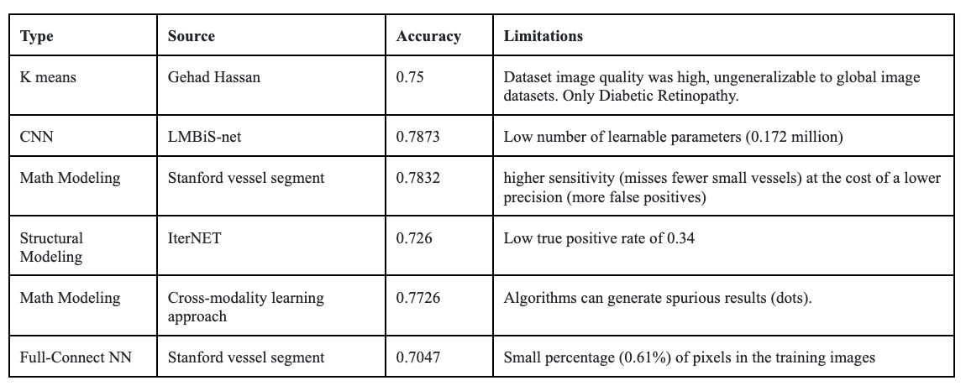
Previous Approaches

Slide 4
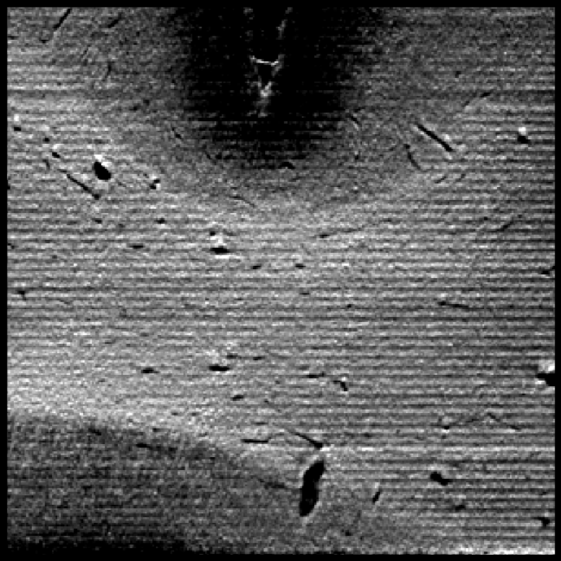
DATA
Lots of .jpeg images that are converted to .nii format
Each .nii image is a 3d image that has voxels in .2 microns
The data has a total 600 images which results into 600.nii images that are either 128 or 256 voxel cubes.

Slide 5
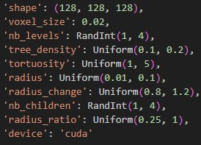
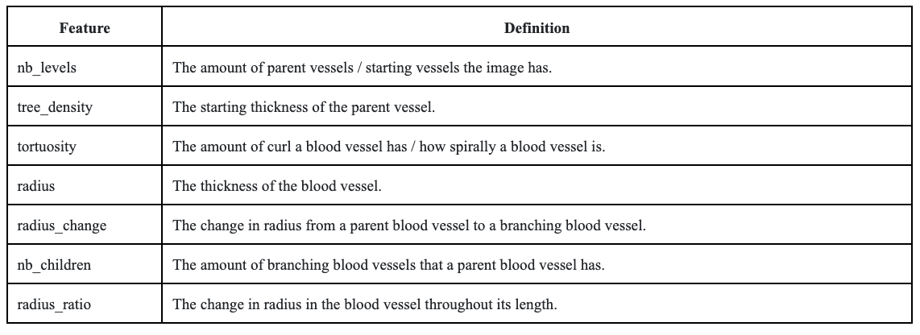
Pre-Processing
The .nii images were split into multiple smaller 64 voxel cube images to save computational time.
A total of 1000 .nii images were used for this project selected based on:
Clarity of image
Amount of vessels we can see
Amount of noise in the image
Amount of variability(good representability of all variables)

Slide 6
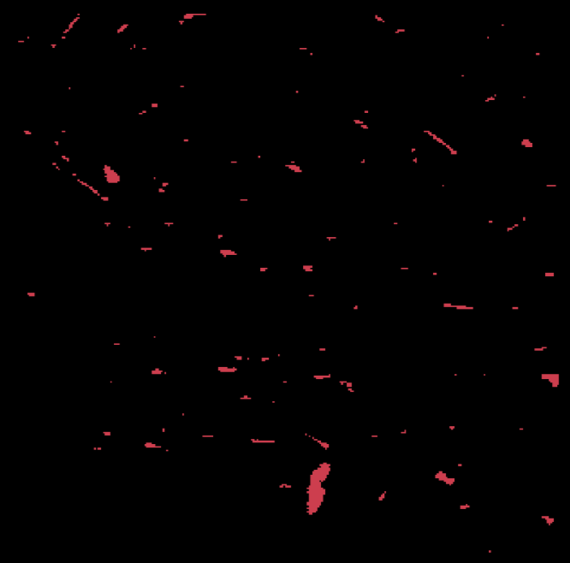
DATA

Slide 7
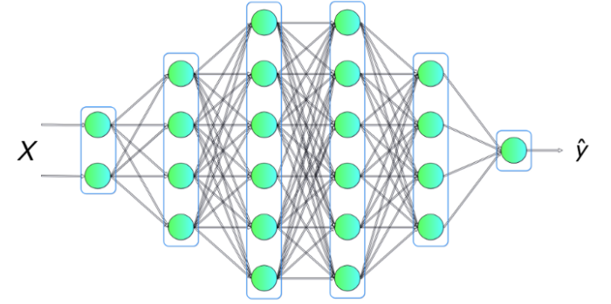
METHODS
A previous research paper used a fully connected neural network (FCNN) to find blood vessels in MRI images.
A FCNN consists of layers where each neuron is connected to every neuron in the previous layer.
Given an input vector, weights, and biases, the output of a layer is computed using a non-linear activation function such as ReLU or sigmoid.
FCNNs are effective for learning global patterns but struggle with data that exhibits strong spatial locality, such as images.

Slide 8
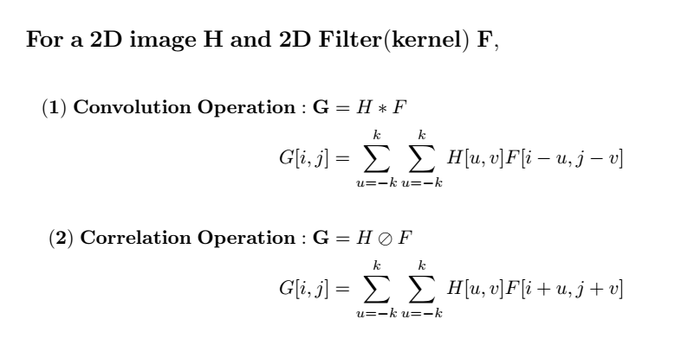
METHODS
CNNs improve on FCNNs by using convolutional layers that exploit local spatial structure in data.
A convolutional layer applies a set of learnable filters over the input, producing feature maps.
For an input image and filter, the convolution operation can be expressed as a convolution operation.
CNNs reduce the number of trainable parameters by sharing weights across different spatial locations, making them more efficient for image data.

Slide 9
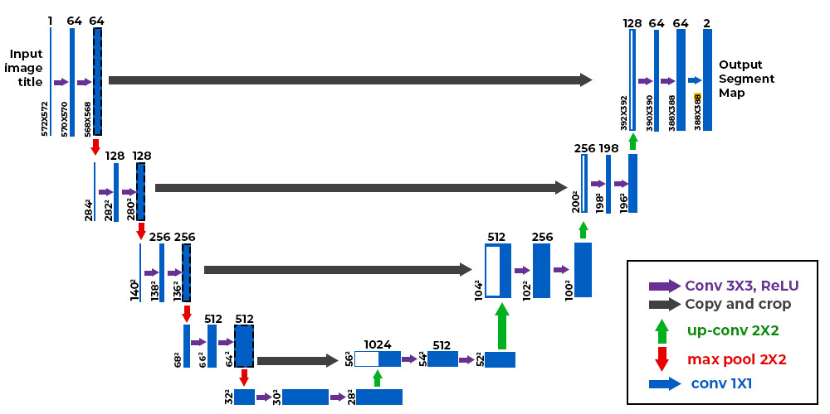
METHODS
U-Nets build on CNNs, specifically for image segmentation tasks, by employing a symmetric encoder-decoder structure with skip connections.
The encoder extracts hierarchical features while progressively reducing spatial resolution, such as the size of a blood vessel or the amount of blood vessels.
After each feature extraction, the image is decreased by a certain factor; if the factor is 2, every 4 pixels in a 2 by 2 box would be converted to 1 pixel.
The pixel would be the value that occurs the most or the average of the values.
The decoder then upsamples the feature maps to reconstruct a segmented image.

Slide 10
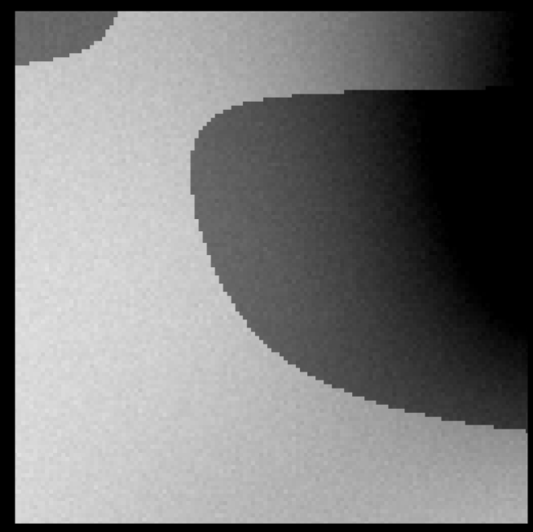
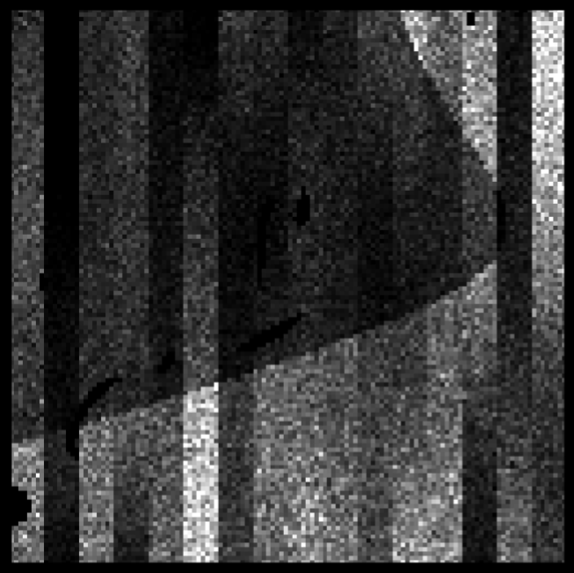
Noise Examples

Slide 11
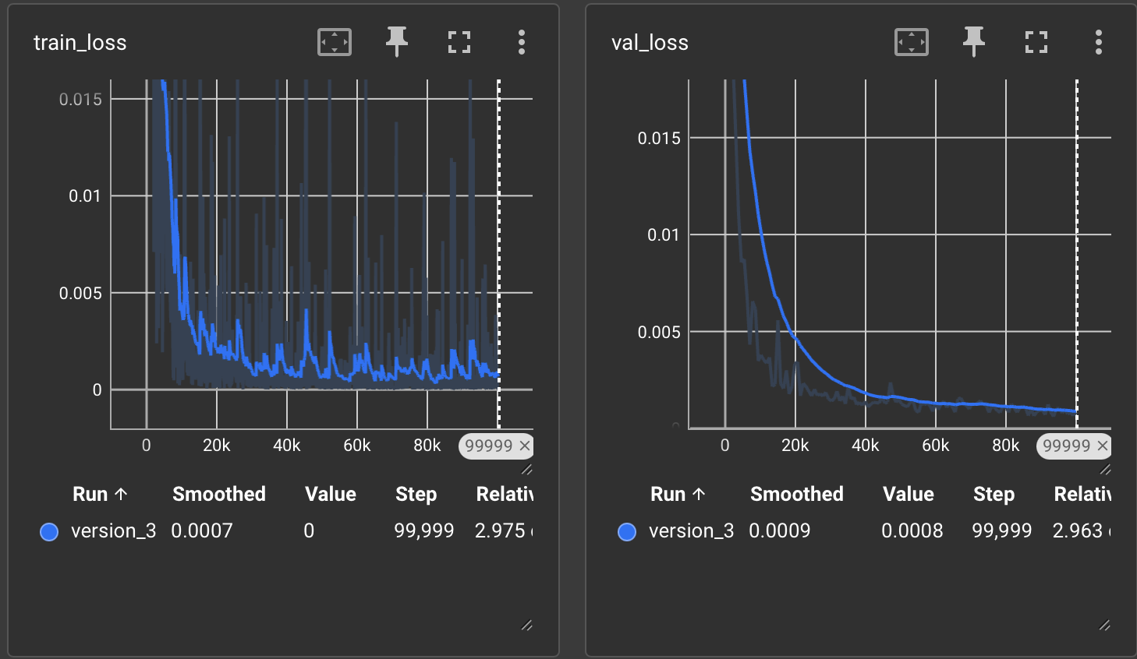
Model Training
1000 volumes
0.8 Training to validation
100,000 steps
1 batch size
0.001 learning rate

Slide 12
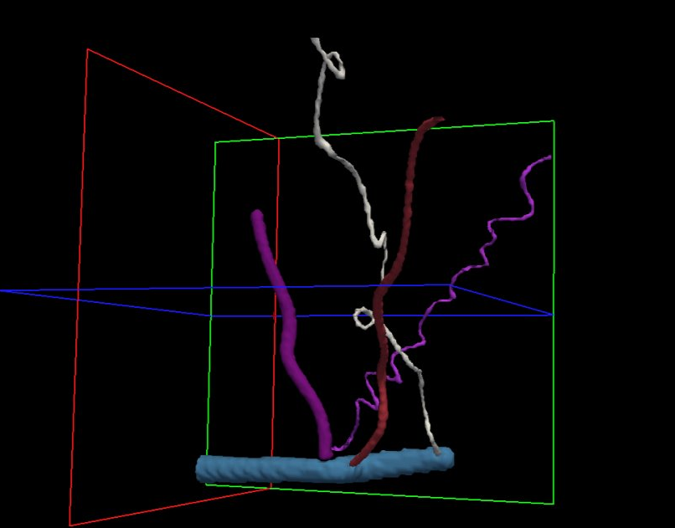
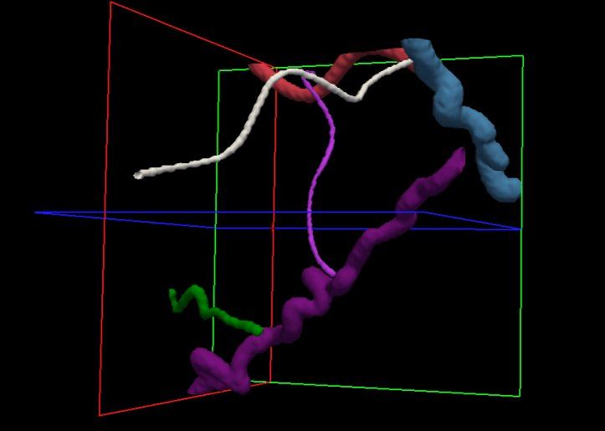
Vessel Example

Slide 13
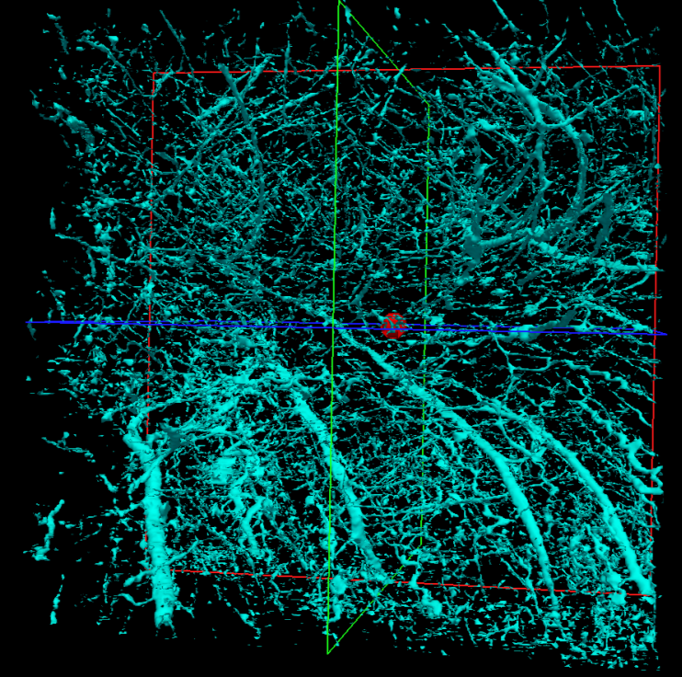
Final Product

Slide 14
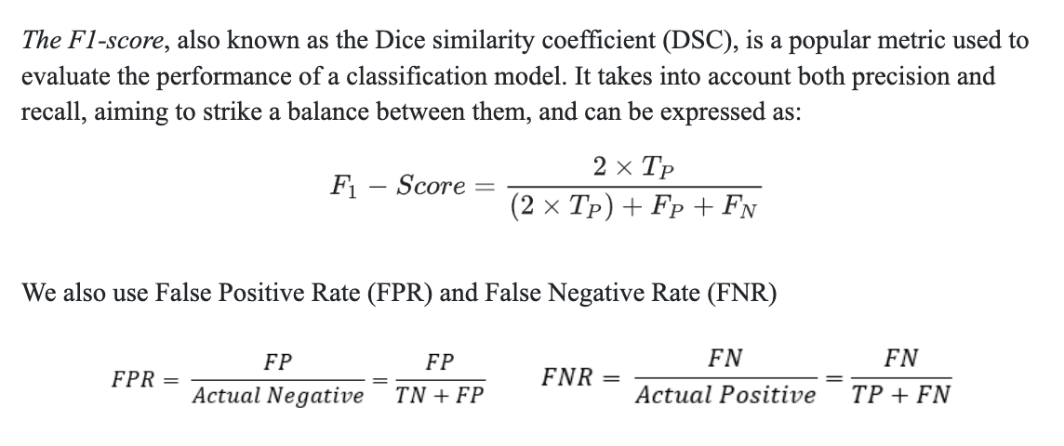
Results

Slide 15
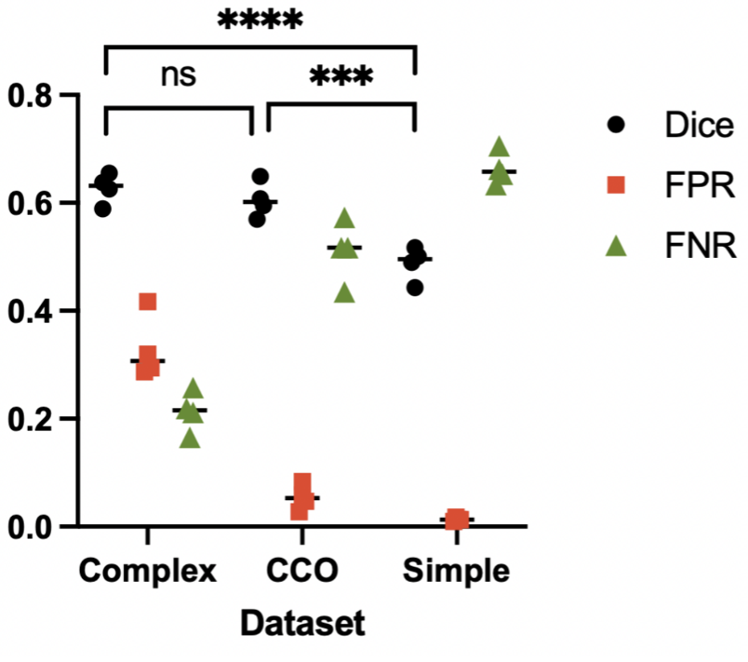
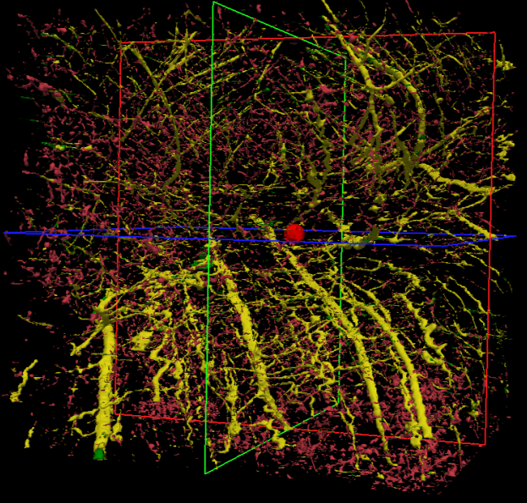
Results
Our results:
Dice = 0.681
FPR = 0.194
FNR = 0.289
FCNN results

Slide 16
Results

Slide 17
Conclusion
U-net algorithm performed better than the one FCNN one used in the paper.
Based on the train loss, we could have trained the algorithm a bit more steps.
Another thing we noticed was how much the algorithm highlighted small little blobs on the images.
We can code it is that if there are no children blood vessels or parent blood vessels then we remove the blobs that were labeled as vessels.
We can do is denote a size where if a vessel takes up fewer than a certain amount of space than its not considered a blood vessel and can subsequently be removed

Slide 18


Questions?

