Slide 1
Cell-DEVS M&S: Post-Pandemic Work Practices and Corporate Building Energy Waste
Michael De Santis

Slide 2
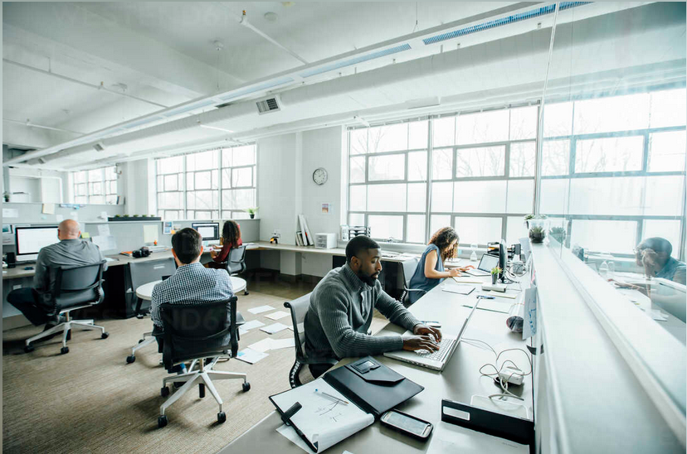
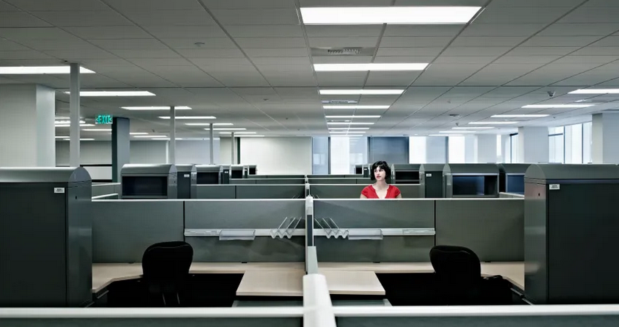
Post-Pandemic Work Policies and Practices
In-Office Days
Full floor occupancy
Uniform distribution of occupants
Entire floor is maintained:
HVAC, lights, etc.
Work-from-Home Days
Reduced floor occupancy
Sparse distribution of occupants
Entire floor still maintained!?

Slide 3
Research Questions
?
?
?
What effects do post-pandemic work practices have on corporate building energy consumption and waste?
Should building systems employ different energy strategies based on work policies and occupancy patterns?
Can Cell-DEVS M&S provide guidance towards more efficient post-pandemic corporate building operational practices?

Slide 4
Core Activities
I'm here!
Literature Review
Define Models
Develop Experimental Frame
Run Experimental Simulations
Analyze Results

Slide 5
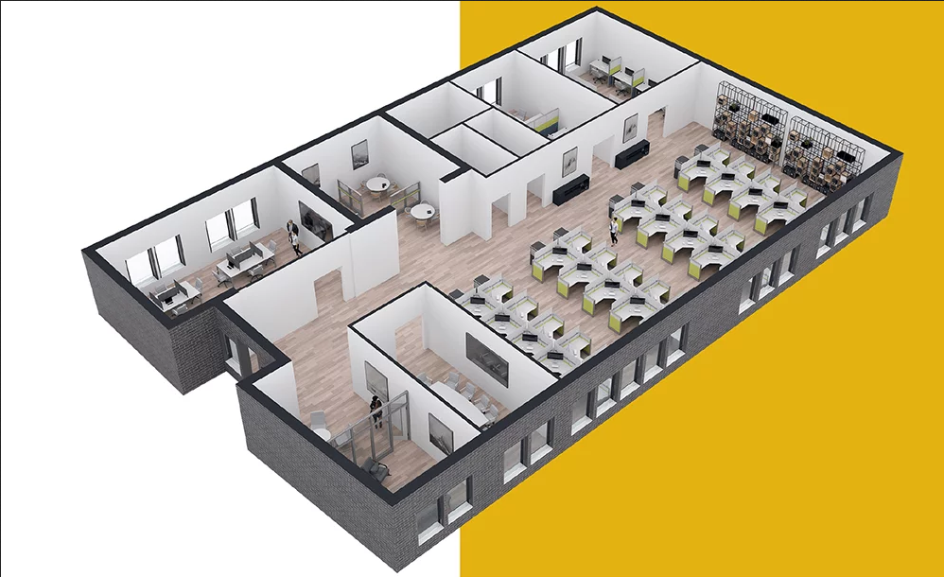
Building Information Modeling (BIM)
Building Infrastructure
Floorplan
HVAC
Lights
Monitoring Mechanisms
Sensors
CO2
Motion
Temperature
Occupants
State
Behaviour

Slide 6
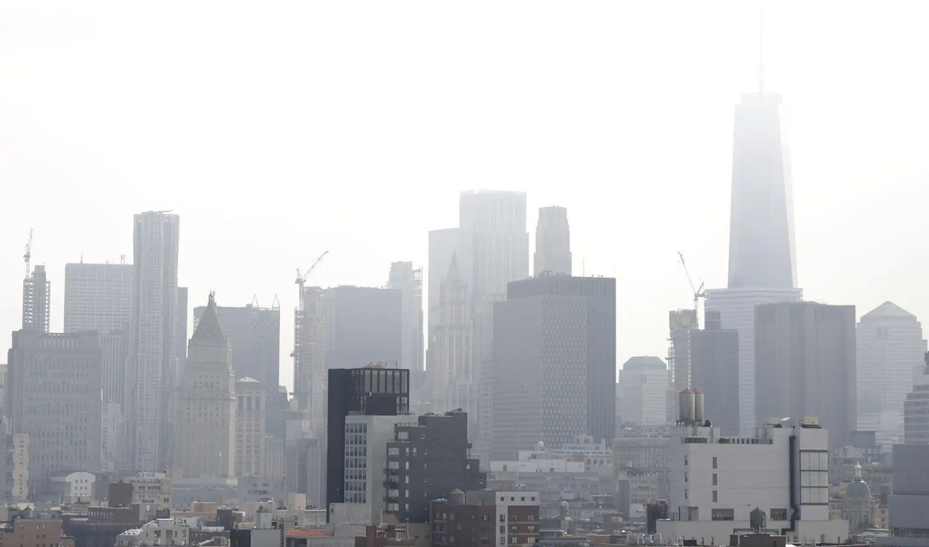
Corporate Building Energy Consumption and Waste
Buildings consume and waste significant amounts of energy
HVAC accounts for ~50% of building energy costs
Occupant-Controlled vs. Demand-Driven systems
Few optimizations to accommodate post-pandemic work practices

Slide 7
Existing Models
Extending the Models
CO2 Detection
Sensor configurations for optimal occupancy detection
Room properties and their effect on detectable CO2 levels
Occupancy Modeling
Occupant emissions
Occupant behaviour
Use existing models as basis for
Sensors
Floorplan
Occupant properties and behaviour
Validated experimental values
Enable tracking of energy usage (kWh)
HVAC, lights, etc.
Simulate different scenarios
In-Office Day vs. Work-from-Home Day

Slide 8
Thanks!

Slide 9
Images
https://www.westend61.de/en/photo/BLEF01983/business-people-working-in-busy-office
https://www.nbclosangeles.com/news/business/money-report/employees-could-be-heading-back-to-the-office-sooner-than-they-think/2564835/?os=www.youtube.comwatch&ref=app
https://www.skutchi.com/professional-design-services/
https://nypost.com/2019/07/18/de-blasio-orders-office-towers-to-lay-off-ac-during-heat-wave/

