Slide 1
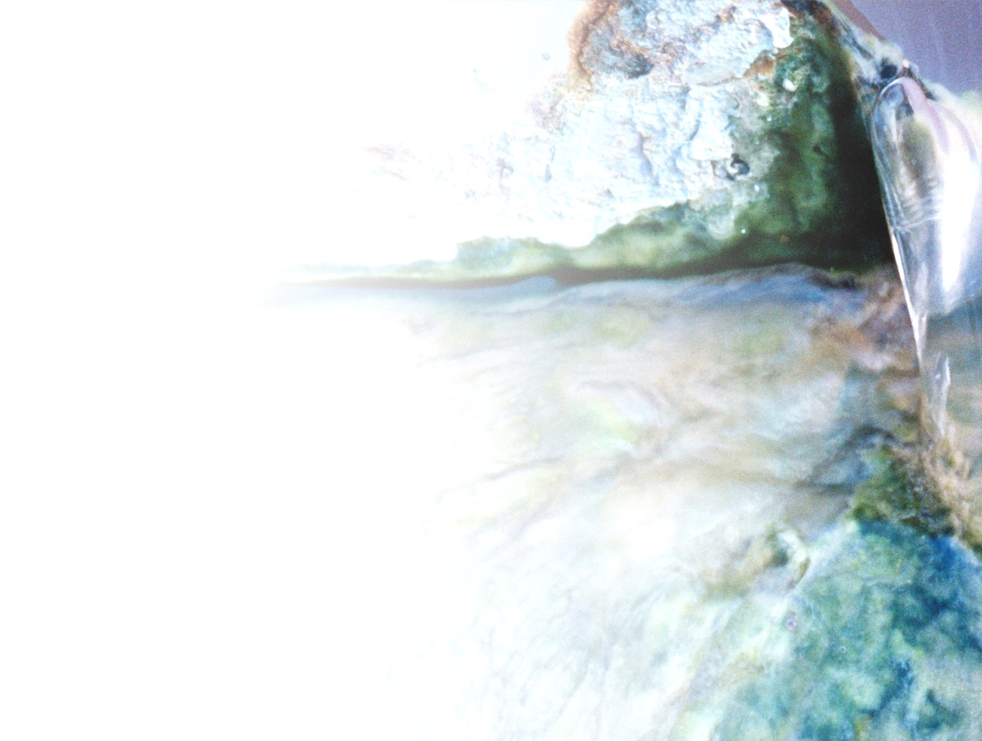


Hands-on:
Application of ampvis2 for microbial community analysis
MiDAS workshop

Slide 2
Aim of the hands-on
Get hands-on experience in microbial community analysis using R, with a focus on the ampvis2 package
Example of typical workflow:
Hands-on
Raw sequences
ASV table
QC
Data exploration
metadata

Slide 3
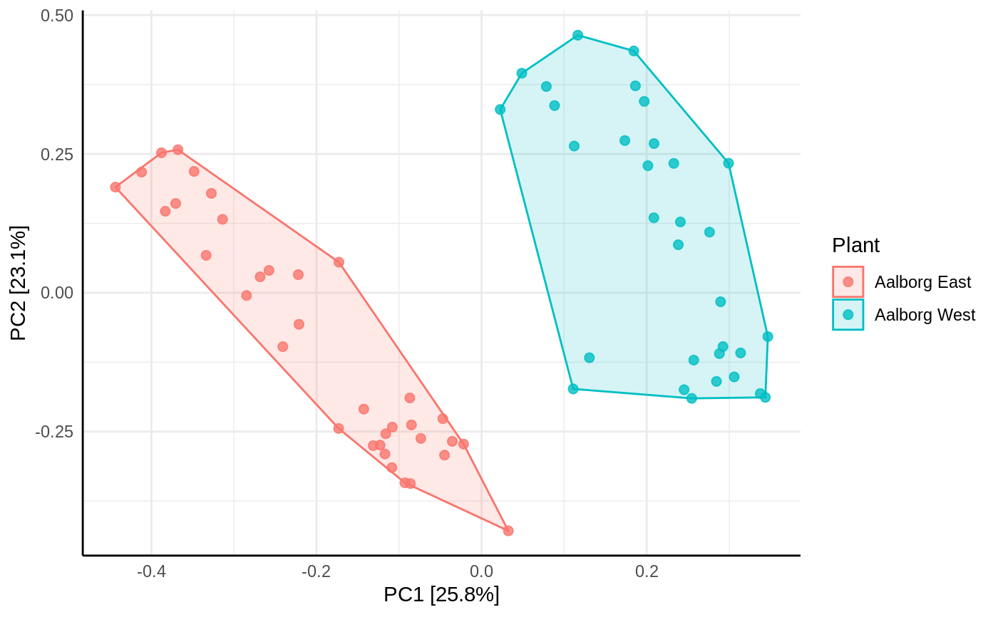
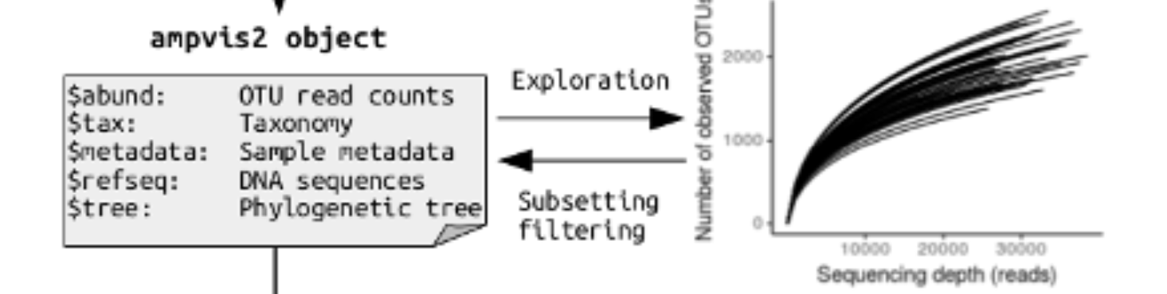
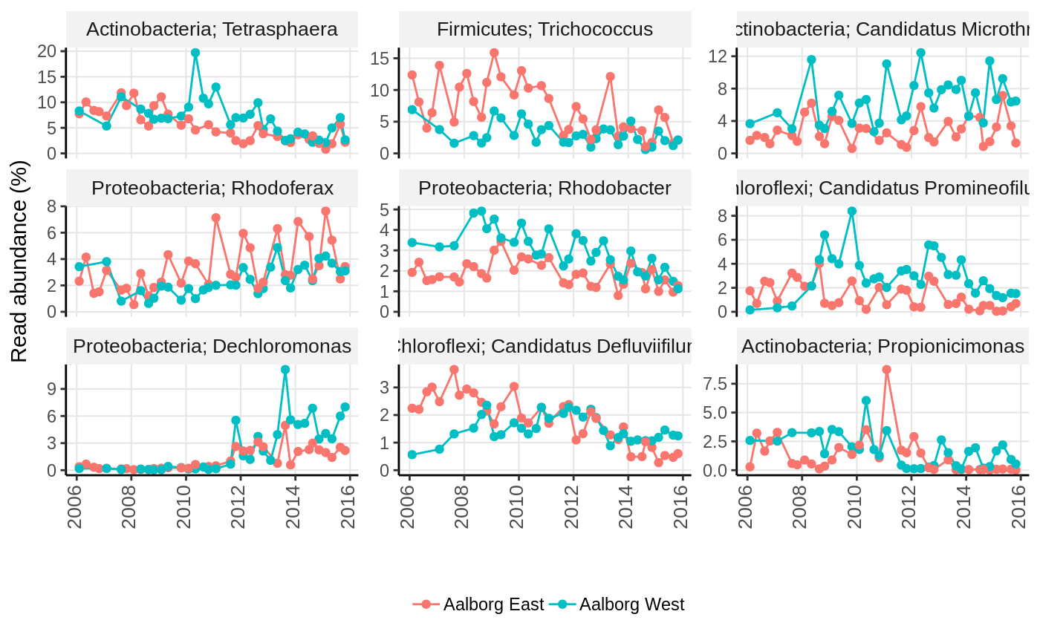
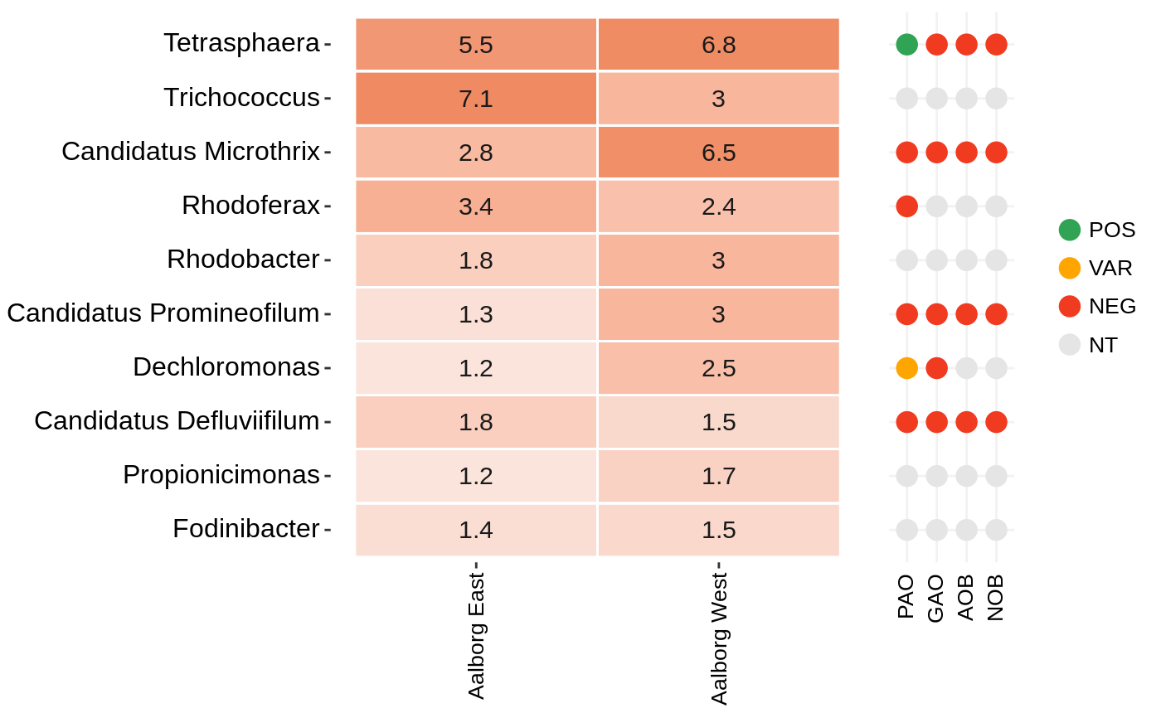
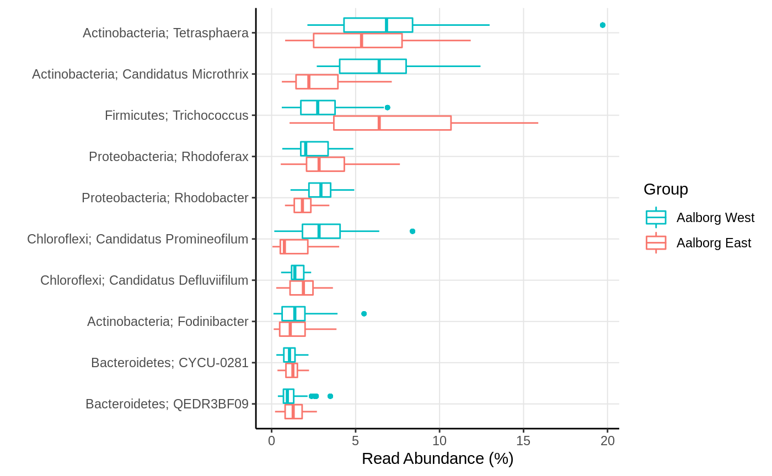
The ampvis2 R package
Ordinations
Tools for visualising amplicon data
Time-series
Heatmaps
Boxplots
And more

Slide 4
Structure of the hands-on
Install R and Rstudio (if not done)
Install ampvis2 in Rstudio
Download data from github
Load data
Explore data!

Slide 5
Install R and Rstudio
Download R: https://mirrors.dotsrc.org/cran/
Download Rstudio: https://posit.co/download/rstudio-desktop/#download
See guide: https://www.geeksforgeeks.org/how-to-install-r-studio-on-windows-and-linux/

Slide 6
Install ampvis2 in Rstudio
Go to documentation: https://github.com/KasperSkytte/ampvis2
Install other packages in Rstudio
https://tidyverse.tidyverse.org/

Slide 7
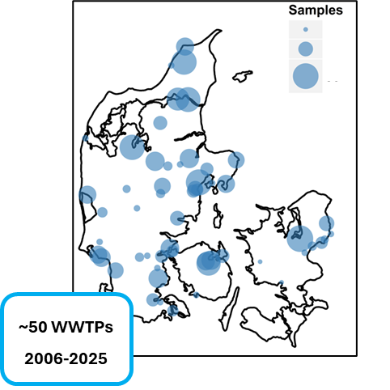
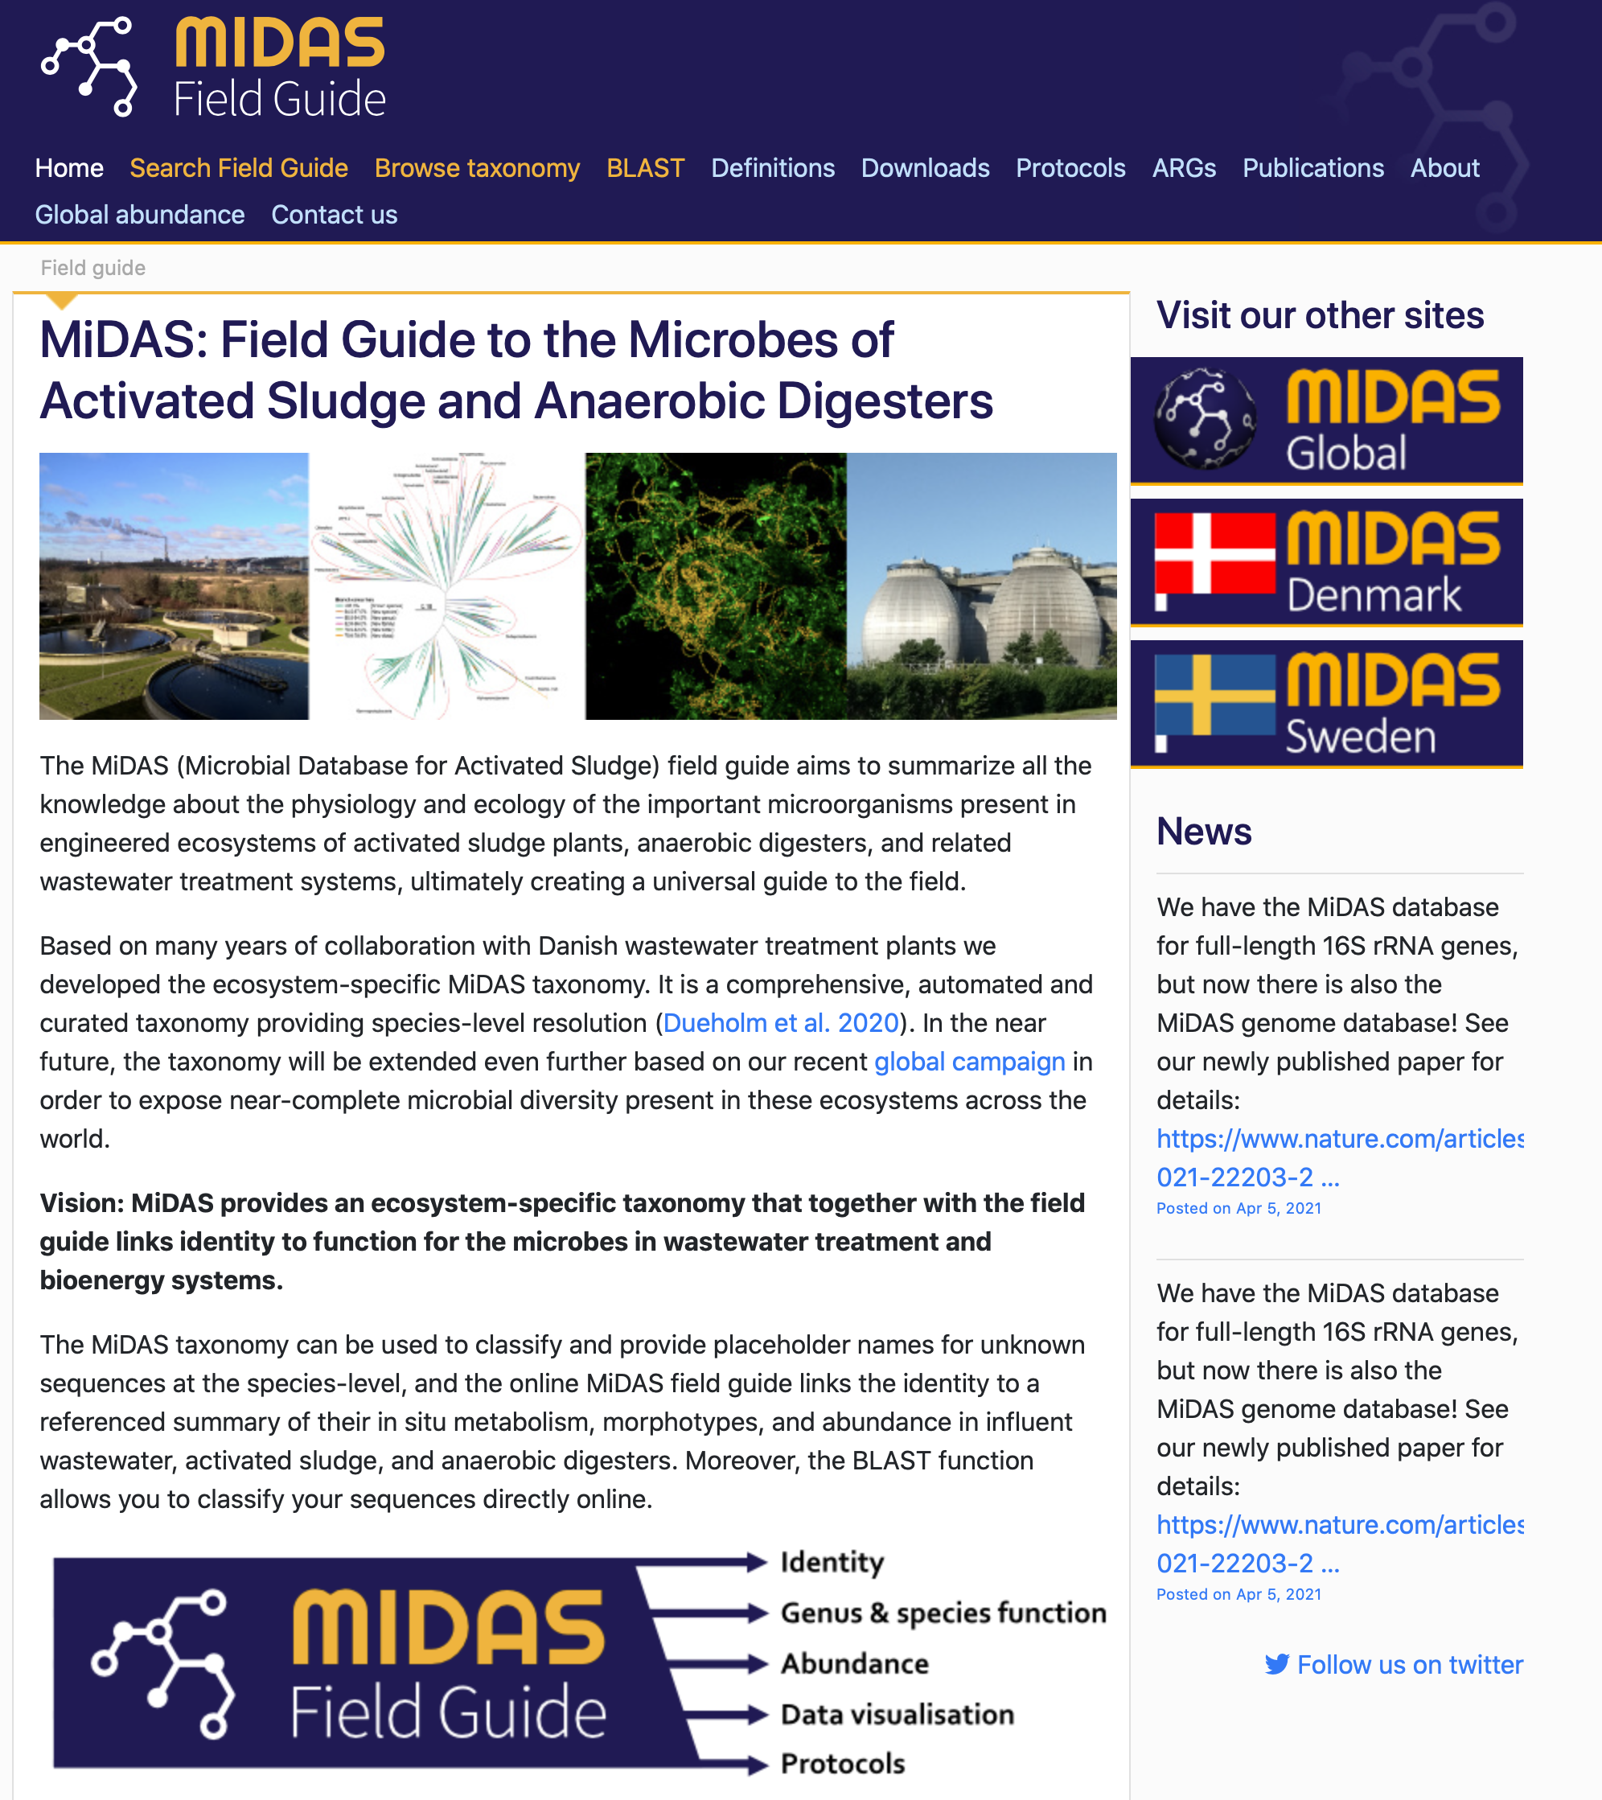
Data for the hands-on
4 WWTPs
~ 140 samples
January – December 2020

Slide 8
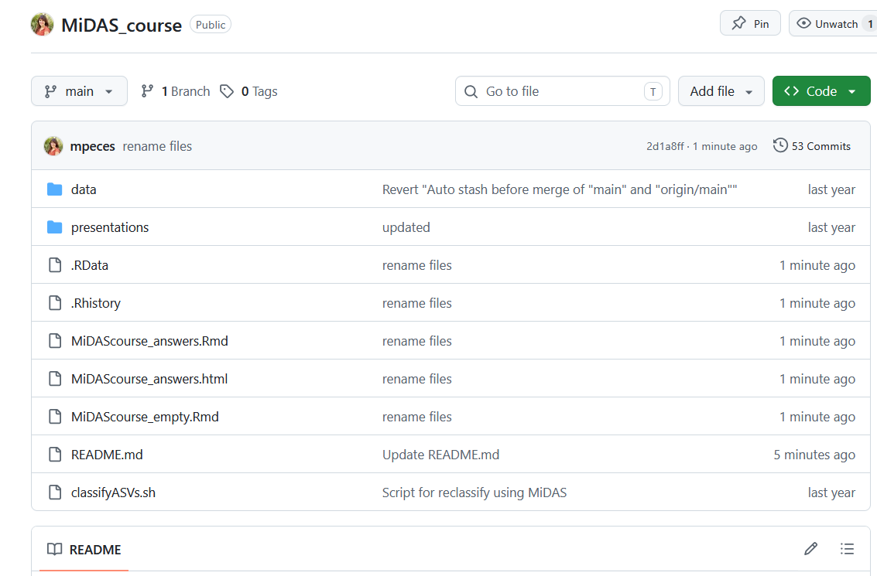
Find and download data
https://github.com/mpeces/MiDAS_course

Slide 9
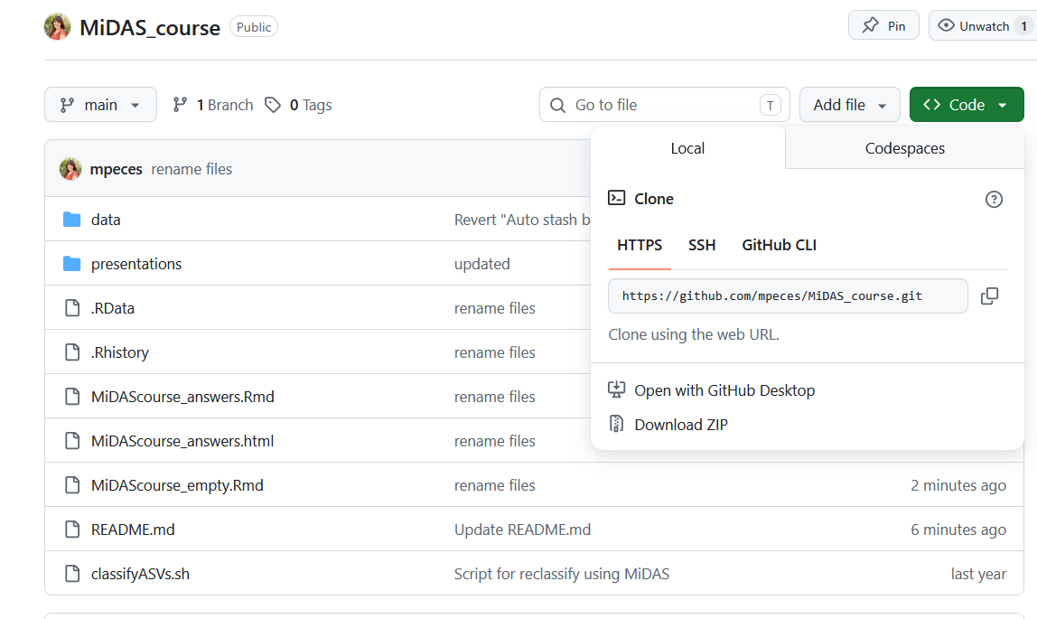
Find and download data
https://github.com/mpeces/MiDAS_course

Slide 10
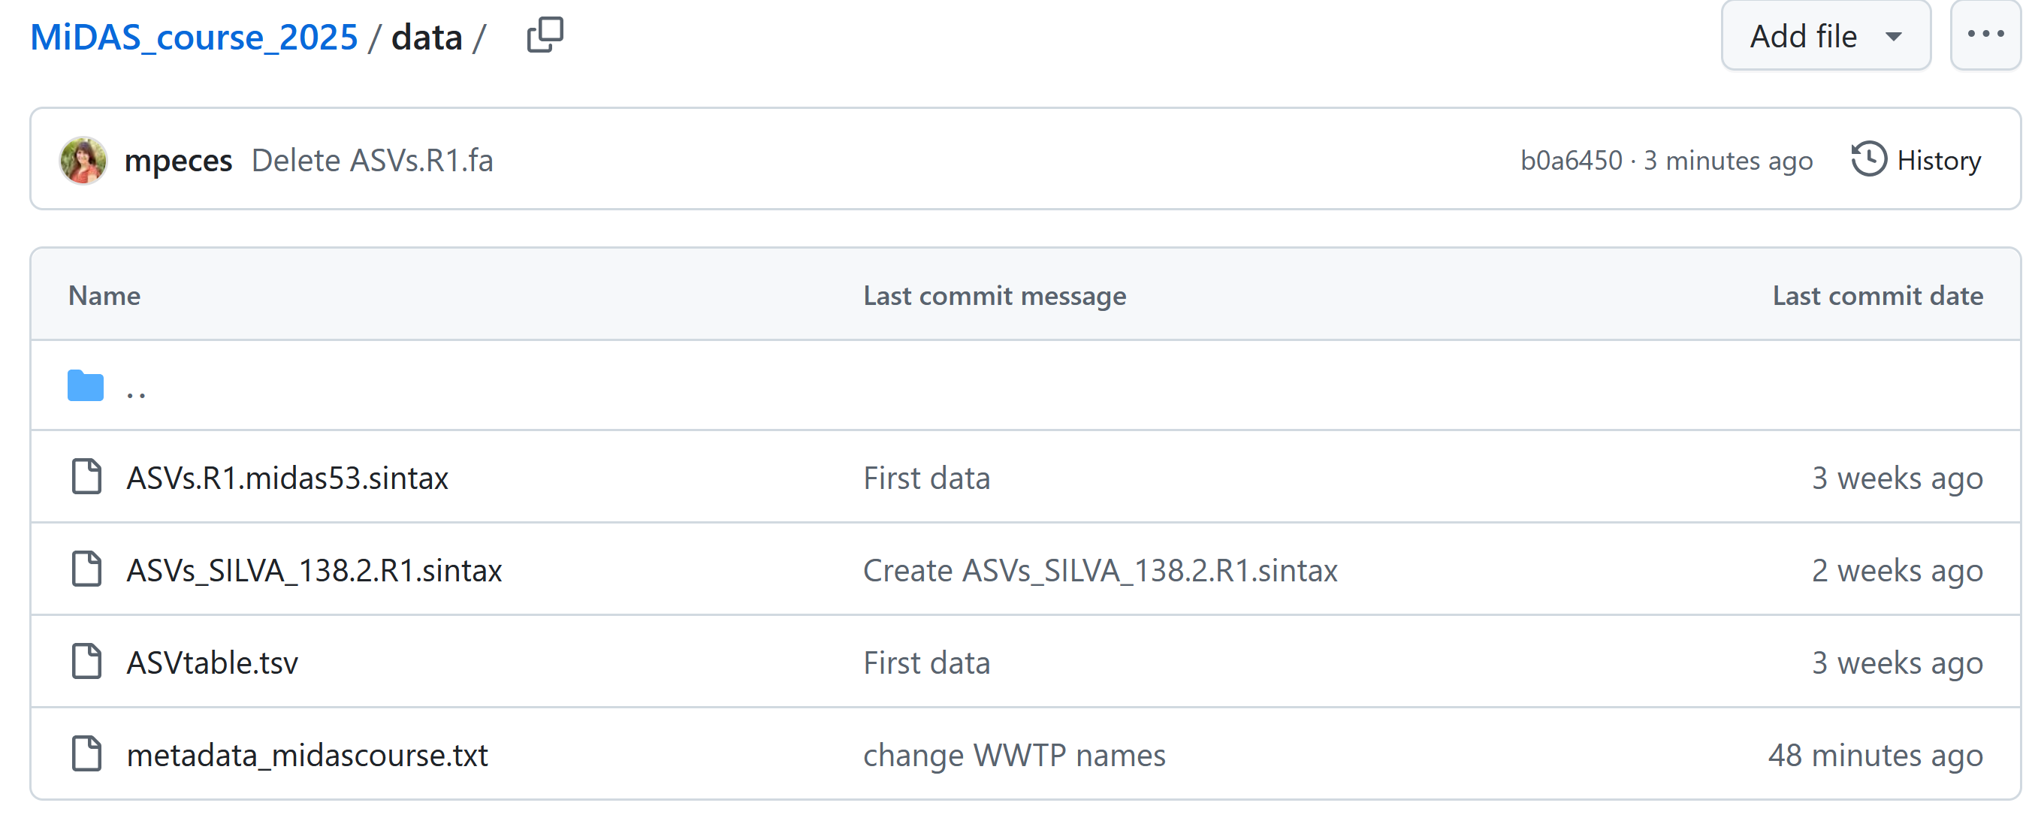
Find and download data
https://github.com/mpeces/MiDAS_course
MiDAS 5.3 taxonomy
SILVA taxonomy
ASV table
Sample metadata

Slide 11
Install ampvis2 (https://kasperskytte.github.io/ampvis2/articles/ampvis2.html)
In the R terminal:
install.packages("remotes")
remotes::install_github("kasperskytte/ampvis2")
Other needed packages:
install.packages(“tidyverse")
Load packages (do for all packages):
library("ampvis2")
library(" tidyverse")

Slide 12
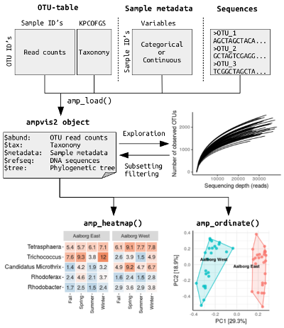
Typical amplicon analysis workflow in ampvis2

