Slide 1

Testing with Mocks
Macon Pegram
Blog: http://blogs.captechconsulting.com/blog/author/Macon%20Pegram
Code: https://github.com/mpegram3rd/testing-with-mocks

Slide 2
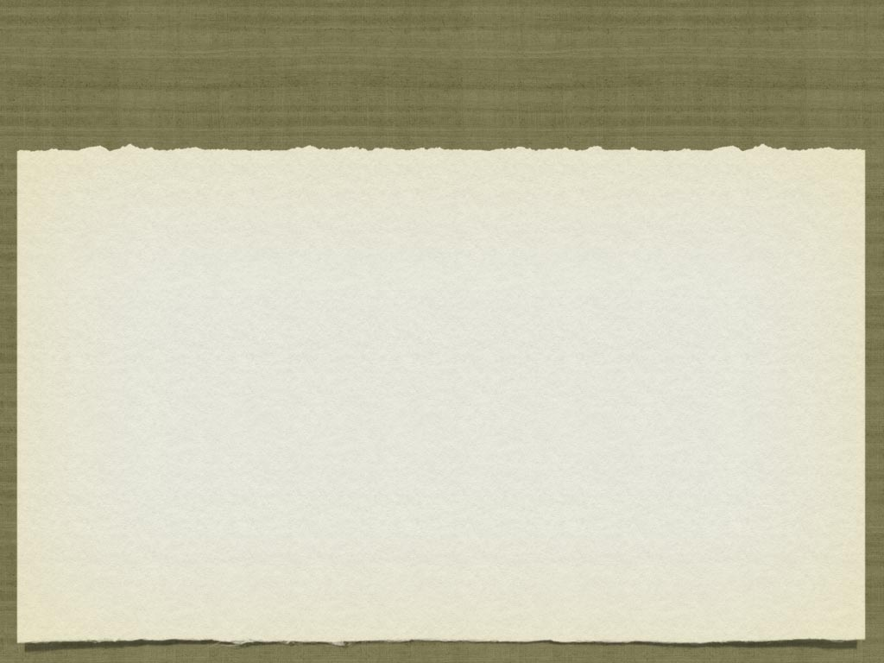

Sound familiar?
I’d rather not change that function
This defect keeps coming back
It’s impossible to unit test our project
The backend/database is not available
Setting up my test environment takes too long
I have a testing specific Spring context

Slide 3

Unit testing:
Why Bother?
Detect / Avoid defects
Validate Bug Fixes
Refactor without hesitation
Forces you to think about the design
Keeps you out of the debugger

Slide 4
What do we test?
Testing State
  Does it have the expected values after execution?
  Usually via “assertXXX”
Verifying Behavior
  Did the Method Under Test do what I expected?

Slide 5
Obstacles to testing
Method under test:
  Has void return type
  Runs slow
  Has complicated dependencies (IE: EJB, Servlet APIs, Persistence APIs)
Hard to Create scenarios (Network Exception)

Slide 6

Typical Solutions
Run Integration Tests
In container testing
Roll your own “stub”
Don’t test

Slide 7
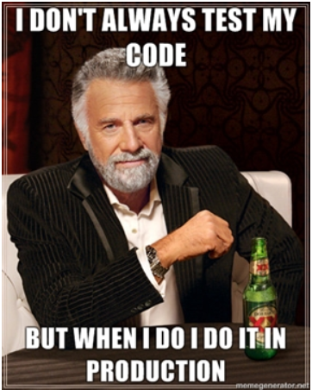

Don’t be these guys

Slide 8
Terminology
test double - pretend object used for testing (encompasses all of the below)
dummy - object passed around but not used
fake - simple working implementation of a dependency
stub - canned answers to calls within tests.
mock - objects pre-programmed with expectations.
  Used to verify “behavior”
http://xunitpatterns.com/Test%20Double.html

Slide 9

Stub vs. Mock
Stubs
  Preserve and test state
  You write the implementations.
Mocks
  Simulate Behavior
  Validate behavior

Slide 10
Behavior Matters
How many of you have worked with a system like this?
How many of you have seen a method like this?
Did you test it?
Why not?

Slide 11

WHy Mock:
Isolation
Application is complex
Real object may be slow
Real object is difficult to setup
Writing isolated tests is hard

Slide 12
Why Mock: Project Constraints
Real implementation not available
  3rd party code
  Not yet developed
Limited time for test development
Fluid Requirements

Slide 13

Mocks make you think
I have to create a lot of mocks to test.
  Class / method has too many responsibilities?
My Mocks need mocks
  Is the method too dependent on internal details?

Slide 14

Mocks make you think
I can’t mock that dependency
  Does your class have tightly bound dependencies, instead of dependency injection?
  Are statics being used?

Slide 15
Mockrunner
Does not require a container!
Supports JavaEE 1.3 - 5
  Servlets, filters, tags, JNDI, JMS, JDBC, EJBs
  Does not support EJB 3.0
Supports Struts 1.1 - 1.3
Manual Dependency Management :-(

Slide 16

SOAP-UI “Mocks”
Generate web service stub from WSDL
  Note: This is a stub.. not a mock!
Use Groovy to script responses
Export as WAR file.
  These seem to work well for testing/code validation
  Does not hold up well under extended load!

Slide 17

EasyMock
The original dynamic mocking framework.
Active development
v3.0 added many features that addressed it’s shortcomings when compared with Mockito.
  Extend EasyMockSupport (replayAll(), verifyAll())
Hamcrest argument matchers via bridge library
Good documentation

Slide 18

Mockito
Next Generation mocking framework
Already supports Hamcrest for argument matchers.
No replay
Claims to produce more “readable” (BDD style) code and failures
Great documentation with examples

Slide 19
Easymock vs Mockito
Easymock
  All interactions must be set as expectations
  Explicit “replay” step
Mockito
  Mocks are “nice” by default (verify what you want)
  No replay

Slide 20

Powermock
Extends EasyMock and Mockito
Uses custom classloader
Mock: static methods, constructors, final methods/classes, and private methods

Slide 21

Aside: Hamcrest
Library of Matchers
  contains(), closeTo(), endsWith(), equalTo(), typeCompatibleWith()
Makes Assertions and Mock argument matchers more literate
Works directly with Mockito argument matchers
EasyMock supported via a bridge Matcher
http://code.google.com/p/hamcrest/

Slide 22

Nice vs Strict mocks
Nice Mocks:
  Provides default behaviors/returns if none defined for a method
    IE: nulls for Objects, 0 for numbers
Strict Mocks:
  Undefined/expected behavior fails the test
  Variant: Order matters

Slide 23

Stricts are better(??)
Developer is required to understand the method being tested
Creates the perception of a “brittle” test case.
  This brittleness is a positive
  Failure is success!
Nice Mocks allow tests to pass when they shouldn’t.
Strict Mock Semantics is the Only Way to Mock: http://bit.ly/bj4dSF

Slide 24
Mock TEsting Flow
Create your mocks
Define Expectations
Reset/Replay the Mock
Run your test
Verification

Slide 25
Create Mocks
Often done in @Before or setUp() method
public class AuthenticationFilterTest extends EasyMockSupport {
private AuthenticationFilter filter;
private AuthenticationProvider mockAuthProvider;
private FilterConfig mockFilterConfig;
@Before
public void setUp() throws Exception {
mockFilterConfig = createMock(FilterConfig.class);
mockAuthProvider = createMock(AuthenticationProvider.class);
filter = new AuthenticationFilter(mockAuthProvider);
}
....
}

Slide 26
Set Expectations
Method and Input Parameters
Outcomes
  Return values
  Exceptions
Invocation Count
expect(mockFilterConfig.getInitParameter(eq("authenticationURL")))
.andReturn(expectedURL);
expect(mockFilterConfig.getServletContext())
.andThrow (new ServletException("Something broke!"));
expect(mockFilterConfig.getInitParameter(anyObject(String.class)))
.andReturn(expectedURL)
.times(1,4);

Slide 27
Replay/Test/Verify
Replay - Tell the mock you’re ready to test
Run your Test
Traditional Asserts and Mock Behavior Validation
// Prepare mocks for validation
replayAll();
// Execute test
filter.init(mockFilterConfig);
// Traditional JUnit Assertion (with Hamcrest Matcher)
assertThat(filter.getAuthenticationURL(),
equalTo(expectedURL));
// Validates expected behavior of mocks occurred. If getInitParam() on the
// mockFilter did not get called this would fail.
verifyAll();

Slide 28

Spys / Partial Mocks
Real methods on class are used unless explicitly mocked
Useful for:
  3rd party libraries
  Interim refactoring of legacy code
The need to do this more often than not suggests design issues in the code.

Slide 29

Black or Whitebox?
Traditional Testing tests input/output of publics
  How do you unit test a void?
Verifying branching logic in private methods is challenging from the public method.
Single public method calling multiple privates can be hard to verify.
http://www.quora.com/Should-you-unit-test-private-methods-on-a-class

Slide 30
Testable design
True? “Testable Design is Good Design”
  Most tools don’t support testing private methods or final classes.
  Should test tools govern your design?
  Should you write tests to safely refactor code or refactor code to be able to write tests?
Perhaps: “Good Design is always Testable”
  http://blog.jayway.com/2009/04/01/questioning-testable-design/

Slide 31
Let’s Look at some Code
Simple Mock Setup: com.ctv.mocksamples.servlet.UserPrincipalRequestWrapperTest
Basic Behavior/Assertions: com.ctv.mocksample.servlet.AuthenticationFilterTest
Strict vs Loose: com.ctv.mocksample.servlet.AuthenticationFilterTest
PowerMocking Statics: com.ctv.model.UserTest
PowerMocking privates: com.ctv.model.OrderPowerMockTest

Slide 32

Java Frameworks
Mockrunner: http://mockrunner.sourceforge.net/
SOAP-UI: http://soapui.org/
EasyMock: http://easymock.org/
Mockito: http://mockito.org/http://code.google.com/p/mockito/
Powermock: http://code.google.com/p/powermock/

Slide 33

.NET Frameworks
Rhino Mocks:
  http://www.ayende.com/projects/rhino-mocks.aspx
EasyMock.net
  http://sourceforge.net/projects/easymocknet/
NMock
  http://www.nmock.org/

Slide 34
Resources
“Mocks aren’t Stubs” - Martin Fowler
  http://www.martinfowler.com/articles/mocksArentStubs.html
Questioning “testable design”
  http://blog.jayway.com/2009/04/01/questioning-testable-design/
“Testing the Entire Stack” - Neal Ford
  http://nealford.com/downloads/conferences/2010/Testing_the_Entire_Stack(Neal_Ford).pdf

Slide 35
Resources
Java Mocking Framework Comparison
  http://www.sizovpoint.com/2009/03/java-mock-frameworks-comparison.html
EasyMock / Mockito Comparisons
  http://code.google.com/p/mockito/wiki/MockitoVSEasyMock
  http://blog.octo.com/en/easymock-facts-fallacies/

Slide 36
Resources
xUnit concepts and definitions
  http://xunitpatterns.com/Test%20Double.html
Strict vs Nice Mocks
  Pro Strict: http://bit.ly/bj4dSF
  Design vs Maintainability:
    http://stackoverflow.com/questions/2864796/easymock-vs-mockito-design-vs-maintainability

Slide 37
Presentation Code
You can pull down the code from this presentation on Github
  https://github.com/mpegram3rd/testing-with-mocks

