Slide 1

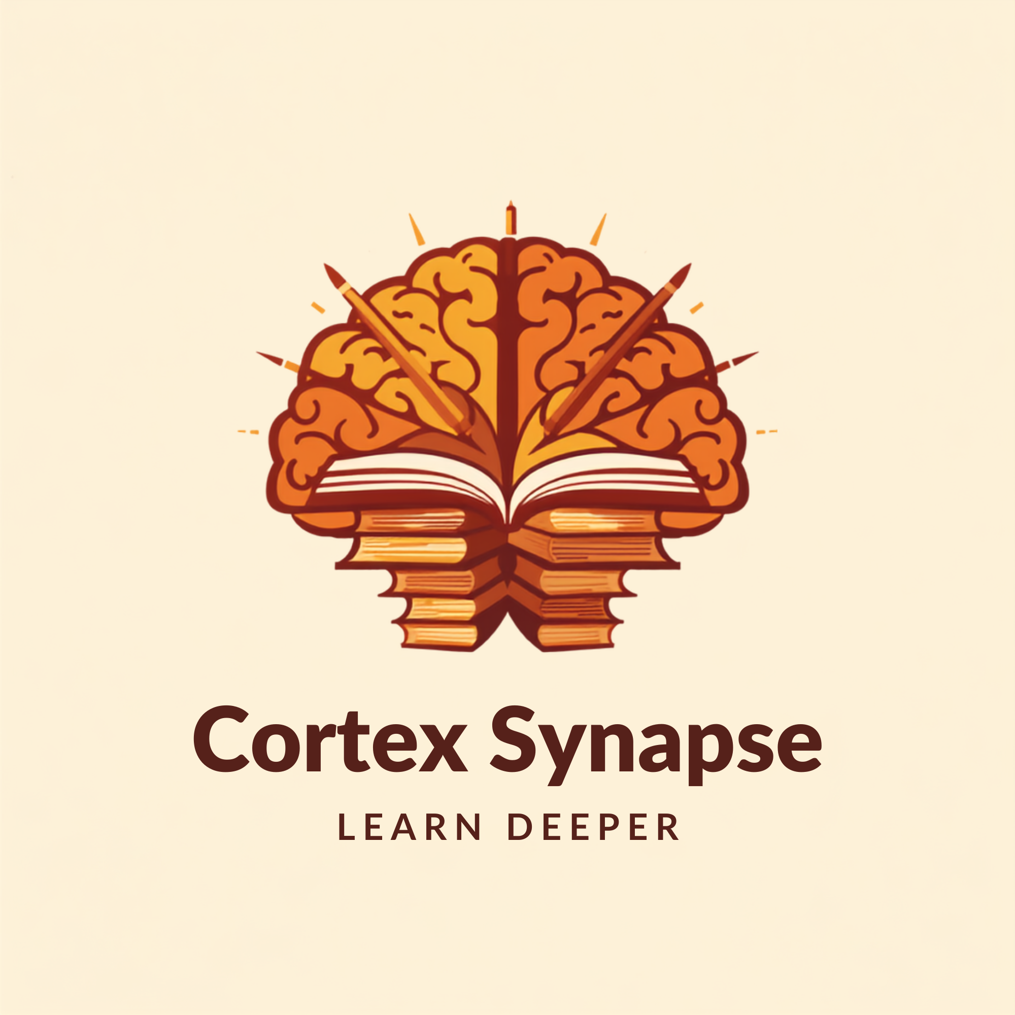
INSPIRE INTERCOLLEGE · MAJUBA TVET INTERNAL ROUND
Cortex Synapse
A South African AI study companion — so that every learner, from every background, walks into an exam room understanding the work instead of fearing it.
LEARN DEEPER
Mpendulo Njabulo — Founder · Tony — Infrastructure
Notes:
Good afternoon. My name is Mpendulo Njabulo, and this is Cortex Synapse. Let me start with a number this country celebrated in January.

Slide 2

The size of the problem
88%
54.7%
34%
of the learners who started Grade 1 together actually finish with a matric. The headline rate counts only those who reach the exam desk.
of candidates even wrote Mathematics in 2025 — and the maths pass rate fell from 69% to 64% in a single year.
The 2025 matric pass rate — the highest in our history.
It is also the number that hides the problem I am here to solve.
83%
R150–450
of South African schools have no laboratory, and 74% have no library. Township and rural learners study without what the exam assumes.
per hour for private tutoring — the one proven fix, priced out of reach of the learners who need it most.
Sources: DBE NSC announcement, Jan 2026; published cohort analyses.
Notes:
Eighty-eight percent. A record matric pass rate. But it counts only the learners who reached the exam desk. Measure the same class from the day they started Grade One and it is closer to fifty-five percent. Only one in three even wrote mathematics. And the fix that works — a tutor at four hundred and fifty rand an hour — cannot be bought by the learners who need it most.

Slide 3

Passing is not understanding
THE GAP IN ONE LINE
We are getting better at producing passes. We are not getting better at producing understanding.
A 30% is a pass. It is not a mark that carries a learner into a degree, a bursary or a job.
Per cent, Class of 2025. DBE NSC announcement, January 2026; cohort completion per published cohort analyses.
Notes:
So we are getting better at producing passes. We are not getting better at producing understanding. A thirty percent is a pass — it is not a mark that carries a learner into a degree or a job.

Slide 4
Our solution
A home-grown AI study companion — built on the South African syllabus, not adapted to it.
1
Notes that match the syllabus
2
Proper maths, properly rendered
Topic-aligned notes with worked examples and the exam tips that show up in CAPS and NATED papers — from a topic, pasted lecture text, or a YouTube link.
Fractions, integrals, ∑, √, π — the full South African exam notation set, not plain-text approximations a learner has to decode.
3
Active recall, built in
4
Paced to the learner
Quizzes and flashcards generated from any note in one click. Mastery is tracked, and the topics a learner gets wrong come back.
Explains one concept five different ways without ever judging, at two in the morning, on cheap data and an entry-level phone.
Notes:
Cortex Synapse is a home-grown AI study companion. A learner drops in a topic, their notes, or a YouTube link, and gets notes aligned to CAPS and NATED, with maths in the notation the exam uses. It then builds quizzes and flashcards from those notes, so they practise recall instead of re-reading, and the topics they get wrong come back. It is patient at two in the morning, and never makes a learner feel slow.

Slide 5
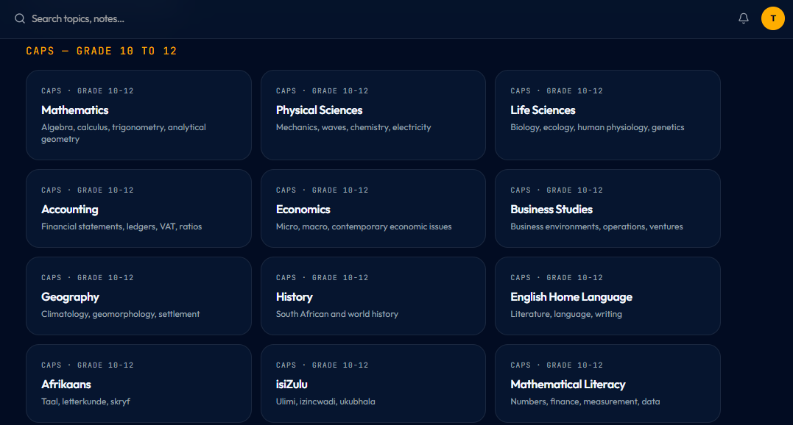
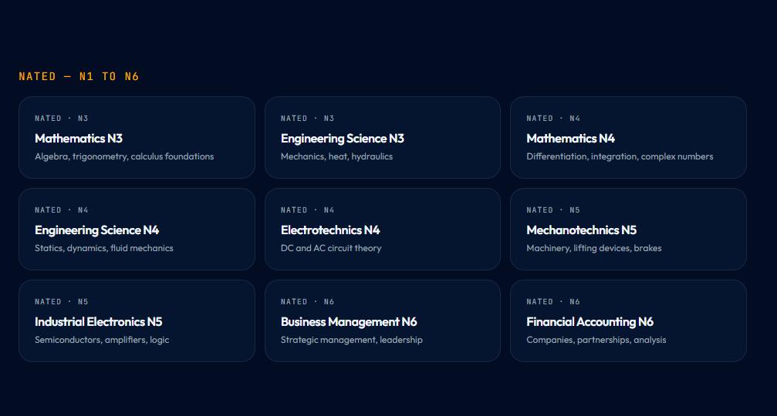
Built, and on the real syllabus
Not a mock-up. This is the product today — every CAPS subject a Grade 10 to 12 learner writes, and the NATED subjects a TVET student writes, side by side in one app.
CAPS — Grade 10 to 12
NATED — N1 to N6
NOW
TERM 3
TERM 4
2027
Built & deploying
Campus pilot
Measured results
Provincial rollout
Notes:
This is not a concept. This is the product — every CAPS subject a Grade 10 to 12 learner writes, and the NATED subjects for TVET students.

Slide 6
Why us, not them
CORTEX SYNAPSE
GLOBAL PLATFORMS
PRIVATE TUTOR
Curriculum
CAPS & NATED, home-grown
US-centric, adapted
Local, tutor-dependent
Cost to a family
Low monthly subscription
Free, but off-syllabus
R150–450 per hour
Available when
Any hour, adapts to the learner
Any hour, fixed video pace
Booked sessions only
Exam practice
Generated from the learner's own notes
Generic exercises
The tutor's own material
Only one of the three is South African, affordable, and awake whenever the learner is.
Notes:
Khan Academy is excellent — and it is American. A private tutor is ours, and costs a family thousands a month. We are South African, affordable, and awake whenever the learner is.

Slide 7

Target market
Where the need is largest, and where we can prove it fastest.
900k+
13m
~500k
matric candidates
learners in basic education
TVET college students
write the NSC every year — the largest cohort in the country's history, and the sharpest moment of need.
with Grade 8 to 12 the immediate addressable band for a study companion like ours.
under-served by every existing study platform, and the beachhead we know best.
Start here
▶
Majuba TVET and the Newcastle high schools — one campus, real learners, and results we can measure before we go wide.
Notes:
Nine hundred thousand matric candidates a year. Thirteen million learners in basic education. Half a million TVET students with no digital support. We start at Majuba, because that is where I can prove it fastest.

Slide 8
Revenue generation
Affordable by design. The learner who cannot pay is never the learner who is locked out.
Free forever tier
1
BREAK-EVEN
Core notes, quizzes and flashcards at no cost. This is the promise, not a trial.
2 000
Family plan
2
paying learners covers hosting, AI inference and support in full.
A low monthly subscription — about the price of one tutoring hour, for a whole year of study.
Surplus funds sponsored seats and more subjects — not dividends.
Institution seats
3
Colleges and schools licence seats per learner, with a lecturer view of weak topics. CSI and telco partners sponsor bundles for no-fee schools.
Notes:
The core stays free, permanently. Families who can pay take a low monthly subscription — one tutoring hour, for a whole year. Colleges licence seats per learner, and CSI partners sponsor no-fee schools. Two thousand paying learners covers our costs.

Slide 9

Impact on society and the environment
SOCIETY
ENVIRONMENT
The same quality of explanation reaches every learner.
Study material with no paper and no travel.
A learner in a school with no laboratory gets the explanation a private-school learner gets.
No printed study packs and no photocopied past papers — material is generated on demand.
Practice replaces panic — by exam day the question has already been answered fifty times.
No weekly travel to a tutoring centre, so no fuel burned to reach an explanation.
Every extra bachelor pass changes a household's trajectory, not just a learner's marks.
Built light, so it runs on cheap data and the older phone a learner already owns.
Notes:
A learner in a school with no laboratory gets the same explanation as one in a private school. Fear drops, because by exam day they have already answered the question fifty times. Nothing is printed. Nothing is driven to.

Slide 10
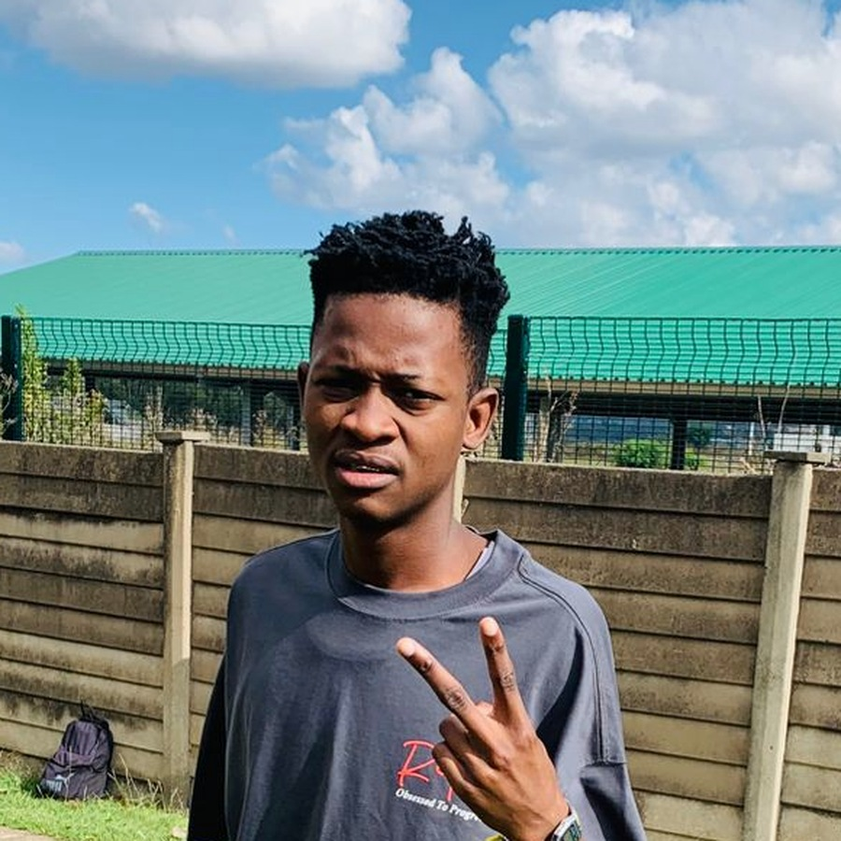
The team, and what we are asking for
THE TEAM
THE ASK
Mpendulo Njabulo — Founder
Funding
Builds the product and carries the mission. A Majuba TVET student who came through the same classrooms Cortex Synapse is built for.
1
Seed funding to cover hosting, AI inference and support for the first year — so the free tier stays free while we prove the model.
T
Tony — Infrastructure
School pilot access
Deployment, data security, and keeping the platform up and cheap to run as learner numbers grow.
2
Introductions to run a term-long pilot at Majuba TVET and two local high schools, with pass rates and topic mastery measured before and after.
“The goal is not the pass mark. The goal is a learner who understands, and is not afraid to write.”
Give us one campus and one term, and we will bring you the marks.
Notes:
The team is me — building this out of the same classrooms it is built for — and Tony on infrastructure. We are asking for funding for our first year, and access to pilot in schools. One campus, one term, and we bring you the marks. Because this was never about money. It is about a learner who understands, and is not afraid to write. The better the education, the better the South Africa that comes after us. Thank you.

