Slide 1
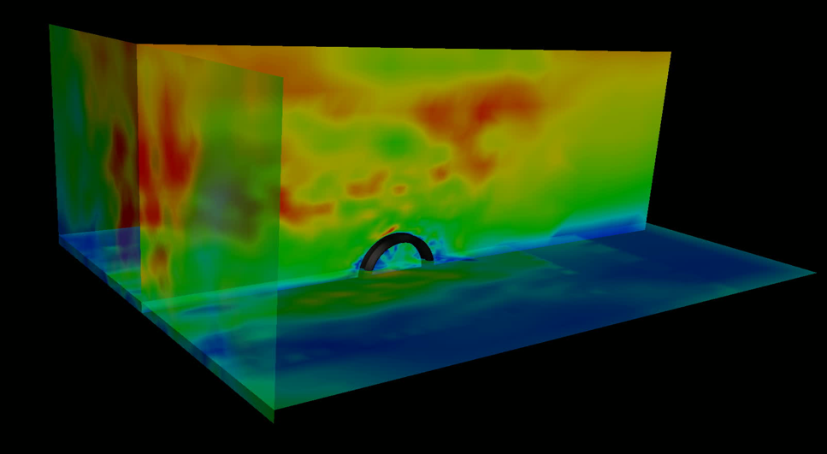

Chair of Structural Analysis
TUM Department of Civil, Geo and Environmental Engineering
Technical University of Munich
STRUCTURAL WIND ENGINEERING
Roland Wüchner, Chair of Structural Analysis, TUM
Máté Péntek, Chair of Structural Analysis, TUM
Structural Wind Engineering | Chair of Structural Analysis | WS 2019/20 | CFD 4

Slide 2
Presentation material from internal and external sources have been used either directly, modified or adapted to fit the purpose. Effort is continuously being made to accurately reference these. Nonetheless, check referencing in both the script as well as slides for completeness. In case of inconsistencies or mistakes please contact us!

Slide 3
Kratos 2D CFD Tutorial
In this tutorial we will solve another 2D example using GiD and Kratos
Covered topics:
Predefined example for simulation (aim of the current lecture, do not forget to do the necessary modifications in the setup parameters)
Or: Pre-processing (out of scope for the current lecture)
- Geometry
- Input data and conditions
Post processing of results
Inlet velocity profiles
Disclaimer: This example serves the sole educational purpose of demonstrating how to setup a basic 2D CFD problem, run the simulation and do some postprocessing. For any real case in wind engineering a 3D setup should be adopted accompanied with detailed mesh and time step study.
Technical note: Tested on 04.12.2019, works with GiD 14.1.7d and the pre-release of the Kratos problemtype (7.1) on Windows 10 and Ubuntu 18 64 bit.3

Slide 4
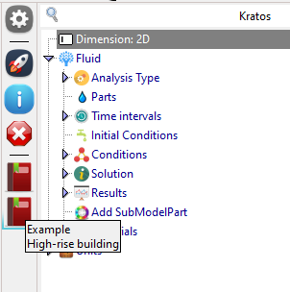
Predefined example in GiD14
Load the Kratos problem type
Data → Problem type → Kratos
Fluid → Fluid → 2D
Load the predefined example “High-rise building”
In case you want to set up the problem from scratch on you own (out of the scope of the current lecture)
→ check out slides 5 to 9
Proceed on page 10 → Check the time and solver settings
Generate the mesh
Run the calculation

Slide 5
Defining the Geometry

Slide 6
Geometry
Create the geometry in the XY-plane using the following points to describe it:
Create the points first, followed by the lines and the surface
Structure X | Y | Z
15.0 | 0.0 | 0.0
15.0 | 190.0 | 0.0
-15.0 | 0.0 | 0.0
-15.0 | 190.0 | 0.0
Boundary X | Y | Z
-600.0 | 0.0 | 0.0
-600.0 | 600.0 | 0.0
1200.0 | 0.0 | 0.0
1200.0 | 600.0 | 0.0

Slide 7
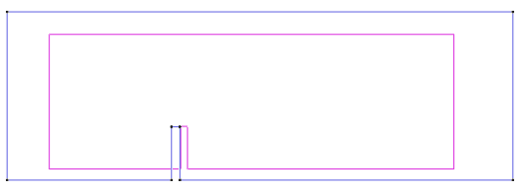
Geometry
The final geometry should look like this:

Slide 8
Problem Input

Slide 9
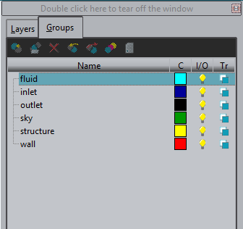
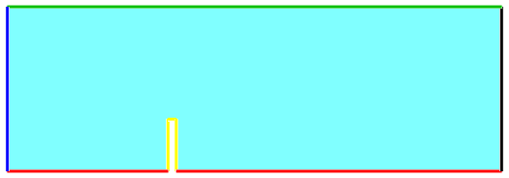
Define the entity groups
fluid group
Select surface
inlet group
Select left line
outlet group
Select right line
structure group
Select lines of the structure
wall group
Select all bottom line
sky group
Select the top line
sky
inlet
fluid
outlet
structure
wall

Slide 10
Model properties & boundary conditions (1)
Load the Kratos problem type
Data → Problem type → Kratos
Fluid → Fluid → 2D
Set End time of the analysis to 50 and Delta time to 0.05
Select an Iterative Solver for velocity and pressure -> AMGCL
Set the same fluid properties and elements as in the first tutorial
Choose the fluid for Group
Assign the following boundary conditions:
inlet: Inlet velocity (X = 25.0)
outlet: Outlet pressure
sky: Is-slip
wall: No-slip
structure: No-slip
Select the structure entity group in order to compute the drag force

Slide 11
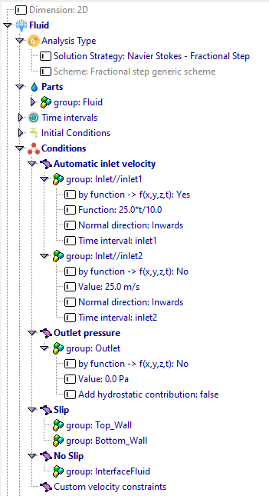
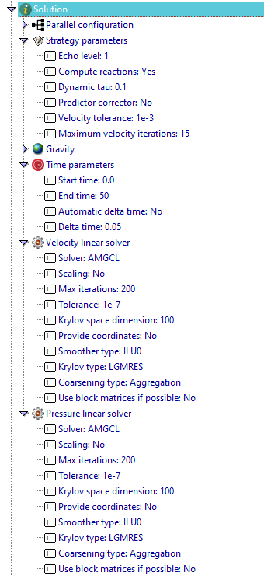
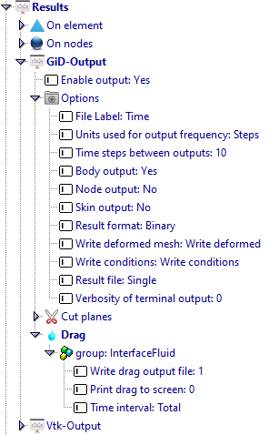
Model properties & boundary conditions (2)

Slide 12
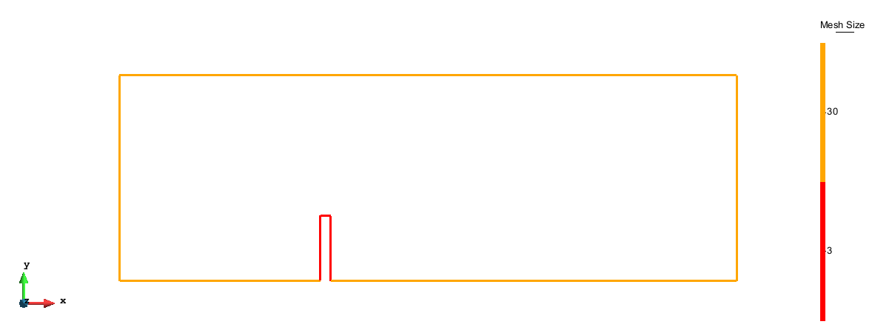
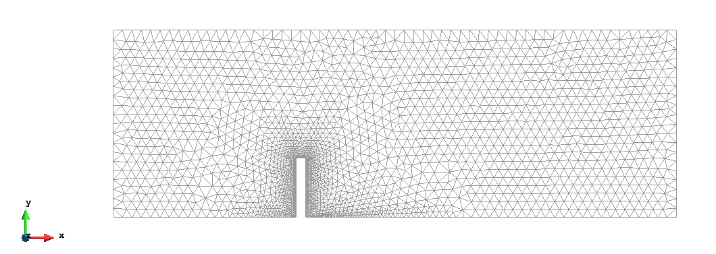
Mesh the domain
Set the following sizes in the domain
Set 30 as element size and mesh the domain
The generated mesh should have ~ 1640 nodes and ~ 3270 elements

Slide 13
Solve the problem
Save the model
Run the analysis
The input data will be checked for errors
The calculation should not take more than 5 minutes
Afterwards, switch to post process

Slide 14
Solution Postprocessing

Slide 15
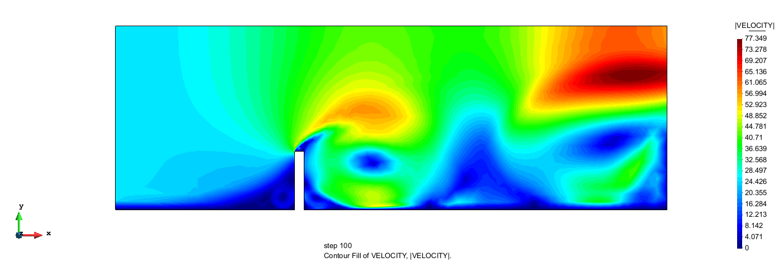
Post processing
Play around with the results and the visualization
Plot and animate the results for the velocity and the pressure and compare them
Results for magnitude of velocity in the last timestep:

Slide 16
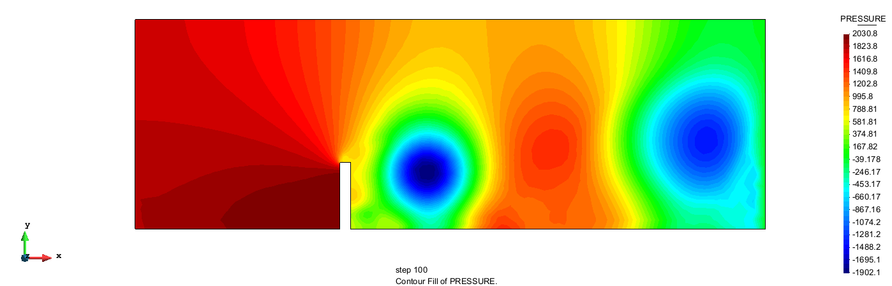
Post processing
Results for pressure in the last timestep

Slide 17
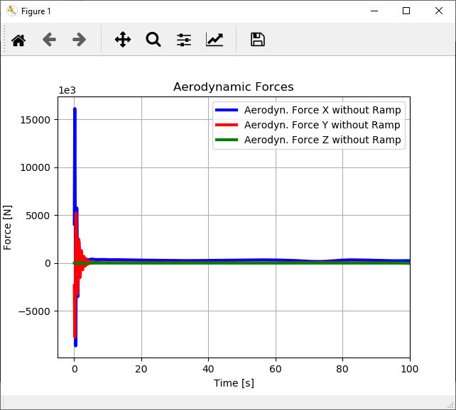
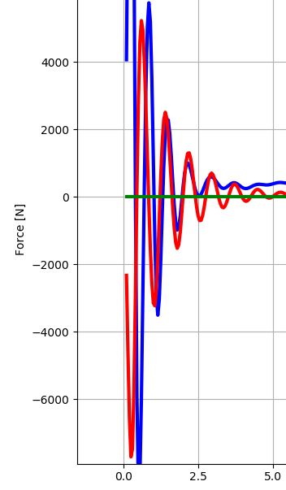
Aerodynamic results
In order to compute the aerodynamic load follow the same procedure as previous tutorial.
Plot the results of the drag using the “plot_aerodynamic_force_results.py“ (available in AdditionalFiles)
The results should look like this:

Slide 18
Inlet Velocity Profiles

Slide 19
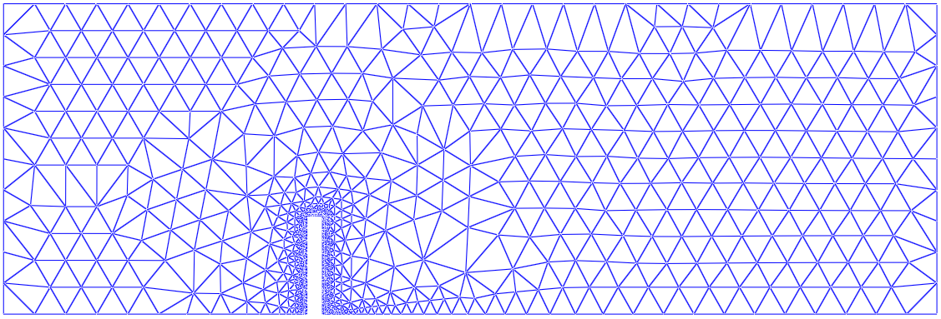
Inlet velocity profiles
Remember Tutorial 2D CFD problem:
Constant inlet velocity V_{x} = 25.0 has been applied
Custom boundary condition, i.e. self defined inlet, is necessary

Slide 20
Inlet velocity profiles
Proposed inlets:
V_{x,ref}
Y_{ref}
α
+
V_{sin}
T
V_{x,shear}
R
Power law
Logarithmic law
Convoluted log/power law

Slide 21
Inlet velocity profiles
All of the inlet velocity profiles can be ramped with respect to time

Slide 22
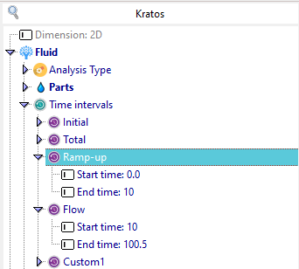
Inlet velocity profiles
Set up two time intervals:
Copy Custom1 (right click: copy)
Rename(F2) them in Ramp-up and Flow
Set time periods

Slide 23
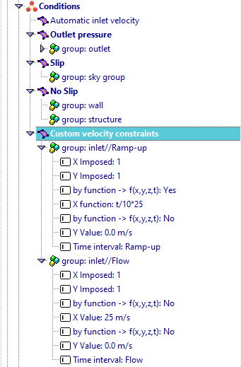
Inlet velocity profiles
Delete the Automatic inlet velocity
Set up two Custom velocity constraints, one for the ramp-up time the other on for the normal flow
Change for the ramp-up:
By function to yes
X function: t/10 * 25
Calculate the model again

Slide 24
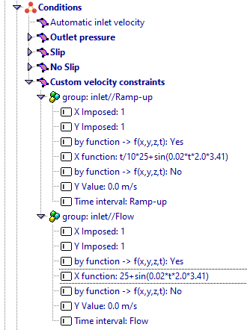
Inlet velocity profiles
Change the velocity function for both time intervals to an oscillating velocity profile
Add to the X function the oscillating sin() function
f(t) = Sin(0.02*t*2.0*3.41)
Task: Use the velocity profile from tutorial 1 Hint x² **2

