Slide 1
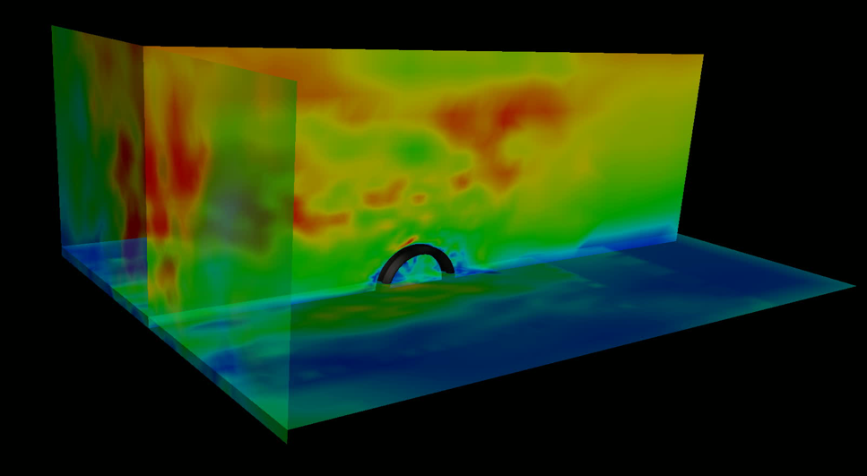

Chair of Structural Analysis
TUM Department of Civil, Geo and Environmental Engineering
Technical University of Munich
STRUCTURAL WIND ENGINEERING
Roland Wüchner, Chair of Structural Analysis, TUM
Máté Péntek, Chair of Structural Analysis, TUM
Structural Wind Engineering | Chair of Structural Analysis | WS 2019/20 | CSD

Slide 2
Presentation material from internal and external sources have been used either directly, modified or adapted to fit the purpose. Effort is continuously being made to accurately reference these. Nonetheless, check referencing in both the script as well as slides for completeness. In case of inconsistencies or mistakes please contact us!

Slide 3
Kratos 2D Fluid Tutorial to an MDoF CSD System
In this tutorial we will investigate how to do a structural simulation using GID and Kratos. We will be using the geometry of structure from Tutorial 4.
Covered topics:
Predefined example for structural simulation (aim of the current lecture, do not forget to do the necessary modifications in the setup parameters)
Or: Preprocessing (out of scope for the current lecture)
Geometry
Input data and conditions
Postprocessing of results
Disclaimer: This example serves the sole educational purpose of demonstrating how to setup a basic 2D CSD problem, run the simulation and do some postprocessing. For any real case in wind engineering a 3D setup should be adopted accompanied with detailed mesh and time step study.
Technical note: Tested on 04.12.2019, works with GiD 14.1.7d and the pre-release of the Kratos problemtype (7.1) on Windows 10 and Ubuntu 18 64 bit.
Note: This set up will be used later for FSI simulation of a building.

Slide 4
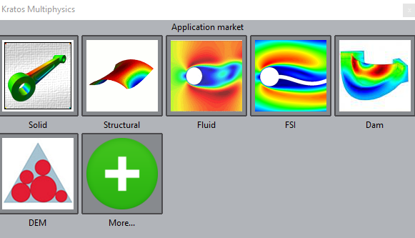
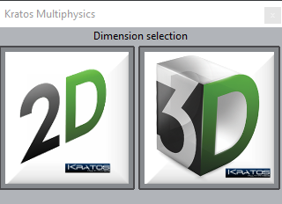
Problem Type
Load the Kratos problem type
Data → Problem type → Kratos
Select Structural in the first window (Application Type) and click the Next button
Select 2D in the second window (Analysis Type) and click the Next button

Slide 5
Use of the predefined example

Slide 6
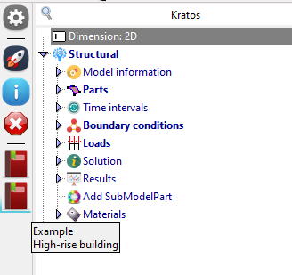
Predefined example „High-rise building“
Load the predefined example “High-rise building”
Continue on page 10 -> Check the time and solver settings
Generate the mesh
Run the calculation

Slide 7
Defining the Geometry

Slide 8
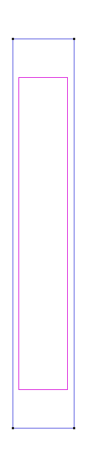
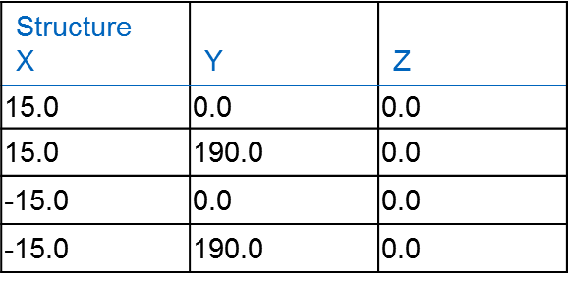
Geometry
Create the geometry in the XY-plane using the following points to describe it:
Create the points first, followed by the lines and the surface.

Slide 9
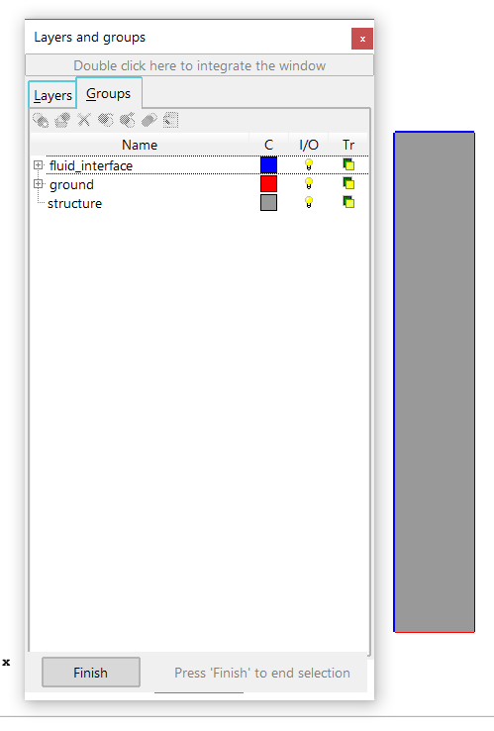
Define the entry groups
structure group
Select surface
ground group
Select bottom line
fluid_interface group
Select the remaining lines

Slide 10
Problem Input

Slide 11
Model Properties and Boundary Conditions (1)
Assign the group structure to the Parts and choose on Surfaces
Specify the property of steel.
Density : 7850 kg/m³
Young‘s Modulus : 206.9 e9 Pa
Poisson Ratio: 0.29
Thickness: 0.1 m
Use the Solid total lagrangian element with Linear elastic Plane stress
Apply fixed boundary condition at the bottom by setting the all displacement value to 0 and assign this boundary condition to ground.
Appy load boundary condition at the fluid_interface by assigning it to Load on lines and set the modulus to 500 in direction x.
Use the time and solver settings same as the figure.

Slide 12
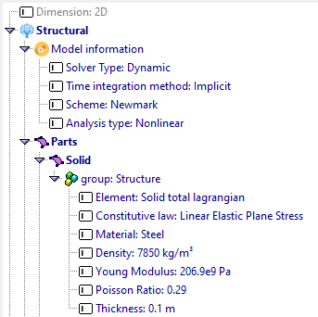
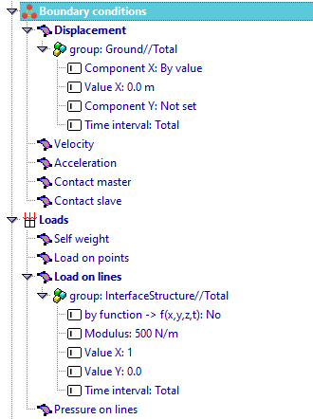
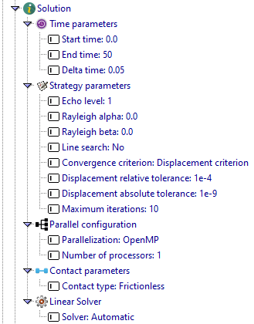
Model Properties and Boundary Conditions (2)

Slide 13
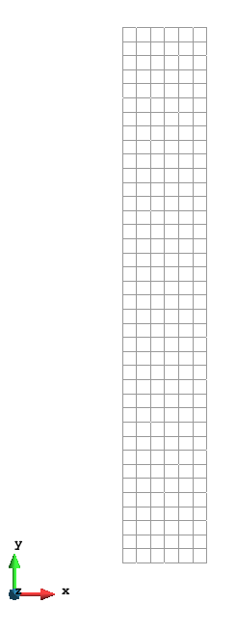
Mesh the Domain
We need to mesh the domain in order to discretize the problem
Mesh → Structured → Lines → Assign size: use size 5.0
In the box that appears, set size to 5.0 and click the Assign button. Then select all lines of the structure and press Esc
Then assign the size to surface
Mesh → Structured → Surface
Select the surface and press Esc
Now generate the mesh by pressing Ctrl+ g.
Note: Size for the mesh could be chosen as it was used in the Tutorial4_2D. This set up could be later used for performing FSI with matching grid. Now assuming 5.0 for a non-matching grid.

Slide 14
Solve the problem
Save your model
Files → Save
or Ctrl + s
Launch Kratos with
Calculate → Calculate
or F5
The input data will be checked for errors
The calculation should take few seconds

Slide 15
Solution Postprocessing

Slide 16

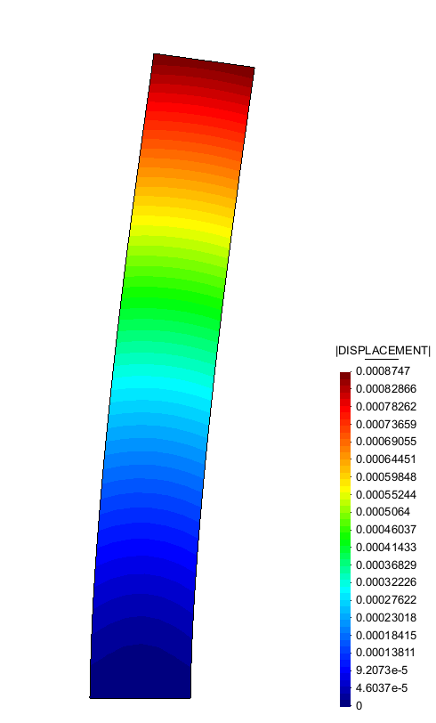
Postprocessing
For viewing deformed shape

