Slide 1
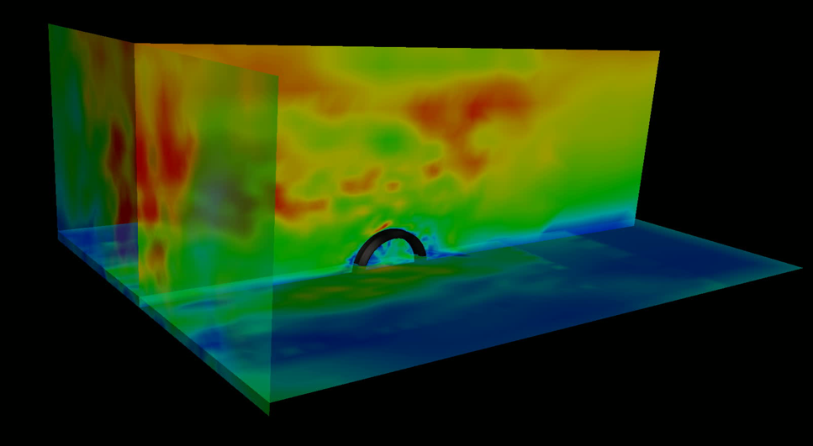

Chair of Structural Analysis
TUM Department of Civil, Geo and Environmental Engineering
Technical University of Munich
STRUCTURAL WIND ENGINEERING
Roland Wüchner, Chair of Structural Analysis, TUM
Máté Péntek, Chair of Structural Analysis, TUM
Structural Wind Engineering | Chair of Structural Analysis | WS 2019/20 | FSI

Slide 2
Presentation material from internal and external sources have been used either directly, modified or adapted to fit the purpose. Effort is continuously being made to accurately reference these. Nonetheless, check referencing in both the script as well as slides for completeness. In case of inconsistencies or mistakes please contact us!

Slide 3
Kratos 2D FSI Tutorial – Building
In this tutorial a fully coupled Fluid-Structure-Interaction (FSI) simulation is introduced. The key points of the simulation are pointed out. The simulation will be executed and the results will be reviewed
Covered topics:
Problem description of FSI
Predefined FSI example
Postprocessing of results
Some theoretical aspects of a FSI-simulation
Disclaimer: This example serves the sole educational purpose of demonstrating how to setup a basic 2D FSI problem, run the simulation and do some postprocessing. For any real case in wind engineering a 3D setup should be adopted accompanied with detailed mesh and time step study.
Technical note: Tested on 04.12.2019, works with GiD 14.1.7d and the pre-release of the Kratos problemtype (7.1) on Windows 10 and Ubuntu 18 64 bit.

Slide 4
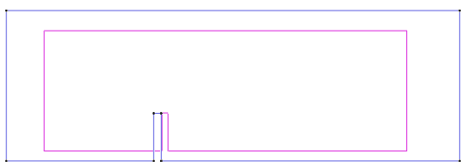
Problem description
The problem investigated in this tutorial is a 2D building in a 2D fluid domain. The building is excited / deformed by the flow surrounding it.
The geometry is same as was used in the second tutorial related to computation methods: → Tutorial4_2D_CFD.gid

Slide 5
Predefined FSI example

Slide 6
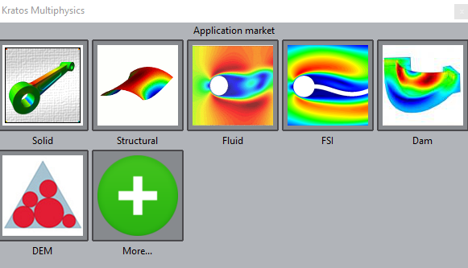
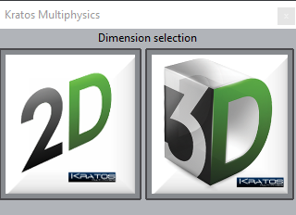
Problem Type
Load the Kratos problem type
Data → Problem type → Kratos
Select FSI in the first window (Application Type) and click the Next button
Select 2D in the second window (Analysis Type) and click the Next button

Slide 7
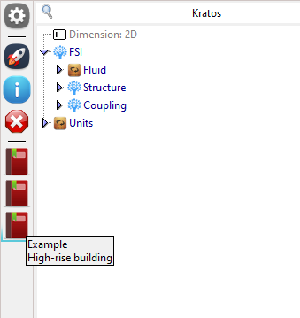
Predefined example „High-rise building“
Load the predefined example “High-rise building”
Note the new list of properties for FSI
Fluid
Structure
Coupling

Slide 8
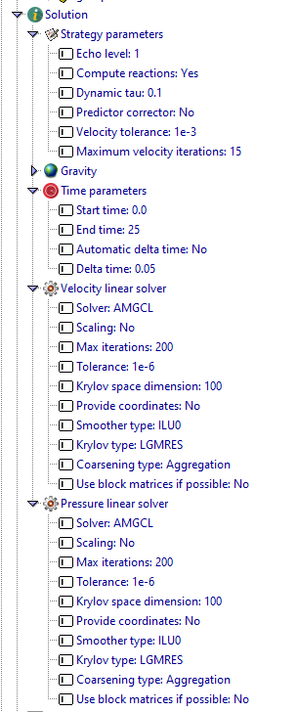
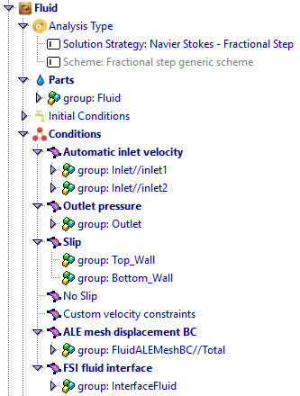
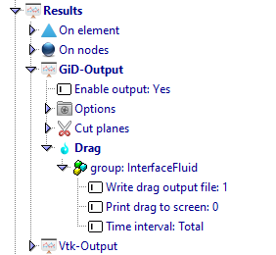
Fluid properties

Slide 9
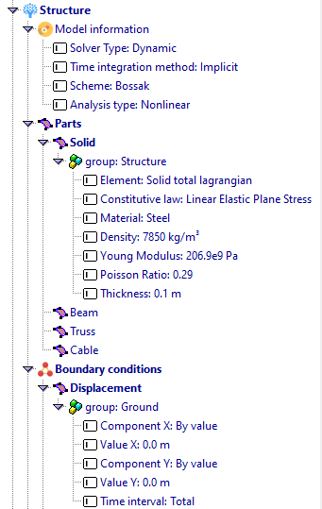
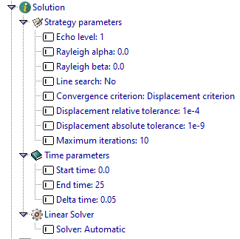
Structure properties

Slide 10
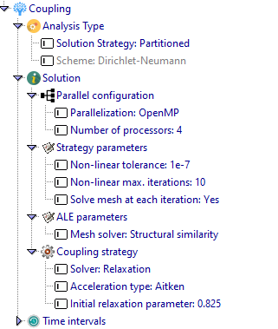
Coupling properties

Slide 11
Solution Postprocessing

Slide 12
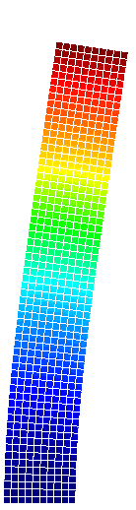
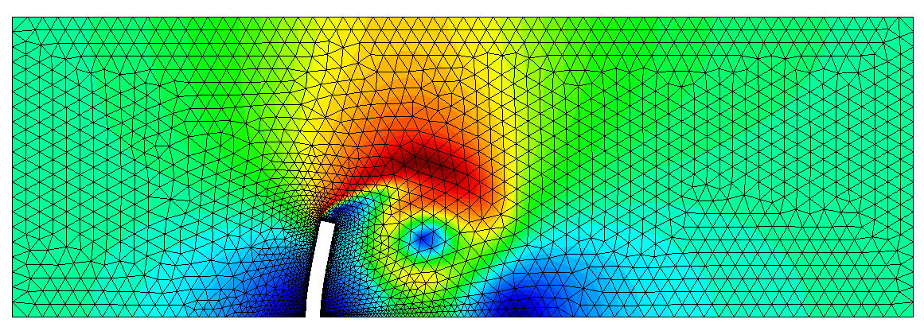
Results
The results for the fluid and for the structure are saved in separate files. (file ending: … .post.bin)
Take a look at the results of the velocity of the fluid and the deformation of the structure (select an appropriate displacement factor)
Observe the influence of the fluid on the structure and vice versa.
Velocity field
in the fluid domain
Displacement field
in the structural domain

Slide 13
Some theoretical aspects of a FSI simulation

Slide 14
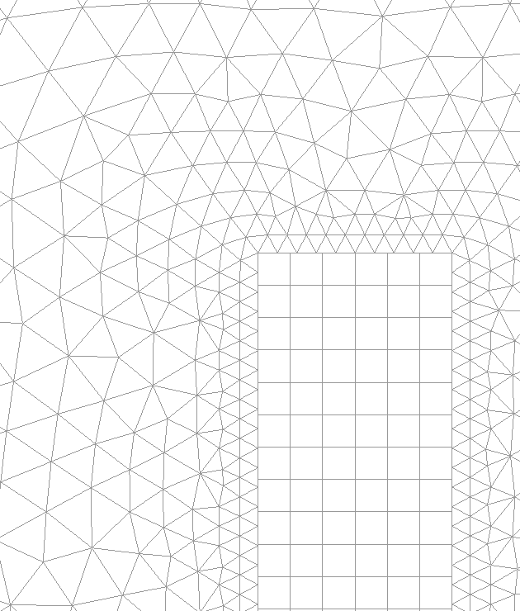
(Non-matching) Grid Mapping
Structural domain:
quadrilateral 2D-plain strain elements
Fluid domain:
2D-triangles

Slide 15
(Non-matching) Grid Mapping
The building is discretized with quadrilateral 2D-plain solid elements. The fluid domain is discretized with 2D-triangles.
Most of the times the fluid domain is finer discretized than the structural domain. Then the nodes on the interface are not matching.
This leads to the requirement that information has to be transferred between the two meshes without the nodes being in the same geometrical position.
Take a look at what these functions do and connect it to the theory from the lecture.
The main functions are:
NeumannToStructureNonMatch → Assigns the reaction forces from the fluid to the structure
DisplacementToMeshNonMatch → Assigns the displacements of the structure to the fluid mesh
Also before the calculation can be started, a coupling matrix for mapping between fluid and structural mesh has to be set up

Slide 16
Structural Solver
The structural solver is responsible for performing the structural simulation.
Kratos uses a solver based on the Finite-Element-Method (FEM).
The simulation can be carried out in many different ways, i.e. considering only a linear behavior or inluding nonlinear phenomena. It is refered to other courses for Finite-Elements.
The typical FSI simulation is conducted dynamically by considering large displacements, i.e. kinematic nonlinearities.
Boundary Conditions for the structural simulation:
Reaction forces from fluid solver

Slide 17
Fluid Solver
The fluid solver is responsible for performing the fluid simulation.
As for the fluid solver, Kratos uses a FEM based solver. This is different from many other solvers, as the most common method to solve fluid problems is the Finite-Volume-Method.
In the general case, the Navier-Stokes equations are solved. Due to the convection term, these equations are always nonlinear.
Therefore and because the fluid domain is normally finer discretized, the fluid part in a FSI simulation is the most expensive part in terms of computational effort.
Boundary Conditions for the fluid simulation:
Mesh velocity from mesh solver
Changing Domain due to moving interface

Slide 18
Monolithic - Staggered
Another very important aspect of FSI-simulations is the order of executing the different simulations.
Two major approaches exist:
Monolithic approach: All simulations are conducted at the same time. Instead of having a system of equation for every simulation, all systems are combinded in one big system of equations. This approach is computationally more expensive but more stable.
Partitioned approach: The simulations are conducted successively. The effort of formulating the systems of equations is low because the formulations for the simulations are already established. However this approach is less stable and often harder to converge. This approach is used for our simulations

Slide 19
Coupling Fluid & Structure
The coupling between the structure and the fluid for the used staggered approach is called a Dirichlet-Neumann coupling scheme.
This refers to the boundary conditions used by solvers that were mentioned above.
There are two ways of coupling:
Weak coupling (staggered): The three fields (mesh, fluid & structure) are solved once per timestep. Uses a prediction.
Strong coupling: The fluids are solved several times until the interface displacements are converged in an iterative way. This coupling is used for our simulations.

Slide 20

Relaxation
The following information is taken from this paper:
Fixed-point fluid-structure interaction solvers with dynamic relaxation by Ulrich Küttler and Wolfgang A. Wall
In order to ensure and accelerate convergence of the iteration a relaxation step is needed after each FSI cycle.
This is necessary for the interface displacements.
d_{Γ} are the interface displacements, ω is the relaxation parameter, r is the interface residual and i is the iteration number of the strong coupling.
The relaxation parameter can be kept fixed for the whole simulation or recalculated in every iteration using Aitken‘s method for an optimal convergence.
$$d_{Γ,i+1}=d_{Γ,i}+ ω_{i}∗r_{Γ,i+1}$$

