Slide 1
Flight Prices Prediction Model
Maria Perez
CIS 5560 – Intro to Big Data
Professor Jongwook Woo

Slide 2
Introduction
Objective
To develop machine learning models to accurately predict flight prices using key features like flight date, origin/destination airports, and base fare.
Use CrossValidation and TrainValidationSplit
Benefits of Analysis
Consumers: Informed booking decisions, finding optimal routes and prices.
Airlines: Maintaining competitiveness, maximizing profitability through strategic pricing

Slide 3
Specifications
Databricks Community Edition:
Version: 9.1 LTS (Apache Spark 3.1.2, Scala 2.12)
Memory: 15.3GB
Cores: 2
Nodes: 1
Hadoop:
Version: Hadoop 3.3.3 / PySpark 3.2.1
CPU Speed: 1995.312 GHz
CPU Cores: 8
Nodes: 5 (2 Master, 3 Worker)
Memory: 806.40GB

Slide 4
Dataset
Dataset sourced from Kaggle, containing flight information between April and October 2022 across major U.S. airports.
The dataset provides valuable insights into the dynamics of flight pricing.
Dataset Size: 2.95GB
Dataset URL: https://www.kaggle.com/datasets/dilwong/flightprices

Slide 5
Data Processing
Data processing is the act of collecting, and manipulating raw data to convert it into a meaningful format.
This is important because it will allow the data to be effectively analyzed.
Data processing done:
Removing irrelevant columns
Extracting and parsing data
Handling missing values

Slide 6
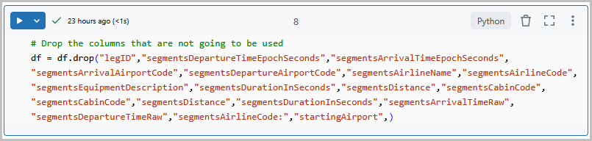
Data Processing (cont’d)
Remove Irrelevant Columns
Not all columns will be used in building the machine learning model, so it's important to remove those that are unnecessary.
drop( ) function is used to remove columns

Slide 7
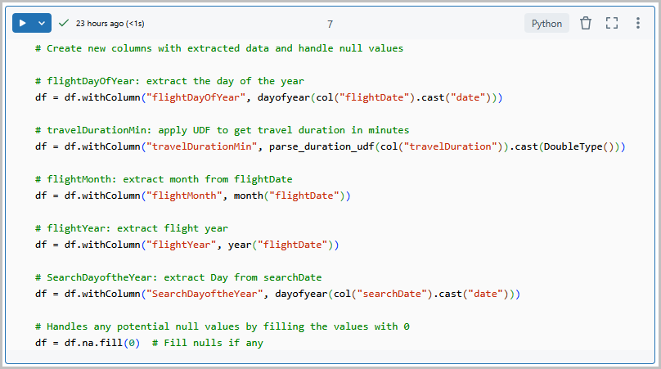
Parse and Extract
To make the data usable, parsing or extracting specific information from these columns was necessary.
From the flightDate column, the month, day, and year were extracted into three separate columns.
Travel duration was in a non-standard format, a function was created to convert it into total minutes using regular expressions
Null values were handled by replacing them with zeros.

Slide 8
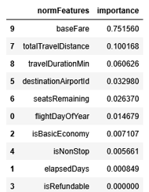
Feature Importance
Feature selection is identifying the most important variables for predicting the target outcome
Feature Importance will assign a score to each input feature based on its contribution to the model’s predictions
Key Features: baseFare, totalTravelDistance, TravelDurationMin, and DestinationAirportID

Slide 9
Model Selection
Random Forest
Method uses multiple decision trees to make predictions.
Handles both numerical and categorical data.
Gradient Boosted
Builds trees sequentially, each new tree correcting the errors of the previous one
Effective for modeling relationship between flight details and pricing

Slide 10
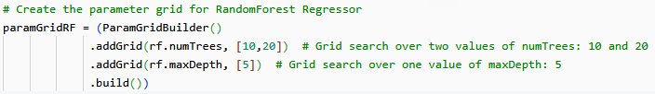
Parameter Tuning – Random Forest
Parameter tuning or hyperparameter tunning is used to improve the model’s performance by finding the best settings
numTrees control how many decision trees are used
maxDepth limits the depth of each tree, which helps control model complexity

Slide 11
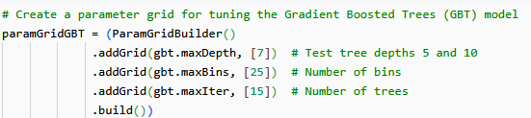
Parameter Tuning – Gradient Boosted
maxDepth: controls how deep each tree can grow. Helps manage model complexity.
maxBins: number of bins used to discretize continuous features. Affects feature splitting.
maxIter: number of boosting iterations.

Slide 12
Comparing Models
RMSE and R² are metrics used to evaluate regression models.
R² shows how well the model fit the data. The closer to 1 the better.
RMSE shows how far the prediction is from real values. The lower the better.
RANDOM FOREST | R² | RMSE | Time (sec)
Cross Validation | 0.8393 | 92.02 | 64.95
TrainValidationSplit | 0.8393 | 92.02 | 30.51
GRADIENT BOOST | R² | RMSE | Time (sec)
Cross Validation | 0.9239 | 63.30 | 329.525
TrainValidationSplit | 0.9239 | 63.30 | 173.47

Slide 13
Recommended Model
Gradient Boosting significantly outperformed Random Forest:
Higher R² and lower RMSE indicate better prediction accuracy.
Trade-off: Gradient Boosting had considerably longer training times.

Slide 14
Conclusion
Accurate prediction of flight prices and seat availability offers significant advantages for airline operations.
Future Improvements:
Incorporating real-time data such as:
Booking patterns
Weather disruptions
Competitor pricing
Investigating deep learning architectures for potential performance gains.

Slide 15
References
[1] Github URL: https://github.com/mperez13/flightPricesML
[2] Dataset URL: https://www.kaggle.com/datasets/dilwong/flightprices
[3] https://xgboost.readthedocs.io/en/stable/tutorials/model.html

Slide 16
Thank you!

