Slide 1
Flight Prices Prediction Model
Maria Perez
CIS 5560 – Intro to Big Data
Professor Jongwook Woo
Notes:
Hello everyone, today I will be presenting my project on predicting flight ticket prices using machine learning algorithms. I’ve analyzed a dataset of Expedia flight bookings to understand the key factors influencing price and developed models to forecast these prices.

Slide 2
Introduction
Objective
To develop machine learning models to accurately predict flight prices using key features like flight date, origin/destination airports, and base fare.
Use CrossValidation and TrainValidationSplit
Benefits of Analysis
Consumers: Informed booking decisions, finding optimal routes and prices.
Airlines: Maintaining competitiveness, maximizing profitability through strategic pricing
Notes:
Understanding why flight prices change constantly is really important in the airline industry. These prices can be affected by several different factors. Analyzing these factors can be incredibly beneficial for both consumers and airlines. It can help the consumer to make smart booking decisions and to find the best deals. On the other hand, airlines can benefit by enabling them to optimize their pricing strategies for better competitiveness and profitability. In this project, I will analyze flight prices using machine learning models to accurately predict fares based on key features such as flight date, origin and destination airports, and base fare.

Slide 3
Specifications
Databricks Community Edition:
Version: 9.1 LTS (Apache Spark 3.1.2, Scala 2.12)
Memory: 15.3GB
Cores: 2
Nodes: 1
Hadoop:
Version: Hadoop 3.3.3 / PySpark 3.2.1
CPU Speed: 1995.312 GHz
CPU Cores: 8
Nodes: 5 (2 Master, 3 Worker)
Memory: 806.40GB
Notes:
In this project, I primarily used the Databricks Community Edition for developing and training our machine learning models. Databricks provide a Spark environment and the version that was used was 9.1 with a memory of 15.3GB, 2 cores and 1 nodes. For the final model execution, we leveraged PySpark CLI through the Hadoop File System, which had its own set of hardware specifications across a cluster of nodes

Slide 4
Dataset
Dataset sourced from Kaggle, containing flight information between April and October 2022 across major U.S. airports.
The dataset provides valuable insights into the dynamics of flight pricing.
Dataset Size: 2.95GB
Dataset URL: https://www.kaggle.com/datasets/dilwong/flightprices
Notes:
The data I used for this project comes from Kaggle and includes information on flights within the US between April and October of 2022, covering major airports. This dataset provides valuable insights into the dynamics of flight pricing. My primary goal was to build machine learning models that can accurately predict flight prices based on key information such as the flight date, the origin and destination airports, and the base fare. Here is the link of where this dataset can be found. It's a substantial dataset, approximately 2.95 gigabytes in size, containing a wealth of information about individual flight ticket purchases.

Slide 5
Data Processing
Data processing is the act of collecting, and manipulating raw data to convert it into a meaningful format.
This is important because it will allow the data to be effectively analyzed.
Data processing done:
Removing irrelevant columns
Extracting and parsing data
Handling missing values
Notes:
Before we could train my models, a crucial step was data processing. Data processing is the essential process of taking raw, often messy data and transforming it into a clean, organized, and useful format for analysis. Raw data is rarely in a state that's directly suitable for machine learning. For this project, the data processing that was done was removing irrelevant column, extracting and parsing data and handling missing values.

Slide 6
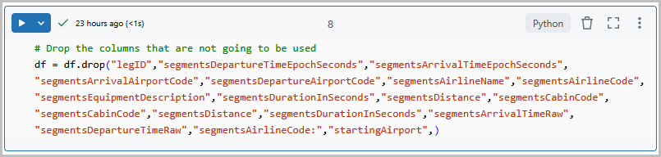
Data Processing (cont’d)
Remove Irrelevant Columns
Not all columns will be used in building the machine learning model, so it's important to remove those that are unnecessary.
drop( ) function is used to remove columns
Notes:
Firstly, the irrelevant columns that were not going to be used were removed, since not all the columns were going to be used in building the machine learning model. I used the function drop to remove the columns from the data frame that was created.

Slide 7
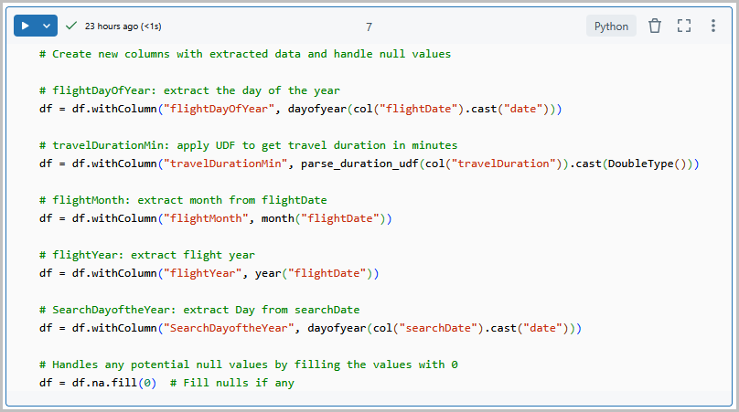
Parse and Extract
To make the data usable, parsing or extracting specific information from these columns was necessary.
From the flightDate column, the month, day, and year were extracted into three separate columns.
Travel duration was in a non-standard format, a function was created to convert it into total minutes using regular expressions
Null values were handled by replacing them with zeros.
Notes:
Some columns contain data that cannot be directly used by machine learning algorithms. To make the data more usable, it was necessary to parse or extract relevant information from these columns. For example, from the flightDate column, I extracted the month, day, and year into three separate columns. The travel duration was also in a format that was difficult to work with, so I created a function that converted it into total minutes using regular expressions. Additionally, missing values were handled by replacing them with zeros.

Slide 8
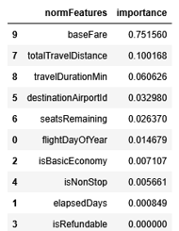
Feature Importance
Feature selection is identifying the most important variables for predicting the target outcome
Feature Importance will assign a score to each input feature based on its contribution to the model’s predictions
Key Features: baseFare, totalTravelDistance, TravelDurationMin, and DestinationAirportID
Notes:
Once the data was clean and properly formatted, the next step was feature selection. Features are the columns that will be used to train the model. Feature selection involves identifying the most important variables that significantly influence our target outcome. To select the most important features, I used a technique called feature importance. This assigns a score to each input feature in our model, reflecting how much each feature contributes to the model's predictions. A higher score indicates a greater impact. We assessed feature importance using the Random Forest Regression model. The top four features with the highest importance are baseFare, totalTravelDistance, TravelDurationMin, and DestinationAirportID.

Slide 9
Model Selection
Random Forest
Method uses multiple decision trees to make predictions.
Handles both numerical and categorical data.
Gradient Boosted
Builds trees sequentially, each new tree correcting the errors of the previous one
Effective for modeling relationship between flight details and pricing
Notes:
The two algorithms that I choose for this project are Random Forest and Gradient Boosted. Random Forest build multiple decision trees and then average their predictions. This approach helps prevents overfitting. Gradient Boosted Trees help improve prediction accuracy by sequentially building multiple decision trees, each tree correcting the errors of the previous one. This makes them effective at handling complex patterns in data.

Slide 10
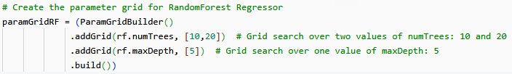
Parameter Tuning – Random Forest
Parameter tuning or hyperparameter tunning is used to improve the model’s performance by finding the best settings
numTrees control how many decision trees are used
maxDepth limits the depth of each tree, which helps control model complexity
Notes:
After selecting our models, the next crucial step was training them using our processed dataset. To ensure our models could generalize to new, unseen data, we split the dataset into training and testing sets. The training set was used to teach the model the relationships between the features and the target variable (price), while the testing set was used to evaluate how well the trained model performed on data it had never seen before. Training and testing data is split to be used for each model created. For both algorithms parameter tuning or hyperparameter tunning is used to improve the model’s performance by finding the best settings. Here we can see the ParamGridBuilder for the Random Forest. For each ParamGridBuilder() initializes the setup for hyperparameter tuning. By using numTrees, we specify that the grid should include two different values for the numTrees parameter of the Random Forest—10 and 20—which control how many decision trees are used in the algorithm. .The maxDepth adds another hyperparameter to the grid, limiting the depth of each tree to 5, which helps control model’s complexity.

Slide 11
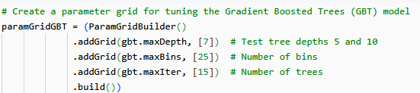
Parameter Tuning – Gradient Boosted
maxDepth: controls how deep each tree can grow. Helps manage model complexity.
maxBins: number of bins used to discretize continuous features. Affects feature splitting.
maxIter: number of boosting iterations.
Notes:
Now, we will take a look at the parameter tuning for the Gradient Boosted algorithm. The grid includes a maximum tree depth of 7. I did not want to deepen the trees as it can lead to overfitting. Next, there are 25 bins for feature discretization (maxBins). This affects how precisely features are split, but adding more bins will increase computation. Finally, there are 15 boosting iterations. More iterations can improve accuracy but may increase the risk of overfitting or longer training times. This configuration results in a single combination, allowing the model to be tested with a focused set of tuning parameters to evaluate performance under these specific settings.

Slide 12
Comparing Models
RMSE and R² are metrics used to evaluate regression models.
R² shows how well the model fit the data. The closer to 1 the better.
RMSE shows how far the prediction is from real values. The lower the better.
RANDOM FOREST | R² | RMSE | Time (sec)
Cross Validation | 0.8393 | 92.02 | 64.95
TrainValidationSplit | 0.8393 | 92.02 | 30.51
GRADIENT BOOST | R² | RMSE | Time (sec)
Cross Validation | 0.9239 | 63.30 | 329.525
TrainValidationSplit | 0.9239 | 63.30 | 173.47
Notes:
To quantify the performance of our models, we used R-squared and RMSE. R-squared shows how well the model fit the data. The closer to 1 the better. RMSE, on the other hand, shows how far the prediction is from real values. The lower the better. Together, these metrics provide a clear picture of how well our models are performing.
Here are the results for our Random Forest Regression model. We evaluated its performance using both cross-validation and a simple TrainValidation Split. The R-squared values are around 0.84, indicating that the model explains a significant portion of the variance in flight prices. The RMSE is approximately 92, meaning our predictions are, on average, about $92 off the actual price. The training time for this model was around 65 seconds for cross-validation and about 30 seconds for the TrainValidation Split.
The Gradient Boosting model significantly outperformed the Random Forest model, achieving a higher R-squared of approximately 0.92 and a lower RMSE of around $63.3. This indicates a substantial improvement in prediction accuracy. However, this improvement came at the cost of significantly longer training times, taking over 300 seconds for cross-validation and around 173 seconds for the TrainValidation Split.

Slide 13
Recommended Model
Gradient Boosting significantly outperformed Random Forest:
Higher R² and lower RMSE indicate better prediction accuracy.
Trade-off: Gradient Boosting had considerably longer training times.
Notes:
In summary of our results, both algorithms demonstrated consistent performance regardless of the evaluation strategy. However, Gradient Boosting clearly provided superior prediction accuracy with a higher R-squared and lower RMSE. It's important to note the trade-off here: the increased accuracy of Gradient Boosting came with a considerably longer training time compared to Random Forest. The choice between these models in a real-world scenario would depend on the specific requirements for accuracy and the available computational resources and time constraints.

Slide 14
Conclusion
Accurate prediction of flight prices and seat availability offers significant advantages for airline operations.
Future Improvements:
Incorporating real-time data such as:
Booking patterns
Weather disruptions
Competitor pricing
Investigating deep learning architectures for potential performance gains.
Notes:
In conclusion, our project demonstrates the potential of machine learning to accurately forecast flight prices. This capability can be transformative for airline operations, enabling smarter pricing decisions, optimized capacity planning, and ultimately supporting long-term strategic goals.
Looking ahead, there are several avenues for future improvement. I could expand the range of predictive inputs by incorporating real-time data such as current booking patterns, potential weather disruptions, and competitor pricing. These dynamic factors could significantly enhance the precision of our forecasts. We could also explore more advanced machine learning methods, including deep learning architectures, which might further elevate model performance.

Slide 15
References
[1] Github URL: https://github.com/mperez13/flightPricesML
[2] Dataset URL: https://www.kaggle.com/datasets/dilwong/flightprices
[3] https://xgboost.readthedocs.io/en/stable/tutorials/model.html

