Slide 1

Checking under the Hood:
A Guide to Rails Engines
Mike Perham
http://mikeperham.com

Slide 2



Me
data_fabric - sharding for ActiveRecord
memcache-client - ships in Rails 2.3

Slide 3


Remember 2004?

Slide 4


Slide 5
Rails Application?
Ruby code
  Initializes Rails
  Conforms to Rails’s MVC conventions

Slide 6


Remember 2006?

Slide 7
Rails Plugins, then
script/plugin list
script/plugin install <url>

Slide 8
Rails Plugin, now
A gem which has rails/init.rb
Activated via config.gem ‘gem_name’
PLUGIN_ROOT/lib is added to load_paths

Slide 9
Plugins
Can:
  provide arbitrary classes, monkeypatch Ruby/Rails
Can’t:
  Do MVC (controllers, views, routes, migrations, ...)

Slide 10
Loading Rails...
Ruby has $LOAD_PATH
  require ‘foo’
Rails has:
  Dependencies.load_path
  ActionController::Routing.controller_paths
  ActionController::Base.view_paths
  ActionController::Routing::Routes.add_configuration_file

Slide 11


Remember 2009?

Slide 12
Rails Engine (2009)
Just a plugin with additional MVC hooks
Effectively becomes another application!

Slide 13
Engines and MVC
app/views added to the view template load path
app/controllers added to the controller load path
app/{models,helpers} added to the load path
Note: Application code always wins!

Slide 14
Models
Rails will look for models in the engine
No way to add Migrations
Beware of name collisions
  Use modules to namespace
  Foo::User, not User

Slide 15
Engine Setup
def configure_engines
if engines.any?
add_engine_routing_configurations
add_engine_controller_paths
add_engine_view_paths
end
end
def add_engine_routing_configurations
engines.select(&:routed?).collect(&:routing_file).each do |routing_file|
ActionController::Routing::Routes.add_configuration_file(routing_file)
end
end
def add_engine_controller_paths
ActionController::Routing.controller_paths += engines.collect(&:controller_path)
end
def add_engine_view_paths
# reverse it such that the last engine can overwrite view paths from the first, like with routes
paths = ActionView::PathSet.new(engines.collect(&:view_path).reverse)
ActionController::Base.view_paths.concat(paths)
ActionMailer::Base.view_paths.concat(paths) if configuration.frameworks.include?(:action_mailer)
end

Slide 16
Controllers
Rails will look for controllers in ENGINE_PATH/app/controllers
Routes are installed from ENGINE_PATH/config/routes.rb
Engine helpers are NOT loaded with helpers :all

Slide 17
View
Rails will search for View templates in the engine
Static assets (JS/CSS/images) need to be copied to RAILS_ROOT/public

Slide 18
Misc
Rake tasks are loaded from ENGINE_PATH/lib/tasks
Use ENGINE_PATH/rails/init.rb or create a Rake task to bootstrap static files and migrations
  install.rb only run with script/plugin install...

Slide 19
Example init.rb
require 'fileutils'
def copy_static_assets
src = File.join(File.dirname(__FILE__), '..', 'public')
FileUtils.cp_r src, RAILS_ROOT if File.exist? src
end
def copy_migrations
FileUtils.cp_r Dir.glob(“#{File.dirname(__FILE__)}/../db/migrate/*.rb”),
File.join(RAILS_ROOT, 'db', 'migrate')
end
copy_static_assets
copy_migrations

Slide 20
Limitations
Change management of those static files

Slide 21
Notable Engines
Clearance - authentication
  http://github.com/thoughtbot/clearance
Queso - dynamic search
  http://github.com/mperham/queso

Slide 22
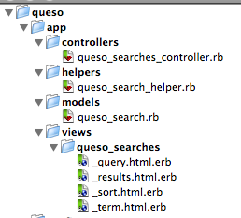
Queso
Looks just like a normal app!

Slide 23

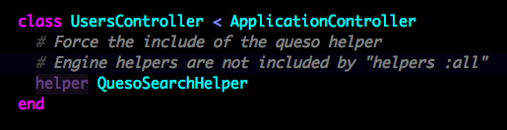
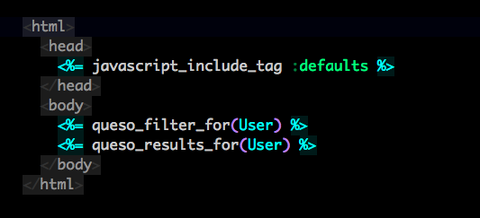
Queso

Slide 24
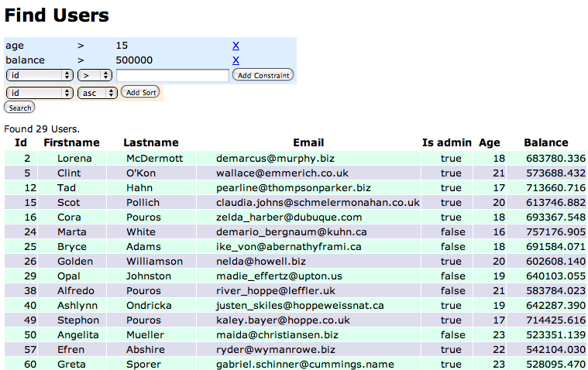
Queso

Slide 25
Conclusion
An Engine is:
  a Rails application within your app
  a plugin with MVC hooks

Slide 26
Thank you!
http://mikeperham.com
@mperham
Questions?

