Slide 1


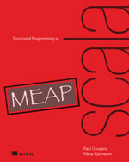
Functional Programming in Scala:
Functional Data Structures
Mark Perry
@mprry
maperry78@yahoo.com.au
mperry.github.io

Slide 2
Overview
FP style does not update or modify data
We want immutable data structures!
Immutable structure definition and use
Pattern matching

Slide 3
Definitions
Immutable data
Compare:
  3 + 4
  a ++ b
Concern: Inefficient copying of data

Slide 4
List
List.scala
Data constructors: Nil, Cons
Nothing is a subtype of all types
Covariant type argument [+A] varies with inheritance
Example:
  Cons(1, Cons(2, Cons(3, Nil)))
  1::2::3::Nil
Data constructor allows pattern matching
sealed trait List[+A]
case object Nil extends List[Nothing]
case class Cons[+A](head: A, tail: List[A]) extends List[A]

Slide 5
Pattern Matching
Sum a list of integers
Extract subexpressions, can nest
def sum(ints: List[Int]): Int = ints match {
case Nil => 0
case Cons(x,xs) => x + sum(xs)
}
ints match {
case Cons(x, Cons(y, Cons(3, Cons(4, _)))) => x + y
case _ => 0
}

Slide 6
Immutability
If elements are immutable we share data
Data sharing or sharing
Avoids pessimistic data copying across loosely coupled components in OO

Slide 7
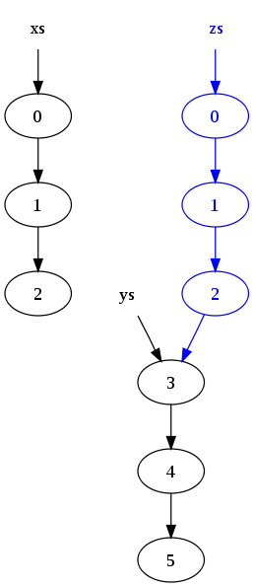
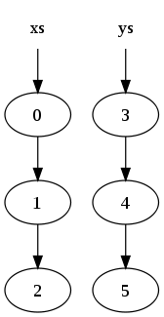
List
def xs = [0, 1, 2]
def ys = [3, 4, 5]
def zs = xs ++ ys

Slide 8
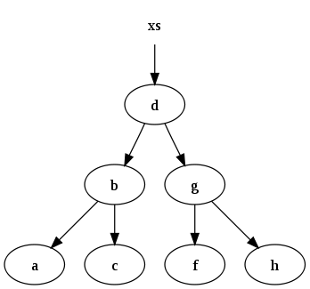
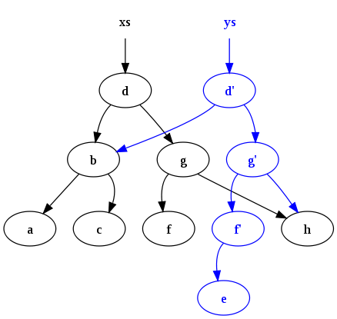
Tree
def xs = [a, b, c, d, f, g, h]
def ys = insert(e, xs)

Slide 9
Exercise
Exercise 3.4, Define the functions:
def drop[A](l: List[A], n: Int): List[A]
def dropWhile[A](l: List[A])(f: A => Boolean): List[A]

Slide 10
Higher Order Functions
Recursion over lists generalises to HOF
Library: fold, filter, map, flatMap, take, takeWhile, forall, exists, etc.
def foldLeft[A,B] (l: List[A], acc: B)(f: (A, B) => B): B
def foldRight[A,B] (l: List[A], acc: B)(f: (A, B) => B): B
e.g. foldLeft(1::2::3::4::Nil, 0) (_ + _)
e.g. foldLeft(1::2::3::4::Nil, 1) (_ * _)
e.g. foldRight(“abc”::”def”::”ghi”::Nil, “”) (_ ++ _)

Slide 11

Algebraic Data Types
List is example of Algebraic Data Type (ADT)
Not an Abstract Data Type (ADT)
The data type is the sum or union of the constructors
Each data constructor the product it's arguments
See [The Algebra of Data]
https://www.youtube.com/watch?v=ftgAG3Vnif8

Slide 12
Trees
Binary tree
Exercise: Write a function that returns the maximum path length
sealed trait Tree[+A]
case class Leaf[A] (value: A) extends Tree[A]
case class Branch[A] (left: Tree[A], right: Tree[A]) extends Tree[A]

Slide 13
Summary
Algebraic Data Types
Pattern Matching
Purely Functional Data Structures

Slide 14
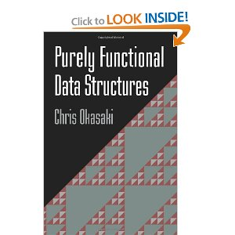
References
Okasaki, Purely Functional Data Structures
  PhD: https://www.cs.cmu.edu/~rwh/theses/okasaki.pdf
  Book
[The Algebra of Data], http://blog.lab49.com/archives/3011

