Slide 1


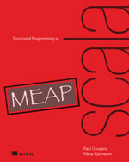
Functional Programming in Scala:
Errors Without Exceptions
Mark Perry
@mprry
maperry78@yahoo.com.au
mperry.github.io

Slide 2
Exceptions break RT
<pre>
</pre>

