Slide 1
Lambda Cube
Mark Perry
maperry78@yahoo.com.au
@mprry

Slide 2
Dependency Relationships
 | Term | Type
Term | Term → Term | Term → Type
Type | Type → Term | Type → Type

Slide 3
Dependency Relationships
 | Term | Type
Term | Term → Term Typeability | Term → Type Dependent Types init : Πn:Nat. data → Vector n
Type | Type → Term Parameteric polymorphism nil : ∀X. List X, e.g. nil Int | Type → Type Type Constructors & Kinding

Slide 4
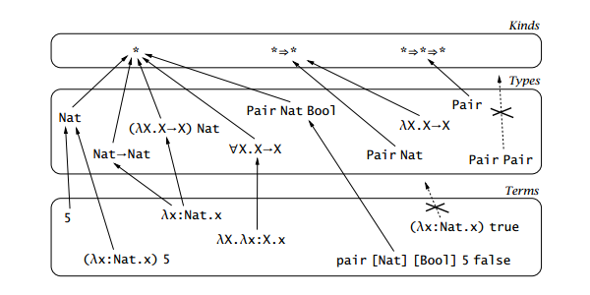
Type Hierarchy

Slide 5
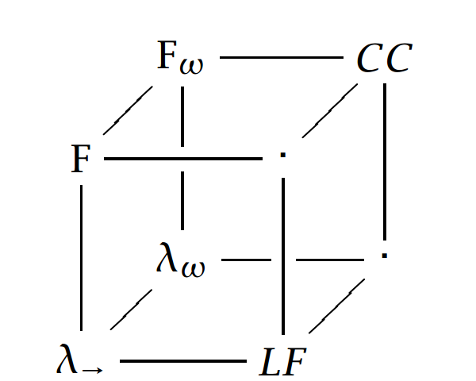
Lambda Cube

Slide 6
Lambda Cube
Polymorphism
Type Constructors &
Kinding
Dependent Types

