Slide 1

MAD Team
Michela petrozzi
Alienor Viollet
Deepmala agarwal

Slide 2
Agenda
Introduction: Project Execution Steps
User Stories for this project
Scope of the Project
Deep Dive into the User stories
Questions

Slide 3
Project execution steps
Analysis
Understand the stories
Identify the data sets needed to answer these questions
Design
Data design
UI design
Algorithms to answer each story
Development
Build data sources for Uber data using Kaggle for Russia and Newyork
Derivation of city name based on Latitude and Longitude using citypy package
Creation of dataframes
Creation of charts (pie charts, bar charts, scatter plots, line graphs, box plots)
Statistical analysis (correlation, linear regression, ANOVA)
Hypothesis analysis and null hypothesis

Slide 4
Understanding the story
As a Uber customer, I want to lower my payments and find out what the best time is to book Uber – Rush hour analysis.
As a Uber customer, I want to know the peak time in popular cities and avoid cancellations.
As a Uber customer, I want to know which cities have maximum Uber drivers level and offer least expensive rides.
As a Uber customer, I want to know how much I have to pay based on distance.
As a Uber customer, I want to know the average waiting time and the probability that the ride will get cancelled.
As a Uber driver, I want to know which car is the preferred one to drive while working for Uber.
As a Uber driver, where I should choose to drive for Uber in order to earn the highest income.
As a Uber driver, I want to know during what kind of weather there is the max number of trips.
As a data analyst, we want to know the distance wise pricing trends for Uber trips.

Slide 5
Scope of the project
Data:
Personal Uber trips recorded by a customer
Timeframe of the recorded trips:
From May 11th 2015 to April 27th 2018 (almost 3 years)
Location:
Multiple Russian cities mainly Moscow City, Saint Petersburg and Ekaterinburg
Number of trips recorded:
678 trips (average of 0.6/day, 4.35/week, 18.8/month, 226/year)
Big Data Analysis (1 million records)
New York State data for all UBERs rides was analyzed for Sept 2014 and perform rush hour and rush city analysis.
Notes:
Timeframe: 1095 days, 156 weeks, 36 months

Slide 6
Deep Dive into the User Stories

Slide 7
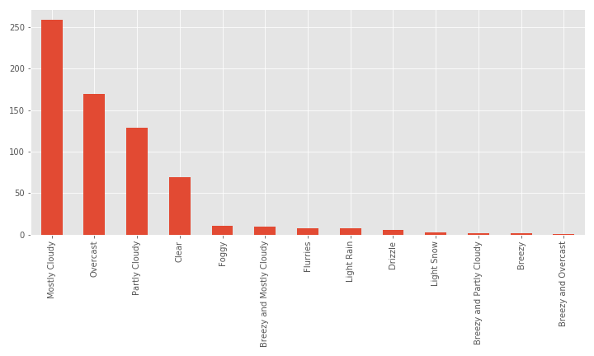
Trip count depending on the weather
Mostly Cloudy
Overcast
Partly Cloudy
Learning Applied:
Bar Chart
Correlation
Notes:
The above bar chart shows the trip count for each type of weather. We can see that majority of trips were taken during mostly cloudy days.

Slide 8
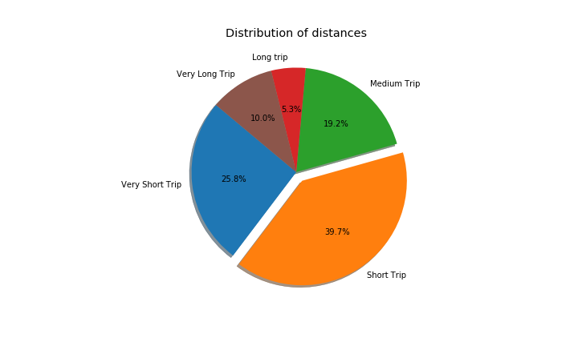
Trip count by distance (in km)
Very short trip (0-4km)
Short trip (5-9km)
Medium trip (10-14km)
Long trip (15-19km)
Very long trip (20-47km)
Learning Applied:
Pie Chart
Binning Concept

Slide 9
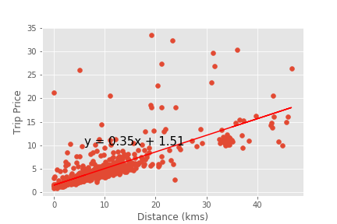
Distance and trip price
Correlation = 0.73
Moderate
R-squared = 72.6%
Positive Linear Regression
Learning Applied:
Scatter Plot
Linear Regression
Notes:
Based on the above scatter plot there is a moderate correlation between the distance in kms and the trip fare since the correlation number is 0.73, closer to 1. The r-squared is also near 1 which means that 72.6% of the variance for the trip fare can be explained by the distance in kms. The linear equation shows a positive linear regression line between the 2 variables, which means that an increase in the distance in kms corresponds to an increase in the trip fare.

Slide 10
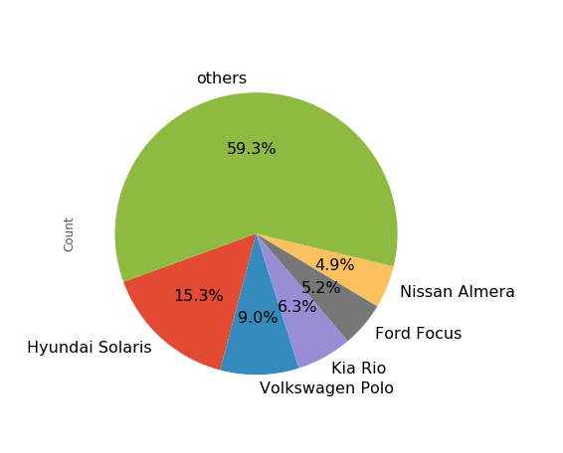
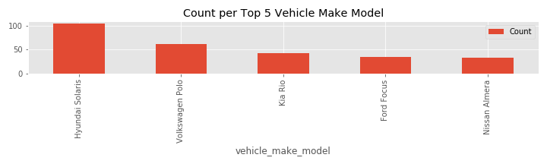
Top 5 cars among Uber drivers
Hyunday Solaris
Volkswagen Polo
Kia Rio
Learning Applied:
Pie Chart
Data slicing using sort and top 5
Notes:
The above pie chart shows the top 5 vehicle make models used by UBER drivers in Russia. The 1st one is the Hyunday Solaris, a south Korean car, which is sold as Hyundai Accent in the USA. For the Russian market it is assembled by the TagAZ plant in Taganrog. The 2nd one is the Volkswagen Polo, a car produced by the German manufacturer Volkswagen since 1975. The 3rd one is Kia Rio, another South Korean car.

Slide 11
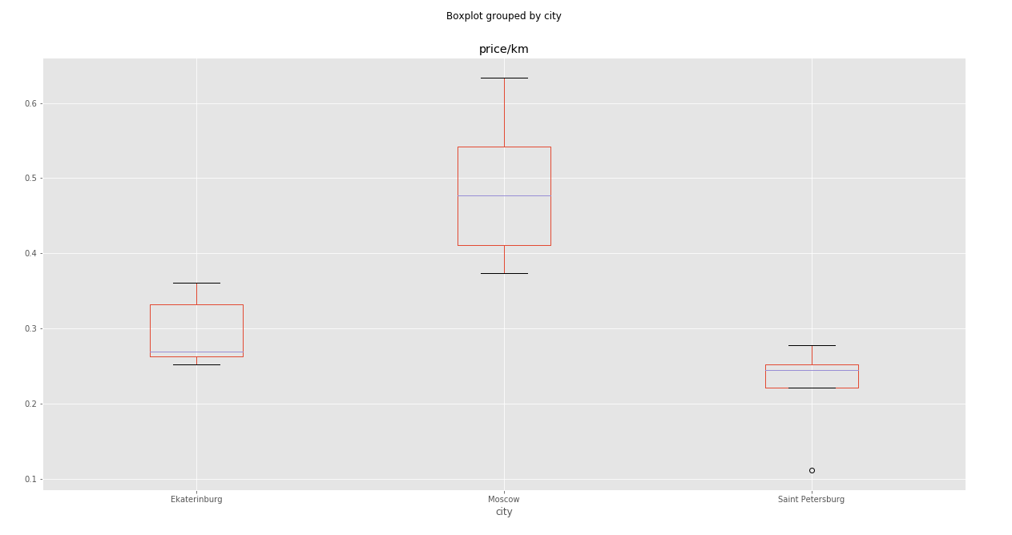
Price per km comparison in the 3 Russian cities
Learning Applied:
Box Plot using Pandas
Notes:
The 3 above boxplots show 3 different distributions of prices/km in the 3 Russian cities.
The box plot representing the distribution of prices/km in Saint Petersburg is very short comparted to the other 2, which shows less variability in the data while the boxplot representing prices/km in Moscow shows the highest variability.
While the Moscow boxplot shows a symmetric/normal distribution as the median falls in the middle of the Interquartile range, the other 2 boxplots show a very skewed distribution: the Ekaterinburg boxplot is skewed to the right and the Saint Peterburg is skewed to the left.
The length of the whiskers indicate data's minimum and maximum.
The Saint Petersburg boxplot shows a low outlier.
ANOVA testing: Since the p-value is less than 0.05, there is a significant difference between the mean prices of UBER rides in the 3 Russian cities.

Slide 12
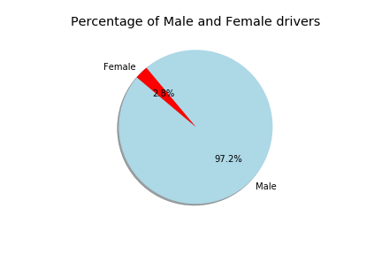
Drivers’ gender
For all the Uber trips the customer took in Russia between 2015 and 2018:
97.2% of the drivers were men (659)
2.8% of the drivers were women (19)
Learning Applied:
Pie Chart

Slide 13
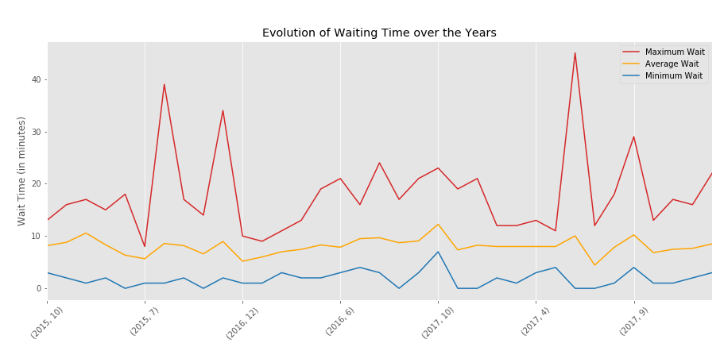
Wait time over the years
For all the trips recorded:
7 minutes average wait
2 minutes average minimum wait
17 minutes average maximum wait
The customer waited the most in June 2017, with a maximum average of 45 minutes
Learning Applied:
Multi Line Charts
Group by concepts

Slide 14
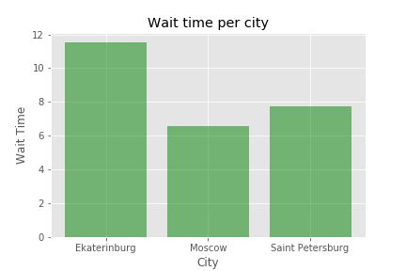
Wait time by city
For all the trips recorded:
Ekaterinburg 11.5 minutes
Moscow 6.6 minutes
Saint Petersburg 7.7 minutes
Notes:
678 drivers total

Slide 15
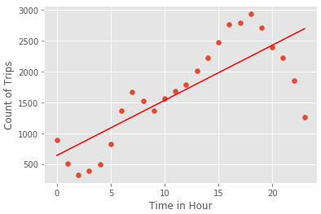
Correlation between number of rides and rush hours
For the Uber Data:
Correlation coefficient and linear regression model for rush hours and trip count
0.8 correlation coefficient: good
Learning Applied:
Correlation
Linear Regression
Notes:
# Calculate the correlation coefficient and linear regression model for Hour of day time # and Trip Count for the UBER Data # Coorelation was identified to be pretty good with 0.8 coorelation coefficient. Hour_Time = rush_hour_df['Hour'] Trip_Count = rush_hour_df['Trip Count'] correlation = st.pearsonr(Hour_Time,Trip_Count) print(f"The correlation coefficient between both factors is {round(correlation[0],2)}") # Calculate the linear regression model for for Hour of day time and Trip Count for the UBER Data x_values = rush_hour_df['Hour'] y_values = rush_hour_df['Trip Count'] (slope, intercept, rvalue, pvalue, stderr) = linregress(x_values, y_values) regress_values = x_values * slope + intercept print("The regression values for each hour of the day as part of linear regression model is:") print(regress_values) # Plot the linear regression model on top of the previous scatter plot. line_eq = "y = " + str(round(slope,2)) + "x + " + str(round(intercept,2)) plt.scatter(x_values,y_values) plt.plot(x_values,regress_values,"r-") plt.annotate(line_eq,(6,10),fontsize=15,color="red") plt.xlabel('Time in Hour') plt.ylabel('Count of Trips') print(f"The r-squared is: {rvalue}") plt.show()

Slide 16
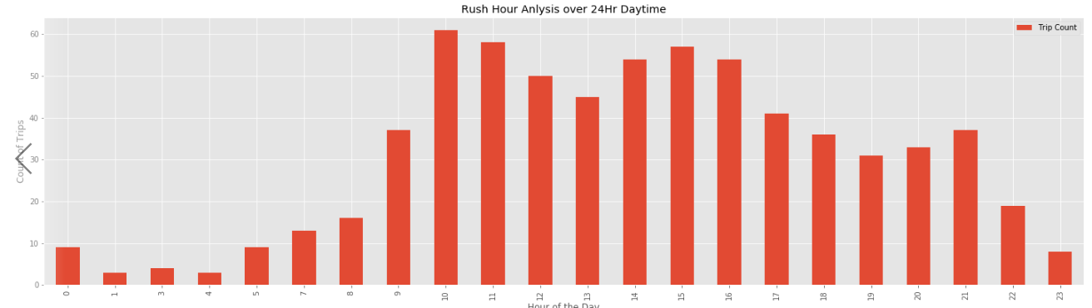
Hypothesis – Possibility of getting an UBER Ride in Rush hour?
Question: I am a resident of Saint Petersburg. Will I get UBER if I book it at 10 AM ?
Hypothesis: If you are booking an UBER during rush hour from 9 am to 11 am, your chances of getting UBER is less or wait will be high.
Null Hypothesis: If you are booking an UBER outside rush hour i.e. 9 am to 11 am, your chances of getting UBER is High or wait will be less.
Learning Applied:
Bar Chart
Group by concepts

Slide 17
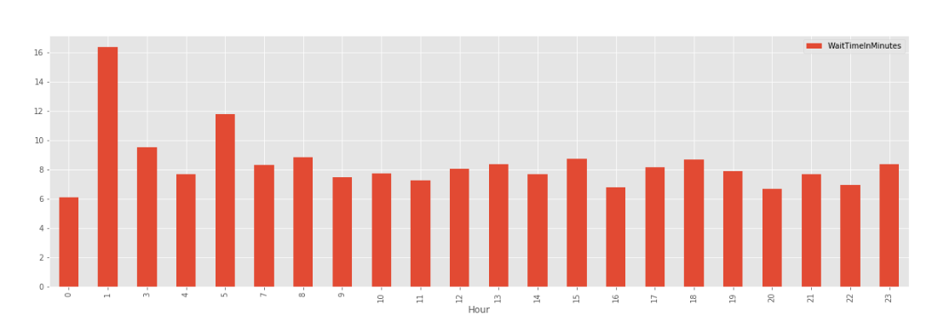
Hypothesis – Wait time for UBER ride
Learning Applied:
Bar Chart
Hypothesis
Question: I am a resident of Saint Petersburg. Will I get UBER in 5 mins if I book it at 7 AM ?
Hypothesis: If you are booking an UBER in morning, your chances of getting UBER within 8 mins is less.
Null Hypothesis: If you are booking an UBER in afternoon, your chances of getting UBER is within 8hr is high.

Slide 18
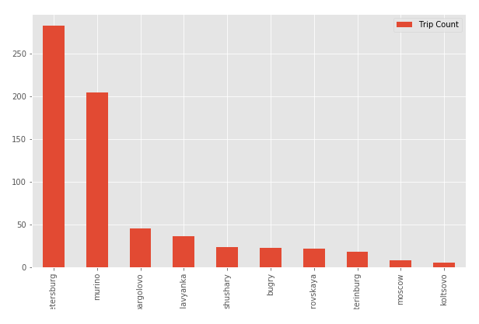
UBER Trip Count by City
Question:
Learning Applied:
Bar Chart
Correlation

Slide 19
Link to Project Git
https://github.com/deepmalaagarwal/Project_one_MAD/blob/master/UberMadCool.ipynb

Slide 20
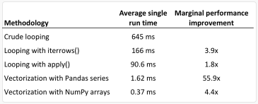
Post Project Learning & Findings
How to use a commercial API like Uber
Moderate correlation between distance and price
Strong correlation between time of the trip and wait time
Looping thru a BIG Dataframe

Slide 21
MAD Team
Thank You
Michela petrozzi
Alienor Viollet
Deepmala agarwal

