Slide 1
NeuroVAT
Neuromorphic Synapse Modeling — without Cadence
Behavioral Python twins of ECFET / FeFET Verilog-A devices, a live stimulus designer, a spiking-network trainer on a memristive crossbar, and an embedded Claude agent — all in one desktop app.
Live demo deck · screenshots captured from the running app

Slide 2
OVERVIEW
What is NeuroVAT?
The problem
The approach
Iterating on neuromorphic synapse devices in Cadence/Spectre is slow: a license, a compile, a netlist and a long transient for every parameter tweak.
Exploring learning behaviour (LTP/LTD, STDP, network accuracy) on top of that loop is painful and hard to visualise.
Fast Python “twins” of each .va device — same physics, no EDA loop.
Design any stimulus and see I / R / G respond live.
Train a spiking LIF network on a crossbar of those devices and watch it learn.
Edit the Verilog-A in-app; ask the built-in Claude agent to explain or tune it.
NeuroVAT
01

Slide 3
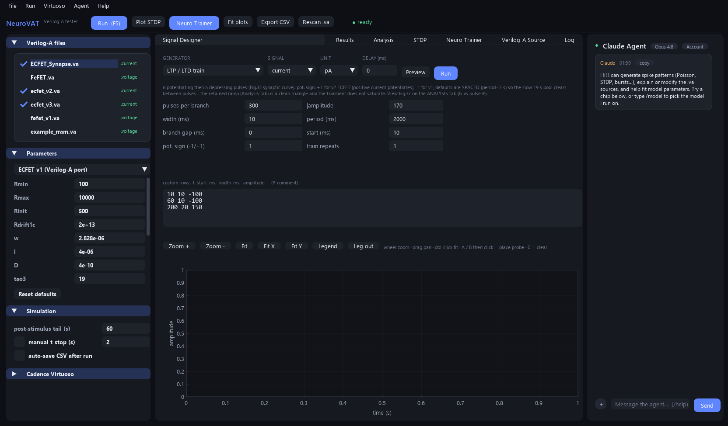
STIMULUS
Signal Designer
10+ generators: single spike, pulse train, LTP/LTD, paired-pulse, Poisson, burst, STDP pairs, staircase, custom CSV.
Current- or voltage-drive with pA → A / mV → V unit scaling.
Live waveform preview before you run.
One click sweeps every selected device twin.
NeuroVAT
Default LTP/LTD train shown — 300 potentiating then 300 depressing pulses.
02

Slide 4
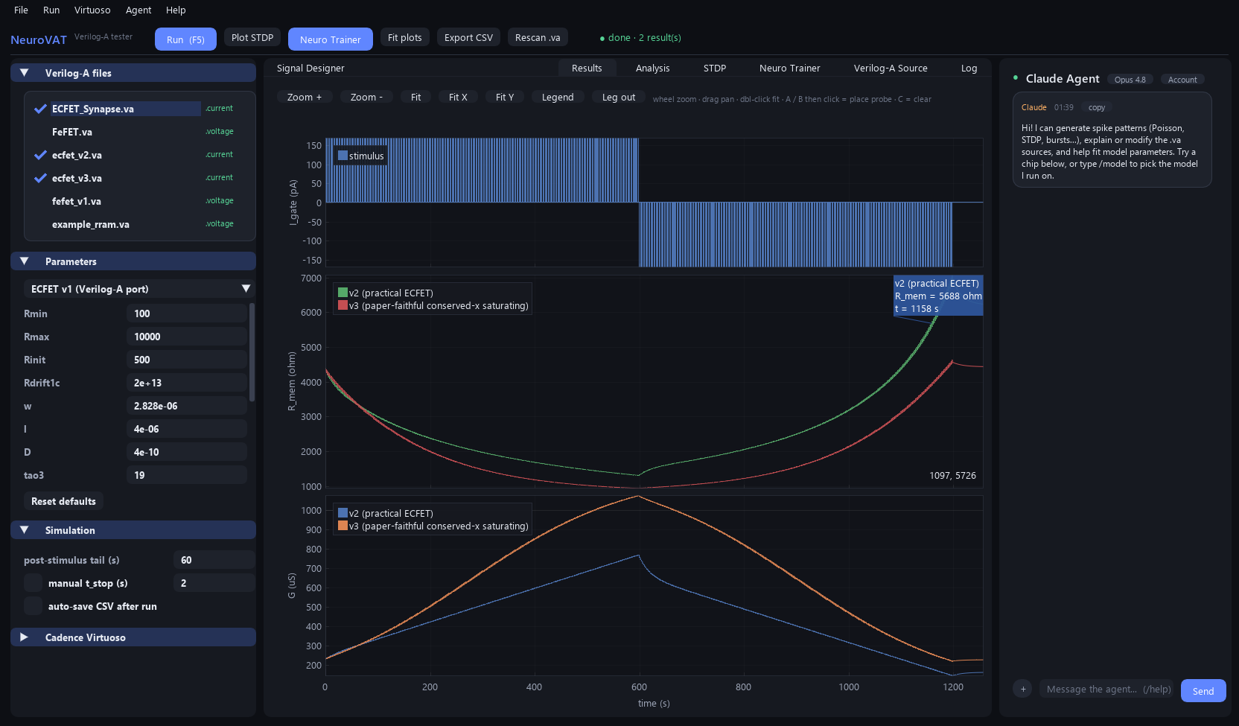
DEVICE RESPONSE
Results — linked I / R / G
Three time-locked plots: drive current, memory resistance R_mem, and synaptic conductance G.
Shared time axis with interactive zoom, pan and A/B probe markers.
Potentiation vs. depression branches are clearly separated.
Export CSV for a direct Spectre overlay.
NeuroVAT
03

Slide 5
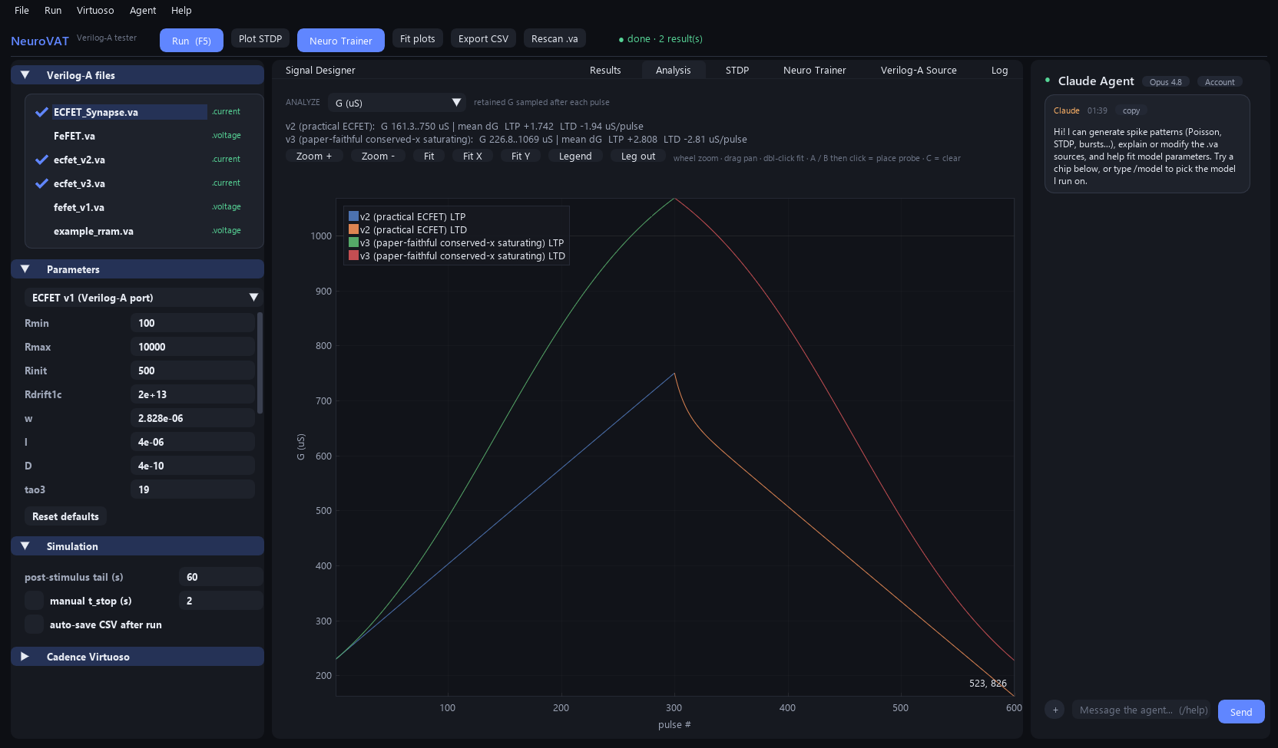
ANALYSIS
Per-pulse LTP / LTD curve
Retained conductance (or resistance) after each pulse vs. pulse number.
Reproduces the paper's Fig. 3c potentiation/depression staircase.
≥ 250 distinguishable states per ramp, near-linear (R² ≈ 1.0).
Symmetric LTP and LTD branches.
NeuroVAT
04

Slide 6
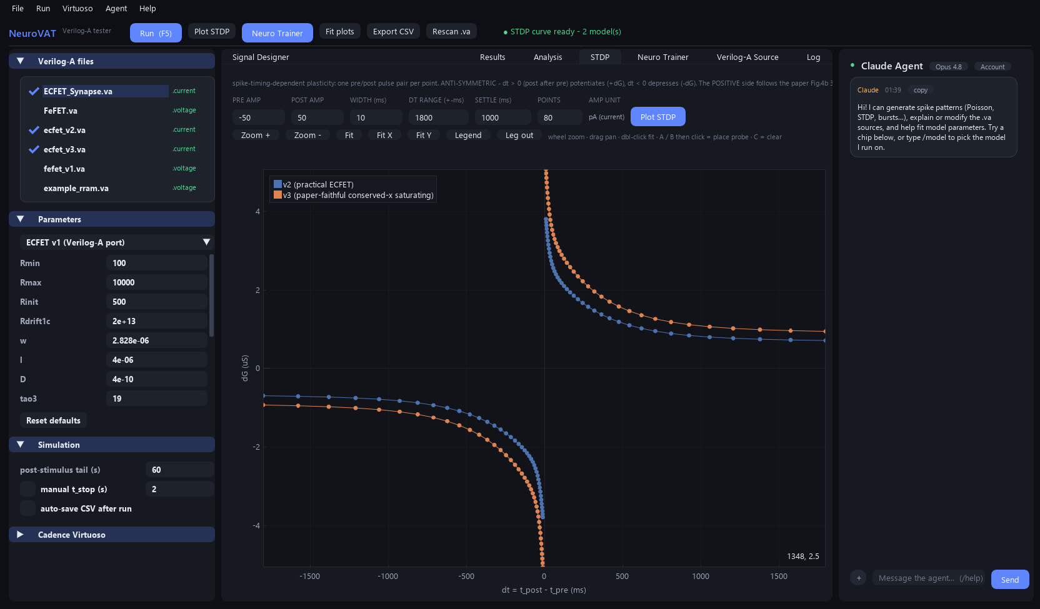
PLASTICITY
STDP learning window
Sweeps pre/post spike timing Δt and measures ΔG.
Anti-symmetric window: causal (pre→post) potentiates, anti-causal depresses.
Decay constants come straight from device geometry (τ₁ 22 ms, τ₂ 315 ms, τ₃ 19 s).
Logarithmic Δt sampling — dense on the fast rise, out to the slow tail.
NeuroVAT
05

Slide 7
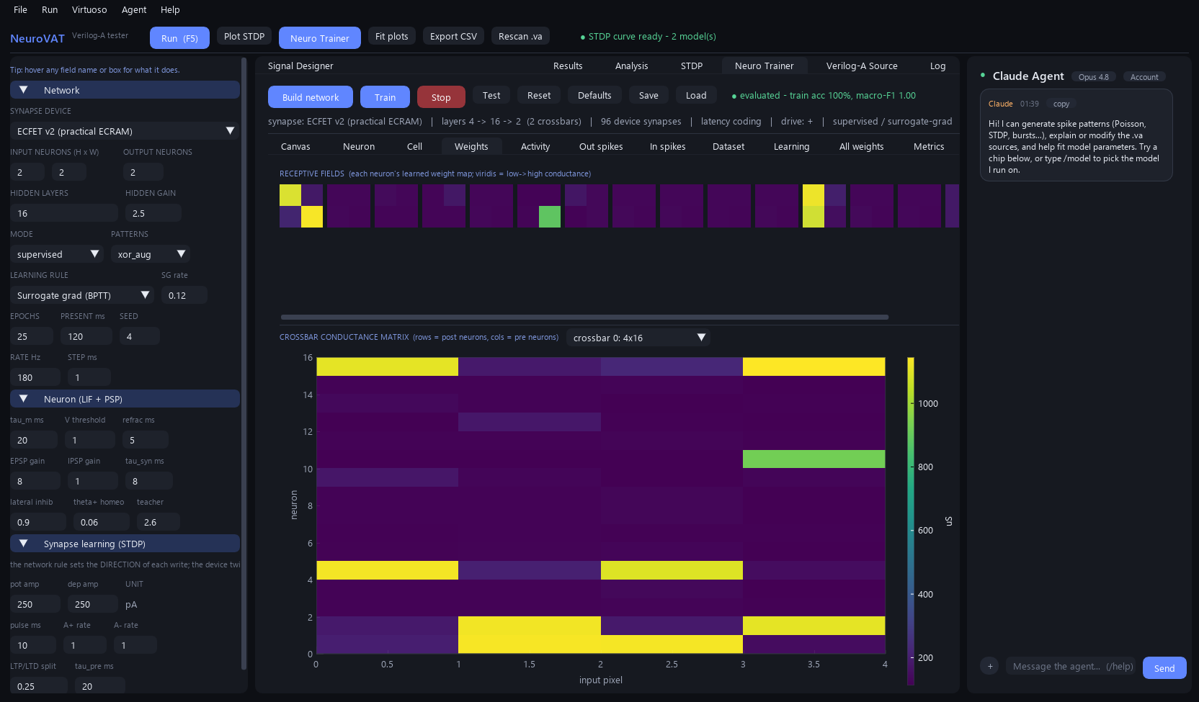
NETWORK
Neuro Trainer — live crossbar
A spiking LIF network whose synapses ARE the device twins, on a real crossbar.
Live conductance heatmap (rows = output neurons, cols = inputs).
Device-local STDP or surrogate-gradient (BPTT) learning rules.
Weights update in real time as the network trains.
NeuroVAT
06

Slide 8
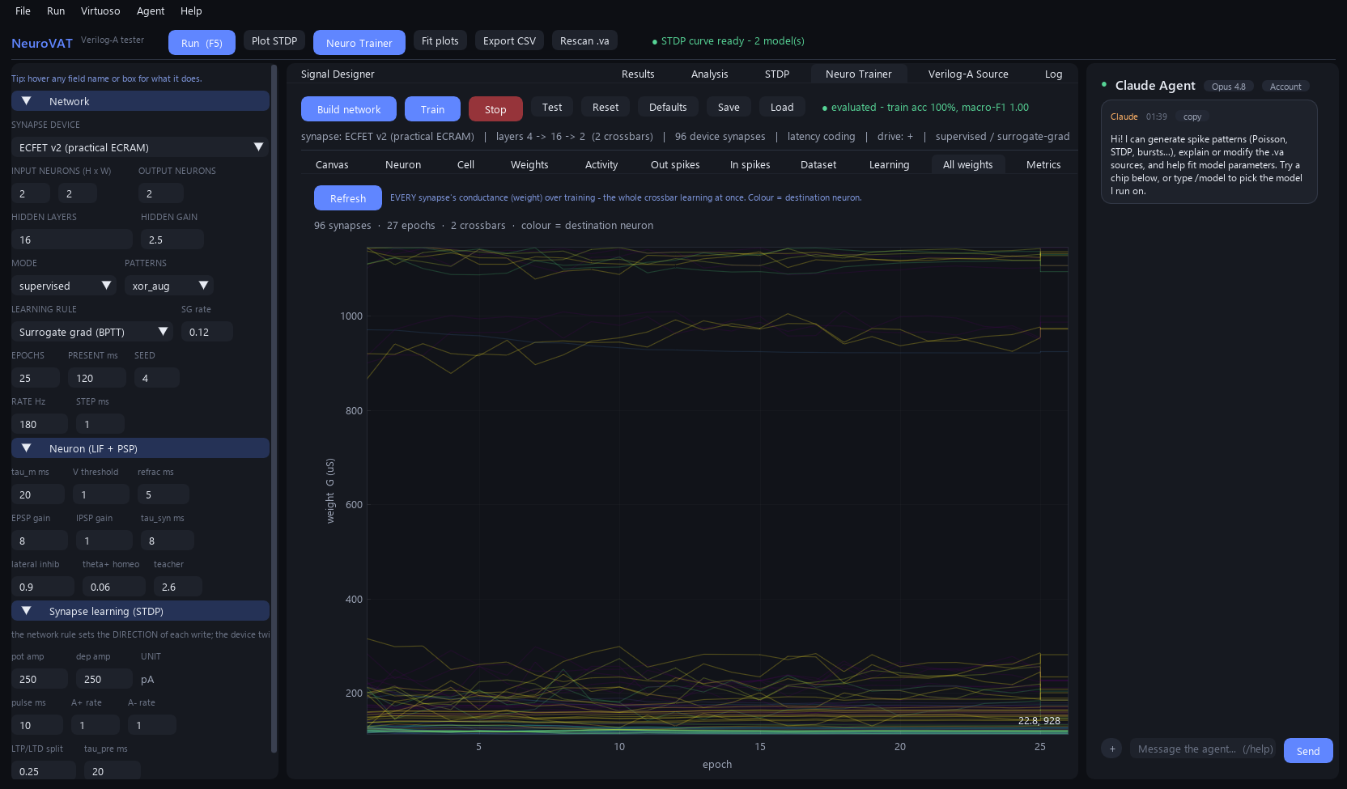
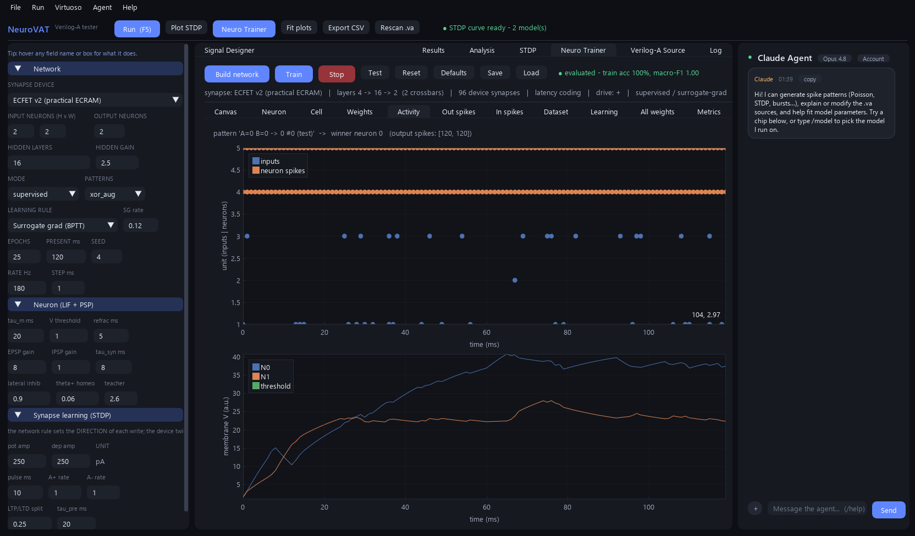
NETWORK
Neuro Trainer — learning dynamics
Every synapse's weight trajectory over training
Spike raster + live train / test accuracy curve
Watch competition and convergence directly: weight traces fan out and settle while accuracy climbs to 100% — every signal is live, not a mock-up.
NeuroVAT
07

Slide 9
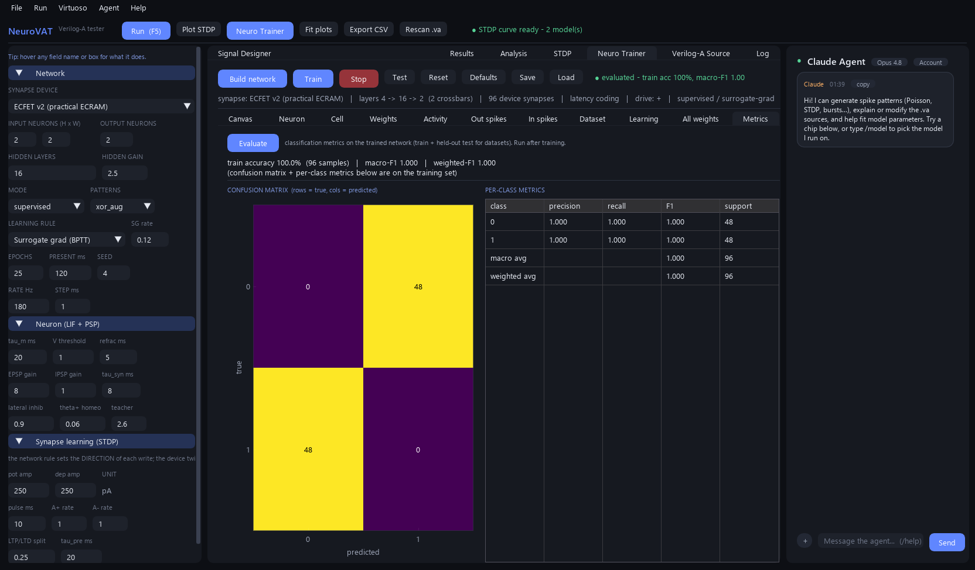
RESULTS
100% accuracy on XOR
Trained ECFET-v3 crossbar solving the non-linear XOR task.
Confusion matrix is fully diagonal — every pattern classified correctly.
Per-class precision / recall / F1 all = 1.000.
Held-out test set + live train/test accuracy curve during training.
NeuroVAT
Loaded from saved_model/ecfetv3_xor_neuro_model.json, then re-trained & evaluated live.
08

Slide 10
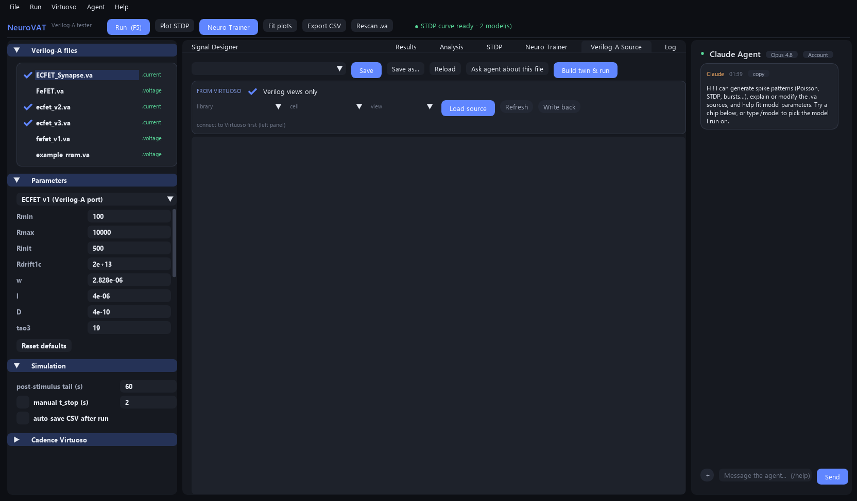
TOOLING
Verilog-A source & embedded agent
Workspace auto-scans every .va file (ECFET v1/v2/v3, FeFET …).
Editable device parameters with live re-simulation.
In-app Verilog-A editor with one-click write-back.
Claude agent (right) explains devices, writes spike patterns, tunes the network.
NeuroVAT
09

Slide 11
VALIDATION & START
Paper-validated — and one command to run
Matches Sharbati et al., Adv. Mater. 2018
Getting started
observable paper model
pip install -r requirements.txt
Fig.3a retained ΔR′
−10 Ω
−9.8 Ω
python run_gui.py
Fig.3c distinct states
> 250
≥ 250 / ramp
Fig.3c linearity
R² = 0.994
R² ≈ 1.000
Auto-loads every .va in the folder.
Click Neuro Trainer → Load a saved model → Train.
Export CSV for Spectre cross-checks anytime.
Fig.4b τ₁ / τ₂ / τ₃
22 / 315 ms / 19 s
22.2 / 312.5 / 19.0
Retention (13 h)
3.2 %
2.83 %
Every electrical synaptic observable reproduced to figure-reading accuracy.
NeuroVAT
10

