Slide 1
Help yourself on a remote server
bioinformatics@age.mpg.de
https://mpg-age-bioinformatics.github.io
Notes:
Start with
http://www.datacarpentry.org/lessons/#genomics-workshop
Then move on to:
https://software-carpentry.org/lessons/
Missing from first one:
**variables** -> use a path example
**.bashrc**
**du**
**ln**
**ssh and scp**
**Permissions**
Sort (after cat)
Cut –d , -f 2 animals.txt (eg.
2012-11-05,deer
2012-11-05,rabbit
2012-11-05,raccoon
2012-11-06,rabbit
2012-11-06,deer
2012-11-06,fox
2012-11-07,rabbit
2012-11-07,bear
grep {deer, rabbit, raccoon, deer, fox, bear} animals.txt | wc -l
sort animals.txt | uniq -c
sort -t, -k2,2 animals.txt | uniq -c
cut -d, -f 2 animals.txt | uniq -c
cut -d, -f 2 animals.txt | sort | uniq -c
cut -d, -f 2 animals.txt | sort | uniq -c | wc -l
Loops: https://swcarpentry.github.io/shell-novice/05-loop/
Scripting:
# Calculate reduced stats for data files at J = 100 c/bp.
for datafile in "$@"
do
echo $datfile
bash goostats -J 100 -r $datafile stats-$datafile
Done
Grep –v and grep –w :: https://swcarpentry.github.io/shell-novice/07-find/
-i to make our search case-insensitive
-n to number the lines that match
grep -E '^.o' haiku.txt

Slide 2
Outline
Connecting to a remote server
Copying files to/from a remote server
The modules system
Shifter/Docker for HPC
Installing software without `su` access
Installing R packages
Installing python packages
Installing perl packages
SLURM

Slide 3
Connecting to a remote server
Connecting to a remote server over a Secure Shell (ssh) – ssh username@remote.adress :
ssh JBoucas@amalia.age.mpg.de
With X forwarding:
ssh –X JBoucas@amalia.age.mpg.de

Slide 4
Download rc files for your user into your home folder in amalia
cd
wget https://raw.githubusercontent.com/mpg-age-bioinformatics/cluster_first_steps/master/.bashrc
wget https://raw.githubusercontent.com/mpg-age-bioinformatics/cluster_first_steps/master/.bash_profile
source ~/.bash_profile
source ~/.bashrc
# remember that next time you login this files will be automatically sourced

Slide 5
Copying files to/from a remote server
Copying files over ssh to your home folder on a remote server:
scp file.txt UName@ServerAddress:~/
Copying files over ssh from your home folder on a remote server:
scp UName@ServerAddress:~/file.txt .
Both `scp` will only allow you to copy files (not directories) unless you use the `-r` argument for `recursively`. For speed use `-o Cipher=arcfour`.
rsync to a remote server
rsync –rtvh –e "ssh –c arcfour" source_folder \
UName@ServerAddress:destination
Not all servers will have the less costly cipher arcfour encryption algorithm and therefore you can remove the whole `-e "ssh –c arcfour"` block.

Slide 6
The modules system
A centralized software system.
The modules system loads software (version of choice) and changes environment
variables (eg. LD_LIBRARY_PATH)
module avail # shows available modules
module whatis SAMtools # shows a description of the SAMtools module
module show SAMtools # shows environment changes for SAMtools
module load SAMtools # loads SAMtools
module list # lists all loaded modules
module unload SAMtools # unloads the SAMtools module
module purge # unloads all loaded modules
more on http://modules.sourceforge.net

Slide 7
Shifter/Docker for HPC
Mobile, ready to go, reproducible science!

Slide 8



Computers are not all the same
App
App
Bins/Libs
Bins/Libs
App
Bins/Libs

Slide 9
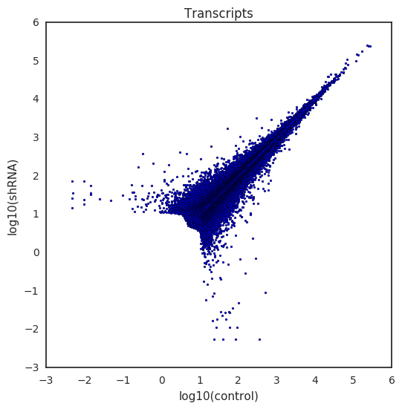
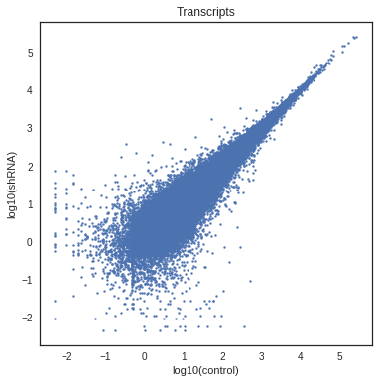
The same apparent code can give different results
App
App
Bins/Libs
Bins/Libs
App
Bins/Libs
Different version of dependency in bin/
== different input in one step
== code breaks

Slide 10
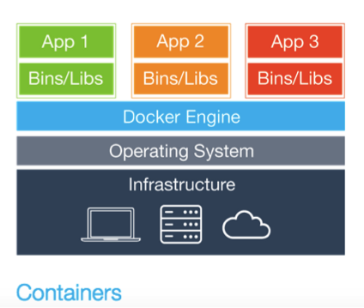
Containers
https://blog.logentries.com/2015/07/an-all-inclusive-log-monitoring-container-for-docker/

Slide 11
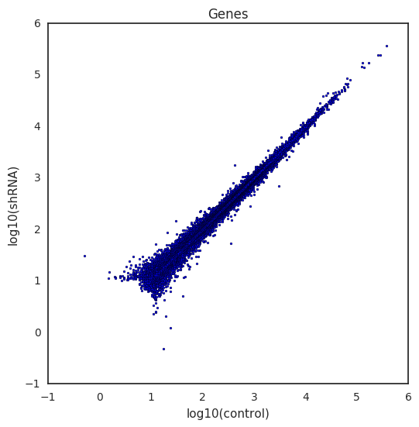
Containers are independent of their host

Slide 12
Multiple environments per machine

Slide 13
Shifter/Docker for HPC
# load respective module
module load shifter
# list available images
shifterls
# get an interactive shell on ubuntu and check you
# are in the intended image
shifter --image=ubuntu:15.10 bash -login
cat /etc/lsb-release
# use the Bioinformatics image
shifter --image=mpgagebioinformatics/bioinformatics_software:v1.0.0
# run a script inside an image
shifter --image=<provider>/<image_name>:<tag> /path/to/script

Slide 14
Working interactively on the mpi age bioinformatics software image
module load shifter # load respective module
shifterls # list available images
which R # check if you have R
# login to our software image
shifter --image=mpgagebioinformatics/bioinformatics_software:v1.0.1
pwd
module avail
module load rlang
which R

Slide 15
Running a script inside the mpi age bioinformatics software image
Example `~/test.shifter.sh`:
Running the script:
#!/bin/bash
source ~/.bashrc
module load rlang python
which python
python << EOF
print "This is python"
EOF
which R
Rscript -e "print('This is R')"
chmod +x test.shifter.sh
shifter \
--image=mpgagebioinformatics/bioinformatics_software:v1.0.1 \
./test.sh

Slide 16
Shifter/Docker for HPC
More infos on
shifter,
docker (eg. for your own laptop),
singularity (running @ draco.mpcdf.mpg.de),
and creation of images on
http://bioinformatics.age.mpg.de/#callout > Jupyter on Docker
https://github.com/mpg-age-bioinformatics/cluster_first_steps#shifter
More infos on our software image and how to run it on your laptop:
https://github.com/mpg-age-bioinformatics/software_docker#software-container
Running the script:

Slide 17
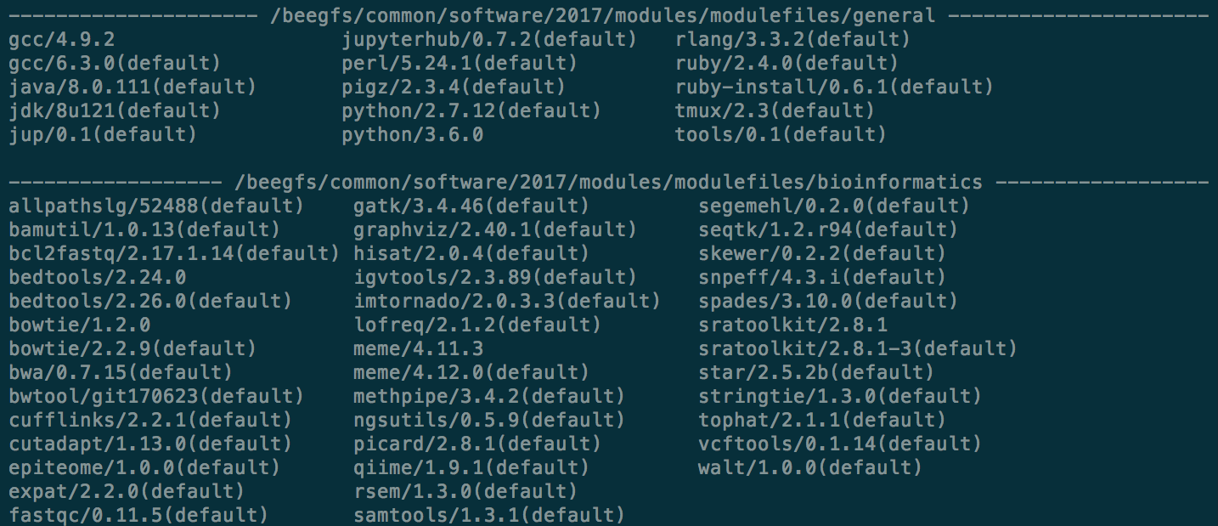
module avail
Example `module avail` output.
Notice the 2 arrows and the two distinct blocks of software being shown.
The distinct blocks are generated by the different paths kept on the `MODULEPATH` variable set like this:
export MODULEPATH=/beegfs/common/software/2017/modules/modulefiles\
/general:/beegfs/common/software/2017/modules/modulefiles/bioinformatics

Slide 18
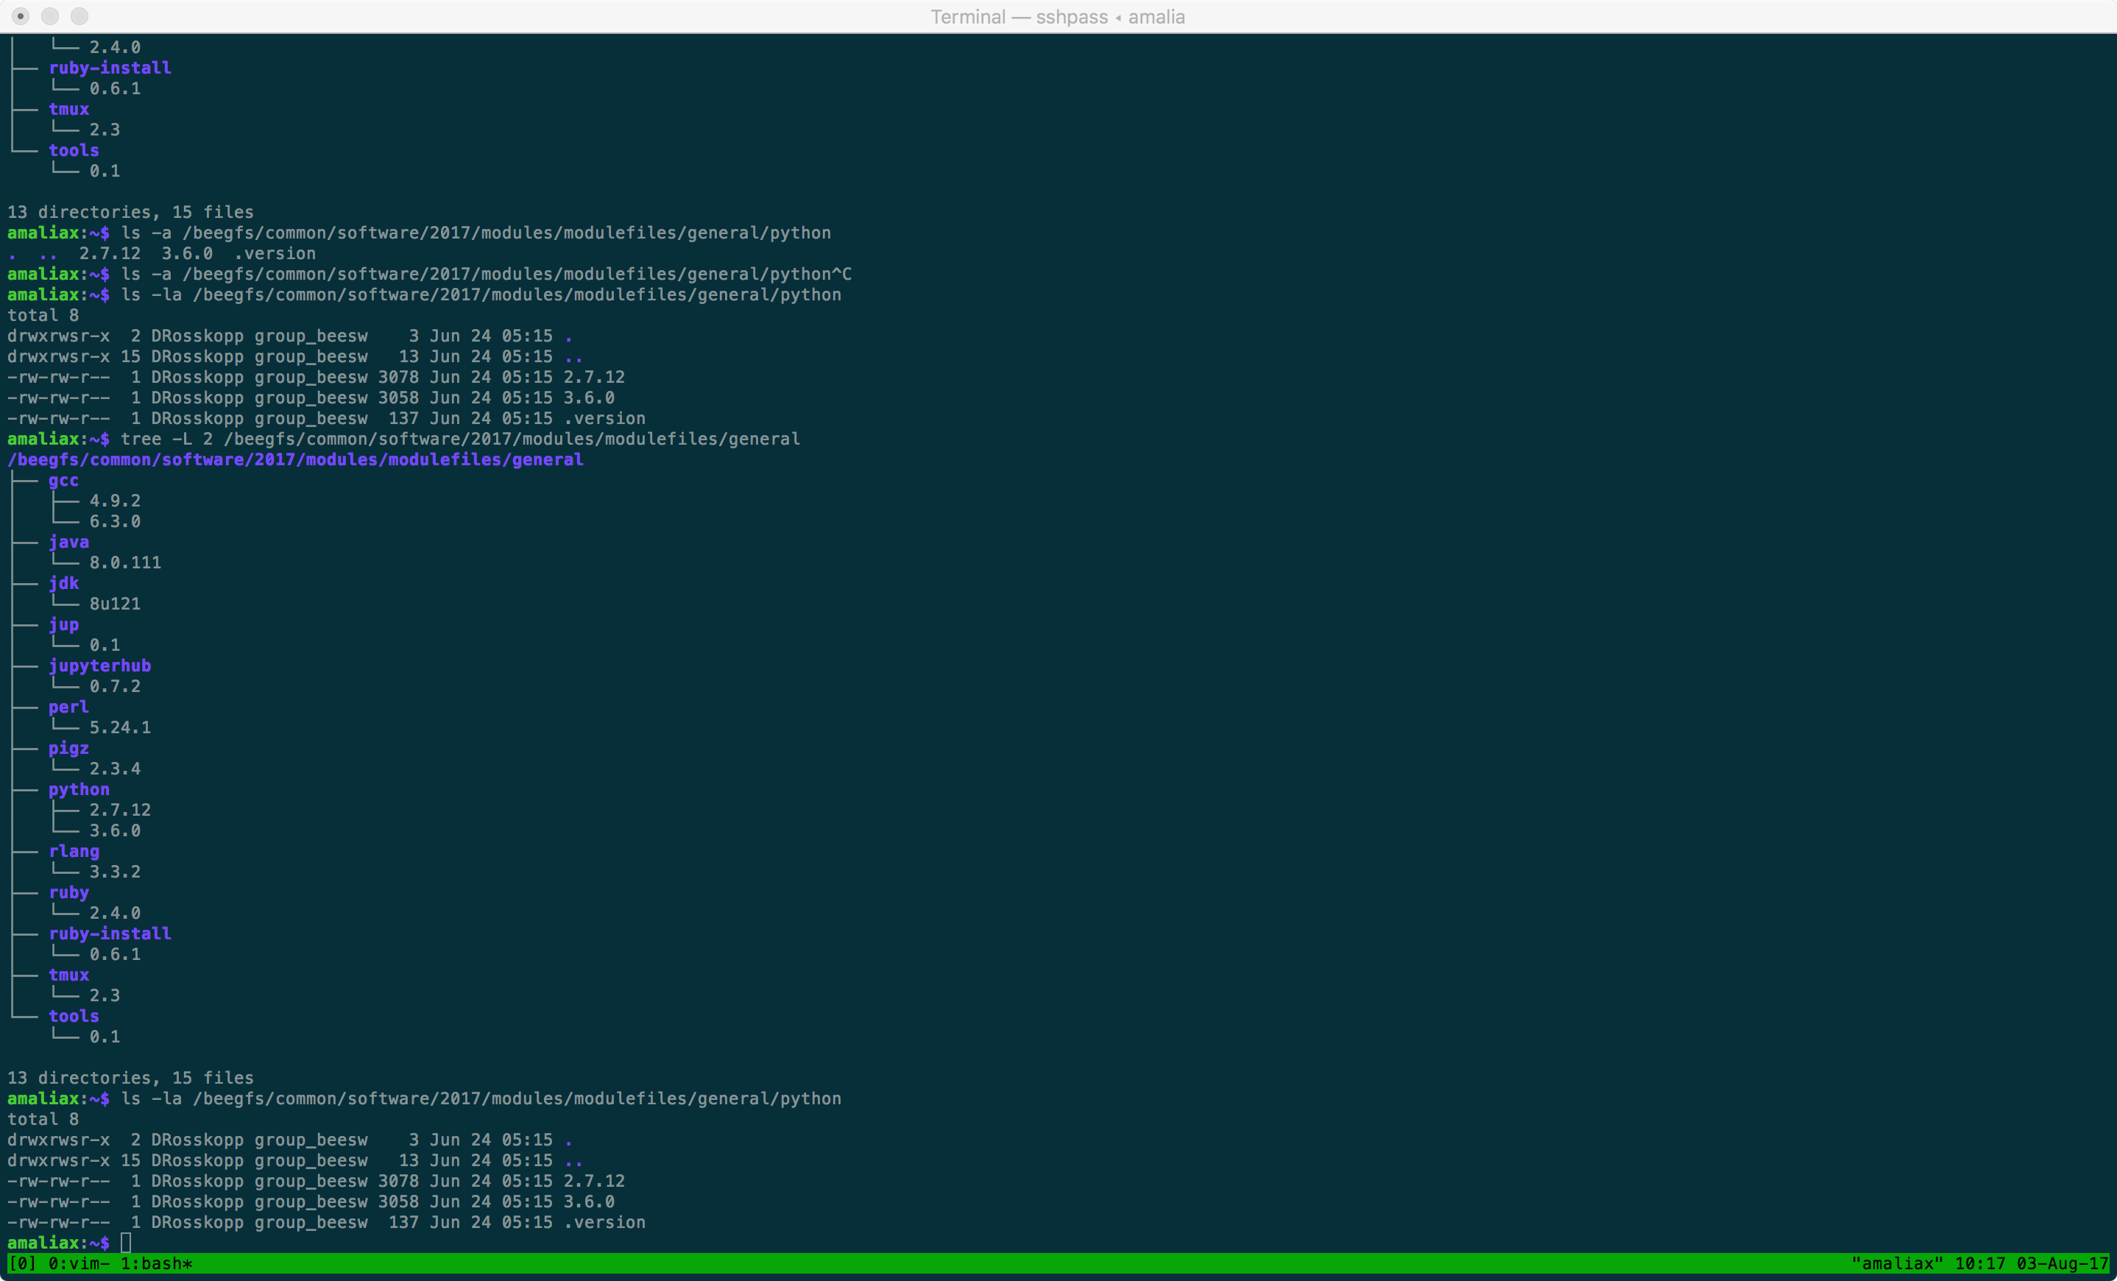
The modules system
`module avail` simply lists the contents of the `MODULEPATH` variable.
Example content of a folder in the `MODULEPATH`.
Example content for Python.

Slide 19
The modules system
`2.7.12` module file for python 2.7.12
`3.6.0` module file for python 3.6.0
`.version` file defining the default version:
#%Module1.0###########################################################
##
## version file for python
##
set ModulesVersion "2.7.12"

Slide 20
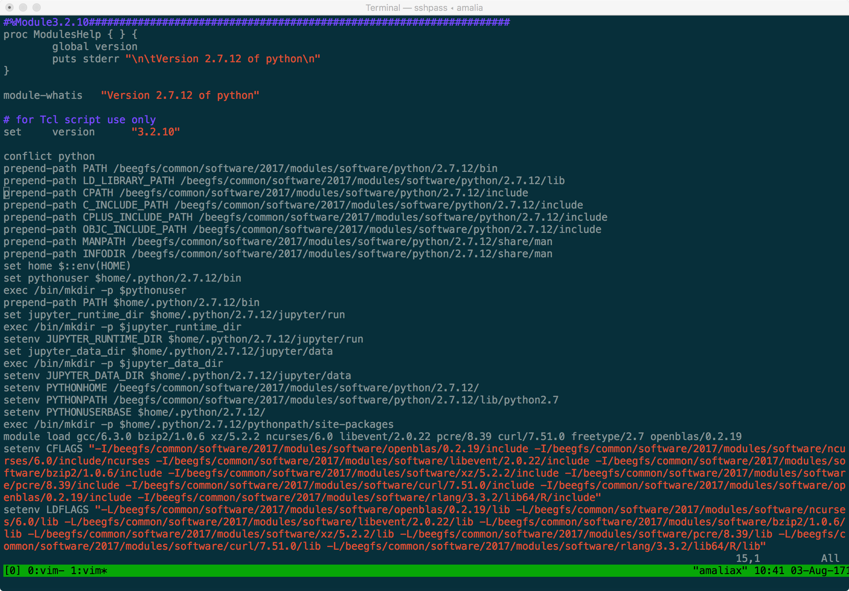
module file

Slide 21
module file
Help message shown for this modules with`module help python/2.7.12`
Message to be shown by `module whatis python/2.7.12`.
Modules system version.
Conflicts. ie. Do not load if a different python version is already loaded.
Paths prepended when the module is loaded and removed when the module is unloaded.

Slide 22
module file
`$::env(HOME)` captures the variable HOME from the environment of the user loading the module.
`set home $::env(HOME)` sets a variable `home` to be used within the module with the result of `$::env(HOME)`.
Sets the python user variable to be used within the module.
Executes the command `/bin/mkdir –p $pythonuser` every time the module is loaded.
Prepends `$home/.python/2.7.12/bin` to the user environment PATH variable.

Slide 23
module file
Please notice `PYTHONUSERBASE`
Loads other modules as dependencies when loading the python module.

Slide 24
Installing software without `su` access
Several examples can be obtained from:
https://github.com/mpg-age-bioinformatics/draco_pipelines/blob/master/software/software.sh
Structure:
mkdir –p ~/my_software/sources ~/my_software/software \
~/my_software/logs ~/my_software/modules
~/my_software
/sources
/software
/logs
/modules

Slide 25
Installing software without `su` access
Download and edit the script for automatic generation of module files:
cd ~/
wget https://raw.githubusercontent.com/mpg-age-bioinformatics/
draco_pipelines/master/software/newmod.sh
sed –i 's/\/u\/jboucas\/modules/~\/my_software/g' newmod.sh
chmod +x newmod.sh
Add the `~/my_software/modules` to the MODULEPATH:
export MODULEPATH=$MODULEPATH:~/my_software/modules
You might want to add this line to your `~/.bashrc`

Slide 26
Installing software without `su` access
cd ~/my_software/sources
wget http://zlib.net/pigz/pigz-2.3.4.tar.gz
tar -zxvf pigz-2.3.4.tar.gz
cd pigz-2.3.4
make
mkdir –p ~/my_software/software/pigz/2.3.4/bin
cp pigz unpigz ~/my_software/software/pigz/2.3.4/bin
~/newmod.sh –s pigz –p ~/my_software/modules –v 2.3.4 –d 2.3.4
# TEST #
module avail
module show pigz/2.3.4
module load pigz/2.3.4
which pigz

Slide 27
Installing software without `su` access
cd ~/my_software/sources
wget http://zlib.net/zlib-1.2.11.tar.gz
tar -zxvf zlib-1.2.11.tar.gz
cd zlib-1.2.11
make
mkdir –p ~/my_software/software/libz/1.2.11
./configure –prefix=~/my_software/software/libz/1.2.11
make
make install
~/newmod.sh –s libz –p ~/my_software/modules –v 1.2.11 –d 1.2.11

Slide 28
Installing software without `su` access
echo "#!/bin/bash
cd ~/my_software/sources
wget http://zlib.net/zlib-1.2.11.tar.gz
tar -zxvf zlib-1.2.11.tar.gz
cd zlib-1.2.11
make
mkdir –p ~/my_software/software/libz/1.2.11
./configure –prefix=~/my_software/software/libz/1.2.11
make
make install
~/newmod.sh –s libz –p ~/my_software/modules –v 1.2.11 –d 1.2.11
" > ~/my_software/logs/libz-1.2.11.sh
chmod +x ~/my_software/logs/libz-1.2.11.sh
~/my_software/logs/libz-1.2.11.sh 2>&1 | tee \
~/my_software/logs/libz-1.2.11.log

Slide 29
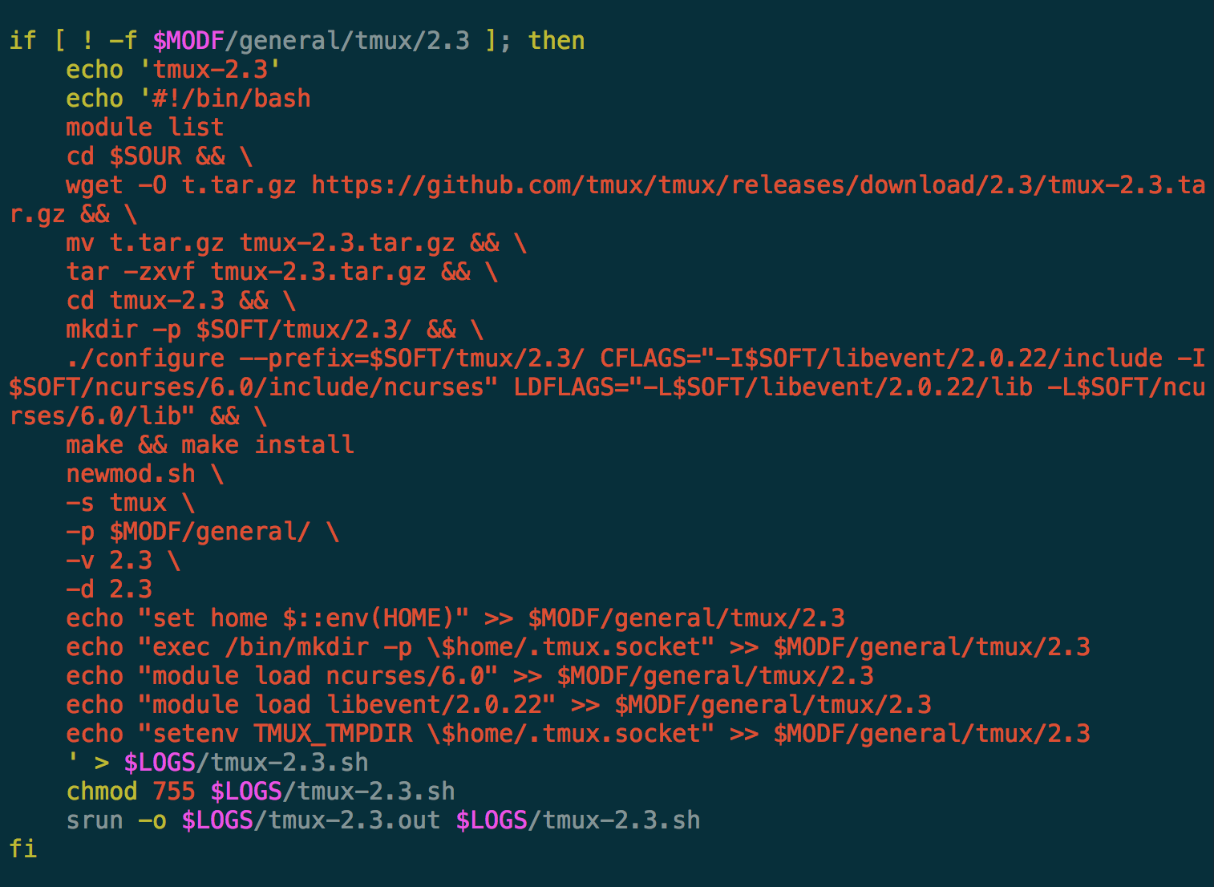
Installing software without `su` access

Slide 30
Installing R packages
R standard packages:
base datasets graphics grDevices methods parallel stats stats4
tcltk tools utils
This are the only packages that should be inside `lib64/R/library`. The `library` folder should have permissions `chmod –R 555 library`. This will enforce the use of the `R_LIBS_USER` variable for installation of new packages.
Alternative (eg. install biomaRt):
source("https://bioconductor.org/biocLite.R")
biocLite("biomaRt”, lib=Sys.getenv("R_LIBS_USER"))
The `lib` argument can also be used in (eg. install packrat):
install.packages(”packrat”, lib=Sys.getenv("R_LIBS_USER"))

Slide 31
Installing python packages
Installing the AGEpy package:
module load python
pip install AGEpy --user
Alternative 1:
module load python
git clone https://github.com/mpg-age-bioinformatics/AGEpy
cd AGEpy
pip install ../AGEpy --user
Alternative 1b (no package control):
cd AGEpy
python setup.py install --user
The `--user` argument will make use of the `PYTHONUSERBASE` variable.

Slide 32
Installing perl packages
Perl libraries are loaded from the value of `PERL5LIB`. We have added a variable to module perl to ease local installations - `PERLUSER` - check out the content of these two variables.
Example instalation of Log::Log4perl:
module load perl/5.24.1
cpanm Log::Log4perl -l $PERLUSER
# check where it got installed
perldoc -l Log::Log4perl

Slide 33
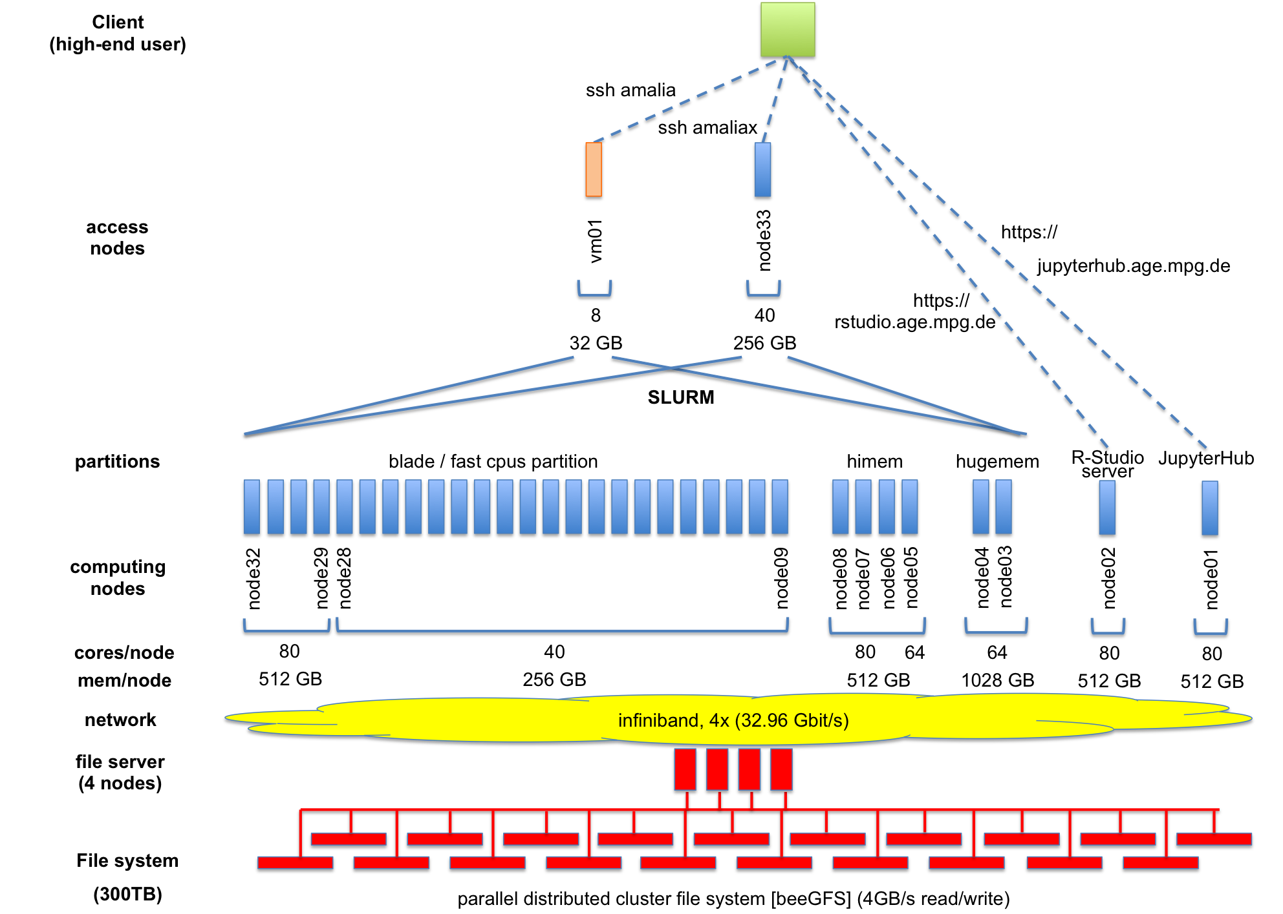
SLURM (Simple Linux Utility for Resource Management )

Slide 34
SLURM: Why an HPC cluster?
MEM
One HPC node:
40 CPUS
256 GB MEM
CPUS
In-house/MPI-AGE
~13 TFlops
Queuing times:
0-20’ : 80% of jobs
0-180’ : 98% of jobs
MAC mini: 8 cpus, 16 GB MEM

Slide 35
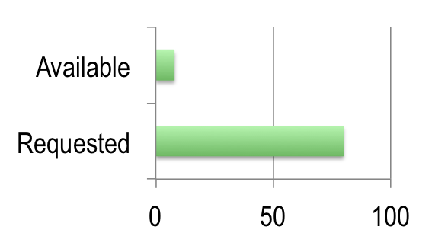
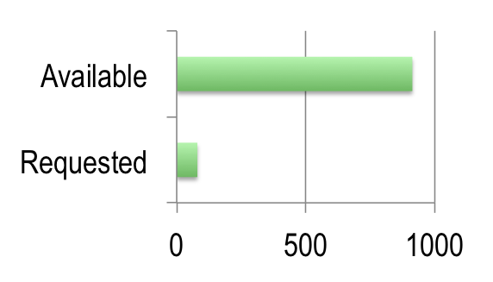
SLURM: Why an HPC cluster?
MAC mini
HPC CLUSTER
1 user
4 raw data files
20 cpus / raw file
1 user
4 raw data files
20 cpus / raw file

Slide 36
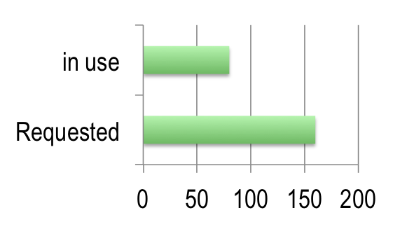
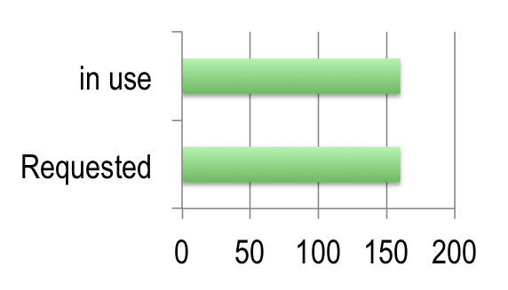
SLURM: Why SLURM?
NO slurm
with slurm
8 users
20 cpus/user
8 users
20 cpus/user

Slide 37
SLURM: Why SLURM?
NO slurm
with slurm
bwa mem sample1.fastq
srun bwa mem sample1.fastq

Slide 38
SLURM: How to?
NO slurm
with slurm
srun --cpus-per-task=18 \
bwa mem –T 18 sample1.fastq
bwa mem –T 18 sample1.fastq

Slide 39
SLURM: How to?
NO slurm
with slurm
srun --cpus-per-task=18 \
--mem=64gb \
bwa mem –T 18 sample1.fastq
bwa mem –T 18 sample1.fastq

Slide 40
SLURM: How to?
NO slurm
with slurm
srun --cpus-per-task=18 \
--mem=15gb \
--time=5-24 \
bwa mem –T 18 sample1.fastq
bwa mem –T 18 sample1.fastq
( 5 days and 24 hours = 6 days
alternative: 144:00:00;
maximum = 14 days )

Slide 41
SLURM: How to?
NO slurm
with slurm
srun --cpus-per-task=18 \
--mem=15gb \
--time=5-24 \
-p blade \
bwa mem –T 18 sample1.fastq
bwa mem –T 18 sample1.fastq

Slide 42
SLURM: How to?
NO slurm
with slurm
srun --cpus-per-task=18 \
--mem=15gb \
--time=5-24 \
-p blade \
-o slurm_logs/bwa_1.out \
bwa mem –T 18 sample1.fastq
bwa mem –T 18 sample1.fastq

Slide 43
SLURM: How to?
NO slurm
with slurm
sbatch --cpus-per-task=18 \
--mem=15gb \
--time=5-24 \
-p blade \
-o slurm_logs/bwa_1.out \
align_1.sh
./align_1.sh
#!/bin/bash
bwa mem –T 18 sample1.fastq
exit

Slide 44
SLURM: scripting
NO slurm
with slurm
#!/bin/bash
#SBATCH --cpus-per-task=18
#SBATCH --mem=15gb
#SBATCH --time=5-24
#SBATCH -p blade
#SBATCH -o slurm_logs/bwa_1.out
cd ~/project/raw_data
bwa mem –T 18 sample1.fastq
exit
sbatch align_1.sh
#!/bin/bash
cd ~/project/raw_data
bwa mem –T 18 sample1.fastq
exit
./align_1.sh

Slide 45
SLURM with modules sytem
#!/bin/bash
#SBATCH --cpus-per-task=18
#SBATCH --mem=15gb
#SBATCH --time=5-24
#SBATCH -p blade
#SBATCH -o slurm_logs/bwa_1.out
module load bwa
cd ~/project/raw_data
bwa mem –T 18 sample1.fastq
exit

Slide 46
SLURM with shifter & the modules system
#!/bin/bash
#SBATCH --cpus-per-task=18
#SBATCH --mem=15gb
#SBATCH --time=5-24
#SBATCH -p blade
#SBATCH -o slurm_logs/bwa_1.out
shifter –-image=mpgagebioinformatics/bioinformatics_software:v1.0.1 << SHI
#!/bin/bash
source ~/.bashrc
module load bwa
cd ~/project/raw_data
bwa mem –T 18 sample1.fastq
exit
SHI

Slide 47
SLURM: iterating jobs over files
#!/bin/bash
cd ~/project/raw_data # go to folder containing files
for f in $(ls *.fastq); do echo “#!/bin/bash # for each file, echo a script
cd ~/project/raw_data # that goes to folder
bwa mem –T 18 ${f} # executes job on file and
rm ~/project/tmp/${f}.sh # once completed removes
“ > ~/project/tmp/${f}.sh # temporary script
chmod 755 ~/project/tmp/${f}.sh
rm ~/project/slurm_logs/${f}.*.out # removes pre-existing logs
sbatch --cpus-per-task=18 --mem=15gb \ # start batch job
--time=5-24 -p blade \
-o ~/project/slurm_logs/${f}.%j.out \ # keeps log with job number
~/project/tmp/${f}.sh
done; exit

Slide 48
SLURM: iterating jobs over files
#!/bin/bash
cd ~/project/raw_data
for f in $(ls *.fastq);
do rm ~/project/slurm_logs/${f}.*.out
sbatch --cpus-per-task=18 --mem=15gb --time=5-24 \
-p blade -o ~/project/slurm_logs/${f}.%j.out << EOF
#!/bin/bash
cd ~/project/raw_data
bwa mem –T 18 ${f}
EOF
done
exit

Slide 49
SLURM: iterating without crashing
#!/bin/bash
cd ~/project/raw_data
for f in $(ls *.fastq);
do rm ~/project/slurm_logs/${f}.*.out
while [ `squeue –u Jboucas | wc –l` -gt “500” ];
do echo “sleeping”; sleep 300
done
sbatch --cpus-per-task=18 --mem=15gb --time=5-24 \
-p blade -o ~/project/slurm_logs/${f}.%j.out ~/project/tmp/${f}.sh <<EOF
#!/bin/bash
cd ~/project/raw_data
bwa mem –T 18 ${f}
EOF
done
exit

Slide 50
SLURM with shifter
#!/bin/bash
cd ~/project/raw_data
for f in $(ls *.fastq);
do rm ~/project/slurm_logs/${f}.*.out
sbatch --cpus-per-task=18 --mem=15gb --time=5-24 \
-p blade -o ~/project/slurm_logs/${f}.%j.out ~/project/tmp/${f}.sh <<EOF
#!/bin/bash
shifter –image=mpgagebioinformatics/bioinformatics_software:v1.0.1 << SHI
#!/bin/bash
cd ~/project/raw_data
bwa mem –T 18 ${f}
SHI
EOF
done
exit

Slide 51
SLURM: other options
--mail-type=BEGIN, END,FAIL,REQUEUE,ALL
# Specifies when email is sent to the job owner. The option argument may consist of a combination of the allowed mail types
--mail-user=username@age.mpg.de

Slide 52
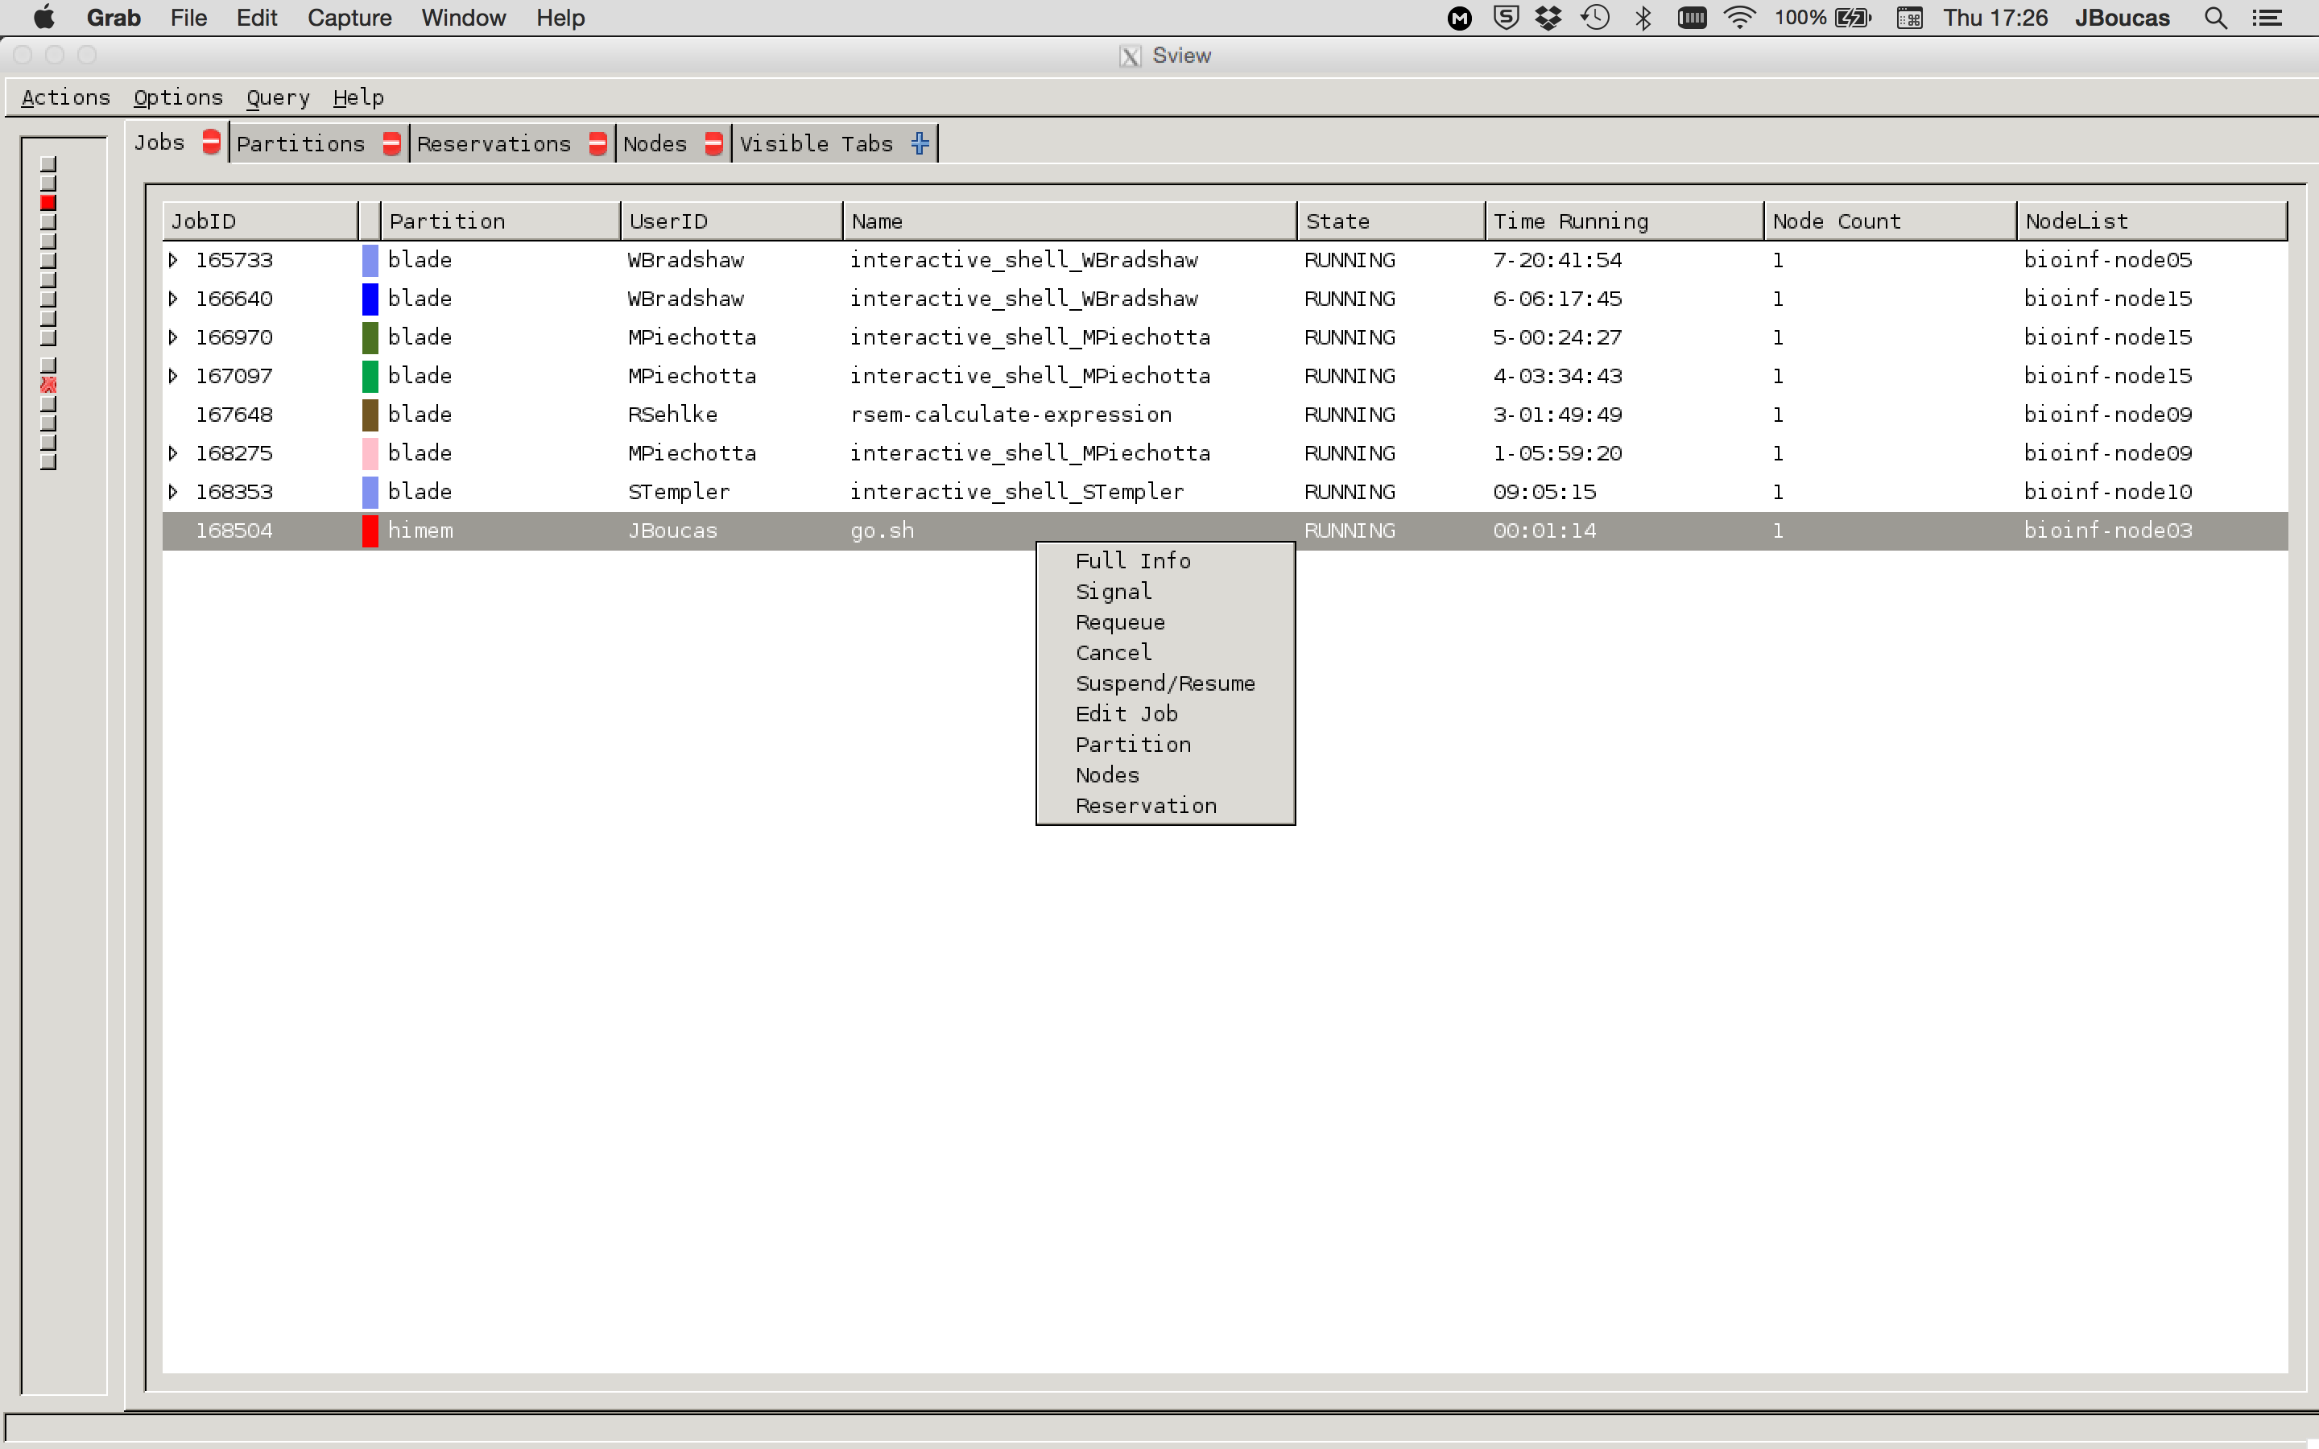
SLURM: sview

Slide 53
SLURM: other useful commands
# show the partitions
sinfo
# show information on nodes
sinfo -N -O partitionname,nodehost,cpus,cpusload,freemem,memory
# requires X forwarding and allows viewing and manipulation of submitted jobs
sview
# lists running jobs
squeue
# show the queue for a user
squeue -u <user name>

Slide 54
SLURM: other useful commands
# cancels job 65673
scancel 65673
# cancels all jobs of user JBoucas
scancel -u JBoucas
# shows detailed resource information on job 43433
scontrol show job 43433
# show information on a partition
scontrol show partition <parition name>
# show information on a node
scontrol show node <node name>

Slide 55
SLURM: other useful commands
# starts an interactive terminal window on node15
srun –w node15 –-pty bash
# submit a job3 after job1 and job2 are successfully ready
job1=$(sbatch --parsable <script1>)
job2=$(sbatch --parsable <script2>)
sbatch -d afterok:${job1}:${job2} <script3>
# attach to a running job and run a command
srun --jodib <JOBID> --pty <command>
# change the partitions of a pending job
scontrol update job <job id> partition=<partition1>,<partition2>,<partition3>

Slide 56
Notes:
For current information on RStudio server and JupyterHub please check our cluster first steps page:
https://github.com/mpg-age-bioinformatics/cluster_first_steps
SLURM manual:
http://slurm.schedmd.com/man_index.html
Coming soon:
docker on HPC

Slide 57
END
bioinformatics@age.mpg.de
https://mpg-age-bioinformatics.github.io

