Slide 1
Group Project
CS 3420 – Introduction of software Engineering
Minh Pham
Nhan Nguyen
Anthony Nguyen

Slide 2
Student Information System Management
Iphone Application

Slide 3
Team model - Classical Chief Programmer Team
Chief programmer: Anthony nguyen
Programming secretary: Nhan nguyen
Programmer: Minh pham

Slide 4
Use Case diagram - Admin

Slide 5
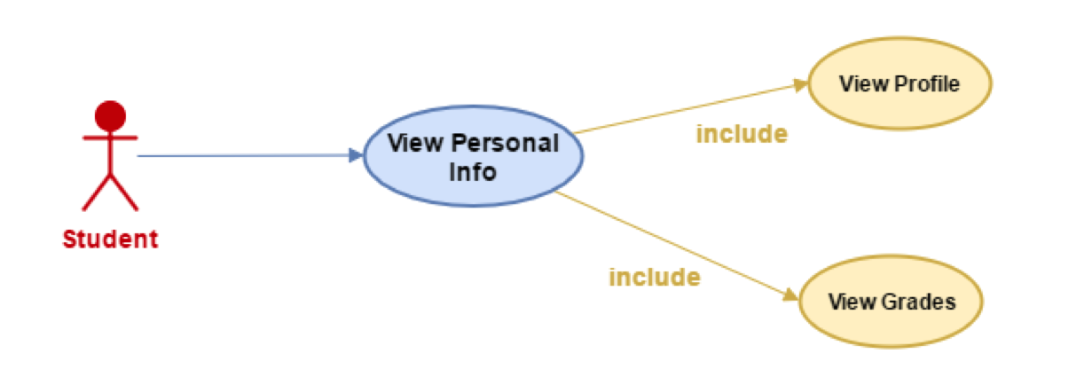
Use Case diagram - Student

Slide 6
Class diagram

Slide 7
Database diagram

Slide 8
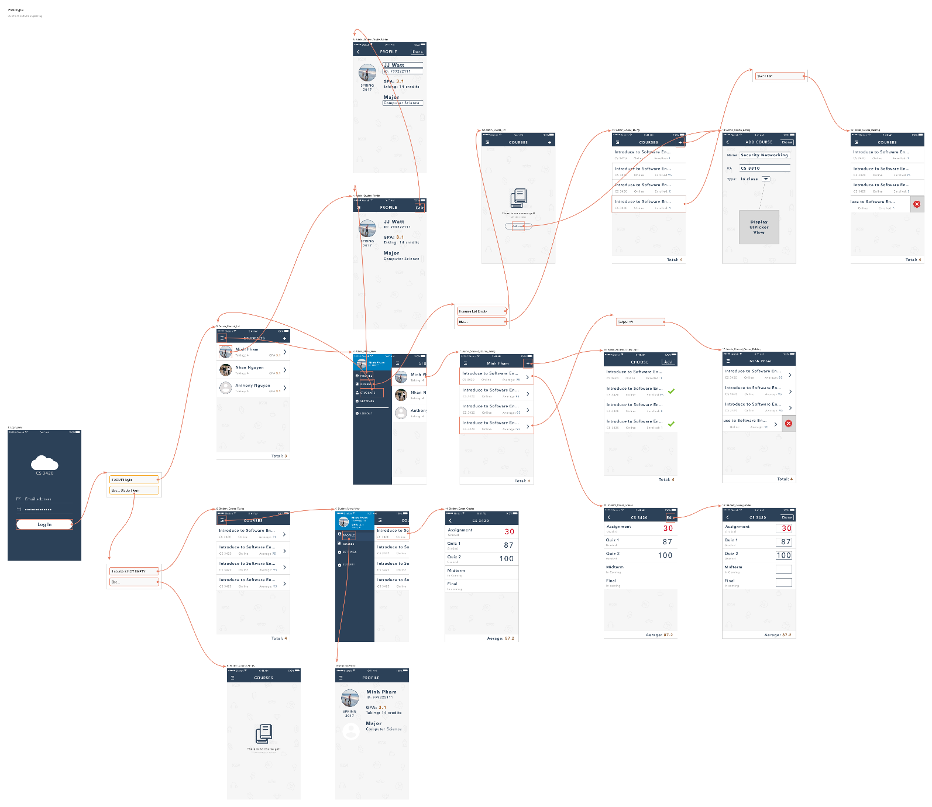
User Interface flow diagram

Slide 9
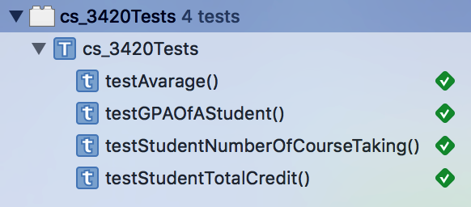
Unit Testing

Slide 10
Demo

