Slide 1

Python Programming
Practice Sheets
Generic - Spring 2022 – V. 1

Slide 2


Practice 1:
1- Develop a Python program to print the multiplications table from 1x1 to 10x10. Consider a nice tabular format, possibly with separators.
2- Write a Python program that reads 3 numbers from the keyboard and checks if they can be sides of a rectangular triangle or not. (a** == b**+c**) ??
Your program should show the result by printing appropriate messages.
<number>

Slide 3
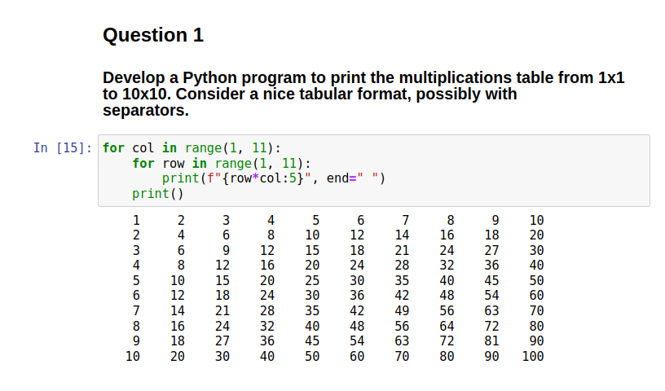
PRACTICE 1:

Slide 4
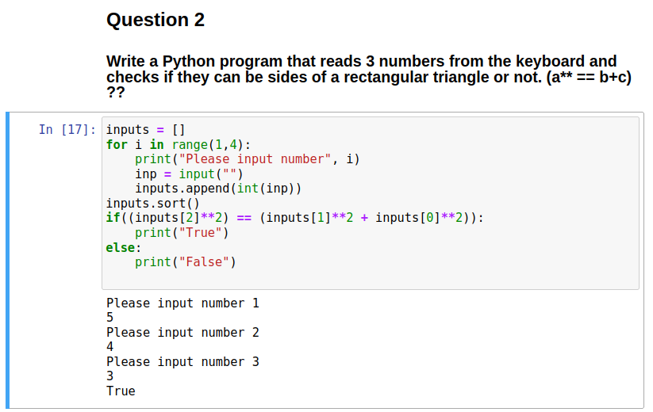
PRACTICE 1:

Slide 5
Practice 2: DATA Files
Open and read the contents of the resale.csv data file.
Find and print the most expensive flat
Find and print the cheapest flat
Find and print the average and variance of the flat’s prices.
How many flats are in the WOODLANDS?
<number>

Slide 6
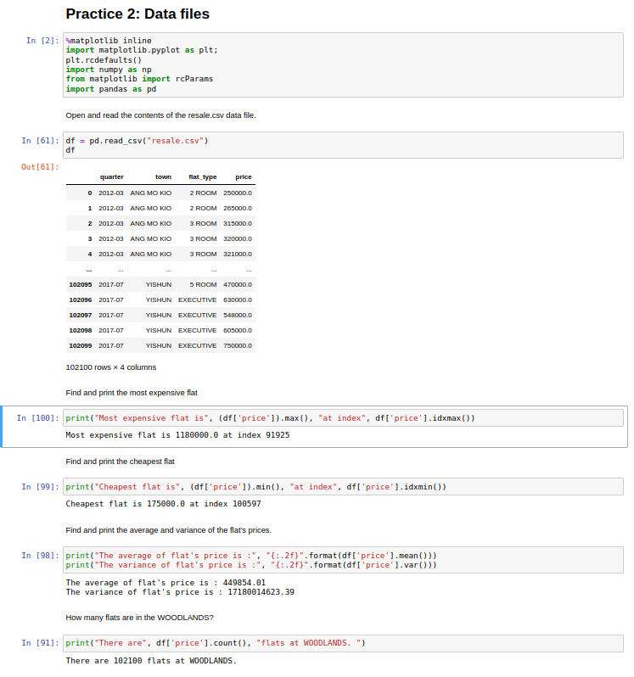
Practice 2: DATA Files
<number>

Slide 7
Practice 3: Visualization
Open and read the contents of the resale.csv data file.
Separate WOODLANDS flats.
Depict the line chart of WOODLANDS flat’s prices.
Depict the scatter plot of WOODLANDS flat’s prices.

Slide 8
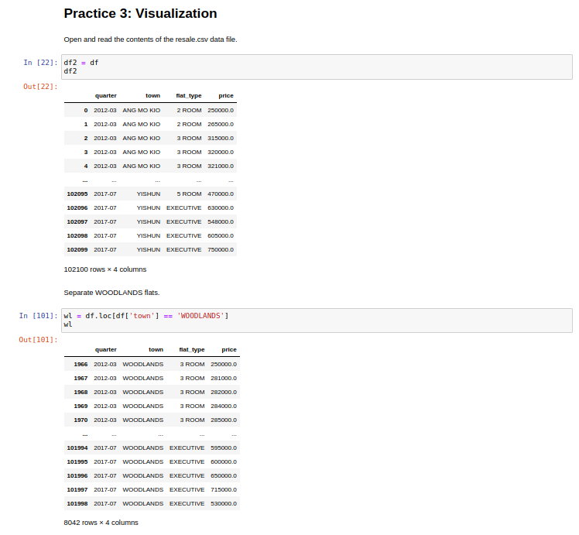
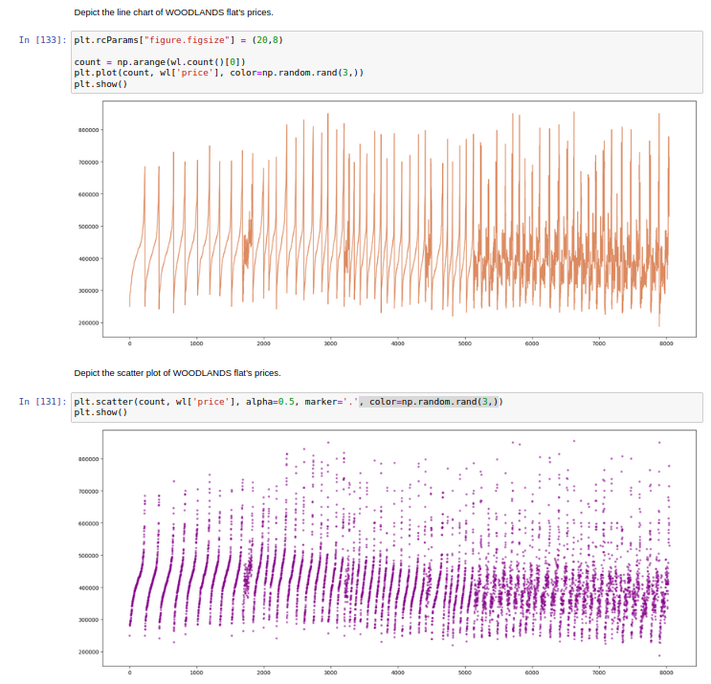
Practice 3: Visualization
<number>
Notes:
<number>

Slide 9
Mini Project 1: Logistic Regression
Open 2.15-Mini-Project Logistic Regression notebook.
Complete and run it
Report the results
<number>

Slide 10
Mini Project 1: Logistic Regression
<number>

Slide 11
Mini Project 2: Regression
Open 2.17-Mini-Project Regression notebook
Complete and run it
Report the results
<number>

Slide 12
Mini Project 2: Regression
<number>

Slide 13

This is The End …
<number>

