Slide 1
AngularJS
Mpho Musengua

Slide 2
What is AngularJS
Is a client side JavaScript MVC framework to developdynamic web applications
It is a one core library
It is a full-featured SPA framework

Slide 3
Features of AngularJS
Two-way Data Binding – with full support for templates.
Directives – Extend HTML
MVC
Dependency Injection
Testing
Deep Linking (Map URL to route Definition)
Server-Side Communication
Model-View-Controller Concept
Routing f the views
DOM manipulation jQLite is built-in

Slide 4
What are Directives
Directives are markers on a DOM element (such as an attribute, element name, comment or CSS class) that tell AngularJS's HTML compiler ($compile) to attach a specified behavior to that DOM element (e.g. via event listeners), or even to transform the DOM element and its children.
AngularJS comes with a set of these directives built-n like ngBind, ngApp, ngModel, ngClass etc

Slide 5
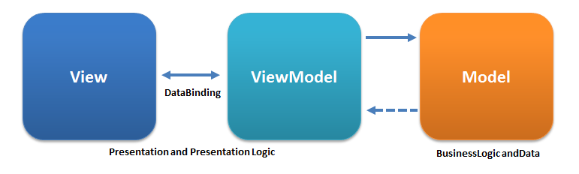
MVVM(Model View ViewModel)

Slide 6
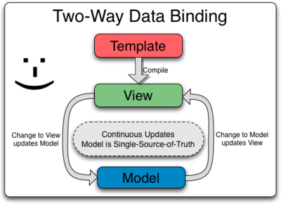
Data Binding
is the automatic synchronization of data between the model and view components.
AngularJS lets you treat the model as the single-source-of-truth in your application.
The view is a projection of the model at all times. When the model changes, the view reflects the change, and vice versa.

Slide 7
Controllers
In AngularJS, a Controller is defined by a JavaScript constructor function that is used to augment the AngularJS Scope.
AngularJS controllers control the data of AngularJS application
Controllers can be attached to the DOM in different ways. For each of them, AngularJS will instantiate a new Controller object, using the specified Controller's constructor function:
the ngController directive. A new child scope will be created and made available as an injectable parameter to the Controller's constructor function as $scope.
a route controller in a $route definition.
the controller of a regular directive, or a component directive.
If the controller has been attached using the controller as syntax then the controller instance will be assigned to a property on the scope.
Use controllers to:
Set up the initial state of the $scope object.
Add behavior to the $scope object.

Slide 8
Scope
The glue between the View and the Controller is something called the Scope,

Slide 9
The VIEW

