Slide 1
AngularJS
Mpho Musengua

Slide 2
What is AngularJS
Is a client side JavaScript MVC framework to developdynamic web applications
It is a one core library
It is a full-featured SPA framework

Slide 3
Features of AngularJS
Two-way Data Binding – with full support for templates.
Directives – Extend HTML
MVC
Dependency Injection
Testing
Deep Linking (Map URL to route Definition)
Server-Side Communication
Model-View-Controller Concept
Routing f the views
DOM manipulation jQLite is built-in

Slide 4
What are Directives
Directives are markers on a DOM element (such as an attribute, element name, comment or CSS class) that tell AngularJS's HTML compiler ($compile) to attach a specified behavior to that DOM element (e.g. via event listeners), or even to transform the DOM element and its children.
AngularJS comes with a set of these directives built-n like ngBind, ngApp, ngModel, ngClass etc

Slide 5
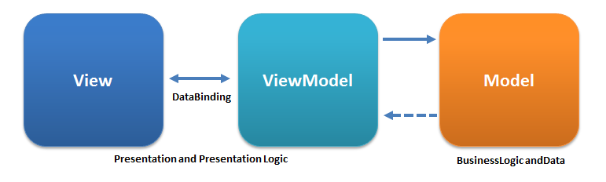
MVVM(Model View ViewModel)
Model
The model is the source of data, or data itself.
View
The view is what the user sees and interacts with, in this case, the dynamic view respresented by Angular on the web page
View Model
The view model binds the data from the model to the view and vice versa. In angular it is encapsulated by the scope variable which is decorated by a function called a Controller

Slide 6
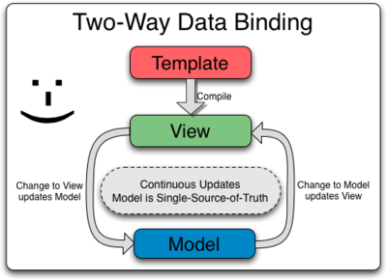
Data Binding
is the automatic synchronization of data between the model and view components.
AngularJS lets you treat the model as the single-source-of-truth in your application.
The view is a projection of the model at all times. When the model changes, the view reflects the change, and vice versa.

Slide 7
Controllers
Controllers are a JavaScript Constructor Function. As their name implies, their primary purpose is to control; in this case, control the view model contained within the Angular Scope.
Controllers are used to:
Set the initial state of Scope variables, which are then made available for the View to consume and interact with
Add behavior to the Scope by two-way binding variables and declaring Scope functions
Set up communications to and from the view and Model objects such as Services, brought in through Dependency Injection
Angular invokes the controller with a $scope object. Any objects (or primitives) assigned to the scope become model properties. The role of controllers in Angular is to expose data to our view via $scope, and to add functions to $scope that contain business logic that enhances view behavior.
For example, you may have a variable that determines whether a DOM element, (say a button), is visible to the user. You declare that variable JavaScript (in the controller code) using the scope object as $scope.showLDBtn = true. Because you've declared it this way in the controller, the view (the HTML) that is associated with that controller can simply reference the variable: <button ng-show="showLDBtn == true">Load Data</button>. The ng-show property checks the value of showLDBtn and sets the visibility of the button accordingly. As the value of showLDBtn changes in JavaScript--say in response to some event--the button will be shown or hidden simply by changing the showLDBtn property to true or false.
A controller should contain only the business logic needed for a single view; presentation logic should remain within views and directives. Note that the most efficient way to use controllers is by encapsulating work that doesn't belong to controllers into services, and then using these services in controllers via dependency injection (DI)

Slide 8
Scope
The glue between the View and the Controller is something called the Scope,
The $scope object is used to make the model available to the view. It is also referred to as the view model.
Essentially, if you want a variable to be able to be used or influenced by the view, you assign it as a subproperty to the Scope.
As discussed prior, the scope is defined and controlled by Controllers.

Slide 9
Scope Properties
The $scope variable allows you to tell your HTML that there is a value in your controller that needs to be displayed in the HTML.
Angular will keep up on $scope variables and update them as they change.
This is the fundamental difference between Angular and standard JavaScript programming, as you are setting up code for your view to keep up with the logic and maintain the values itself, rather than having to change the view yourself as values change.
To Declare a Scope Function
In addition to creating values for your views to reference, the $scope object can also hold functions for your view to interact with using Angular's event handlers such as ng-click, ng-mouseover, etc. This has several advantages, such as not having to manage event handlers separately or deal with the lifecycle of unbinding them when elements are removed from the DOM.

Slide 10
TO TWO-WAY BIND A VARIABLE with ng-model
When you are working with $scope variables, the communication between the view and the controller can go both ways.
The view can update automatically when the $scope variable's value changes in the controller, changes in the view can also cause the $scope variable's value to change in the controller.
In order to set this two-way communication up, we must set up a two-way binding.
by using the ng-model attribute.

Slide 11
SERVICES
AngularJS services are substitutable objects that are wired together using dependency injection (DI). You can use services to organize and share code across your app.
AngularJS services are:
Lazily instantiated – AngularJS only instantiates a service when an application component depends on it.
Singletons – Each component dependent on a service gets a reference to the single instance generated by the service factory.
AngularJS offers several useful services (like $http), but for most applications you'll also want to create your own.
Note: Like other core AngularJS identifiers, built-in services always start with $ (e.g. $http).
To use an AngularJS service, you add it as a dependency for the component (controller, service, filter or directive) that depends on the service. AngularJS's dependency injection subsystem takes care of the rest.

Slide 12
CREATING SERVICES
Application developers are free to define their own services by registering the service's name and service factory function, with an AngularJS module.
The service factory function generates the single object or function that represents the service to the rest of the application.
The object or function returned by the service is injected into any component (controller, service, filter or directive) that specifies a dependency on the service.
Services are registered to modules via the Module API.
Dependencies
Services can have their own dependencies. Just like declaring dependencies in a controller, you declare dependencies by specifying them in the service's factory function signature.
For more on dependencies, see the dependency injection docs.

Slide 13
DEPENDENCY INJECTTION
Dependency Injection (DI) is a software design pattern that deals with how components get hold of their dependencies.
The AngularJS injector subsystem is in charge of creating components, resolving their dependencies, and providing them to other components as requested.

Slide 14
USING DEPENDENCY INJECTION
Dependency Injection is pervasive throughout AngularJS. You can use it when defining components or when providing run and config blocks for a module.
Services, directives, filters, and animations are defined by an injectable factory method or constructor function, and can be injected with "services", "values", and "constants" as dependencies.
Controllers are defined by a constructor function, which can be injected with any of the "service" and "value" as dependencies, but they can also be provided with "special dependencies". See Controllers below for a list of these special dependencies.
The run method accepts a function, which can be injected with "services", "values" and, "constants" as dependencies. Note that you cannot inject "providers" into run blocks.
The config method accepts a function, which can be injected with "providers" and "constants" as dependencies. Note that you cannot inject "services" or "values" into configuration.
The provider method can only be injected with other "providers". However, only those that have been registered beforehand can be injected. This is different from services, where the order of registration does not matter.

Slide 15
WHY DEPENDENCY INJECTION
There are only three ways a component (object or function) can get a hold of its dependencies:
The component can create the dependency, typically using the new operator.
The component can look up the dependency, by referring to a global variable.
The component can have the dependency passed to it where it is needed.
The first two options of creating or looking up dependencies are not optimal because they hard code the dependency to the component. This makes it difficult, if not impossible, to modify the dependencies. This is especially problematic in tests, where it is often desirable to provide mock dependencies for test isolation.
The third option is the most viable, since it removes the responsibility of locating the dependency from the component. The dependency is simply handed to the component.

Slide 16
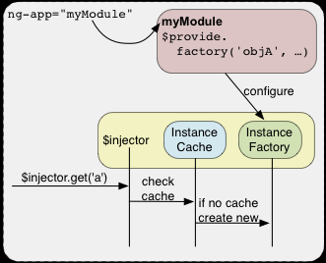

Slide 17
DEPENDENCY INJECTION
Dependency Injection is pervasive throughout AngularJS. You can use it when defining components or when providing run and config blocks for a module.
Services, directives, filters, and animations are defined by an injectable factory method or constructor function, and can be injected with "services", "values", and "constants" as dependencies.
Controllers are defined by a constructor function, which can be injected with any of the "service" and "value" as dependencies, but they can also be provided with "special dependencies". See Controllers below for a list of these special dependencies.
The run method accepts a function, which can be injected with "services", "values" and, "constants" as dependencies. Note that you cannot inject "providers" into run blocks.
The config method accepts a function, which can be injected with "providers" and "constants" as dependencies. Note that you cannot inject "services" or "values" into configuration.
The provider method can only be injected with other "providers". However, only those that have been registered beforehand can be injected. This is different from services, where the order of registration does not matter.

