Slide 1
Enabling Profiling/Tracing of MPI-IO Internal Communication via MPI-T Interface
MPI Tools Working Group
14.09.2026 -- Maximilian Sander / Bill Williams
Proposal

Slide 2
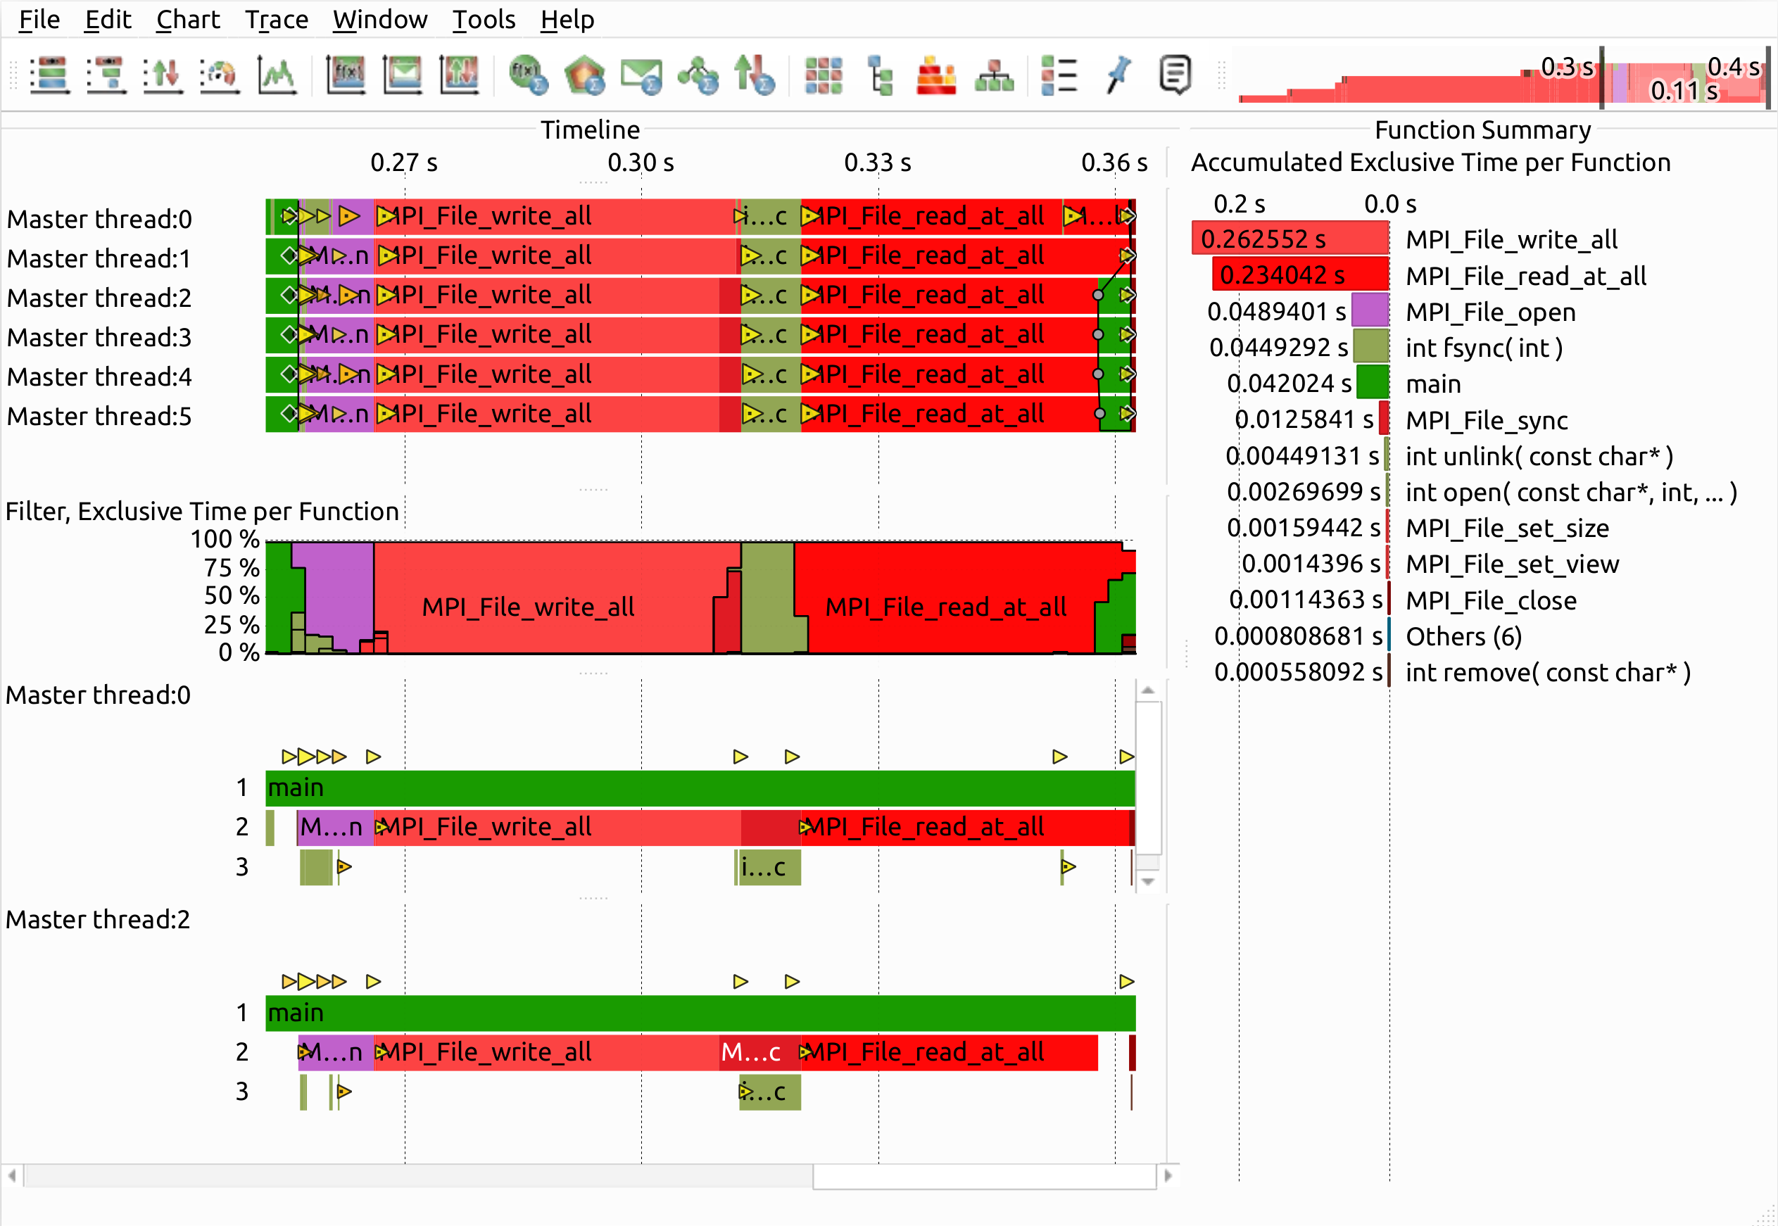
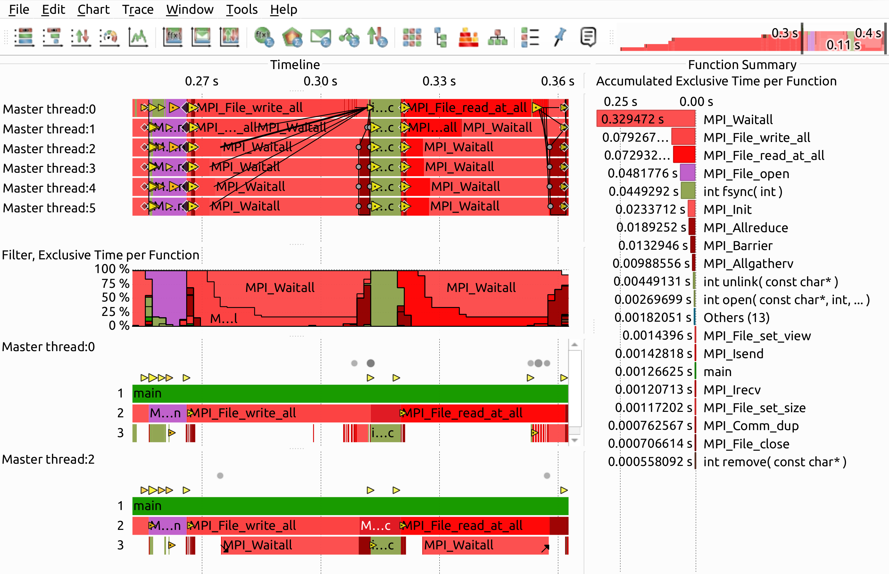
Enabling MPI-IO Tracing for Better Understanding
    Better understanding of communication from MPI_File_* to POSIX-IO
    See/verify/tune effect of e.g. cb_nodes/cb_buffer_size/…
Fig.1: Current MPI-IO-Tracing (Open MPI)
Fig.2: Proposed MPI-IO-Tracing (Open MPI)

Slide 3
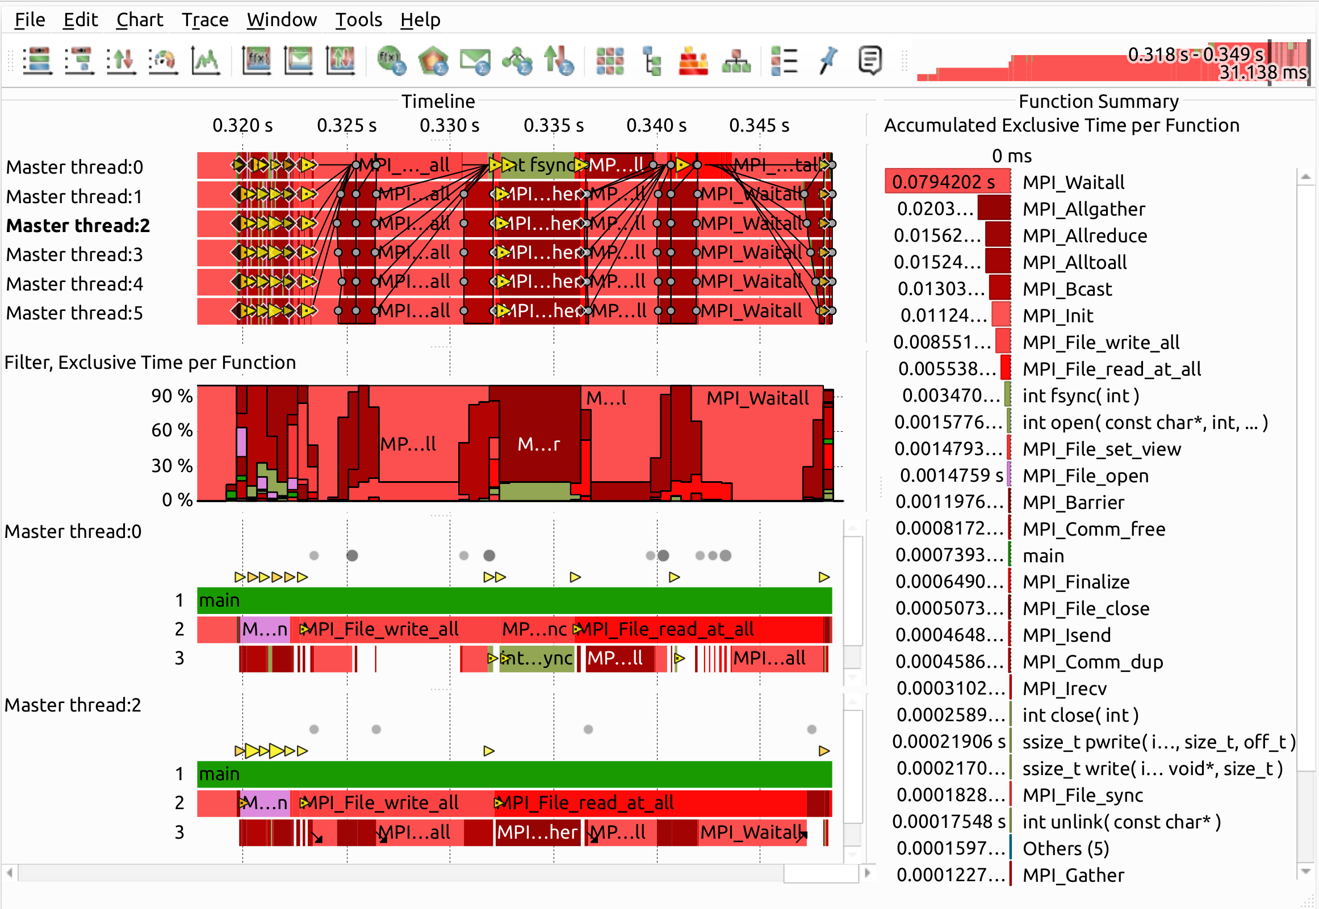
MPI-IO Internal Communication
Expose MPI-IO internal communication as regular MPI_* events → use existing tools
    E.g. already compile time switch for MPICH (ROMIO component: -DUSE_MPI_VERSIONS)
Propose: runtime CVAR (e.g)
    MPIR_CVAR_MPIIO_INTERNAL_USE_MPI
Compare implementations and alternatives
    Open MPI
    MPICH
    HDF5 MPI-IO backend implementation
    ADIOS2 (‘native’/HDF5 backend)
Fig.1 (background): Proposed MPI-IO-Tracing (Open MPI)
Fig.2 (foreground): Proposed MPI-IO-Tracing (MPICH)

Slide 4
maximilian.sander1@tu-dresden.de william.williams@tu-dresden.de
Maximilian Sander
Bill Williams

