Slide 1
MPI ABI WG Status
Jeff Brown, LANL (chair)
April 28, 2008

Slide 2
Where we are
Spreadsheet in development detailing mpi.h implementations
Some initial observations …
  Many vendors follow open source implementations
    Sun: OpenMPI
    Intel, Cray, Pathscale, Microsoft: MPICH
    A few outliers: HP, LAMPI
  Constants will be easy (just agree on something)
  Typedefs harder
  To be discussed in detail at WG session

Slide 3
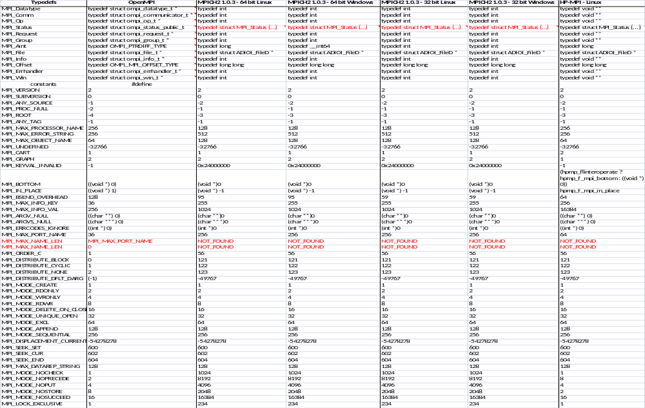
The spreadsheet …

Slide 4
What’s next?
Ensure column 1 is complete per the 2.1 standard (initially developed from OpenMPI mpi.h)
Complete the spreadsheet (need an “owner” for each column)
  are we missing implementations that wish to be considered?
  IBM? SGI? NEC? …
Develop the “ABI” mpi.h column(s)
Consider other items that need to be standardized:
  library name (e.g. libmpi.so – not dealing with path)
  calling sequence (doesn’t the API deal with this?)
  …
Put a proposal together for consideration as part of the MPI 3.0 standard (perhaps in time for the next meeting)
Testing? Prototype implementations?

Slide 5
ABI WG Session
Goal: enable the ability to dynamically link to a functional alternate MPI implementation at run time
C bindings only (not dealing with Fortran, C++)
  Fortran, C++ possibly later
What needs to be addressed:
mpi.h
Library names (not dealing with the path)
  Libmpiabi (not libmpi) (Jeff B. to send out a proposal)
calling sequence (?) (Ezra/Alexander to send out a proposal)
  Stdcall vs. cheeta _cdecl
How to deal with handle conversion functions (Alexander)
  Ftoc, ctof
Some operating principles:
Minimize impact on the implementations
Allow implementation flexibility
Minimize impact on quality of implementation

Slide 6
Discussion …
mpi.h
Validate column 1
  extract from section A.1 (Defined values and handles) of 2.1 document
implementation columns
  Owners assigned
  Do we have enough data?
  Constants (A.1.1) should be “easy”
  Typedefs (A.1.2) have alternate implementations
  Info Keys (A.1.3) – standardize where needed
Develop the ABI column(s)
  Are there OS/architecture dependencies here?
Library name standard
Calling sequence issue

Slide 7
Mpi.h discussion
A.1.1
Return Codes – pick an implementation
Assorted constants – categorize per Gropp paper
Error-handing specifiers – add to spreadsheet
Max sizes for strings – query function? (Jeff/HP guy)
Named predefined datatypes (C) -

