Slide 1
MPI 2.1 at
MPI Forum
Dublin, September 3-5, 2008
Rolf Rabenseifner
rabenseifner@hlrs.de
(Chairman of MPI 2.1 Task)
University of Stuttgart
High-Performance Computing-Center Stuttgart (HLRS)
www.hlrs.de

Slide 2
MPI-2.1 – Working plan: June 30 – July 2, 2008
Wednesday: 2:00 pm - 2:30 pm : MPI 2.1 - Working plan and preparation for votes
Thursday: 9:00 am - 9:30 am : MPI 2.1 - MPI-1.3 (May 30, 2008) 2nd vote
MPI-2.1 (June 23, 2008) 2nd vote
= final votes
Friday: 9:00 am - 9:30 am : MPI 2.1 - Implementation schedule and wrap up

Slide 3
MPI-2.1 – Current Status
Wednesday 2:00 pm
All ballot and review discussions are done
MPI-1.3 (May 30, 2008) and
MPI-2.1 (June 23, 2008)
  Finished
  Official reading was April 28-30, 2008
  First vote was July 1, 2008
  Printed books are available at this meeting
    2 x MPI-1.3 (dark yellow / gold)
    1 x MPI-2.1 (June 23, 2008) – Part I (light yellow) + Part II (orange)
      Colored version (marking the merging and review process)
    N x MPI-2.1 (June 23, 2008) as hardcover book
  2nd vote in Dublin, Sep. 2, 2008
Errata list is setup (currently 4 entries [state Sep. 1, 2008])
    https://svn.mpi-forum.org/trac/mpi-forum-web/
    wiki/mpi22/mpi21-errata
Additional list for missing entries or errata in the Change-Log
  Currently 1 entry (state Sep. 1, 2008)
    https://svn.mpi-forum.org/trac/mpi-forum-web/
    wiki/mpi22/mpi21-change-log-errata
Voting handled by the MPI-2.2 process

Slide 4
Rules for Errata List
Dis-cussion:
Are these rules okay
?
Yes:
28
No:
0
Abstain:
0
If you detect that some information in MPI-2.1 is wrong compared to the documents MPI-1.1, MPI-2.0, the 4 ballots of MPI-2.1 changes, and the MPI Forum decisions in the MPI-2.1 project, then you should
make a new entry in the list of MPI-2.2 items, and
add the same link to the following MPI-2.1 errata list.
The bug must be clearly a bug of the editing process of MPI-2.1.
Bugs in original MPI-1.1, MPI-2.0, or in the MPI Forum decisions, e.g. in Ballots 1-4, are not handled as an MPI-2.1 errata.
Those bugs are treated as part of MPI-2.2.
If you are an implementer of MPI-2.1, you should check the MPI-2.1 errata list.
All MPI-2.1 errata items are part of the MPI-2.2 process and should be amended in version 2.2 of the MPI standard.
Formally voted MPI-2.1 errata items can be viewed also as an integral part of MPI-2.1.
The MPI Forum may make exceptions.

Slide 5
Errata (→ discussed in MPI-2.2 slots)
MPI-2.1 Errata MPI::F_DOUBLE_COMPLEX (page 495 line 11)
  At MPI-2.1 p495.11, substitute "MPI::DOUBLE_COMPLEX" by "MPI::F_DOUBLE_COMPLEX"
MPI-2.1 Errata MPI_MAX_OBJECT_NAME (page 237 lines 1+3, page 563, lines 18+20)
  At MPI-2.1 p237.1, p237.3, p563.18 (*), and p563.20 (*), substitute "MPI_MAX_OBJECT" by "MPI_MAX_OBJECT_NAME"
  Remove MPI_MAX_OBJECT from the Index of MPI Constants and Predefined Handles (pg 576)
MPI_REPLACE in MPI_Accumulate [was Ballot 2 Item 7]
  pg 332, ln 16: delete ", like the other predefined operations," because the other predefined operations *are* defined for derived datatypes.
  pg 332: For the same reason, the Rationale on lines 19-22 is incorrect. It needs to be replaced with whatever was the real rationale for making this exception for MPI_REPLACE in 2.1.
Typo in MPI_Cart_rank
  Last line of pg 250: "coord is not significant" should be "coords is not significant". The variable name is coords.
(*) Located in the Change-Log → also mentioned in the additional Change-Log-Errata-List

Slide 6
Published Files – already on www.mpi-forum.org/docs/
Normal Version with colored links (for online usage or colored printing):
mpi-report-2.1-2008-06-23.pdf *)
Normal Version with colored links (for colored printing only):
mpi-report-2.1-2008-06-23.ps
mpi-report-2.1-2008-06-23-small.pdf
mpi-report-2.1-2008-06-23-twice.pdf
mpi-report-2.1-2008-06-23-split-book-A5.pdf
Normal Version with black links (for black/white printing only):
mpi-report-2.1-2008-06-23-black.pdf *) **)
mpi-report-2.1-2008-06-23-black.ps
mpi-report-2.1-2008-06-23-black-split-book-A5.pdf
mpi-report-2.1-2008-06-23-black-twice-part1.pdf
mpi-report-2.1-2008-06-23-black-twice-part2.pdf
Version with colors showing the development of MPI-2.1
(only for reviewing/history purpose):
mpi-report-2.1-2008-06-23-reviewcolors.pdf *)
mpi-report-2.1-2008-06-23-reviewcolors.ps
mpi-report-2.1-2008-06-23-reviewcolors-split-book-A5.pdf
BLUE: Separately compiled (i.e., six files = six independent Latex runs)
ORANGE: Additional files for convenient printing (based on .ps → published shell script)
*) with correct cross references for Acrobat reader (table of content, citations, index)
**) used for hardcover book

Slide 7
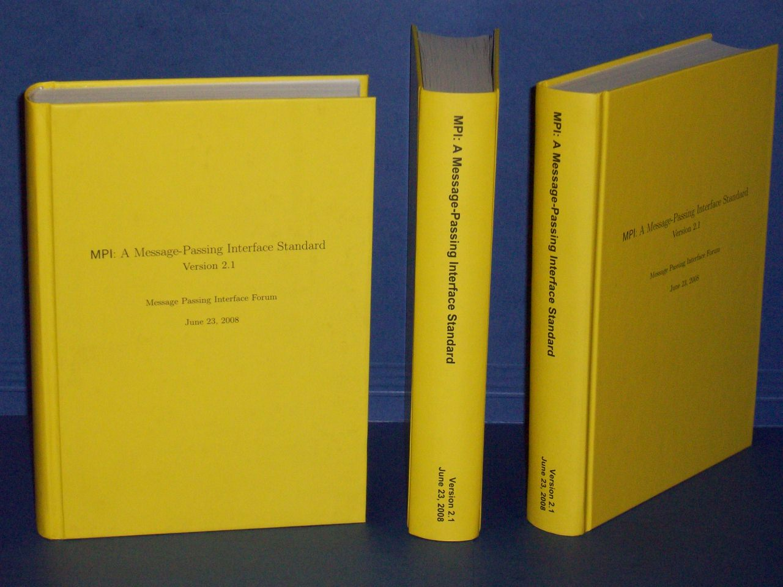
MPI-2.1 as Hardcover Book
Goal:
  Appropriate publishing of MPI-2.1 at EuroPVM/MPI’08
Idea:
  A printed book?
Problems:
  With 608 pages, books with cheap binding do not work
  Sewn binding is necessary
  Printing shops cannot handle this in 3 days
  Short lifetime of MPI-2.1 → commercial publisher don’t like?
  It should be cheap
Decision
  HLRS has printed MPI-2.1 and selling it (at costs) for 17 €
  As a service for the MPI community
Drawbacks
  We knew the risk that the MPI Forum may vote “NO” as 2nd vote
  I discussed it only with the MPI steering committee
  I’m sorry, that I did not discuss it with the whole MPI-Forum

Slide 8
All official votes together
Thursday 9:00 am
Each institution is asked for
two votes:
  MPI-1.3 (May 30, 2008): 2nd vote
  MPI-2.1 (June 23, 2008): 2nd vote
  2nd vote = final vote
You can vote
  2 times the same,
  or making 2 individual decisions.
Official vote:
Do you accept
MPI-1.3 (May 30, 2008), and
MPI-2.1 (June 23, 2008) ?
MPI-1.3: Yes: 22 ; No: 1 ; Abstain: 0
MPI-2.1: Yes: 23 ; No: 0 ; Abstain: 0
Number of institutions: 23
(at this meeting)
Not in the room:
(while voting)

Slide 9
Implementation of MPI-2.1
Friday 9:00 am
Do you expect that your company/organization is able to implement the 33 issues of MPI-2.1 (see Annex B, Change-Log) until EuroPVM/MPI 2008 (Sep. 7-10, 2008)?
If no, please can you give an estimate.
Library | Yes mm/yy | asked
MPICH2 | YES alpha | Rajeev Thakur
Open MPI (in V1.3) | YES upcoming | Jeff Squyres
IBM | 12/ 2008 | Dick Treumann
Sun Microsystems | YES (OpenMPI) | Rolf Vandevaart
Microsoft | 12/ 2008 | Erez Haba
Fujitsu | 6/ 2009 | Sueyasu, Naoki
Library | Yes mm/yy | asked
Bull |  | Yann Kalemkarian
HP | 12/ 2008 | David Solt
Cray | Q1 2009 | Mark Pagel
NEC | YES | Hubert Ritzdorf, Jesper Traeff
Intel | 2009 | Alexander Supalov, Keith Underwood
SiCortex | YES | David Gingold

Slide 10
Follow-Up: Next Steps
MPI-2.1 task is done
Thank you for your strong support
  during all the meetings
  and in the e-mail discussions in the past 8 month

Slide 11
Appendix
Additional slides from previous meeting

Slide 12
MPI-2.1 – ½-Year Project – a Statistical Summary
1st telephone conference, December 21, 2007 – Final MPI-2.1, June 23, 2008
Work
months
MPI 1.3 + 2.0, merging 335 distinguished parts 1
Ballot 1+2 40 items implemented
Ballot 3 14 items / 12 accepted + implemented
Ballot 4 22 items / 20 accepted + implemented 1
+ a lot of e-mails by MPI Forum members 1
Review items 24 also implemented in MPI-1.3
analyzed and … 26 still open questions → MPI-2.2
(814 items) 19 handed over to chapter authors
77 done by MPI-2.1 chapter authors
101 deferred to MPI-2.2
14 question & answer only
68 rejected (reasons communicated to the authors)
485 items implemented by myself (253 since last meeting) 1
Total summary 1225 items
14 chapter authors 21 chapters / annexes / frontm. / bibl. / index 7
( x 2 weeks/author) read and corrected
20 meeting hours Dec.07 telco: 0.5h + Jan.08: 5 h +
( x 40 members) Mar.08: 7 h + Apr.08: 6.5 h + June 08: 1 h 5
16
months

