Slide 1


Foundations of Programming Languages, Verification, and Security Winter 2023/24 @ Ruhr Uni Bochum
Lecturers: Rob Blanco and Cătălin Hrițcu
Teaching Assistant: Jérémy Thibault
Max Planck Institute for Security and Privacy (MPI-SP)

Slide 2

Foundations of Everything
Programming Languages
Imp and Simply Typed Lambda-Calculus (functional)
type systems, program equivalence, semantics, metatheory
Verification
Hoare Logic: verify Imp programs
Relational Hoare Logic (RHL)
Security
Information Flow Control: enforcing noninterference
Static enforcement: RHL, types, cryptographic constant time
Dynamic enforcement: Secure Multi-Execution, ...

Slide 3
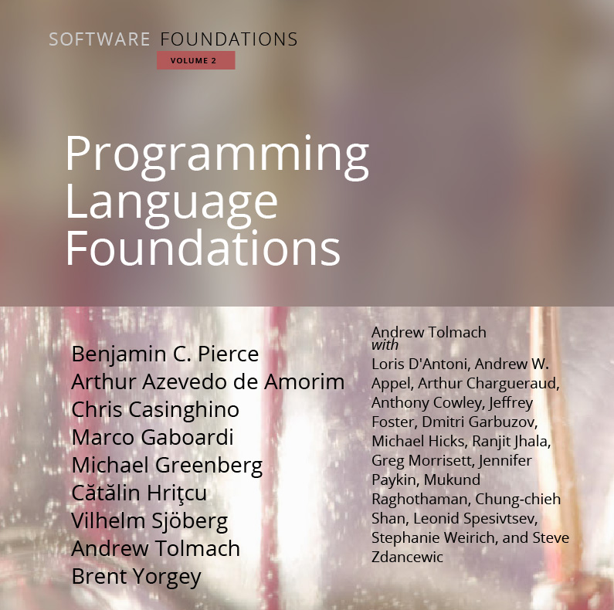
Textbook written in Coq; our extended version at: https://mpi-sp-foe-2023-24.github.io

Slide 4
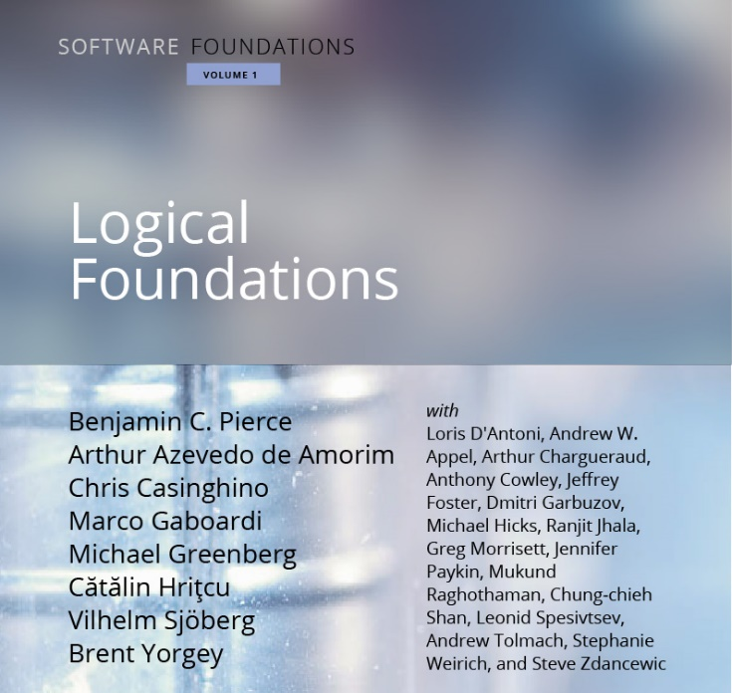
Prerequisite: Proofs are Programs
1. Logic and proofs
2. Functional programming
3. Program verification
Using the Coq proof assistant
Prerequisite: Having attended the Proofs are Programs course last semester or having (self-)studied the Logical Foundations book: https://mpi-sp-pap-2023.github.io

Slide 5
CompCert C compiler verified in Coq to correctly compile, unless program has "undefined behavior"
Why it's helpful to have foundations for Programming Languages?
large subset of C
Rob, Jérémy, Catalin, et al: Formally Secure Compilation of Compartmentalized C Programs
Extended CompCert with compartments
(mutually distrustful, with clearly specified
interfaces, interacting via procedure calls)
Proved in Coq that the impact of undefined behavior is restricted

Slide 6

Motivation for verifying imperative programs =proving mathematically that a program satisfies a specification, for instance in Hoare Logic (introduced in this course)
the seL4 OS microkernel (Isabelle/HOL), the CertiKOS hypervisor (Coq)
EverCrypt cryptographic library (F*) -- shipping in Firefox and the Linux kernel
EverParse3D verified binary parsers (F*) -- shipping in Windows kernel
Cătălin et al working on design of F* proof assistant, which combines dependent types (à la Coq) with Hoare-style verification (Dijkstra monads)
Libjade high-assurance post-quantum crypto library (EasyCrypt, MPI-SP et al)
Rob working on verifying security of masking countermeasures (EasyCrypt)
EasyCrypt proof assistant for Probabilistic Relational Hoare Logic (MPI-SP)

Slide 7
Motivation for secure information flow
Cryptographic constant time (aka secret independent timing)
widely-used programming discipline for writing cryptographic code without leaking secrets via obvious cache side channels:
no secret-dependent branches and no secret-dependent memory accesses
can be checked by a very simple type system
the obtained guarantees formalized as a variant of noninterference
Speculative constant time
Spectre: constant time code can still leak because of speculative execution
Stronger noninterference variant that prevents leaks in speculative executions

Slide 8
Lecture logistics
14 lectures: first 6.5 by Rob, last 6.5 by Cătălin, 1 by Jérémy
Vacation 21 Dec to 8 Jan, so no lecture, no tutorials
Public holiday on 1 November, so no tutorial
We hope for a mostly in-person course
So please attend physically whenever possible!
When you really cannot attend physically you can use Zoom or watch the recording

Slide 9
Exercises (same as last semester)
This is a very hands on course
New exercise sheet will be released on Moodle after most courses
1(-2) Coq file(s) with holes you have to fill (basically 1-2 book chapters)
so there will be 10-12 exercise sheets in total
You have to turn in your solution on Moodle before next course
up to Wednesday at 23:59
Exercises count for 40% of final grade (+5% in bonus points)
not required to do the optional exercises; they don't count for grade
Exercises are individual, please don't share your solutions in any way!
Exercises highly recommended even if you're not taking this for credit

Slide 10
Tutorials: Q&A about the exercise sheets
TA: Jérémy Thibault <jeremy.thibault@mpi-sp.org>
New time: Wednesday at 14:15-15:45
Same room as the course (MB, flour 5, room SM-MO-506)
You can come ask questions
You can also come work on your own during tutorials
and ask questions as they arise
New: you can also join tutorial via Zoom if you prefer
New: you can also write emails to Jérémy to ask questions
We still have Moodle forum; but don't post (partial) solutions there

Slide 11
Exams
Midterm exam (optional)
practice for the final exam
also written, on paper
duration: 60 minutes
bonus points: up to 10%
date: 29 November at 14:00
Final exam
written, on paper
so we will also teach you how to write down proofs informally
duration: 120 minutes
60% of the grade
date: 21 February
re-exam: 22 March

Slide 12
Early final exam registration?
A week ago the CS examination office informed us that a new policy will apply to us, since our course has exercises during the semester:
Students who want to get credit points would need to register by Monday, 23 October (so soon!)
To me this seems like a bad idea
Giving students less freedom in choosing courses
Making our courses less appealing to students who are not sure from the beginning whether this course is for them or not?
Discussing with examination office later this week
Please let me know what you think

Slide 13
Final grade
CASA PhD students
attendance requirement is to receive 50% of the exercises score
You can get credit if you study
Computer Science MSc
IT Security MSc
Mathematics MSc
Exercises (5% bonus)
Exercises (40%)
Final exam (60%)
Midterm (10% bonus)
You need 50% of this to pass and get credit + attending final exam(!)
You need close to 100% of this to get maximum grade

Slide 14

Considering prequel course (next semester?) Functional Programming Probably using the OCaml programming language Potential lecturers: Rob Blanco, Cătălin Hrițcu, Clara Schneidewind

