Slide 1


Foundations of Programming Languages, Verification, and Security Winter 2023/24 @ Ruhr Uni Bochum
Lecturers: Rob Blanco and Cătălin Hrițcu
Teaching Assistant: Jérémy Thibault
Max Planck Institute for Security and Privacy (MPI-SP)

Slide 2

Foundations of Everything
Programming Languages
Imp and Simply Typed Lambda-Calculus (functional)
type systems, program equivalence, semantics, metatheory
Verification
Hoare Logic: verify Imp programs
Relational Hoare Logic (RHL)
Security
Information Flow Control: enforcing noninterference
Static enforcement: RHL, types, cryptographic constant time
Dynamic enforcement: Secure Multi-Execution, ...

Slide 3
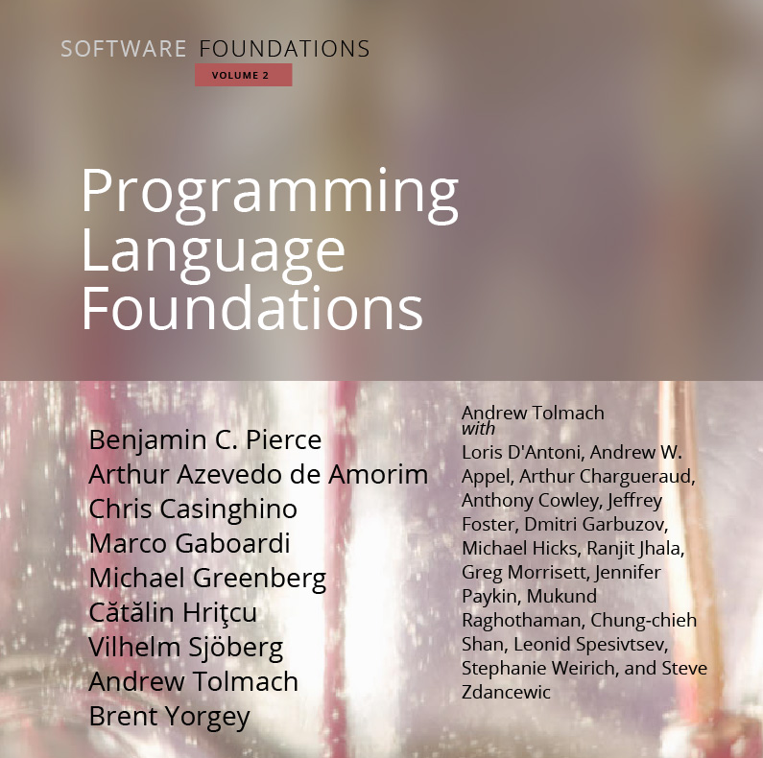
Textbook written in Coq; our extended version at: https://mpi-sp-foe-2023-24.github.io

Slide 4
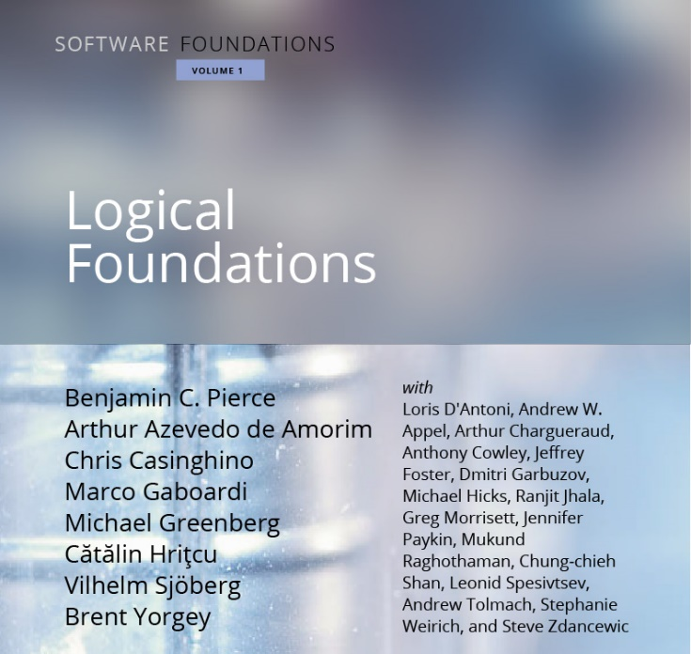
Prerequisite: Proofs are Programs
1. Logic and proofs
2. Functional programming
3. Program verification
Using the Coq proof assistant
Prerequisite: Having attended the Proofs are Programs course last semester or having (self-)studied the Logical Foundations book: https://mpi-sp-pap-2023.github.io

Slide 5
CompCert C compiler verified in Coq to correctly compile, unless program has "undefined behavior"
Why it's helpful to have foundations for Programming Languages?
large subset of C
Rob, Jérémy, Catalin, et al: Formally Secure Compilation of Compartmentalized C Programs
Extended CompCert with compartments
(mutually distrustful, with clearly specified
interfaces, interacting via procedure calls)
Proved in Coq that the impact of undefined behavior is restricted

Slide 6

Motivation for verifying imperative programs =proving mathematically that a program satisfies a specification, for instance in Hoare Logic (introduced in this course)
the seL4 OS microkernel (Isabelle/HOL), the CertiKOS hypervisor (Coq)
EverCrypt cryptographic library (F*) -- shipping in Firefox and the Linux kernel
EverParse3D verified binary parsers (F*) -- shipping in Windows kernel
Cătălin et al working on design of F* proof assistant, which combines dependent types (à la Coq) with Hoare-style verification (Dijkstra monads)
Libjade high-assurance post-quantum crypto library (EasyCrypt, MPI-SP et al)
Rob working on verifying security of masking countermeasures (EasyCrypt)
EasyCrypt proof assistant for Probabilistic Relational Hoare Logic (MPI-SP)

Slide 7
Motivation for secure information flow
Cryptographic constant time (aka secret independent timing)
widely-used programming discipline for writing cryptographic code without leaking secrets via obvious cache side channels:
no secret-dependent branches and no secret-dependent memory accesses
can be checked by a very simple type system
the obtained guarantees formalized as a variant of noninterference
Speculative constant time
Spectre: constant time code can still leak because of speculative execution
Stronger noninterference variant that prevents leaks in speculative executions

Slide 8
Lecture logistics
14 lectures: first 6.5 by Rob, last 6.5 by Cătălin, 1 by Jérémy
Vacation 21 Dec to 8 Jan, so no lecture, no tutorials
Public holiday on 1 November, so no tutorial
Our wish: mostly in-person course
So please attend physically whenever possible!
When you really cannot attend physically you can use Zoom or watch the recording

Slide 9
Exercises
This is a very hands on course
Coq turns proofs & logic into programming, and it's fun!
New exercise sheet will be released on Moodle after most courses
1(-2) Coq file(s) with holes you have to fill (basically 1-2 book chapters)
so there will be 10-12 exercise sheets in total
You have to turn in your solution on Moodle before next course
up to Wednesday at 23:59
Exercises count for 40% of final grade (+5% in bonus points)
not required to do the optional exercises; they don't count for grade
Exercises are individual, please don't share your solutions in any way!
Exercises highly recommended even if you're not taking this for credit

Slide 10
Tutorials: Q&A about the exercise sheets
TA: Jérémy Thibault <jeremy.thibault@mpi-sp.org>
New time: Wednesday at 14:15-15:45
You can come ask questions
You can also come work on your own during tutorials
and ask questions as they arise
New: you can also join tutorial via Zoom if you prefer
New: you can also write emails to Jérémy to ask questions
We still have Moodle forum; but don't post (partial) solutions there

Slide 11
Exams
Midterm exam (optional)
practice for the final exam
also written, on paper
duration: 60 minutes
bonus points: up to 10%
date: 29 November at 14:00
Final exam
written, on paper
so we will also teach you how to write down proofs informally
duration: 120 minutes
60% of the grade
date: 21 February
re-exam: 22 March

Slide 12
Final grade
CASA PhD students
attendance requirement is to receive 50% of the exercises score
You can get credit if you study
Computer Science BSc (soon MSc too)
IT Security BSc and MSc
Mathematics MSc
Exercises (5% bonus)
Exercises (40%)
Final exam (60%)
Midterm (10% bonus)
You need 50% of this to pass and get credit + attending final exam(!)
You need close to 100% of this to get maximum grade

Slide 13

Considering prequel course (next semester?) Functional Programming Probably using the OCaml programming language Potential lecturers: Rob Blanco, Cătălin Hrițcu, Clara Schneidewind

