Slide 1



Foundations of Programming Languages, Verification and Security (SoSe 2025)
Lecturers: Jana Hofmann and Cătălin Hrițcu
Teaching assistants: Federico Badaloni and Yonghyun Kim
Max Planck Institute for Security and Privacy (MPI-SP)

Slide 2


Foundations of ...
Programming Languages
formalize simple imperative and functional languages in Coq
type systems, program transformations, simple compilers
semantics, metatheory (e.g. type safety of the language)
Verification
Hoare Logic: verify imperative programs
Relational Hoare Logic: program equivalence and security
Security
Information flow control: preventing direct + indirect leaks
Preventing timing side channels for crypto code: cryptographic constant time, speculative constant time

Slide 3
Why formalize programming languages?
CompCert C compiler verified in Coq to compile correctly
each language given a semantics
transformations and optimizations
implemented as pure functions
proved to preserve semantics
Cătălin's group building secure compilers
including a secure variant of CompCert
inaugural lecture on April 30, at 4pm

Slide 4
The CompCert compiler is a purely functional program in Coq
verification of purely functional programs often much easier
yet some programs are hard to implement efficiently in functional languages (e.g. crypto, operating systems)
Verifying imperative programs
proving formally (in Coq) that an imperative program satisfies a functional/logical specification
Hoare Logic specifications, in terms of pre- and post-conditions :
if the pre-condition holds for the initial state, then running the program will produce a final state satisfying the post-condition
Relational Hoare Logic specifications:
relating 2+ executions: information flow properties (more on next slide)
relating 2+ programs: program equivalence (compiler optimizations)
predicates on states
predicates on states
{pre} c {post}
program
{rel_pre} c₁ ~ c₂ {rel_post}
relations on states

Slide 5
Secure information flow
What does it mean that a program doesn't leak secrets?
Noninterference for simple imperative programs:
secrets don't flow from secret variables to public variables (assumed observable)
Formally: executing the program twice with different initial values for the secret variables produces two final states whose public variables are still equal
Can be e.g. enforced statically by simple type system (more today)
initial state
public vars
secret vars
allowed flows
public vars
secret vars
final state

Slide 6
More realistic leakage models for information flow
Cryptographic constant time (i.e. secret independent timing)
widely-used programming discipline for writing cryptographic code without leaking secrets via obvious cache side channels:
no secret-dependent branches and no secret-dependent memory accesses
the obtained guarantees formalized as a variant of noninterference
can also be checked by a simple type system
Speculative constant time (MPI-SP folks, including Jana and Cătălin)
Spectre: constant time code can still leak because of speculative execution
Stronger noninterference variant that prevents leaks in speculative executions
Speculative load hardening transformation enforcing this security property

Slide 7
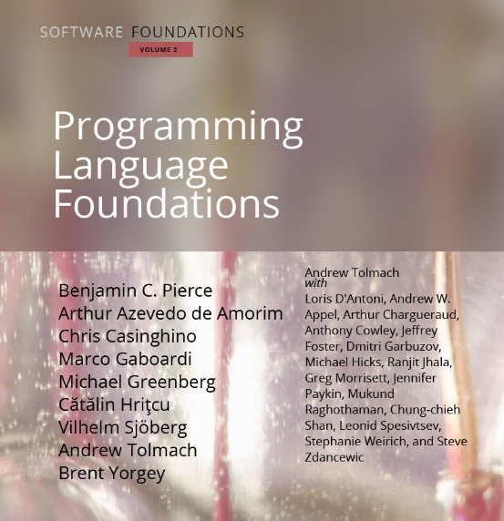
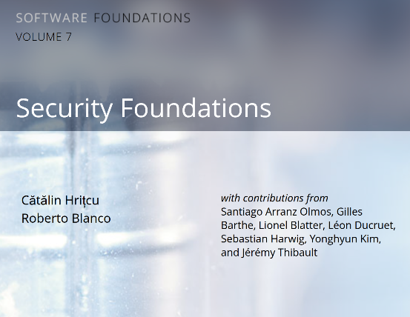
This course is very hands on
Coq proofs can be lots of fun!
Course based on two textbook volumes
lots of exercises in Coq
our book versions linked from Moodle: https://mpi-sp-foe-2025.github.io/book-plf https://mpi-sp-foe-2025.github.io/book-secf
Prerequisite: Proofs are Programs
Having attended the course last semester
or knowing to use Coq and having (self-)studied the Logical Foundations book: https://mpi-sp-pap-2024-25.github.io/book-lf

Slide 8
Lecture logistics
13 lectures: roughly first 1/2 Jana, second 1/2 Cătălin
exceptions: first lecture Catalin, before midterm Rob on RHL
Pentecost Vacation 9-13 June, so no lecture, no tutorials
We hope for a mostly in-person course
So please attend physically whenever possible!
When you really cannot attend physically you can use Zoom or watch the recording (see Moodle)
Join on Moodle for all materials
If external to RUB create account with any email address
Advice: ask questions, interact during the lecture
Notes:
TODO

Slide 9
Exercises
Solving exercising strongly recommended
you will learn the most by writing programs and proofs in Coq
very strong correlation between exercise scores and exam scores
highly recommended even if you're not taking this for credit
Exercises count for up to 20% of bonus points
not required to do the optional exercises; they don't count for grade
New exercise sheet will be released on Moodle after most courses
there will be around 10 exercise sheets in total
You have to turn in your solution on Moodle before next course
up to Wednesday at 11:59 AM (new time, right before noon!)
Exercises are individual, please don't share solutions in any way!
Using generative AI to solve homework exercises is not allowed!

Slide 10
Tutorials: Q&A about the exercise sheets
TAs: Federico Badaloni and Yonghyun Kim
Tuesdays at 10:15-11:45
You can come and ask existing questions
Can also ask about old assignments, but solutions anyway on Moodle
You can also work on your own during tutorials
and ask questions as they arise
If you manage to solve an exercise sheet and don't have any questions, then no problem, you are not forced to come
Zoom participation in Q&A sessions possible (same Zoom room)
if you cannot make it in person, but in-person participants get priority
Notes:
TODO: update

Slide 11
Exams
Midterm exam (optional)
practice for the final exam
also written, on paper
duration: 60 minutes
bonus points: up to 10%
date: Wed, 28 May
time: 14:30-15:30
usual lecture slot, just in larger lecture hall
Final exam
written, on paper
so we will also teach you how to write down proofs informally
duration: 120 minutes
100% of the grade
date: 8 August
re-exam: 16 September

Slide 12
Credit and grade
You can get credit if you study
IT Security MSc
Computer Science MSc
Mathematics MSc
BSc only as free elective / transit semester
Exercises (20% bonus)
Midterm (10% bonus)
Final exam (100%)
Adding up everything, you need 49.01% to pass and get credit,
and you need at least 94.01% to get highest grade

