Slide 1

Proofs are Programs Summary
Write purely functional programs in Coq
natural numbers, lists, maps, trees, program syntax
Verify these programs by proving theorems about them
case analysis, induction, inversion, tactics, ...
Curry-Howard correspondence
proofs = typed purely functional programs
Simple imperative programming language
syntax and operational semantics
["Le coq mécanisé" picture by Lilia Anisimova]

Slide 2
Course evaluation starts today
Please participate
your feedback is very important to us
help us make this better!
2 evaluation forms
one standard form from RUB
one specific form from us
More details via email/Moodle today

Slide 3
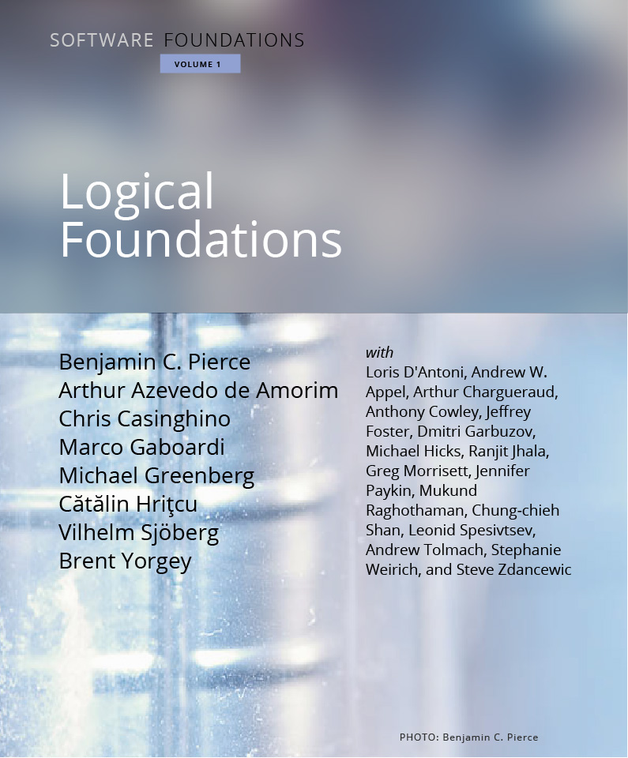
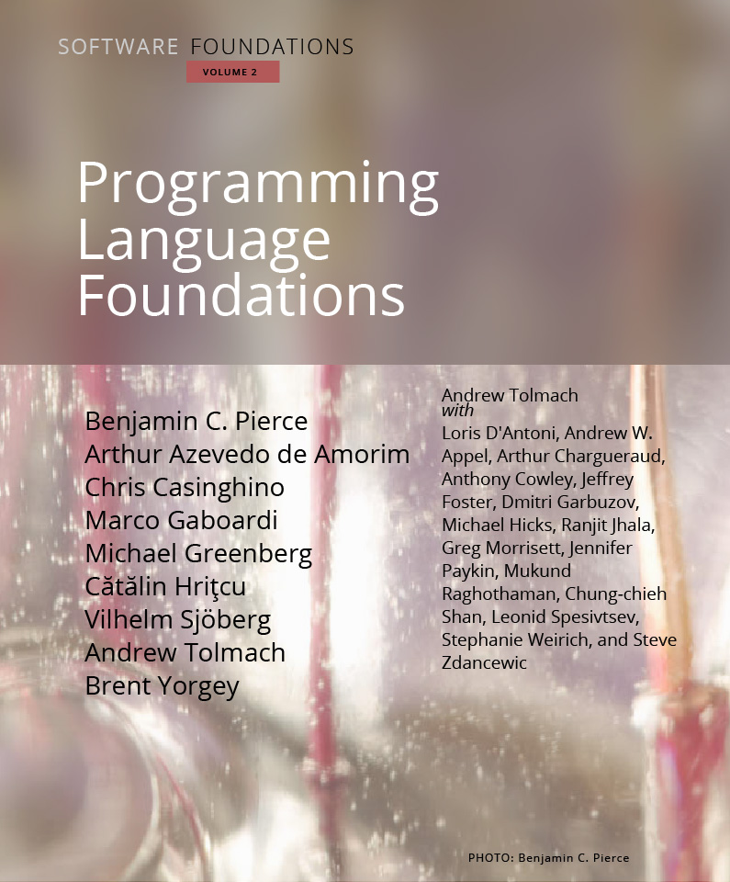
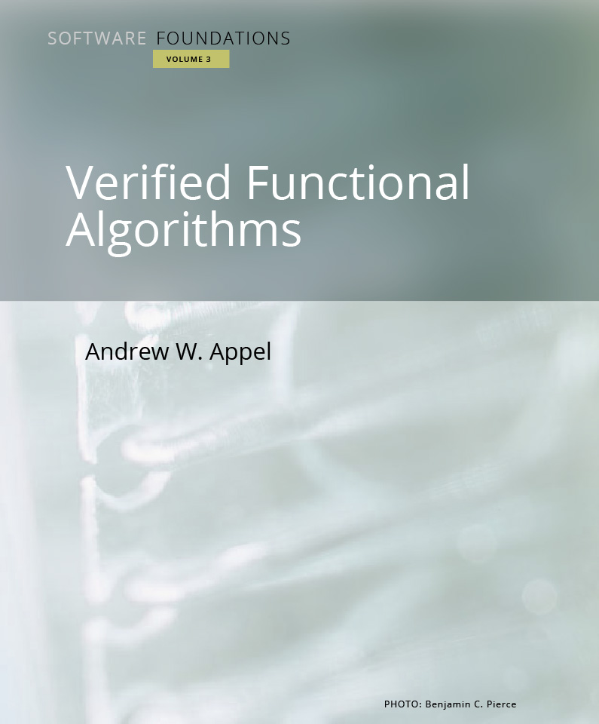
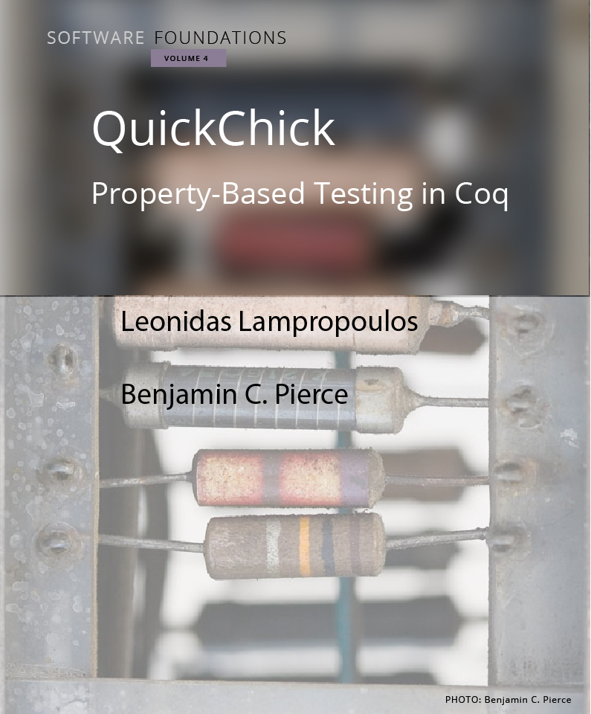
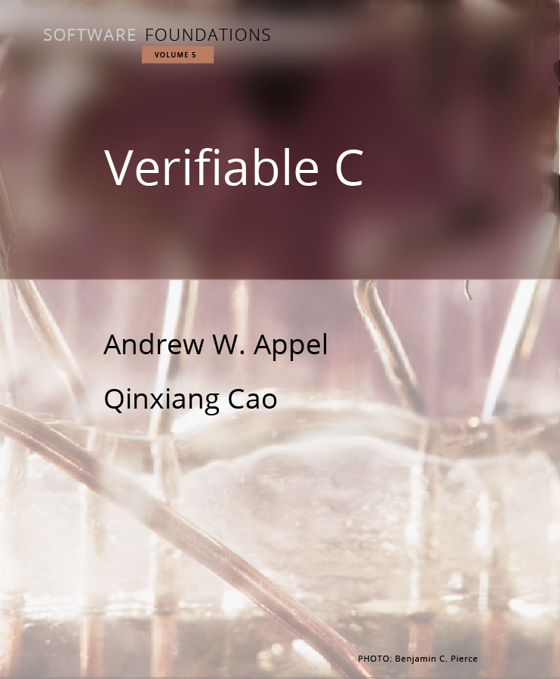
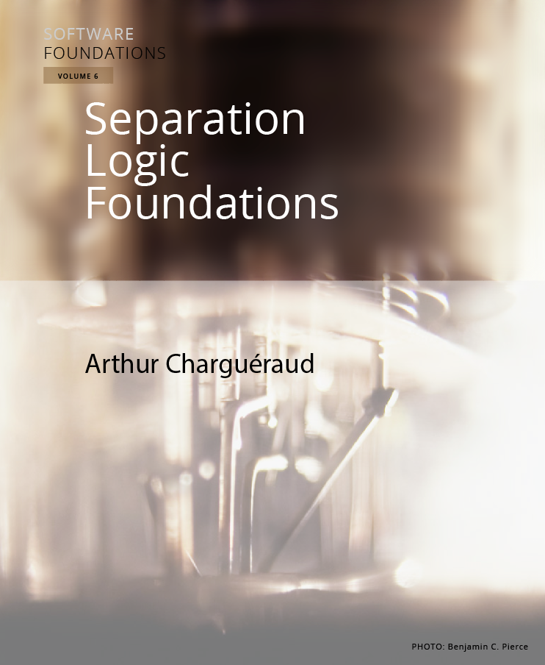
Follow-up course next semester Lecturers: Cătălin Hrițcu and Rob Blanco

Slide 4

Foundations of Everything
Programming Languages
Imp and Simply Typed Lambda-Calculus (functional)
type systems, program equivalence, semantics, metatheory
Verification
Hoare Logic: verify Imp programs
Relational Hoare Logic
Security
Information Flow Control: enforcing noninterference
Static enforcement: types, RHL, cryptographic constant time
Dynamic enforcement: Secure Multi-Execution, ...
reflect
+
Maps.v

