Slide 1

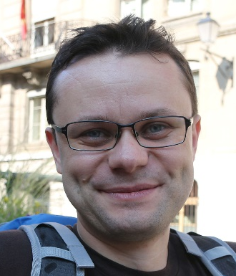
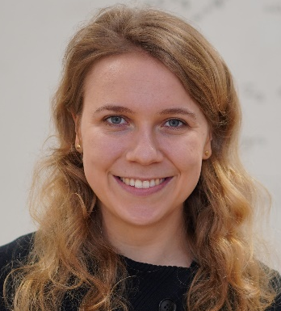
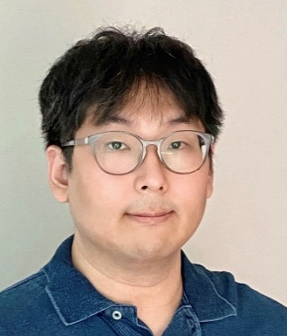

Proofs are Programs Summer 2026 @ Ruhr Uni Bochum
Lecturers: Cătălin Hrițcu and Clara Schneidewind
TAs: Yonghyun Kim and Yan Farba
Max Planck Institute for Security and Privacy (MPI-SP)

Slide 2

This course in a nutshell
Logic and proofs
Verifying functional programs
Formalizing simple imperative language
Secure information flow
Using the Rocq proof assistant
gentle introduction to both functional programming and formal proofs (both in Rocq)

Slide 3

The Rocq proof assistant
Rocq developed at Inria in France since 1983 (in OCaml)
Formerly known as Coq (which in French means rooster)
Rocq helps you build formal proofs interactively
Proving in Rocq is like programming
gamified, addictive, and lots of fun
if you like programming, you will also like Rocq proofs
This helps you deeply understand proofs
In fact, formal Rocq proofs are just purely functional programs
Curry-Howard correspondence (two extra chapters): deep connection between logic and functional programming
["Le Coq mécanisé" picture by Lilia Anisimova]

Slide 4

Functional programming
Write computations as recursive functions
using recursion, immutable datatypes, and pattern matching
limit side-effects, such as mutating stateful data structures
Rocq is purely functional = zero side-effects
all computations are mathematical functions (in particular terminating)
Functional programming languages like OCaml, Haskell, ...
not completely pure, but still try to reduce and control side-effects
they still make it as easy as possible to write functional code
BSc course previous semester using OCaml (again next semester)
Not a prerequisite for this course though
Notes:
Explanation from preface: computation should be pure, in the sense that the only effect of execution should be to produce a result: it should be free from side effects such as I/O, assignments to mutable variables, redirecting pointers, etc

Slide 5

Functional Programming in practice
Functional languages have some practical success
Meta (OCaml, Haskell, Rust), Microsoft (OCaml, F#, F*, and Rust), X (Scala), Mozilla (Rust), Google (Rust), Amazon (Rust), Financial industry, Blockchains and smart contracts (Clara's group does research on this), ...
Not yet fully mainstream, but ...
Many cool ideas already adopted by mainstream languages:
Lambdas, Generics in Java/C#, Rust's type system, datatypes, pattern matching (most admired language on Stack Overflow for the last 11 years!)
Functional programmers often earn more (Stack Overflow developer survey)
Functional programs are concise, elegant, beautiful
This makes understanding and reasoning about programs much easier, both informally and formally
For this course this last point is very important
formal verification by proving theorems about purely functional programs in Rocq

Slide 6

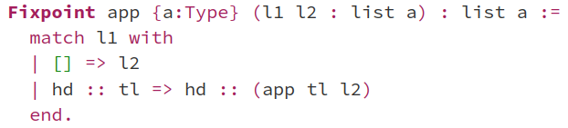
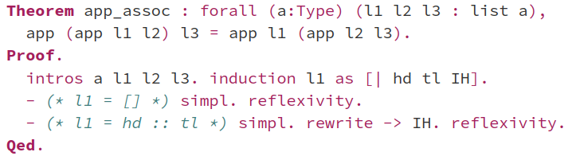
proof that append is associative

Slide 7
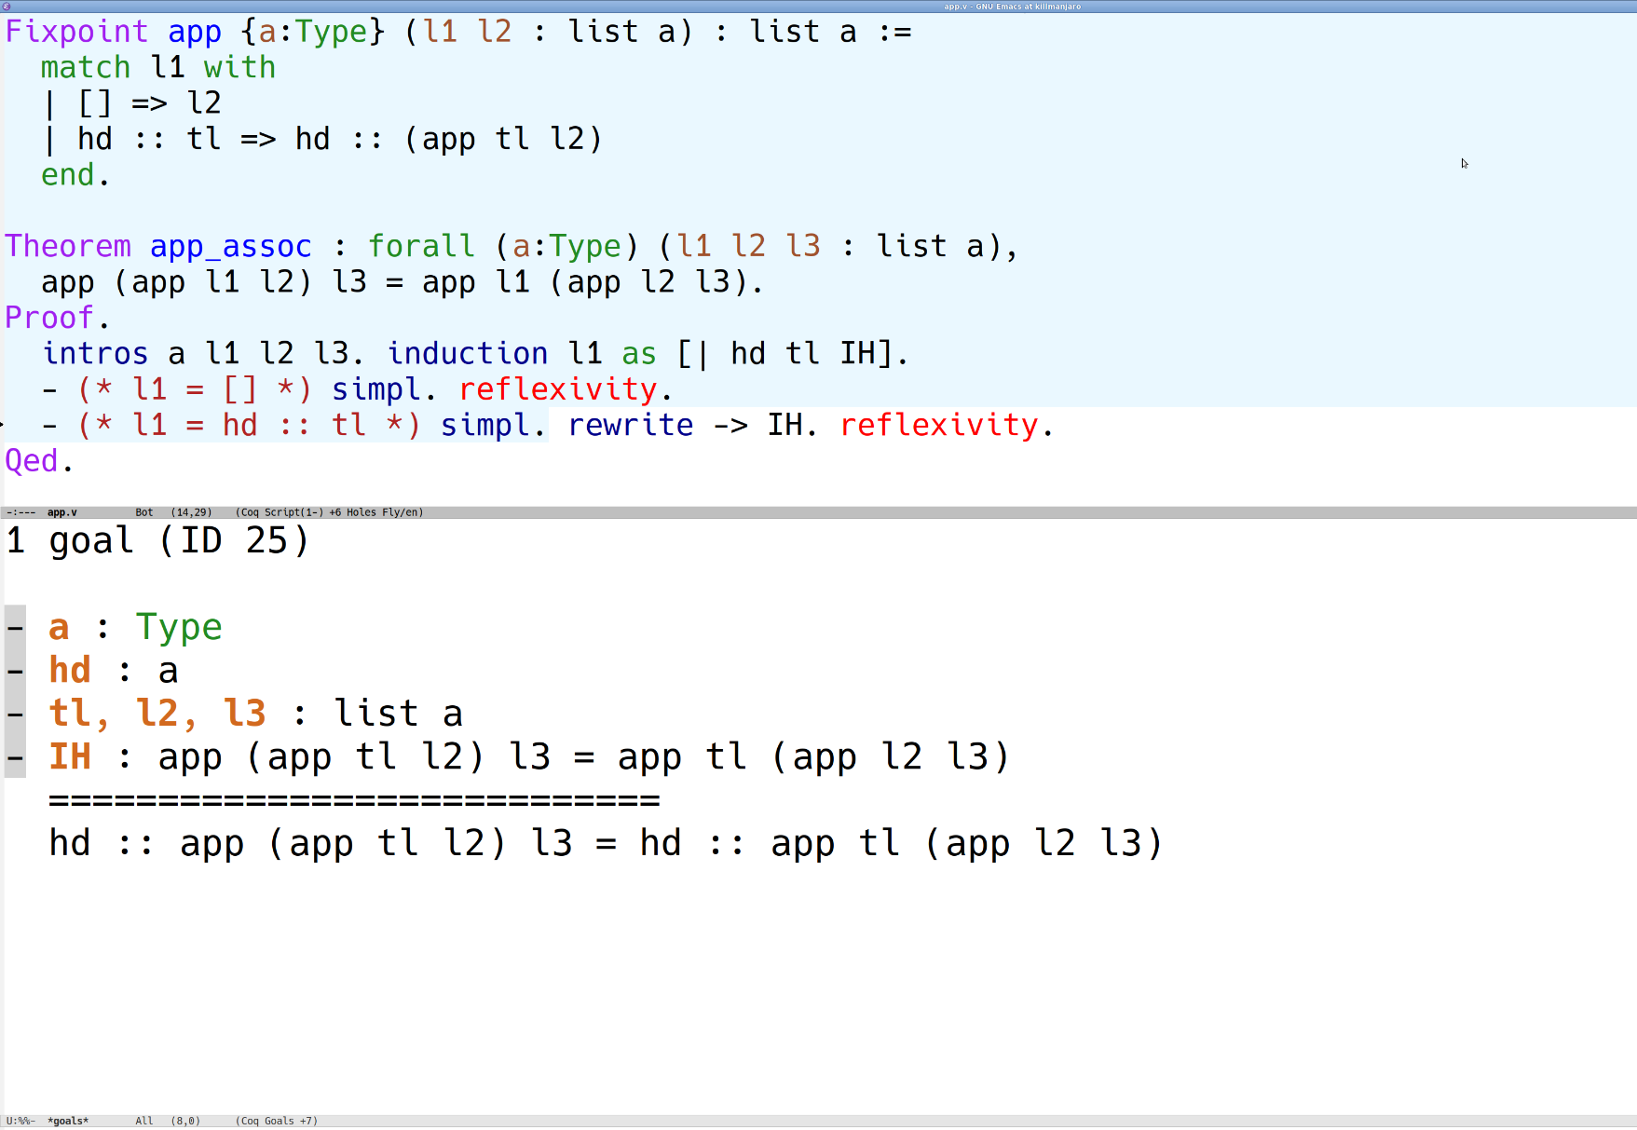

Slide 8
Define inductive datatypes
bools, numbers, lists, trees, abstract syntax trees
Define pure functions on these datatypes
pattern matching & structural recursion (terminating)
Prove properties of these functions by induction

Slide 9
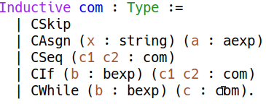

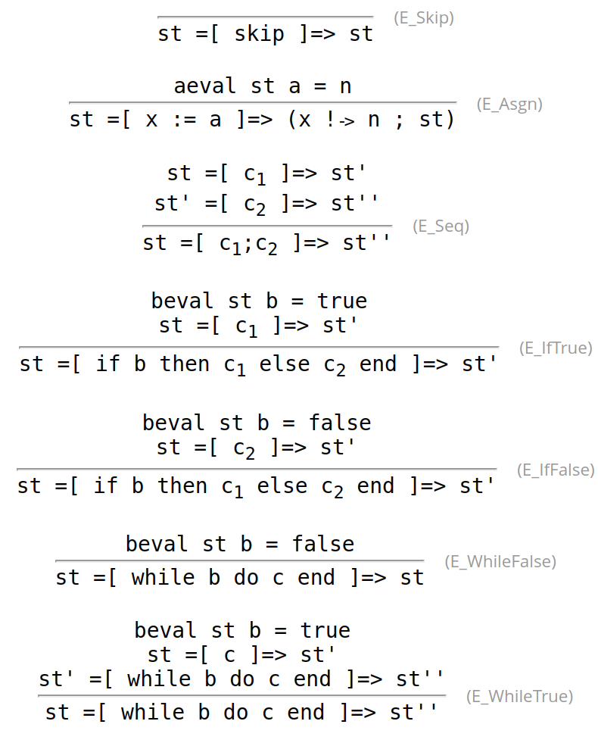
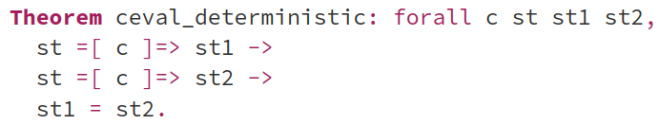
Formalizing simple imperative language
Abstract syntax tree (inductive datatype)
Operational semantics (inductive relation)
Proving properties of some/all programs
e.g. in our simple language evaluation is deterministic:
by induction (often on derivation trees of inductive relation)

Slide 10
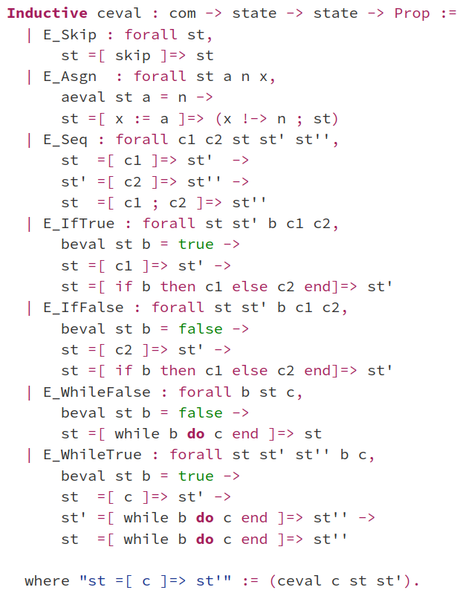
Inductive relation
Formalized in

Slide 11
Why formalize programming languages?
CompCert C compiler verified in Rocq to compile correctly
each language given a semantics
transformations and optimizations
implemented as pure functions
proved to preserve semantics
used in safety-critical systems
Cătălin, Yonghyun, Yan, et al building secure compilers and verifying them in Rocq
including a secure variant of CompCert
side-channel defenses (more later)
Clara et al built secure compiler from BitMLx smart contracts to cross-chain contracts and protocols

Slide 12
Secure information flow
initial state
public vars
secret vars
What does it mean that a program doesn't leak secrets?
Noninterference (for simple imperative programs):
secrets don't flow from secret variables to public variables
Formally: executing the program twice with different initial values for the secret variables produces two final states whose public variables are still equal
Can be enforced statically by simple type system
Prevent explicit flows: public := 2*secret + 1
Prevent implicit flows, via the control flow: if secret=0 then public := 0 else public := 1
Can also be enforced dynamically
e.g. Secure Multi-Execution
secure and precise, but less efficient and less correct
allowed flows
public vars
secret vars
final state
initial state
dummy
secret vars
public vars
secret vars
public exec
secret exec
final state
public vars
secret vars

Slide 13
More realistic leakage models for information flow
Cryptographic constant time (i.e. secret independent timing)
widely-used programming discipline for writing cryptographic code without leaking secrets via obvious cache side channels:
no secret-dependent branches and no secret-dependent memory accesses
the obtained guarantees formalized as a variant of noninterference
can also be checked by a simple type system
Speculative security (Cătălin, Yonghyun, Yan, et al and Jana et al.)
Spectre: constant time code can still leak because of speculative execution
Speculative constant time
variant of noninterference that prevents leaks in speculative executions
Speculative load hardening transformation enforcing this security property

Slide 14
In this course you will learn ...
to write purely functional programs in Rocq
natural numbers, lists, trees, program syntax
to verify these programs by proving theorems about them
case analysis, induction, inversion, proof automation, ...
to formalize a simple imperative programming language
syntax and operational semantics (evaluation derivations)
to make programs secure with information-flow control
enforcing noninterference statically or dynamically
even against side-channels and speculative executions attacks (optional for BSc students)
Notes:
TODO: a bit about imp + security too

Slide 15
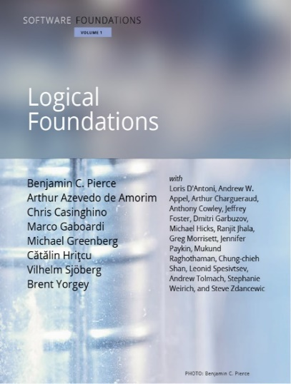
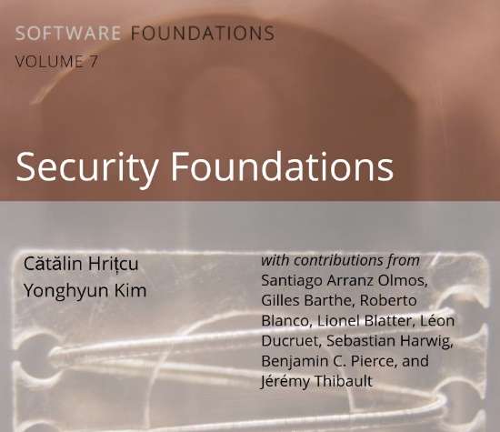
This course is very hands on
Rocq is your personal proof assistant
Taking gamification to the next level!
Course based on two textbook volumes
lots of exercises in Rocq, from very simple to more challenging ones
our volume versions available at: https://mpi-sp-pap-2026.github.io/book-lf https://mpi-sp-pap-2026.github.io/book-secf
You will understand proving
It's not hard, it's just programming!
If you like programming, you will like formal proofs too!
Advice: ask questions, interact

Slide 16
Lecture logistics
14 lectures: roughly first 1/2 Clara, second 1/2 Cătălin
exceptions: first lecture mostly Cătălin, Imp lecture Clara, ...
Pentecost Vacation 25-29 May, so no lecture, no tutorials
We hope for a mostly in-person course
So please attend physically whenever possible!
When you really cannot attend physically you can use Zoom or watch the recording (see Moodle)
Join on Moodle for all materials
If external to RUB please create account with any email address
Advice: ask questions, interact during the lecture
Notes:
TODO

Slide 17
Exercises
Solving exercises strongly recommended
you will learn the most by writing programs and proofs in Rocq
very strong correlation between exercise scores and exam scores
highly recommended even if you're not taking this for credit
Exercises count for up to 10% of bonus points
not required to do the optional exercises; they don't count for grade
New exercise sheet will be released on Moodle after all courses
there will be around 13 exercise sheets in total
You have to turn in your solution on Moodle before next course
up to Wednesday at 11:59 AM
Exercises are individual, please don't share solutions in any way!
Using generative AI to solve homework exercises is not allowed!

Slide 18
Tutorials: Q&A about the exercise sheets
TAs: Yonghyun Kim and Yan Farba
Tuesdays at 10:15-11:45, on the 5th floor of this building
You can come and ask existing questions
Can also ask about old assignments, but solutions anyway on Moodle
You can also work on your own during tutorials
and ask questions as they arise
If you manage to solve an exercise sheet and don't have any questions, then no problem, you are not forced to come
Zoom participation in Q&A sessions possible (same Zoom room)
if you cannot make it in person, but in-person participants get priority
Notes:
TODO: update

Slide 19
Exams
Midterm exam (optional)
practice for the final exam
also written, on paper
duration: 60 minutes
bonus points: up to 10%
date: Tue, 2 June
time: 10:15-11:15
Final exam
written, on paper
so we will also teach you how to write down proofs informally
duration: 120 minutes
100% of the grade
date: 7 August
re-exam: 29 September

Slide 20
Credit and grade
CASA PhD students
attendance requirement is 50% of the exercises score
You can get credit if you study
Computer Science BSc and MSc
IT Security BSc* and MSc
*ITS BSc only as "free elective" (sorry!)
Mathematics MSc
Exercises (10% bonus)
Midterm (10% bonus)
Final exam (100%)
Adding up everything, you need 49.01% to pass and get credit,
and you need at least 94.01% to get highest grade

Slide 21
Backup Slides

Slide 22
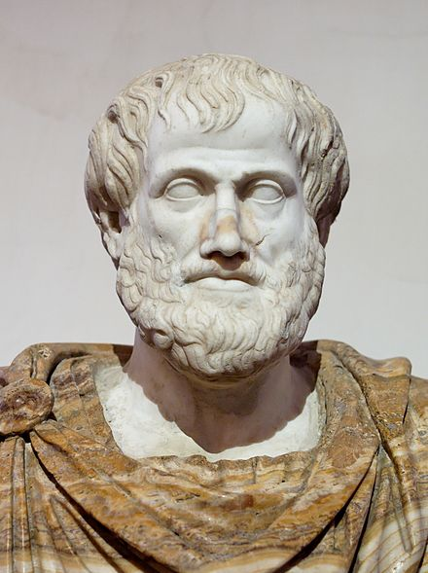
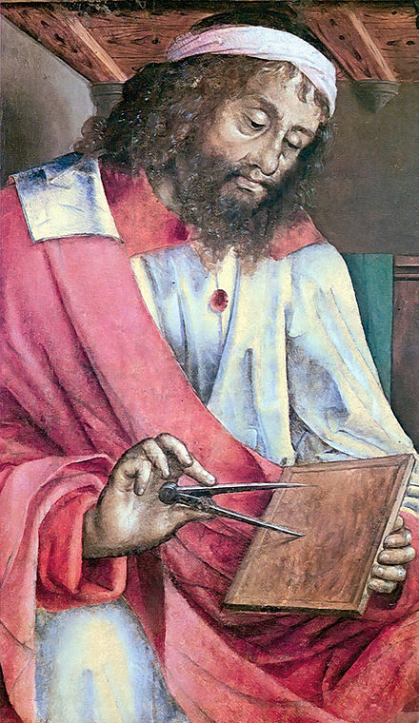
Logics and proofs
Q: How do we know something is true?
A: We prove it
Q: How do we know that we have a proof?
A: We need to know what it means for something to be a proof. First cut: A proof is a “logical” sequence of arguments, starting from some initial assumptions
Q: How do we agree on what is a valid sequence of arguments? Can any sequence be a proof? E.g.
All humans are mortal
All Greeks are human
Therefore I am a Greek!
A: No, no, no! We need to think harder about valid ways of reasoning...
Aristotle
384 – 322 BC
Euclid
~300 BC

Slide 23

The story of logics is quite fascinating
David Hilbert (1862 – 1943)
Gottlob Frege (1848-1925)
first-order logic (∀x. P x /\ R x x)
derive the laws of arithmetic from first principles (Hilbert's 2nd problem)
Bertrand Russell (1872 - 1970)
paradox, inconsistency in Frege's logical system, tried to fix it
Principia Mathematica
Kurt Gödel (1906 - 1978)
incompleteness theorems
Gerhard Gentzen (1909-1945) -- consistency of arithmetic
Alonzo Church (1903 - 1995) -- lambda calculus, simple theory of types
Alan Turing (1912 - 1954) -- undecidability of arithmetic, halting problem
...
Notes:
TODO: not full convinced this was so helpful?

Slide 24

Logics and computer science
Logics is a foundation of mathematics and computer science
precise proofs with respect to valid inference steps/rules
Logics and CS greatly influenced each other, e.g.:
automated theorem provers (e.g., SAT and SMT solvers)
model checkers
proof assistants: Rocq, Isabelle, HOL family, F*, ACL2, etc.
interactively constructed, machine-checked proofs
addictive, gamification of proofs

Slide 25
Logics and proofs
Foundation of mathematics and computer science
formal proofs with respect to valid inference steps/rules
This course: typed constructive higher-order logic
higher-order
can quantify not only over individuals (∀x:nat. P x)
but also over propositions (∀P:Prop. P), predicates (∀Q:nat->Prop. Q x), relations (∀R:nat->nat->Prop. R x y), functions (∀f:nat->bool, ∀g:(nat->bool)->bool), ...
constructive, aka intuitionistic logic:
a proposition is valid if one can construct a proof
philosophically rejects excluded middle (P ∨ ¬P, classical logic)
typed (dependently typed)

Slide 26
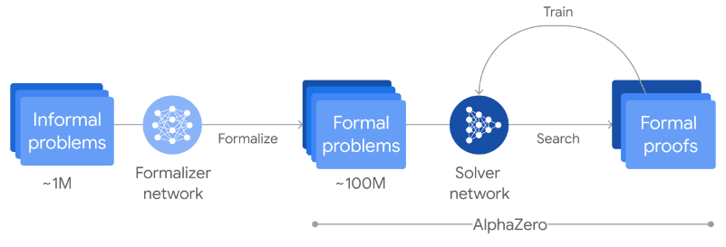
Machine-checked proofs of math theorems
The 4-color theorem
proved in 1976, simplified in 1996
proofs rely on a computer
infeasible for a human to check
initially not accepted by all mathematicians
mechanized in Rocq by Georges Gonthier in 2005
Construction of perfectoid spaces (Peter Scholze, Lean community, 2020)
Mathlib math library for Lean has over 100,000 theorems, over 1,000,000 lines of code, and an active community including many mathematicians (e.g. Terence Tao)
AlphaProof: Google DeepMind AI achieves silver medalist level in IMO (2024)
Key ingredient: the Lean proof assistant checks each step of the AI
[World map from Wikipedia]
Notes:
4 color: no more than four colors are required to color the regions of any map so that no two adjacent regions have the same color
Feit-Thompson:
first major step in the classification of finite simple groups
states that every finite group of odd order is solvable
Saved slide space:
Odd order theorem (Feit-Thompson)
Rocq proof from 2012 introduced the Mathematical Components library
Hales' proof of Kepler conjecture (HOL Light and Isabelle)

Slide 27

Verifying realistic imperative programs
the seL4 OS microkernel (Isabelle/HOL), the CertiKOS hypervisor (Rocq)
EverCrypt cryptographic library (F*) -- shipping in Firefox and the Linux kernel
EverParse3D verified binary parsers (F*) -- shipping in the Windows kernel
Cătălin, Cezar, et al designing and using F* proof assistant, which combines features of Rocq (dependent types) with Hoare Logic verification (Dijkstra monads)
Libjade high-assurance post-quantum crypto library (EasyCrypt, MPI-SP et al)
EasyCrypt proof assistant using Probabilistic Relational Hoare Logic (MPI-SP et al)
Verification of smart contracts (Rocq, F*, ...)
Clara, Jana, and their groups at MPI-SP working on this hot topic

