Slide 1
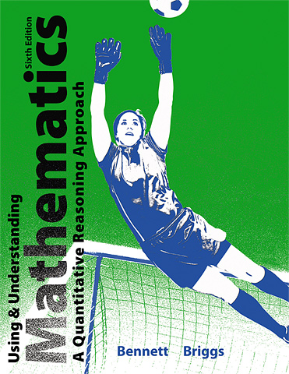

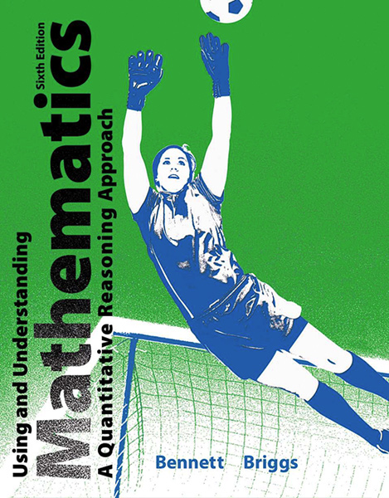
2
Approaches to Problem Solving

Slide 2
Unit 2A
Working with Units

Slide 3
Units
The units of a quantity describe what that quantity measures or counts.
Unit Analysis is the process of working with units to help solve problems.

Slide 4
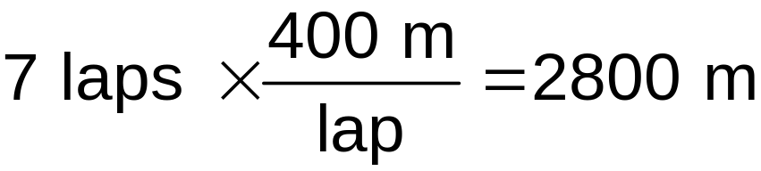
Example
Show operations and units clearly to answer the question: What is the total distance traveled when you run 7 laps around a 400-meter track?
Solution We could express the same idea as “7 laps of a 400-meter track.” Therefore, this problem requires multiplying 7 laps by the 400 meters you run per lap:

Slide 5
Key Words and Operations with Units
Key word or symbol
Operation
Example
per
Division
Read miles ÷ hours as “miles per hour.”
of or hyphen
Multiplication
Read kilowatts × hours as “kilowatt-hours.”
square
Raising to second
power
Read ft × ft, or ft², as
“square feet” or “feet squared.”
cube or cubic
Raising to third power
Read ft × ft × ft, or ft³, as
“cubic feet” or “feet cubed.”

Slide 6
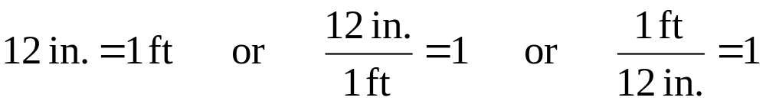
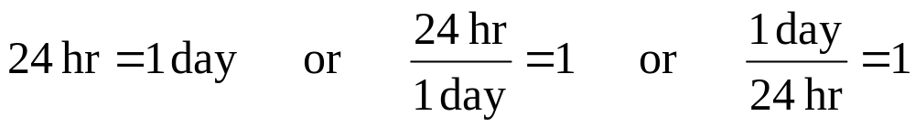
Conversion Factors
A conversion factor is a statement of equality that is used to convert between units.
Some conversion factors:

Slide 7
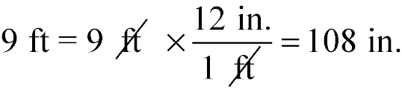
Unit Conversions
Convert a distance of 9 feet into inches.

Slide 8
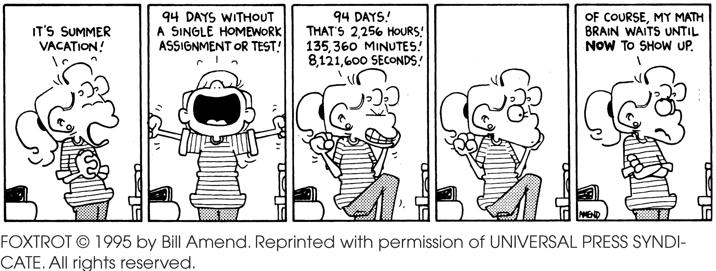
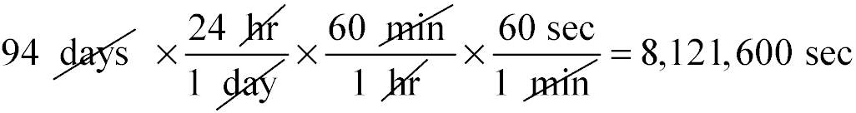
Using a Chain of Conversions

Slide 9
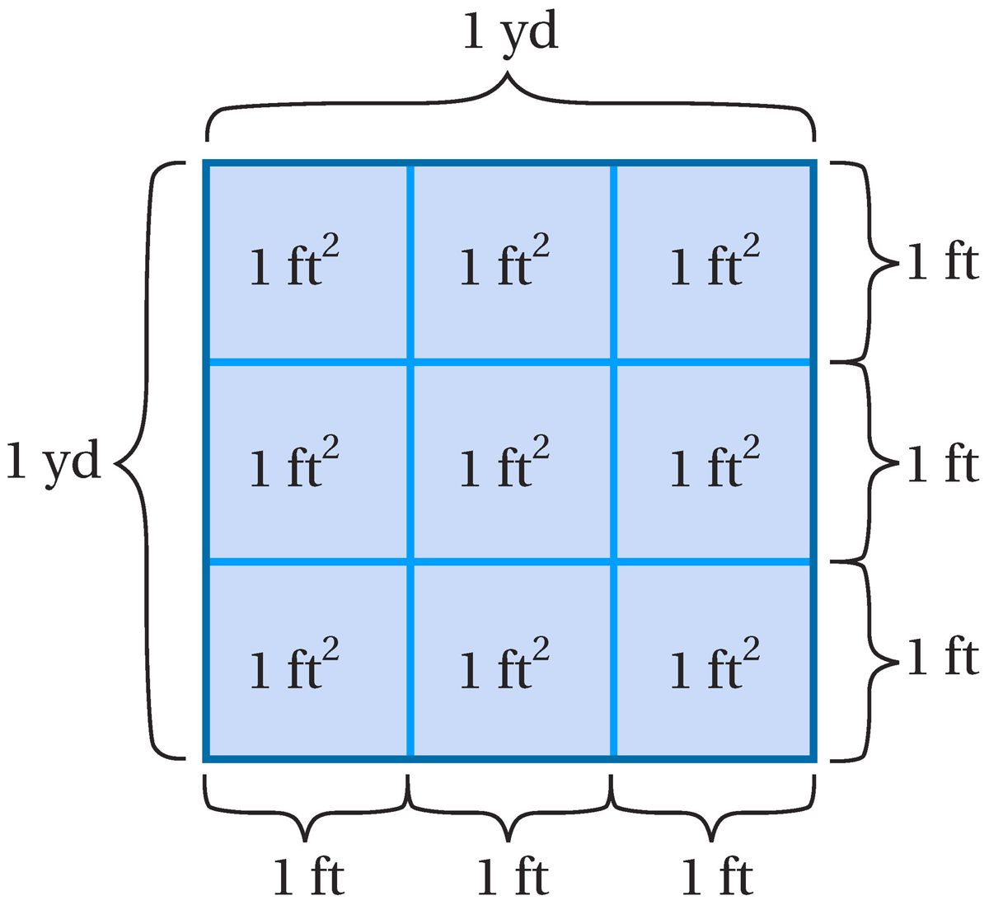
Conversions with Units Raised to Powers
1 yd = 3 ft
1 yd² = 1 yd × 1 yd
= 3 ft × 3 ft
= 9 ft²

Slide 10
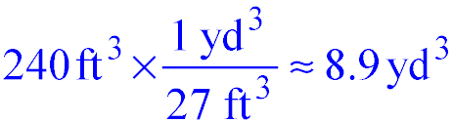
Example
How many cubic yards of soil are needed to fill a planter that is 20 feet long by 3 feet wide by 4 feet tall?
The volume is 20 ft × 3 ft × 4 ft = 240 ft³
1 yd = 3 ft, so (1 yd)³ = (3 ft)³ = 27 ft³

Slide 11
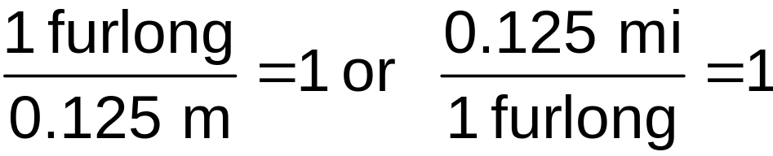
Example
The length of the Kentucky Derby horse race is 10 furlongs. How long is the race in miles?
Solution
See page 78 for Table 2.1, 1 furlong = 1/8 mi which is the same as 0.125 mile. We can write the conversion factor in two other equivalent forms:

Slide 12
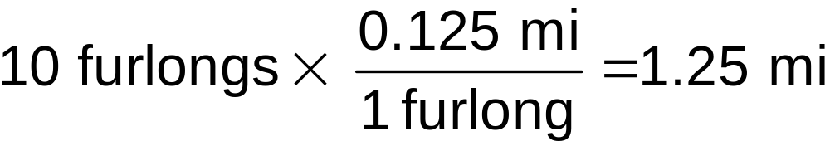
Example (cont)
The length of the Kentucky Derby horse race is 10 furlongs. How long is the race in miles?
The Kentucky Derby is a race of 1.25 miles.

Slide 13
Metric System
The international metric system was invented in France late in the 18th century for two primary reasons: (1) to replace many customary units with just a few basic units and (2) to simplify conversions through use of a decimal (base 10) system. The basic units of length, mass, time, and volume in the metric system are
• the meter for length, abbreviated m
• the kilogram for mass, abbreviated kg
• the second for time, abbreviated s
• the liter for volume, abbreviated L

Slide 14
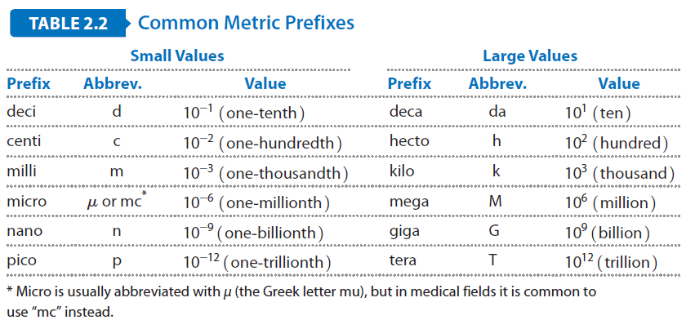
Common Metric Prefixes

Slide 15
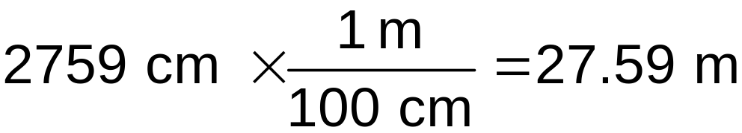
Example
Convert 2759 centimeters to meters.
Solution
Table 2.2 shows that centi means 10⁻² so
1 cm = 10⁻² m or, equivalently, 1 m = 100 cm. Therefore, 2759 centimeters is the same as

Slide 16
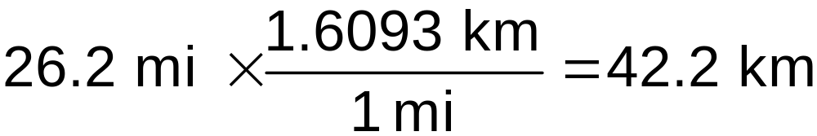
Example
The marathon running race is about 26.2 miles. About how far is it in kilometers?
Solution
Table 2.3 shows that 1 mi = 1.6093 km. We use the conversion in the form with miles in the denominator to find

Slide 17
Temperature Units
The Fahrenheit scale, commonly used in the United States, is defined so water freezes at 32°F and boils at 212°F.
The rest of the world uses the Celsius scale, which places the freezing point of water at 0°C and the boiling point at 100°C.

Slide 18
Temperature Units
In science, we use the Kelvin scale, which is the same as the Celsius scale except for its zero point, which corresponds to -273.15°C. A temperature of 0 K is known as absolute zero, because it is the coldest possible temperature. (The degree symbol [°] is not used on the Kelvin scale.)

Slide 19
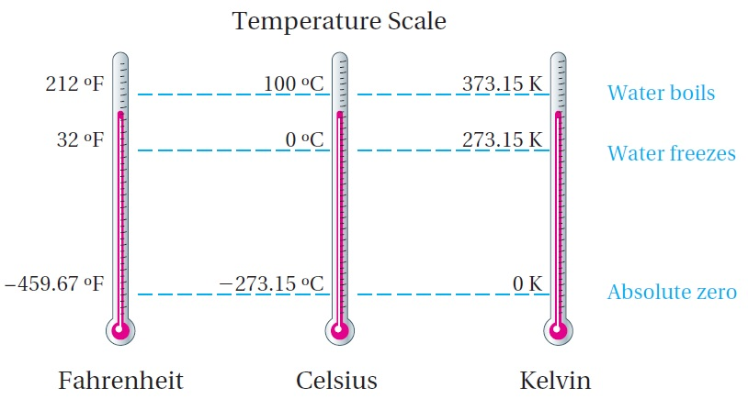
Temperature Units

Slide 20
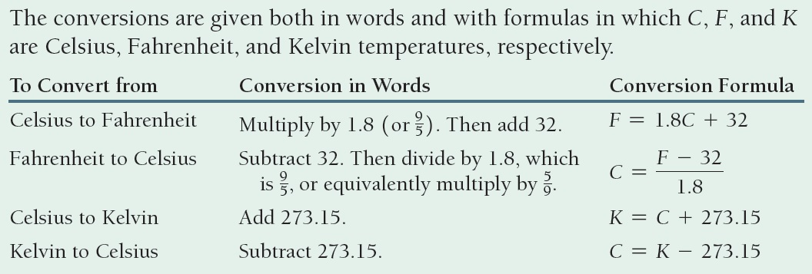
Temperature Conversions

Slide 21
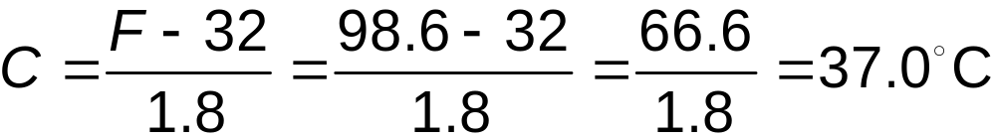
Example
Average human body temperature is 98.6°F. What is it in Celsius and Kelvin?
Solution
Convert from Fahrenheit to Celsius by subtracting 32 and then dividing by 1.8:
We find the Kelvin equivalent by adding 273.15 to the Celsius temperature:
K = C + 273.15 = 37 + 273.15 = 310.15 K

Slide 22
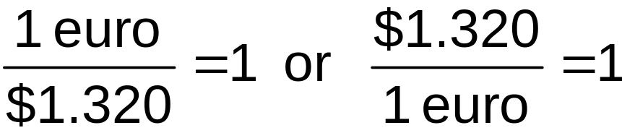
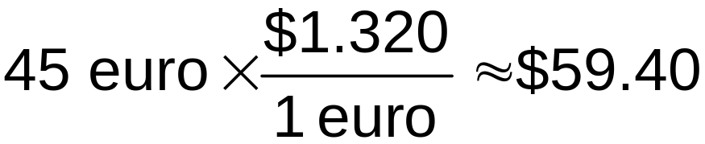
Example
At a French department store, the price for a pair of jeans is 45 euros. What is the price in U.S. dollars? Use the exchange rates in Table 2.4.
Solution
From the Dollars per Foreign column in Table 2.4, we see that 1 euro = $1.320. As usual, we can write this conversion factor in two other equivalent forms:

Slide 23
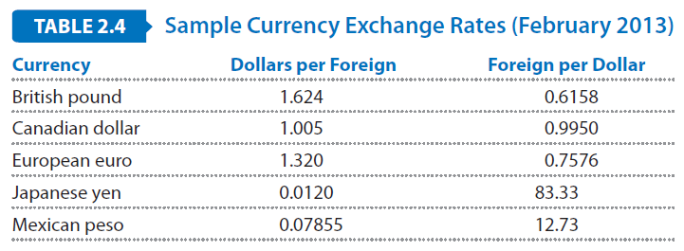
Currency Conversions
Converting between currencies is a unit
conversion problem in which the conversion factors are known as the exchange rates. Table 2.4 shows a typical table of currency exchange rates:

Slide 24
Example
A gas station in Canada sells gasoline for CAD 1.34 per liter. (CAD is an abbreviation for Canadian dollars.) What is the price in dollars per gallon? Use the currency exchange rate in Table 2.4.
Solution
We use a chain of conversions to convert from CAD to dollars and then from liters to gallons. From Table 2.4, the currency conversion is $1.005 per CAD, and from Table 2.3, there are 3.785 liters per gallon.

Slide 25
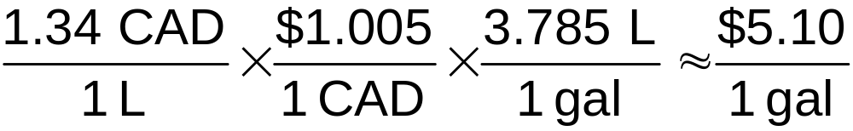
Example
A gas station in Canada sells gasoline for CAD 1.34 per liter. (CAD is an abbreviation for Canadian dollars.) What is the price in dollars per gallon? Use the currency exchange rate in Table 2.4.

