Slide 1
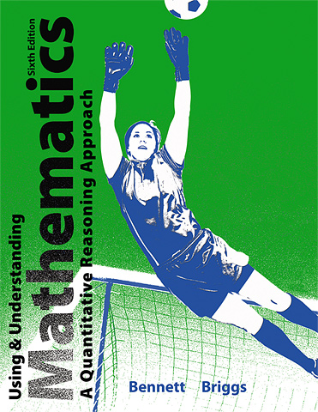

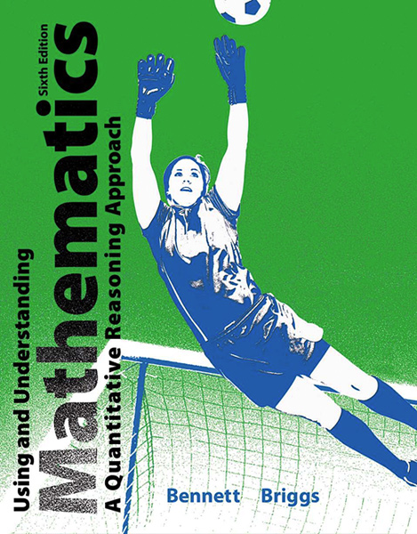
2
Approaches to Problem Solving

Slide 2
Unit 2B
Problem-Solving with Units

Slide 3
Unit Analysis in Problem Solving
Step 1. Identify the units involved in the problem and the units that you expect for the answer.
Step 2. Use the given units and the expected answer units to help you find a strategy for solving the problem. Be sure to perform all operations (such as multiplication or division) on both the numbers and their associated units.

Slide 4
Unit Analysis in Problem Solving
Remember:
• You cannot add or subtract numbers with different units, but you can combine different units through multiplication, division, or raising to powers.
• It is easier to keep track of units if you replace division with multiplication by the reciprocal. For example, instead of dividing by 60 s/min, multiply by 1 min/60 s.
Step 3. When you complete your calculations, make sure that your answer has the units you expected. If it doesn’t, then you’ve done something wrong.

Slide 5
Example
You are buying 30 acres of farm land at $12,000 per acre. What is the total cost?
Solution
Step 1. The question asks about total cost, and one of the given units is dollars, so we expect an answer in dollars.
Step 2. The key word of suggests multiplication, and we realize that we can end up with an answer in dollars by multiplying the acreage by the cost per acre:

Slide 6
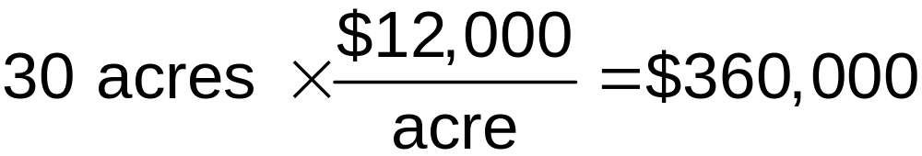
Example
You are buying 30 acres of farm land at $12,000 per acre. What is the total cost?
Step 3. We have found that the land costs $360,000. Note that the answer has come out with the units we expect.

Slide 7
Example
You are planning to make pesto and need to buy basil. At the grocery store, you can buy small containers of basil priced at $2.99 for each
2/3-ounce container. At the farmer’s market, you can buy basil in bunches for $12 per pound. Which is the better deal?
Solution
To compare the prices, we need them both in the same units.
Convert the small container price to a price per pound.

Slide 8
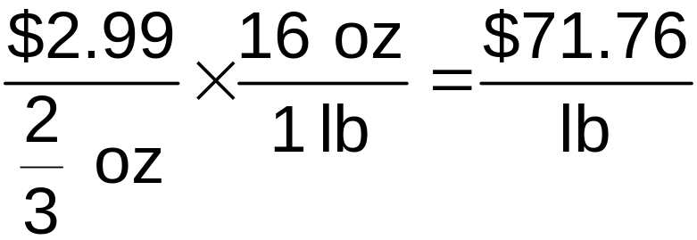
Example
The container price is $2.99 per 2/3 ounce, which means we need to divide. We then multiply by the conversion of 16 ounces per pound:
The small containers are priced at almost $72 per pound, which is six times as much as the farmer’s market price.

Slide 9
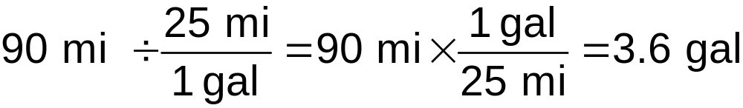
Example
Your destination is 90 miles away, and your fuel gauge shows that your gas tank is one-quarter full. Your tank holds 12 gallons of gas, and your car averages about 25 miles per gallon. Do you need to stop for gas?
Solution
You will need 3.6 gallons of gas for the 90-mile trip, but one-quarter of a 12-gallon tank is only 3 gallons. Therefore, you should stop for gas.

Slide 10
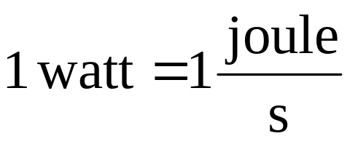
Units of Energy and Power
Energy is what makes matter move or heat up. International metric unit is the joule.
Power is the rate at which energy is used. International metric unit is the watt.
A kilowatt-hour is a unit of energy.
1 kilowatt-hour = 3.6 million joules

Slide 11
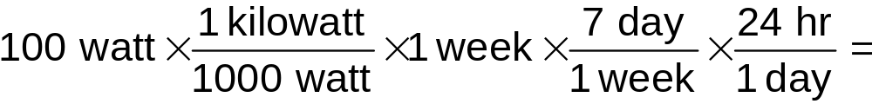

Operating Cost of a Light Bulb
A utility company charges 15¢ per kilowatt-hour of electricity. How much does it cost to keep a 100-watt light bulb on for a week? How much will you save in a year if you replace the bulb with an LED bulb that provides the same amount of light for only 25 watts of power?
Solution

Slide 12
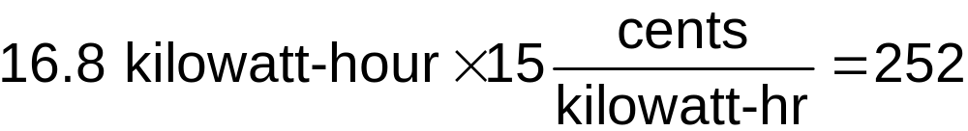

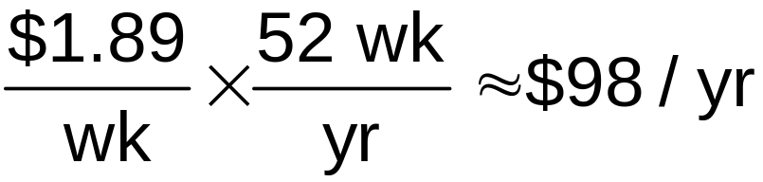
Operating Cost of a Light Bulb
Now find the cost.
The electricity for the bulb costs $2.52 per week. If you replace the 100-watt bulb with a 25-watt LED, you’ll use only 1/4 as much energy, which means your weekly cost will be only 63¢. In other words, your savings will be $2.52 - $0.63 = $1.89 per week, so in a year you’ll save about:

Slide 13
Units of Density and Concentration
Density describes compactness or crowding.
Material density is given in units of mass per unit volume.
  e.g., grams per cubic centimeter (g/cm³)
Population density is given by the number of people per unit area.
  e.g., people per square mile (people/mi²)
Information density is given in units of mass per unit volume.
  e.g., gigabytes per square inch (GB/in.²)

Slide 14
Units of Density and Concentration
Concentration describes the amount of one substance mixed with another.
The concentration of an air pollutant is often measured by the number of molecules of the pollutant per million molecules of air.
  e.g., parts per million (ppm)
Blood alcohol content (BAC) describes the concentration of alcohol in a person’s body.
  e.g., grams of alcohol per 100 milliliters of blood

Slide 15
Example
A child weighing 15 kilograms has a bacterial ear infection. A physician orders treatment with amoxicillin at a dosage based on 30 milligrams per kilogram of body weight per day, divided into doses every 12 hours.
a. How much amoxicillin should the child be prescribed every 12 hours?
b. If the medicine is to be taken in a liquid suspension with concentration 25 mg/ml, how much should the child take every 12 hours?

Slide 16
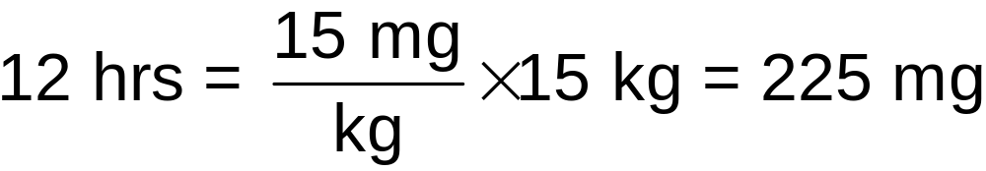
Example
a. How much amoxicillin should the child be prescribed every 12 hours?
The prescribed dosage is 30 mg/kg of body weight per day, but because it will be given in two doses (every 12 hours), each dose will be based on half of the total, or 15 mg/kg of body weight. Therefore, for a child weighing 15 kilograms, the dosage should be

Slide 17
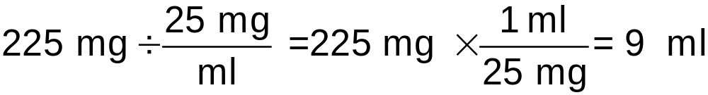
Example
b. If the medicine is to be taken in a liquid suspension with concentration 25 mg/ml, how much should the child take every 12 hours?
The liquid suspension contains 25 milligrams of amoxicillin per milliliter (ml) of liquid, and from part (a) we know the total amount of amoxicillin in each dose should be 225 mg. We are looking for the total amount of liquid that the child should be given for each dose, so the answer should have units of milliliters.

