Slide 1
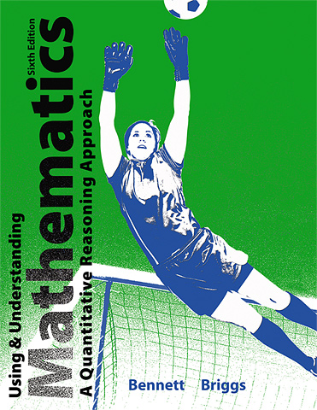

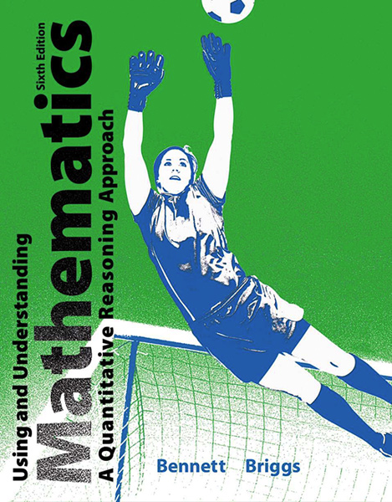
2
Approaches to Problem Solving

Slide 2
Unit 2C
Problem-Solving Guidelines and Hints

Slide 3
Four Step Problem-Solving Process
Step 1: Understand the problem.
Step 2: Devise a strategy for solving the problem.
Step 3: Carry out your strategy, and revise if necessary.
Step 4: Look back to check, interpret, and explain your result.
Notes:
Have the students apply the steps in working out a significant problem from section 2-C.

Slide 4
Four Step Problem-Solving Process:
Step 1
Step 1: Understand the problem.
Think about the context of the problem to gain insight into its purpose.
Make a list or table of the specific information given in the problem.
Draw a picture or diagram to help make sense of the problem.
Restate the problem in different ways to clarify the question.
Make a mental or written model of the solution.

Slide 5
Four Step Problem-Solving Process:
Step 2
Step 2: Devise a strategy for solving the problem.
Obtain needed information that is not provided in the problem statement.
Make a list of possible strategies and hints that will help you select your overall strategy.
Map out your strategy with a flow chart or diagram.

Slide 6
Four Step Problem-Solving Process:
Step 3
Step 3: Carry out your strategy, and revise it if necessary.
Keep an organized, neat, and written record of your work.
Double-check each step so that you do not risk carrying errors through to the end of your solution.
Constantly reevaluate your strategy as you work. Return to step 2 if you find a flaw in your strategy.

Slide 7
Four Step Problem-Solving Process:
Step 4
Step 4: Look back to check, interpret, and explain your result.
Be sure that your result makes sense.
Recheck calculations or find an independent way of checking the result.
Identify and understand potential sources of uncertainty in your result.
Write your solution clearly and concisely.
Consider and discuss any pertinent implications of your result.

Slide 8
Problem Solving Guidelines and Hints
Hint 1: There may be more than one answer.
Hint 2: There may be more than one strategy.
Hint 3: Use appropriate tools.
Hint 4: Consider simpler, similar problems.
Hint 5: Consider equivalent problems with simpler solutions.
Hint 6: Approximations can be useful.
Hint 7: Try alternative patterns of thought.
Hint 8: Do not spin your wheels.
Notes:
Choose several of the hints to discuss and challenge students with some thought-provoking problems.

Slide 9
Example
Tickets for a fundraising event were priced at $10 for children and $20 for adults. Shauna worked the first shift at the box office, selling a total of $130 worth of tickets. However, she did not keep a careful count of how many tickets she sold for children and adults. How many tickets of each type (child and adult) did she sell?
Solution
Try trial and error. Suppose Shauna sold just one $10 child ticket. In that case, she would have sold $130 - $10 = $120 worth of adult tickets.

Slide 10
Example (cont)
Because the adult tickets cost $20 apiece, this means she would have sold $120 ÷ ($20 per adult ticket) = 6 adult tickets.
We have found an answer to the question: Shauna could have collected $130 by selling 1 child and 6 adult tickets. But it is not the only answer, as we can see by testing other values.
For example, suppose she sold three of the $10 child tickets, for a total of $30. Then she would have sold $130 - $30 = $100 worth of adult tickets, which means 5 of the $20 adult tickets.

Slide 11
Example (cont)
We have a second possible answer—3 child and 5 adult tickets—and have no way to know which answer is the actual number of tickets sold. In fact, there are seven possible answers to the question. In addition to the two answers we’ve already found, other possible answers are 5 child tickets and 4 adult tickets; 7 child tickets and 3 adult tickets; 9 child tickets and 2 adult tickets; 11 child tickets and 1 adult ticket; and 13 child tickets with 0 adult tickets. Without further information, we do not know which combination represents the actual ticket sales.

Slide 12
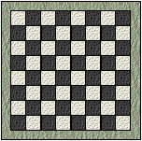
Example
Find the total number of possible squares on the chessboard by looking for a pattern.
Solution
Start with the largest possible square:
There is only one way to make an
8 x 8 square.
Notes:
It may be necessary to help students along in the problem-solving process by starting with a simpler problem in which the chessboard contains just 4, 9, or perhaps 16 squares. Emphasize the importance of searching for patterns when solving certain quantitative problems.

Slide 13
Example (cont)
Find the total number of possible squares on the chessboard by looking for a pattern.
Now, look for the number of ways to
make a 7 x 7 square.
There are only four ways.

Slide 14
Example (cont)
Find the total number of possible squares on the chessboard by looking for a pattern.
If you continue looking at 6 x 6, then
5 x 5 squares, and so on, you will see the perfect square pattern as indicated in the following table for this chessboard problem:

Slide 15
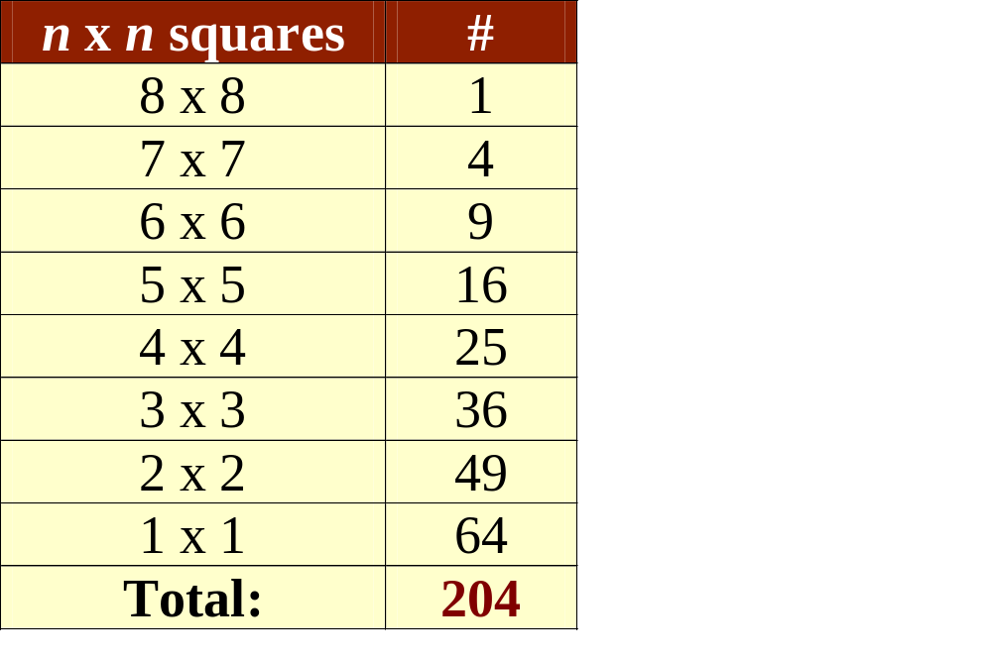
Example (cont)
Find the total number of possible squares on the chessboard by looking for a pattern.

