Slide 1

Poker Night
UCD Math Club
Spring 2016

Slide 2
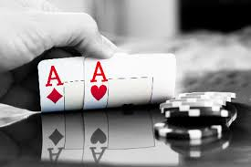
Event Details
Place and Time
Benefits
Event/Program Date:
Thur. Jan 28, 2016
Event/Program Time:
6:30 pm – 8:30pm
Event Location:
Academic Building Room 4021
Math Department
Evening event allows for more attendance
Space can accommodate up to 50 people

Slide 3
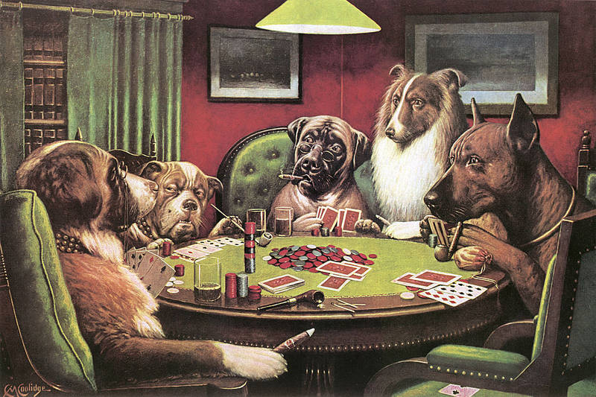
Goals
Engage the student body outside the mathematics field.
Foster connections among students through play
Discussion and hands-on activities will leave students contemplating what “poker” means.
Entertaining exploration of a fascinating and practical utilization of mathematical theory

Slide 4
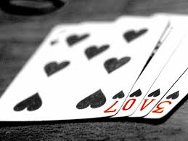
Itinerary
Detailed Itinerary
Dr. Burt Simon
6:30 pm - Sign-in
6:45 pm - Presentation by Dr. Simon
Brief Overview of Game Theory/Poker
7:15 pm - Games
Poker: Classic and “New”
8:30 pm - Cleanup
Applied Probabilist
Academic interests:
Evolutionary Biology
Simulation
Game theory
Queueing theory (optimization)

Slide 5
Itemized Budget
Estimated Minimum Attendance: 40
Name of Item | Price | Quantity | Total
Soda | $3.33 | 8 | $26.68
Sandwiches | $29.99 | 4 | $119.96
Veggies | $7.99 | 4 | $31.96
Starbursts | $2.29 | 12 | $27.48
Delivery fee | $11.00 | 1 | $11.00
Prizes | $35.00 | 1 | $35.00
Total Requested 252.08

Slide 6
Marketing
Social media advertising
Facebook
Orgsync
“Math-people” list serve announcement
Fliers
Math department TV’s

Slide 7

Success Criteria
Attendance numbers
Attendance from a variety of departments
We hope to draw in students from outside the Mathematics department - engage through play
Survey for interest in similar future events

