Slide 1
Analysis of Massive Graphs
DSCI 553

Slide 2
Outline
Different types of network.
How to create networks.
Work with Gephi.
Save, load, analyze.
Degree and degree centrality
Betweenness centrality.
Homework Discussion.

Slide 3
Different Types of Networks
Collaboration network
Retweet network
Mention network
Following-Follower network
Protein network
Depending on the network, you may need to incorporate different characteristics in the network.

Slide 4
What Characteristics?
Some networks are directed.
Some are weighted.
Some are undirected.
Some have different edge types.
Some have combination of two or more characteristics above!

Slide 5
How Can We Create Such Networks
Using networkx!
networkx supports different types of graphs with variety of analysis tools.
You can install networkx by simply doing:
  Pip install netowrkx
We will test this and make sure everyone has this installed and is able to work with it couple of slides later… (for now you can try to install it.)

Slide 6
Some Types of Graphs in Networkx
Graph
  Undirected graphs with self loops.
DiGraph
  Directed graphs with self loops.
MultiGraph
  Undirected graphs with self loops and parallel edges.
MultiDiGraph
  Directed graphs with self loops and parallel edges.

Slide 7
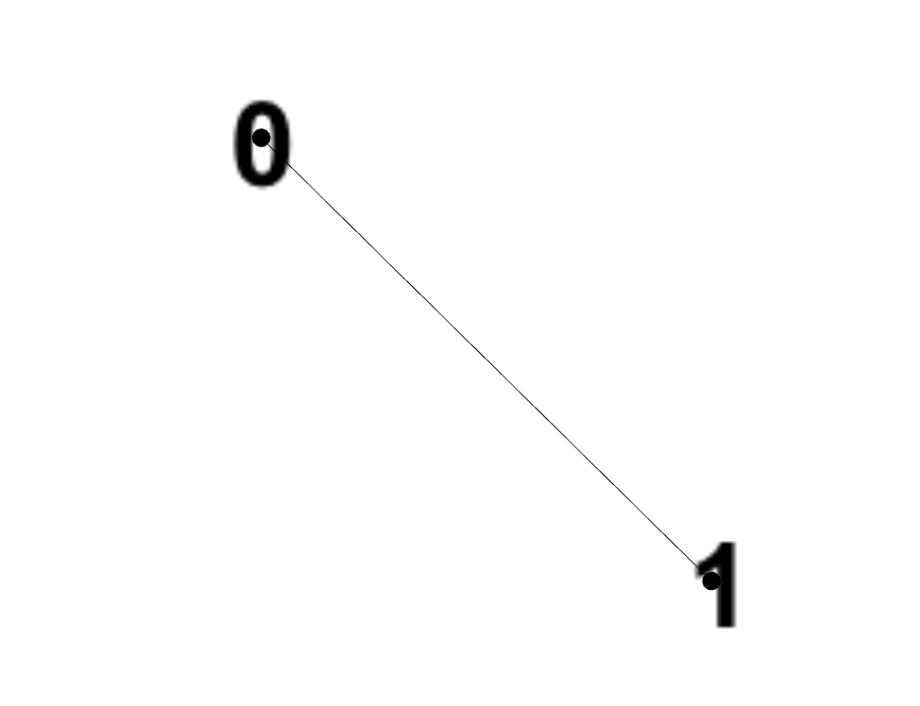
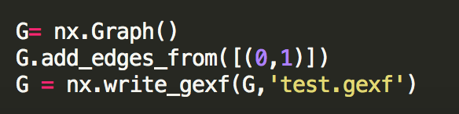
Graph

Slide 8

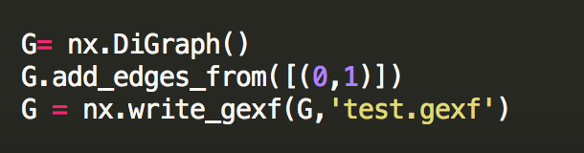
DiGraph

Slide 9
MultiGraph
Hard to visualize this type!
Different edges:
  0 and 1 can be friends and at the same time neighbors, so two types of edges and relations.

Slide 10
What Type is Correct Here?
Movie data
In this network nodes are actors and edges connecting actors that have appeared in a movie together.
What type of network will be appropriate to use here?
Notes:
Show them the data

Slide 11
Lets Create This Network!
Refer to code! (create_network.py)

Slide 12
Lets Use Gephi.
What is Gephi?
  “Gephi is the leading visualization and exploration software for all kinds of graphs and networks.”
  https://gephi.org/
Install Gephi
  https://gephi.org/users/install/
Gephi Tutorial

Slide 13
Load a Graph
To avoid creating the network everytime you can save and load graphs!
You want to calculate the total number of movies per actor and list the top five, but you do not want to recreate the network all over, so you just load the previously created graph.
Show the code. (movie_per_actor.py)
Notes:
Walk them step to step and show them the edges

Slide 14
Degree and Degree centrality
Degree: Number of edges touching a node.
Degree centrality: degree of a node/maximum possible degree (number of nodes in the network minus one)
Code
For degree: G.degree(v)
For degree centrality: nx.degree_centrality(G)

Slide 15
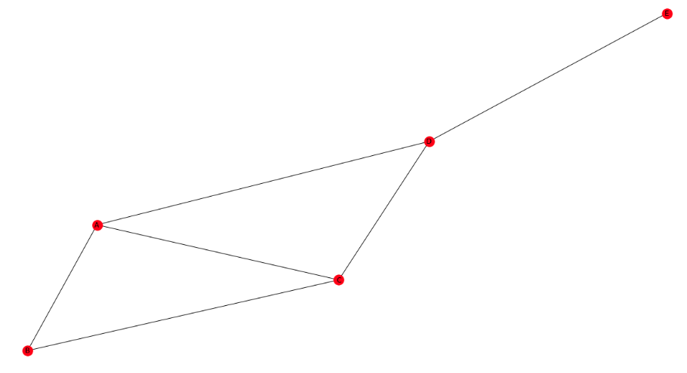
Exercise

Slide 16
Lets see its usefulness in live!
Which actor worked with many other actors?
Refer to code (active_actor.py)

Slide 17
Degree Distribution
In class you went over degree distribution.
Lets plot the degree distribution of our graph this time if the graph is a simple undirected graph!

Slide 18

Betweenness Centrality
Number of shortest paths that pass through a node.
You can also use networkx’s betweenness_centrality to achieve this.

Slide 19
What you need to do in the homework
For the first part of the homework
  You will need to create a retweet network
  Do some analysis based on the degree of the nodes (note in that case direction matters as we are dealing with a directed graph)
We will cover what needs to be done for the second part of the homework next week
Third part of the homework is just using gephi which was covered today.

Slide 20
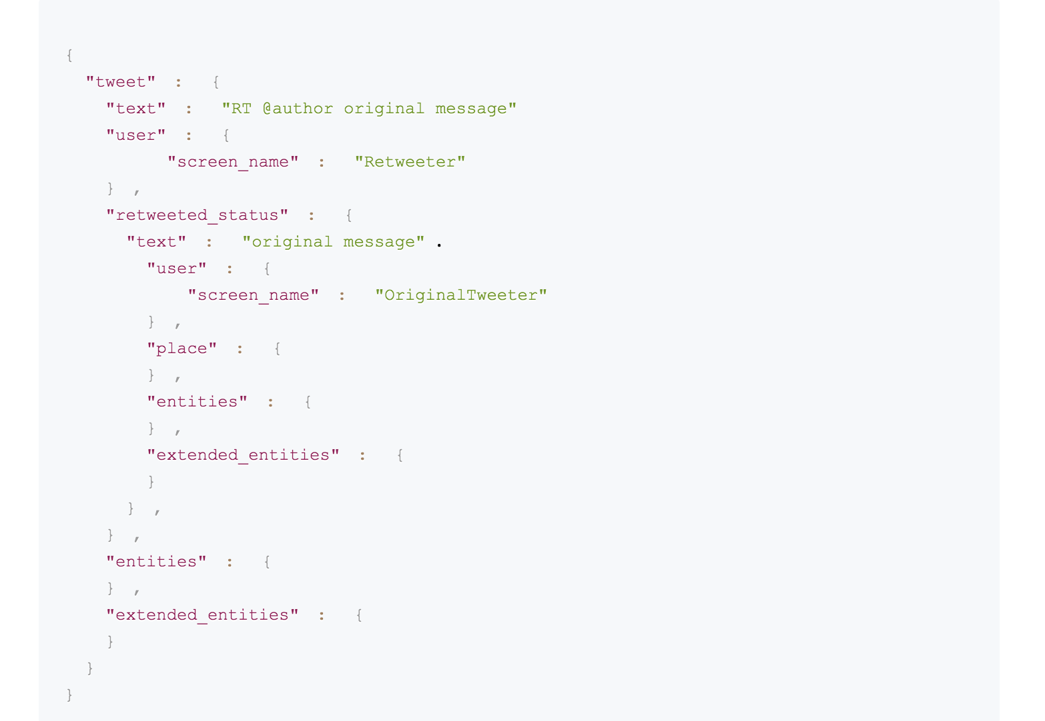
Other Types of Networks
Retweet Network
What would be its type?
Relation X retweets Y (edge between X source to Y target)

Slide 21
Next Time
We will discuss about community detection algorithms.
We will have a tutorial on training a text classifier.
These two sessions (today and next) will hopefully contain all you need to finish doing your homework.

Slide 22
References
The material of this lecture was partly adapted from Rhydian Lewis’s tutorial.

