Slide 1
EMOTION RECOGNITION IN DIALOGUE SYSTEMS
Notes:
Hello Everyone,
Topic for our project is “Emotion Recognition in Dialogue Systems”

Slide 2
PROBLEM STATEMENT
Conversation is multimodal
Facial expressions
Vocal tonality
Language
Gestures
Determining the emotions in a conversation by identifying the verbal and non-verbal cues
Notes:
Conversation in its natural form is multimodal. In dialogues, we rely on others’ facial expressions, vocal tonality, language, and gestures to anticipate their stance. Our project aims to identify the verbal and non-verbal cues and their impact in determining the emotion of a person during a conversation.

Slide 3
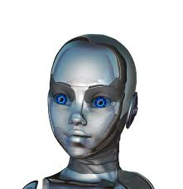
MOTIVATION
Artificial agents such as Alexa, Siri in our day-to-day life motivated us to add emotional cognitive ability for real time useful applications
Notes:
Working with artificial agents such as Cortana, Alexa, Siri, etc in our day to day life. It really motivated us to add emotional cognitive ability to the responses given by artificial agents.
Therefore we focus on multimodal learning of expression, which is used as emotional receptors in generative dialogue systems.

Slide 4
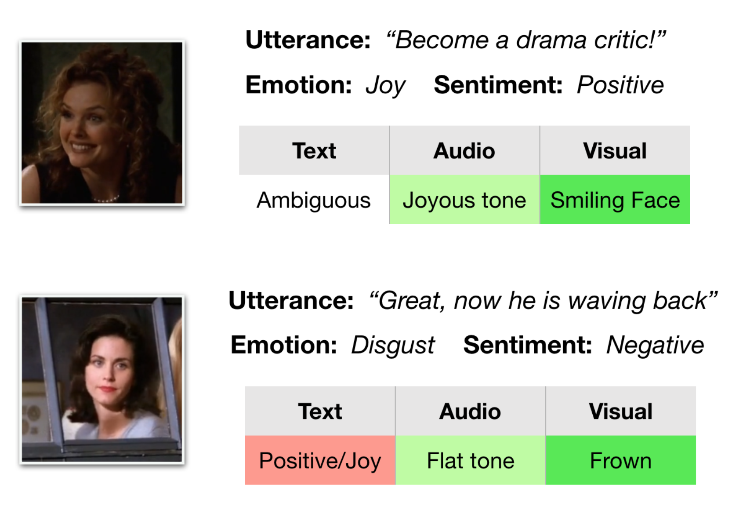
DATASET
Notes:
We are planning to utilize the dataset named Multimodal Emotion Lines Dataset (MELD.) .
It consists of audio and visual modality along with text from Friends TV series. As multiple speakers have participated in the dialogues, we feel that this will best match our requirements. For example if the utterance is “Great, now he is waving back” we will classify it using emotional receptors for all the three forms.

Slide 5




RESPONSIBILITIES
Disha
Emotion recognition for text utterances
Mehak
Emotion recognition for audio utterances
Rhushabh
Emotion recognition for video utterances
😡 🤢 😨 😂 😐 ☹️ 😱
Notes:
We, being a team of three, are planning to divide the responsibilities equally so that everyone will be able to analyze human communicative behaviors in social settings. We will use models for classifying the emotions into 7 categories - Anger, Disgust, Fear, Joy, Neutral, Sadness, Surprise.

Slide 6
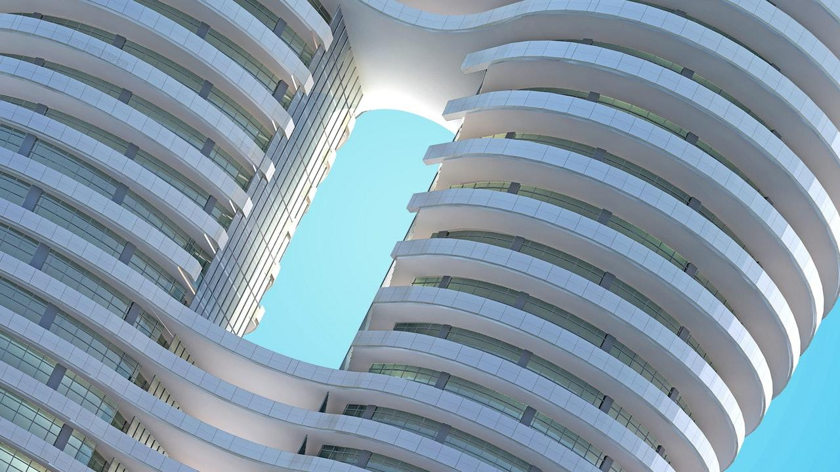
THANK YOU
Disha Kedige Chandrashekarachar
Mehak Piplani
Rhushabh Vaghela
Notes:
Thank you from my team Disha, Mehak and Rhushabh

