Slide 1
EMOTION RECOGNITION IN DIALOGUE SYSTEMS
Notes:
Hello everyone, we are team Emoexperts working on Emotion Recognition in Dialogue System. We will be presenting in the order Disha, Mehak and Rhushabh.

Slide 2
PROBLEM STATEMENT
Conversation is multimodal
Facial expressions
Vocal tonality
Language
Gestures
Determining the emotions in a conversation by identifying the verbal and non-verbal cues
Notes:
Conversation can itself be considered as multimodal in its natural form. In dialogues, we rely on others’ facial expressions, vocal tonality, language, and gestures to anticipate their stance. For emotion recognition, multi-modality becomes particularly important when the language is difficult to understand. In these cases, we resort to other modalities, such as prosodic and visual cues. Our project aims to identify the verbal and non-verbal cues for determining the emotion of a person during a conversation. We propose several strong multimodal baselines and show the importance of multimodal information for emotion recognition in conversations.

Slide 3

DATASET
MELD : Multimodal Emotion Lines Dataset
1400⁺ dialogues & 13000⁺ utterances from TV Show
The dataset is divided in three sets:
Train
Dev
Test
Notes:
For our project, we are utilizing MELD (Multimodal Emotion Lines Dataset) dataset which contains more than 1,400 dialogues and 13,000 utterances from FRIENDS TV show. The dataset is divided into Training, Testing and Development sets

Slide 4
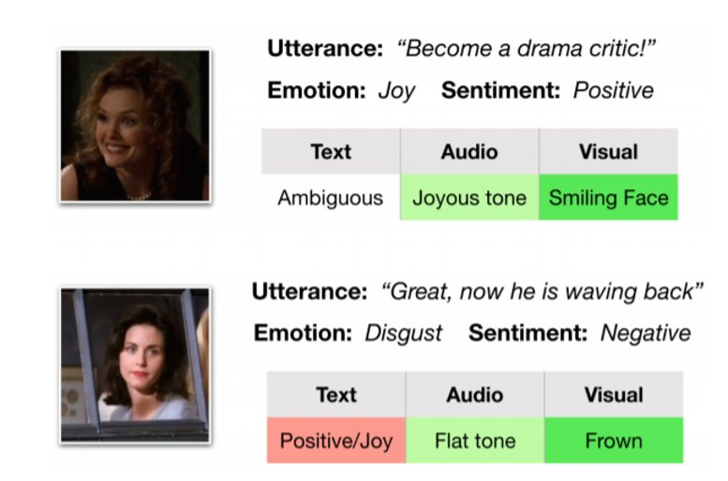
WHY MULTI-MODAL?
Fig 1: Importance of multimodal cues. Green shows primary modalities responsible for sentiment and emotion [1].
Notes:
This example from the dataset demonstrates the importance of multimodal cues. Green shows primary modalities responsible for sentiment and emotion. In order to make correct predictions of their emotions and sentiments, presence of multimodal signals in addition to the text is necessary. The utterance “Great, now he is waving back” has its actual emotion classified as “Disgust”. But if we just consider text modality, we might interpret it as “Joy” which is completely wrong. Therefore, a multimodal system is required for our system.

Slide 5
METHODOLOGY
Feature Extraction
Acoustic: openSMILE toolkit functionals and Dense representation using SVM.
Lexical: GOLVE and BERT Embeddings
Visual: Mean pooling across frames and LSTM encoder network embeddings.
Data Preprocessing
“Neutral" and "Joy" samples down-sampled
Augmentations: random rotation, shifts, shear and flips.
Notes:
Methodology, First step is feature extraction. For acoustic features, we used the openSMILE toolkit which extracts 6k-dimensional features from which Two representations were considered first, an L2-based feature selection (SVM) to get a dense representation and for the second only the functionals (Means, Centroid, Peaks, Segments) were considered. For Lexical: GOLVE and BERT Embeddings were extracted. For the visual features, average-pooling was used to merge the Resnet Features for each frame and LSTM encoder network embeddings were used.
Next preprocessing step, where we tried to create a class balanced dataset by down sampling examples for Neutral and Joy and data augmentation techniques for getting better visual features like random rotation, shifts, shear and flips.​

Slide 6
METHODOLOGY
Experimental Setup
ADAM optimizer and weighted cross-entropy loss
Epochs range 20 to 300 with Early Stopping
Acoustic features: Functionals
Lexical Features: BERT embeddings
Visual Features: Embeddings from LSTM encoder network
Evaluation Metrics: Class wise F1 score and Weighted F1 score
Notes:
For our experiments we have considered functionals as acoustic features, bert embeddings as lexical features and embeddings from LSTM encoder as visual features. And for testing these models two evaluation metrics were considered class wise F1 score and weighted F1 score.

Slide 7
METHODOLOGY
Multimodal Models
EARLY AND LATE Fusion using MLP Networks and CNN-LSTM Networks:
Additive Fusion techniques to serve as baselines
MLP Networks: 2-3 Linear layers with RELU
CNN-LSTM: 2 Convolution with 3 bi-directional LSTM
Tensor Fusion Network (Inspired from [2]):
Learns both the intra-modality and inter-modality dynamics end-to-end.
Inter-modality dynamics are modeled by fusing uni-modal, bi-modal and multi-modal interactions.
Intra-modality dynamics are modeled through Modality Embedding sub networks.
Notes:
For baselines we have considered early fusion and late fusion for two networks MLP networks and CNN-LSTM networks.
Next , Inspired from the work where TFN was used for sentiment analysis. Inter-modality dynamics are modeled with a new multimodal fusion approach, named Tensor Fusion, which explicitly aggregates uni-modal, bi-modal and multimodal interactions. Intra-modality dynamics are modeled through three Modality Embedding sub networks,

Slide 8
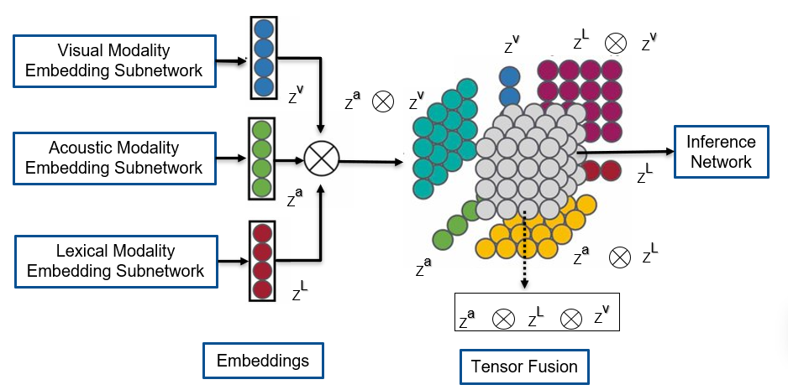
METHODOLOGY
Fig 3: Tensor Fusion Network
Notes:
Here is the visualization of the Network , language, visual and acoustic modality Embedding sub networks, are composed of CNN - Bidirectional LSTM layers. Then, the tensors are fused by an outer product which has no learnable parameters forming the fusion later. The final component of the network is an inference sub network made of linear layers for emotion inference.

Slide 9
METHODOLOGY
Multimodal Models
Dialogue RNN (Inspired from [3]):
Three major aspects relevant to the emotion in a conversation:
speaker, context from preceding utterances & emotion of preceding utterances.
Employs three gated recurrent units (GRU): Global, Party, and Emotion
Global state aims to capture the context of a given utterance
Party State are representative of the speakers’ state in the conversation
Emotion GRU: Inference
Notes:
Inspired by Dialogue RNN modelled for emotion recognition for the dataset IEMOCAP, we chose to explore this model as it models context by tracking individual speaker states, preceding utterance and emotion throughout the conversation for emotion classification. It employs three stages of gated recurrent units (GRU): Global GRU, Party GRU, and Emotion GRU.

Slide 10
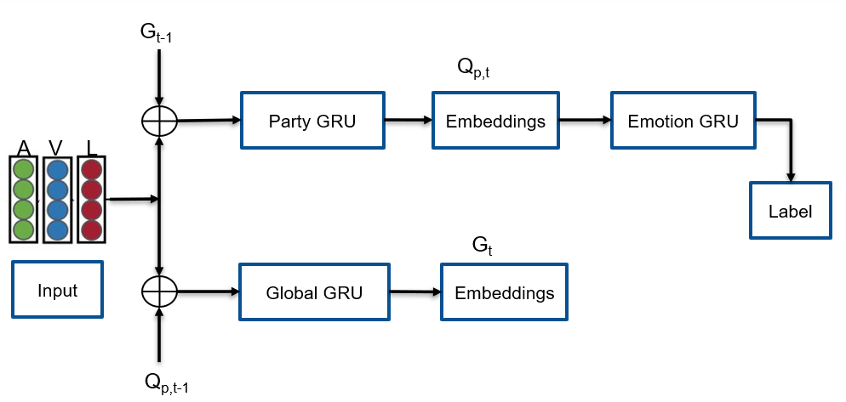
METHODOLOGY
Fig 4: Dialogue RNN
Notes:
To understand the working of the model, we can see a simplistic diagram of the network.
In each turn, the party GRU maintains a speaker’s characteristic state by updating its state based on the utterance spoken features, the speaker’s previous state, and the conversational context summarized by the global GRU of the previous step and The Global GRU updates the context of the utterance based on previous state and current speaker state. Finally, the updated speaker state is fed into the emotion GRU which models the emotional information for classification.

Slide 11
RESULTS
Uni-Modal test-set class wise & weighted F1-score results comparison
Notes:
For Acoustic uni-modal network, our MLP network outperforms the SOTA for emotions Anger, Surprise and Sadness and give a close weighted F1 score due to improved features and technique of Class balancing and weighted loss

Slide 12
RESULTS
Uni-Modal test-set class wise & weighted F1-score results comparison
Notes:
For lexical uni-modal network, SOTA model gives a very high f1 score for Neutral class due to the imbalance in the number of training samples, whereas our model achieves similar results for all classes .

Slide 13
RESULTS
Uni-Modal test-set class wise & weighted F1-score results
Notes:
For Visual uni-modal network, we observed that Neutral has a low f1 score due to the ambiguity in the cues.

Slide 14
RESULTS
Models | Modality | Anger | Joy | Surprise | Sadness | Neutral | Weighted F1
MLP + Early Fusion | Acoustic + Lexical | 0.50 | 0.37 | 0.29 | 0.47 | 0.49 | 0.46
MLP + Late Fusion | Acoustic + Lexical | 0.51 | 0.52 | 0.38 | 0.61 | 0.59 | 0.52
Dialogue RNN [1] | Acoustic + Lexical | 0.48 | 0.53 | 0.48 | 0.20 | 0.77 | 0.61
MLP + Early Fusion | Visual + Lexical | 0.32 | 0.44 | 0.19 | 0.32 | 0.27 | 0.31
MLP + Late Fusion | Visual + Lexical | 0.22 | 0.10 | 0.18 | 0.41 | 0.14 | 0.20
MLP + Early Fusion | Visual + Acoustic | 0.31 | 0.46 | 0.19 | 0.34 | 0.23 | 0.31
MLP + Late Fusion | Visual + Acoustic | 0.35 | 0.19 | 0.15 | 0.17 | 0.25 | 0.23
Uni-modal Results
Table 2: Bi-Modal test-set class wise & weighted F1-score results
Notes:
For bi-modality models, we observe that the SOTA model outperforms our Late fusion Model. A key observation here is that it achieves a very low f1 score for Sadness as compared to our. For models using visual modality early fusion seems to work better than late fusion may be because of ...

Slide 15
RESULTS
Models | Anger | Joy | Surprise | Sadness | Neutral | Weighted F1
MLP + Early Fusion | 0.51 | 0.51 | 0.37 | 0.48 | 0.52 | 0.49
MLP + Late Fusion | 0.51 | 0.54 | 0.58 | 0.41 | 0.61 | 0.54
CNN-LSTM + Early Fusion | 0.52 | 0.53 | 0.40 | 0.47 | 0.51 | 0.51
CNN-LSTM + Late Fusion | 0.53 | 0.56 | 0.59 | 0.40 | 0.62 | 0.55
TFN* | 0.44 | 0.52 | 0.36 | 0.61 | 0.57 | 0.50
Dialogue RNN* | 0.75 | 0.27 | 0.43 | 0.48 | 0.53 | 0.59
* - our implementation
Table 3: Multi-Modal test-set class wise & weighted F1-score results
Notes:
These are our multi-modal networks and we found Dialogue Rnn outperforms all the other models

Slide 16
OBSERVATIONS
Our best model: Dialogue RNN
Down sampling with weighted loss performs better than Up sampling..
Batch Normalization improved the multimodal model's results.
Down sampling Neutral class prevented misclassification of other classes.
Notes:
Observations: As suggested by the professor, we experimented with Downsampling with weighted-loss and found that it performed better than upsampling. Another interesting thing we observed is that Batch Normalization improved multimodal network’s results but didn’t have much effect in uni-modal networks. When we compared the DialogueRNN model from MELD paper, we observed that neutral class has more F1 score as compared to others, so to counter this problem we down-sampled “Neutral” class to avoid misclassification of other classes.

Slide 17
LESSONS LEARNT
Additive fusion techniques like early fusion and late fusion rely on figuring out relative emphasis on different modalities. However, in the real world, not every modality is reliable due to noises like sensor noise, etc.
Tensor Fusion explicitly models uni-modal, bi-modal and multi-modal interactions but Late Fusion perform better may be due to contradictory examples.
Dialogue RNN captures inter-speaker influence by keeping track of the individual party states and global context state throughout the conversation.
Notes:
Additive fusion techniques like early fusion and late fusion rely on figuring out relative emphasis on different modalities. However, in the real world, not every modality is reliable due to noises like sensor noise, etc.
We also understood how Tensor Fusion explicitly models uni-modal, bi-modal and multi-modal interactions but we found Late Fusion’s performance better. This may be due to contradictory examples or complexity of model. Lastly, we found that to determine an emotion for an utterance, we require the context, state of the speaker, state of the previous speaker, and emotion of the previous speaker. Dialogue RNN captures all these aspects efficiently by maintaining individual party states and global context state throughout the conversation.​

Slide 18
Conclusion
Lexical uni-modal networks achieve the highest F1 score as they capture the context in a conversation for emotion recognition.
Few sentences could have ambiguous context. Acoustic features when combined with lexical can help resolve ambiguity.
There could be contradictory cues in the two modalities. Hence, we rely on multimodal interactions that can determine emotion by capturing the facial expressions, tone, context, and other cues.
Notes:
Lexical uni-modal networks achieve the highest F1 score as they capture the context in a conversation for emotion recognition. But these conversations could be ambiguous like we saw in the sample before. To handle this, we experimented with various bi-modal networks and found that acoustic features when combined with lexical handle this Best. We also observed cases where there were contradictory cues in these two modalities, so we shifted to multimodal networks. We concluded that these multimodal interactions have the ability to capture the facial expressions, tone, context, and other cues. Which can determine the emotion label efficiently.

Slide 19
References
[1] Poria, S. (2018, October 5). MELD: A Multimodal Multi-Party Dataset for Emotion Recognition in Conversations. ArXiv.Org. https://arxiv.org/abs/1810.02508
[2] Sahay, S. (2018, June 7). Multimodal Relational Tensor Network for Sentiment and Emotion Classification. ArXiv.Org. https://arxiv.org/abs/1806.02923
[3] Majumder, N. (2018, November 1). DialogueRNN: An Attentive RNN for Emotion Detection in Conversations. ArXiv.Org. https://arxiv.org/abs/1811.00405
Notes:
Our experiments were based on these references.

Slide 20




RESPONSIBILITIES
Disha
Lexical Uni-modal model
Lexical + Visual Bi-modal
model
Early and Late Fusion MLP Multimodal Networks
Mehak
Acoustic Uni-modal model
Lexical + Acoustic Bi-modal model
Tensor Fusion Network
Early and Late Fusion CNN-LSTM Multimodal Networks
Rhushabh
Visual Uni-modal model
Acoustic + Visual Bi-modal
model
Dialogue RNN Multimodal Network
Data Preprocessing and Feature extraction was performed by everyone
Notes:
Here are our responsibilities

Slide 21

THANK YOU
Mehak Piplani
Disha Kedige Chandrashekarachar
Rhushabh Vaghela
Notes:
Thank you.

Slide 22
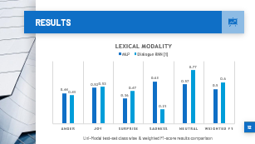
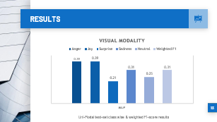
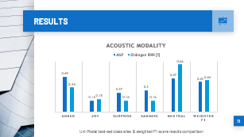
RESULTS
Notes:
From the above results we can see, that the weighted average for Lexical modal is much better than Acoustic and Visual Modal for Uni-Modals. And Acoustic + Lexical modal did much better in terms of Early fusion and Late fusion for Bi-Modals.

Slide 23
RESULTS
Models | Modality | Anger | Joy | Surprise | Sadness | Neutral | Weighted F1
MLP | Acoustic | 0.49 | 0.16 | 0.27 | 0.30 | 0.47 | 0.423
Dialogue RNN [1] | Acoustic | 0.34 | 0.18 | 0.16 | 0.16 | 0.66 | 0.44
MLP | Lexical | 0.44 | 0.52 | 0.36 | 0.61 | 0.57 | 0.50
Dialogue RNN [1] | Lexical | 0.41 | 0.53 | 0.47 | 0.21 | 0.77 | 0.60
MLP | Visual | 0.39 | 0.39 | 0.21 | 0.31 | 0.25 | 0.31
Table 1: Uni-Modal test-set class wise & weighted F1-score results
Notes:
From the above results we can see, that the weighted average for Lexical modal is much better than Acoustic and Visual Modal for Uni-Modals. And Acoustic + Lexical modal did much better in terms of Early fusion and Late fusion for Bi-Modals.

Slide 24
FUTURE WORK
Explore variations of Dialogue RNN and TFN
Inspect and mitigate gender bias ( if any)
Inspect for bias due to enacted emotions and see if models perform on spontaneous emotions
Notes:
After exploring the context of the conversation through glove embeddings, we plan to extract interlocutor state, and the preceding and future emotions to improve the efficiency of our models. The current state of the art method: DialogueRNN will be explored since it captures context by tracking individual speaker states throughout a conversation to effectively emotion emotional states. Fusion techniques like Multilogue-Net and Tensor fusion networks will be explored which try to capture the interactions between all the three modalities to predict the emotions. We also plan to inspect if there is gender bias in the dataset and take steps to handle it. Last, we also plan to check for bias due to enacted emotions and see if our models perform efficiently in a conversation possessing spontaneous emotions.

Slide 25
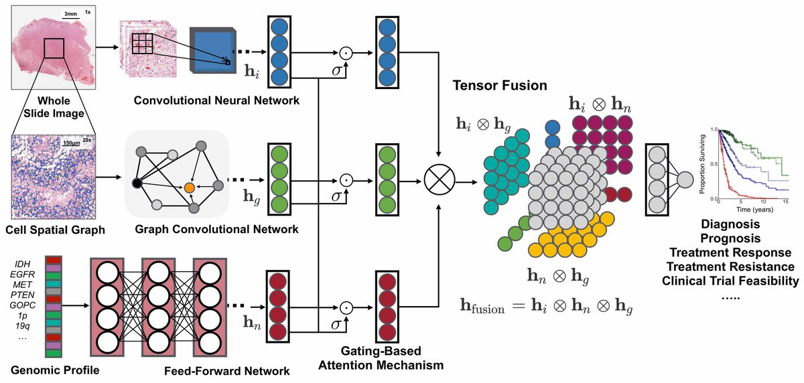
Model Design 1
Visual Modality Embedding Subnetwork
_{Z}^{v}
_{Z}^{L}
_{Z}^{v}
_{Z}^{v}
_{Z}ª
_{Z}^{v}
Acoustic Modality Embedding Subnetwork
Inference Network
_{Z}^{L}
_{Z}ª
Lexical Modality Embedding Subnetwork
_{Z}^{L}
_{Z}ª
_{Z}ª
_{Z}^{L}
_{Z}^{L}
_{Z}^{v}
_{Z}ª
Embeddings
Tensor Fusion
Notes:
The lessons we learnt are : Emotion for a dialogue predominantly depends on 4 factors interlocutor state, interlocutor intent, the preceding and future emotions, and the context of the conversation. The context has been captured by the glove embeddings which lead to higher and class balanced F1-score. Additive fusion techniques like early fusion and late fusion rely on figuring out relative emphasis on different modalities. However, in the real world, not every modality is reliable due to sensor noise, etc. Inter-speaker influence is a key aspect in determining emotion as people tend to change their responses and behaviour based on the response from the person they are conversing to.

Slide 26
Model Design 2
G_{t-1}
Q_{p,t}
Party GRU
Embeddings
Emotion GRU
A V L
Label
G_{t}
Input
Global GRU
Embeddings
Q_{p,t-1}
Notes:
The lessons we learnt are : Emotion for a dialogue predominantly depends on 4 factors interlocutor state, interlocutor intent, the preceding and future emotions, and the context of the conversation. The context has been captured by the glove embeddings which lead to higher and class balanced F1-score. Additive fusion techniques like early fusion and late fusion rely on figuring out relative emphasis on different modalities. However, in the real world, not every modality is reliable due to sensor noise, etc. Inter-speaker influence is a key aspect in determining emotion as people tend to change their responses and behaviour based on the response from the person they are conversing to.

