Slide 1
EMOTION RECOGNITION IN DIALOGUE SYSTEMS
Notes:
Hello everyone, we are team Emoexperts working on Emotion Recognition in Dialogue System. We will be presenting in the order Disha, Rhushabh, and Mehak.

Slide 2
PROBLEM STATEMENT
Conversation is multimodal
Facial expressions
Vocal tonality
Language
Gestures
Determining the emotions in a conversation by identifying the verbal and non-verbal cues
Notes:
Conversation can itself be considered as multimodal in its natural form. In dialogues, we rely on others’ facial expressions, vocal tonality, language, and gestures to anticipate their stance. For emotion recognition, multi-modality becomes particularly important when the language is difficult to understand. In these cases, we resort to other modalities, such as prosodic and visual cues. Our project aims to identify the verbal and non-verbal cues and their impact in determining the emotion of a person during a conversation.

Slide 3

DATASET
MELD : Multimodal Emotion Lines Dataset
1400⁺ dialogues & 13000⁺ utterances from TV Show
The dataset is divided in three sets:
Train
Dev
Test
Notes:
For our project, we are utilizing MELD (Multimodal Emotion Lines Dataset) dataset which contains more than 1,400 dialogues and 13,000 utterances from FRIENDS TV show. The dataset is divided into Training, Testing and Development sets.
Multiple speakers (aged 25 to 32 yrs) enacted these dialogues with 6 main characters. Each utterance in dialogue has been labeled by an emotion from Anger, Disgust, Sadness, Joy, Neutral, Surprise, and Fear.

Slide 4
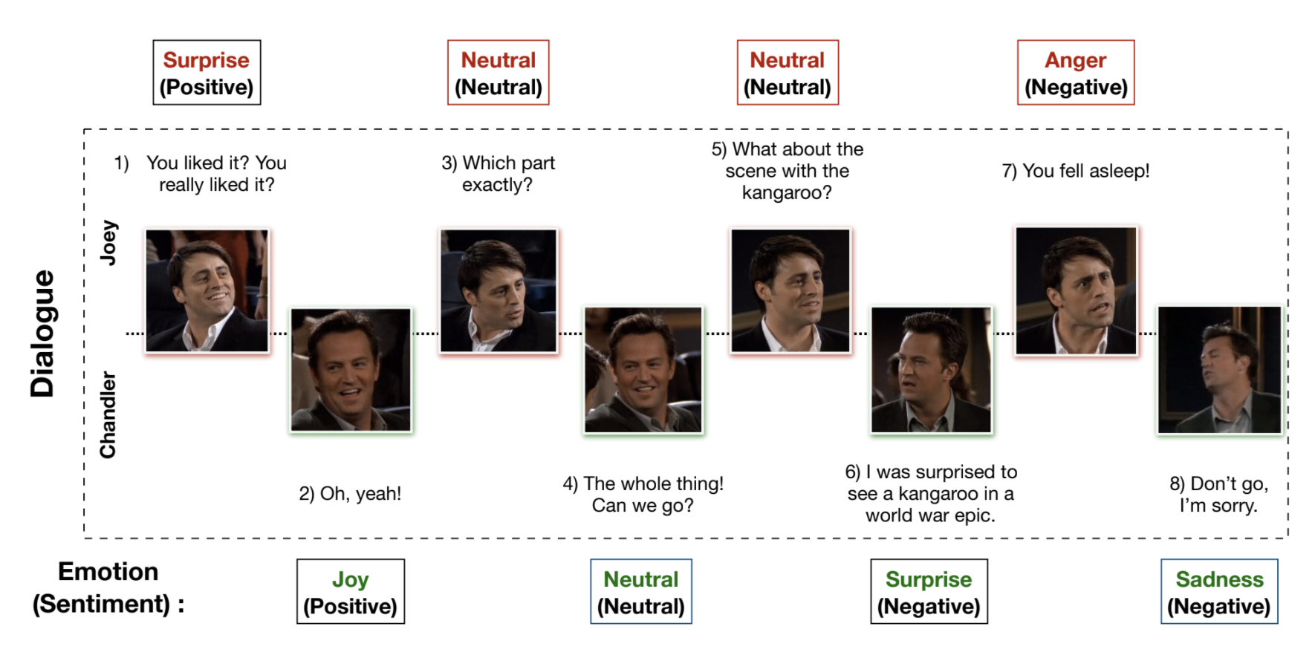
😱
😐
😐
😡
😂
😐
😱
☹️
MELD: A Multimodal Multi-Party Dataset for Emotion Recognition in Conversations
Notes:
Following Image shows an example of a conversation from the dataset showcasing the modalities : lexical, and visual. We can also observe an emotion shift from surprise to sadness in a single conversation. Here as we can see, In a conversation between two characters, “Joey” and “Chandler”, Chandler’s emotion changed from “Joy” to “Sadness” within a conversation. We can say that, the emotional dynamics here depend on both the previous utterances and their associated emotions.

Slide 5
STATISTICAL ANALYSIS
STATISTICS | TRAIN | DEV | TEST
# of unique words | 10,643 | 2,384 | 4,361
Avg. utterance length | 8.0 | 7.0 | 8.2
Max utterance length | 69 | 37 | 45
# of dialogues | 1039 | 114 | 280
# of utterances | 9989 | 1109 | 2610
# of speakers | 260 | 47 | 100
# of emotion shift | 4003 | 427 | 1003
Avg. duration of an utterance | 3.59s | 3.59s | 3.58s
Dataset statistics
Notes:
We analyzed the dataset statistically and made the certain key observations as shown in the Table like average duration of an utterance is 3.59s. When we visualized the distribution of the class labels, we found Neutral has the highest number of training as well as testing sample whereas Fear and Disgust emotion have the least number of samples.

Slide 6
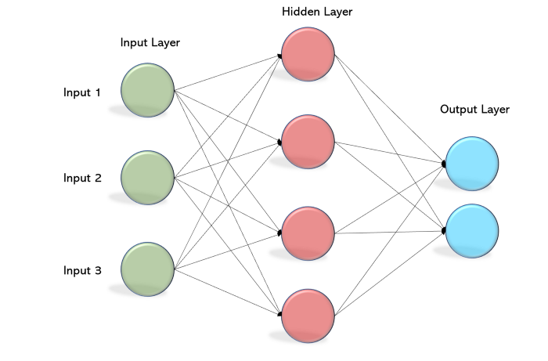
METHODOLOGY
Data Preprocessing
“Neutral" and "Joy" samples down-sampled
“Sadness“ samples up-sampled
Models
Uni-modal models using Multi-Layer Perceptron (MLP) networks
Bi-modal networks for these modalities pairwise via early fusion and late fusion
Experimental Setup
ADAM optimizer and cross-entropy loss
Epochs range 20 to 300 with Early Stopping
Notes:
We followed a three step process for our experiments. First, the preprocessing step, where we tried to create a class balanced dataset by down sampling examples for Neutral" and "Joy" class and up sampling for sadness. For the next step, we build Uni-modality models using Multi-Layer Perceptron networks and Bi-modality models for different combinations of modalities using Early fusion and Late fusion. For training these models we used ADAM optimizer and cross-entropy loss. The training was carried on for epochs ranging from 20 to 300 along with Early Stopping. And for testing these models two evaluation metrics were considered class wise F1 score and weighted F1 score.

Slide 7
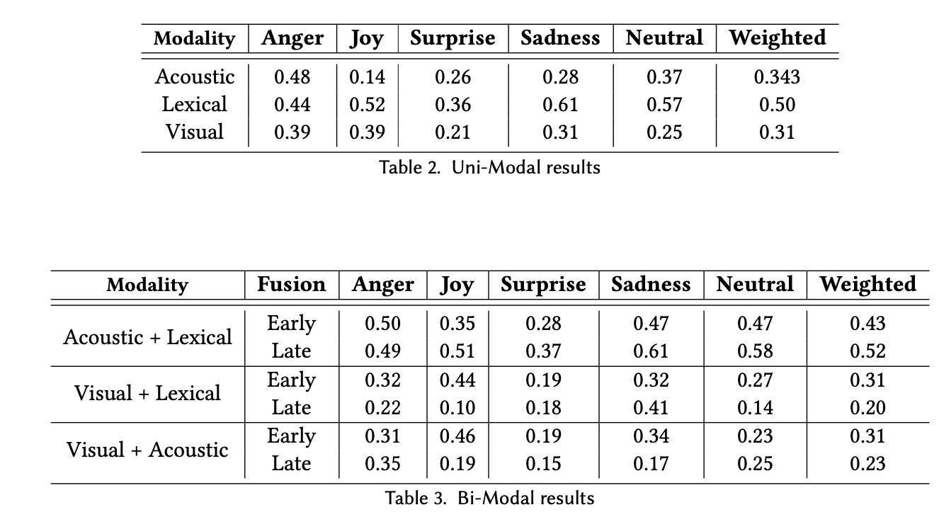
RESULTS
Uni-modal Results
Bi-modal Results
Notes:
From the above results we can see, that the weighted average for Lexical modal is much better than Acoustic and Visual Modal for Uni-Modals. And Acoustic + Lexical modal did much better in terms of Early fusion and Late fusion for Bi-Modals.

Slide 8
OBSERVATIONS
Pre-processing techniques: Up sampling and Down sampling improved the F1-score making it class balanced.
While testing the acoustic model, we observed that joy was getting misclassified to anger.
Batch Normalization improved the acoustic model's results drastically whereas lexical model's results didn't show any major difference.
Early Fusion model of Acoustic-Lexical modality pair outperformed all the other models.
Notes:
We made the following observation from our experiments: Pre-processing techniques: Upsampling and Downsampling improved the F1-score making it class balanced. While testing the acoustic model, we observed that joy was getting misclassified to anger.
\ Batch Normalization improved the acoustic model's results drastically whereas lexical model's results didn't show any major difference. Early Fusion model of Acoustic-Lexical modality pair outperformed all the other models.

Slide 9
LESSONS LEARNT
Glove embeddings capture the context leading to higher F1-score.
Disgust and Fear are complex emotions.
Additive fusion techniques like early fusion and late fusion rely on figuring out relative emphasis on different modalities.
Inter-speaker influence is a key aspect in determining emotion.
Notes:
The lessons we learnt are : Emotion for a dialogue predominantly depends on 4 factors interlocutor state, interlocutor intent, the preceding and future emotions, and the context of the conversation. The context has been captured by the glove embeddings which lead to higher and class balanced F1-score. Additive fusion techniques like early fusion and late fusion rely on figuring out relative emphasis on different modalities. However, in the real world, not every modality is reliable due to sensor noise, etc. Inter-speaker influence is a key aspect in determining emotion as people tend to change their responses and behaviour based on the response from the person they are conversing to.

Slide 10
FUTURE MILESTONES
Explore the current state of art method: DialogueRNN
Explore various fusion techniques: Multilogue-Net and Tensor Fusion Networks
Inspect and mitigate gender bias ( if any)
Inspect for bias due to enacted emotions and see if models perform on spontaneous emotions
Notes:
After exploring the context of the conversation through glove embeddings, we plan to extract interlocutor state, and the preceding and future emotions to improve the efficiency of our models. The current state of the art method: DialogueRNN will be explored since it captures context by tracking individual speaker states throughout a conversation to effectively emotion emotional states. Fusion techniques like Multilogue-Net and Tensor fusion networks will be explored which try to capture the interactions between all the three modalities to predict the emotions. We also plan to inspect if there is gender bias in the dataset and take steps to handle it. Last, we also plan to check for bias due to enacted emotions and see if our models perform efficiently in a conversation possessing spontaneous emotions.

Slide 11




RESPONSIBILITIES
Disha
Lexical Uni-modal model
Lexical + Visual Bi-modal
model
Mehak
Acoustic Uni-modal model
Lexical + Acoustic Bi-modal model
Statistical Analysis
Rhushabh
Visual Uni-modal model
Acoustic + Visual Bi-modal model
Data Preprocessing and Feature extraction was performed by everyone
Notes:
We divided the responsibilities based on modality.
Data Preprocessing and Feature extraction was performed by everyone

Slide 12

THANK YOU
Disha Kedige Chandrashekarachar
Mehak Piplani
Rhushabh Vaghela
Notes:
Thank you

