Slide 1
Lecture 3: Kernels and Processes

Slide 2
What to learn
Process Concept
Context Switch &Process Scheduling
Operations on Processes
Interprocess Communication

Slide 3
Four fundamental OS concepts
Thread
  Single unique execution context
  Program Counter, Registers, Execution Flags, Stack
Address Space w/ Translation
  Programs execute in an address space that is distinct from the memory space of the physical machine
Process
  An instance of an executing program is a process consisting of an address space and one or more threads of control
Dual Mode operation/Protection
  Only the “system” has the ability to access certain resources
  The OS and the hardware are protected from user programs and user programs are isolated from one another by controlling the translation from program virtual addresses to machine physical addresses

Slide 4

Process Concept
memory
process
Textbook uses the terms job and
process almost interchangeably
Process – a program in execution;
  progress in sequential fashion
A process in memory includes:
  program counter
  Stack/heap
  Data/instruction (text) section
Need memory protection and
address translation

Slide 5

OS Bottom Line: Run Programs
Memory
Executable
0x000…
Program Source
instructions
int main()
{ … ;
}
compiler
Load & Execute
instructions
editor
data
data
heap
foo.c
a.out
stack
Load instruction and data segments of executable file into memory
Create stack and heap
“Transfer control to it”
Provide services to it
OS
0xFFF…
PC:
registers
Processor

Slide 6
Load an Executable File to Process
Header “magic number”
indicates type of image.
header
text
program instructions
p
Section table an array
of (offset, len, startVA)
data
immutable data (constants)
“hello\n”
idata
Program/data sections
wdata
writable global/static data
j, s
symbol
table
Used by linker; may be removed after final link step
j, s ,p,sbuf
int j = 327;
char* s = “hello\n”;
char sbuf[512];
int p() {
int k = 0;
j = write(1, s, 6);
return(j);
}
relocation
records

Slide 7
Dual Mode Operation
Hardware provides at least two modes:
  “Kernel” mode (or “supervisor” or “protected”)
  “User” mode: Normal programs executed
What is needed in the hardware to support “dual mode” operation?
  a bit of state (user/system mode bit)
  Certain operations / actions only permitted in system/kernel mode
    In user mode they fail or trap
  User->Kernel transition sets system mode AND saves the user PC
    Operating system code carefully puts aside user state then performs the necessary operations
  Kernel->User transition clears system mode AND restores appropriate user PC
    return-from-interrupt

Slide 8

For example: UNIX System Structure
Applications
User Mode
Standard Libs
Kernel Mode
Hardware

Slide 9
User/Kernal(Priviledged) Mode
User Mode
interrupt
exception
syscall
Kernel Mode
exit
exec
Limited HW access
Full HW access
Notes:
Tao Yang

Slide 10
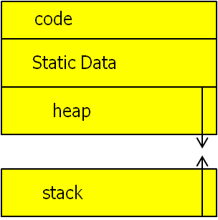
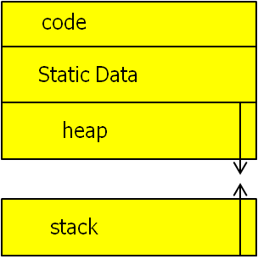
Simple Memory Protection in Process
0000…
0000…
code
Static Data
heap
Base register
stack
1000…
1000…
>=
Program
address
Bound register
<
1100…
1100…
Memory protection with
two registers
Need proper address setting during program loading
FFFF…

Slide 11
Another idea: Address Space Translation
Program operates in an address space that is distinct from the physical memory space of the machine
“virtual address”
“physical address”
0x000…
Processor
translator
Memory
0xFFF…

Slide 12


A simple address translation with Base and Bound
0000…
0000…
code
Static Data
heap
Base Address
stack
1000…
1000…
Program
address
Bound
<
1100…
0100…
Can the program touch OS?
Can it touch other programs?
FFFF…

Slide 13
Process State
As a process executes, it changes state
  new: The process is being created
  running: Instructions are being executed
  waiting: The process is waiting for some event to occur
  ready: The process is waiting to be assigned to a processor
  terminated: The process has finished execution

Slide 14

Diagram of Process State

Slide 15

Process Control Block (PCB)
Information associated with each process
Process state
Program counter
CPU registers
CPU scheduling information
Memory-management information
Accounting information
I/O status information

Slide 16
Context Switch
When CPU switches to another process with a new address space, the system must save the state of the old process and load the saved state for the new process via a context switch.
Context of a process represented in the PCB
Context-switch time is overhead; the system does no useful work while switching

Slide 17

CPU Switch From Process to Process

Slide 18
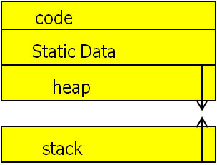
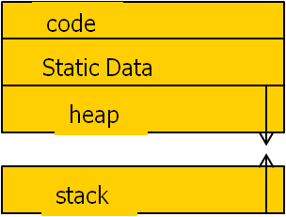
Tying it together: OS loads process
0000…
Proc 1
Proc 2
Proc n
code
…
Static Data
OS
heap
stack
sysmode
1
1000…
Base
xxxx …
0000…
Bound
xxxx…
FFFF…
uPC
xxxx…
1100…
PC
3000…
regs
…
3080…
FFFF…

Slide 19
Simple B&B: OS gets ready to switch
0000…
Proc 1
Proc 2
Proc n
code
…
Static Data
OS
heap
stack
sysmode
1
1000…
Base
1000 …
0000…
Bound
1100…
FFFF…
uPC
0001…
1100…
PC
3000…
regs
00FF…
Return point
…
3080…
FFFF…
Notes:
Tao Yang

Slide 20
Process Scheduling Queues
Job queue – set of all processes in the system
Ready queue – set of all processes residing in main memory, ready and waiting to execute
Device queues – set of processes waiting for an I/O device
Processes migrate among the various queues

Slide 21

Ready Queue And Various
I/O Device Queues

Slide 22

Representation of Process Scheduling

Slide 23
Schedulers
Long-term scheduler
  Selects which processes should be brought into the ready queue
  invoked very infrequently (seconds, minutes)
  controls the degree of multiprogramming
Short-term scheduler
  – selects which process should be executed next and allocates CPU
  is invoked very frequently (milliseconds) ⇒ (must be fast)

Slide 24
Process Creation
Parent process create children processes.
  process identified via a process identifier (pid)
Options in resource sharing
  Parent and children share all resources
  Children share subset of parent’s resources
  Parent and child share no resources
Execution
  Parent and children execute concurrently
  Parent waits until children terminate

Slide 25
Process Creation (Cont.)
Options in address space
  Child duplicate of parent
  Child has another program loaded
UNIX examples
  fork system call creates new process with duplicated address space
    With a copy of same code and data.
  exec system call used after a fork to replace the process’ memory space with a new program

Slide 26
Unix Fork/Exec/Exit/Wait Example
int pid = fork();
  Create a new process that is a clone of its parent.
exec*(“program” [, argvp, envp]);
  Overlay the calling process virtual memory with a new program, and transfer control to it.
exit(status);
  Exit with status, destroying the process.
int pid = wait*(&status);
  Wait for exit (or other status change) of a child.
Fork() > 0
as parent
Fork() ==0
child
initialize child context
exec
wait
exit

Slide 27
Example: Process Creation in Unix
The fork syscall returns twice: it returns a zero to the child and the child process ID (pid) to the parent.
int pid;
int status = 0;
if (pid = fork()) {
/* parent */
…..
pid = wait(&status);
} else {
/* child */
…..
exit(status);
}
Parent uses wait to sleep until the child exits; wait returns child pid and status.
Wait variants allow wait on a specific child, or notification of stops and other signals.

Slide 28
C Program Forking Separate Process
int main() {
int pid;
pid = fork(); /* fork another process */
if (pid < 0) { /* error occurred */
fprintf(stderr, "Fork Failed");
exit(-1);
}
else if (pid == 0) { /* child process */
execlp("/bin/ls", "ls", NULL); //load a new binary
}
else { /* parent process */
wait (NULL); /*parent waits for the child to complete*/
exit(0);
}
}

Slide 29
C Program Forking Separate Process
int main() {
int pid, hello=1;
pid = fork(); /* fork another process */
if (pid < 0) { /* error occurred */
fprintf(stderr, "Fork Failed");
exit(-1);
}
else if (pid == 0) { /* child process */
hello=0;
execlp("/bin/ls", "ls", NULL);
print(“Child hello =%d”, hello);
}
else { /* parent process */
wait (NULL); /*parent waits for the child to complete*/
printf(“hello= %d“, hello);
exit(0);
}
}
What is printed in child?
0, 1, or nothing
What is printed in parent?
0, 1, or nothing

Slide 30
Unix Fork/Exec/Exit/Wait Example
int main() {
int pid, hello=1;
pid = fork();
if (pid == 0) { /* child */
hello=0;
execlp("/bin/ls", "ls", NULL);
printf(“hello= %d“, hello);
} else { /* parent process */
wait (NULL);
printf(“hello= %d“, hello);
exit(0);
}
}
hello=1
Pid==0
child with duplicated
address space
Pid>0
as parent with
old address space
fork()
initialize child context
hello=0
exec()
reloads address space
Old child code
is wiped out
wait
exit
hello==1

Slide 31
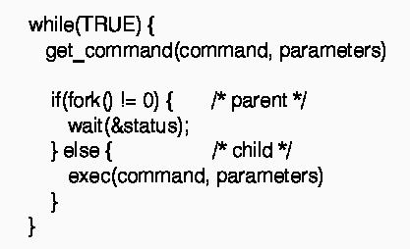
Proj 0
Shell
A shell is a job control system
  Lets user execute system utilities/applications
  Windows, MacOS, Linux all have shells
Typical format:
  cmd arg1 arg2 ... argn
  i/o redirection <, >
  filters & pipes
    ls | more

Slide 32
I/O Redirection with dupe2()
File descriptor for standard input/output/error at Unix
0 – stdin 1 --- stdout, 2 --stderr
dup2(int f_orig, int f_new)
  duplicate file descriptor
Implement shell command “ls > temp”:
  fd = open(“temp”, O_CREAT|O_TRUNC|O_WRONLY, 0644))
  dup2(fd,1) /*Use “temp” file as the standard output*/
  printf(“hello\n”)
  execvp(“ls”,…)
ls
temp

Slide 33
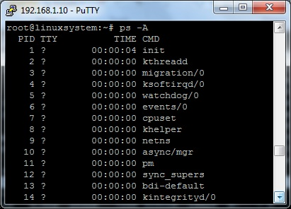
Linux Command: ps
Show your processes or others

Slide 34
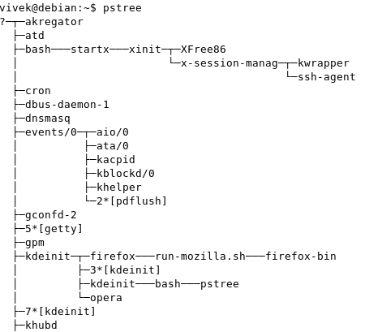
Linux command: Pstree -A
Show Linux processes in a tree structure

Slide 35
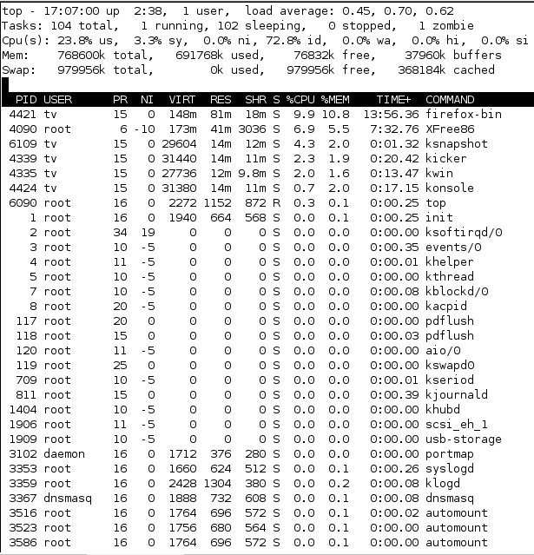
Linux command: Top
Top - Show all active processes in details

Slide 36
Process Termination
Process executes last statement and asks the operating system to delete it (exit)
  Output data from child to parent (via wait)
  Process resources are deallocated
Parent may terminate children processes
  Task assigned to child is no longer required
  If parent is exiting

Slide 37
Interprocess Communication
Processes within a system may
  independent or
  cooperating with information sharing
Cooperating processes need interprocess communication (IPC)
  Shared memory
  Message passing

Slide 38

Communications Models

Slide 39
Interprocess Communication with Message Passing
Direct messages: Processes must name each other explicitly:
  send (P, message) – send a message to process P
  receive(Q, message) – receive a message from process Q
Indirect messages: Messages are directed and received from mailboxes (also referred to as ports)
  Each mailbox has a unique id
  Processes can communicate only if they share a mailbox

Slide 40
Examples of Process Communication
Unix signals
Unix Pipe
Shared memory IPC in Posix
  POSIX is the name of a family of related standard specified by IEEE to define API in Unix.
Sockets
Remote Procedure Calls (RPC)

Slide 41
Unix Signals
A event similar to hardware interrupt without priorities
  Usage: inform a user process of an event
    For example, user pressed delete key
Each signal is represented by a numeric value. Examples:
  02, SIGINT: interrupt a process from a terminal (Ctrl-C)
  09, SIGKILL: terminate a process
  SIGUSR1, SIGUSR2: user defined.
  signal.h defines the signals
A UNIX signal raised by a process using
    a systems call: kill(SIGUSR1, process_id)
    a shell command: kill -s USR1 process_id

Slide 42
UNIX Signals
Each signal is maintained as a single bit in the process table entry of the receiving process
  the bit is set when the corresponding signal arrives (no waiting queues)
A signal is processed as soon as the process enters in user mode
3 ways to handle a signal
  Ignore it: signal(SIG#, SIG_IGN)
  Run the default handler:
    signal(SIG#, SIG_DFL)
  Run a user-defined handler:
    signal(SIG#, myHandler)
Notes:
Tao Yang

Slide 43
Signal Handling
/* code for process p */
. . .
signal(SIG#, sig_hndlr);
. . .
/* ARBITRARY CODE */
void sig_hndlr(...){
…
/* handler code */
}
Process q
Process P
q raises “SIG#” for “p”
q is blocked
sig_hndlr runs in
p’s address space
q resumes execution

Slide 44
Example of signal program
http://web.mst.edu/~ercal/284/SignalExamples/signalEX1.c
#include <signal.h>
main() {
void cnt(int sig);
signal(SIGINT, cnt); // Control-C
printf("Begin counting and INTERRUPTs\n");
for(;;); /* infinite loop */
}
void cnt(int sig) {
static int count=0;
printf("Total of %d INTERRUPTS received\n", ++count);
if(count==1)
signal(SIGINT, SIG_DFL); // default handling for that signal will occur.
}
How many times do you have
to push ctrl-C before exit?1, 2, 3

Slide 45
UNIX Pipes for Process Communication
The pipe interface is intended to look like a file interface
pipe(p) creates the pipe and kernel allocates a buffer with two pointers p[0] and p[1]
File read / write calls are used to send/receive information on the pipe. Processes use p[1] to write and p[0] to read
pipe handles (p[0] & p[1]) are copied on fork() (similar to file handles)
int p[2];
. . .
pipe(p);
. . .
if(fork() == 0) { /* the child */
. . .
read(p[0], inbuf, size);
. . .
} else { /* the parent */
. . .
write(p[1], “hello”, size);
. . .
}

Slide 46
UNIX Pipes
Parent process, P
Child process, Q
int p[2];
pipe(p);
…
fork()
…
write(p[1], “hello”, size);
…
/* gets a copy of parent’s variables including the pipe pointers p[0] and p[1] */
…
read(p[0], inbuf, size);
…
pipe for P and Q
write function
Φolleh
read function
FIFO buffer
Linux capacity: default 64KB

Slide 47
I/O pipeline between two commands
using pipe() and dupe2()
Shell command: ls | wc
pipe(fd)
  Process 1:
    dup2(fd[1],1) /* use pipe as stdout */
    close(fd[0])
    execvp(“ls”, …);
  Process 2:
    dup2(fd[0], 0) /*Use pipe as stdin */
    close(fd[1]) /*close unused part*/
    execvp(“wc”, …)
Who should execute pipe(fd)?
Parent process? Process 1 or
process 2?
Proc 1
pipe fd
Proc 2
ls
wc

Slide 48
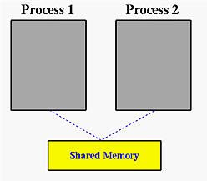
Process Communication through Shared Memory
POSIX shared memory standard
Write process
  Create shared memory segment
segment id = shmget(key, size, IPC_CREAT);
  Attach shared memory to its address space
addr= (char *) shmat(id, NULL, flag);
  write to the shared memory
*addr = 1;
  Detech shared memory
shmdt(addr);
Read process
segment id = shmget(key, size, 0666);
addr= (char *) shmat(id, NULL, 0);
c= *addr;
shmdt(addr);

Slide 49
File I/O as Communication between processes
Communication between processes: view files as communication channels (streams)
Communication across the world
write(wfd, wbuf, wlen);
n = read(rfd,rbuf,rmax);
write(wfd, wbuf, wlen);
n = read(rfd,rbuf,rmax);

Slide 50
Request Response Protocol in Client-Server Communication
Client (issues requests)
Server (performs operations)
write(rqfd, rqbuf, buflen);
requests
n = read(rfd,rbuf,rmax);
wait
service request
write(wfd, respbuf, len);
responses
n = read(resfd,resbuf,resmax);

Slide 51

Sockets in Client-server systems
A socket: Concatenation of IP address and port
  The socket 161.25.19.8:80 refers to port 80 on host 161.25.19.8

Slide 52
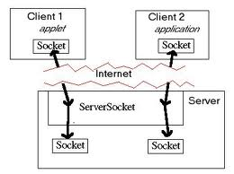
Example: Client connection in Java
Make a connection to server
try {
Socket sock = new Socket("161.25.19.8",80);
InputStream in = sock.getInputStream();
BufferedReader bin = new BufferedReader(new InputStreamReader(in));
String line;
while( (line = bin.readLine()) != null)
System.out.println(line);
sock.close();
}
Read data sent from server and print

Slide 53
Server code: handling client requests one by one
Create a socket to listen
ServerSocket sock = new ServerSocket(80);
while (true) {
Socket client = sock.accept();
// we have a connection
PrintWriter pout = new PrintWriter(client.getOutputStream(), true);
pout.println(new java.util.Date().toString());
client.close();
}
Listen for connections
Write date to the socket
Close the socket and resume listening for more connections

Slide 54
Key OS Concepts so far
Processes
  Memory Protection, Address Space, Dual Mode
States of processes
  PCB (Process control block)
  Context Switch &Process Scheduling
System calls on processes
  fork, wait, exec, dup2
Process communication
  UNIX signals, pipes, shared memory, socket.

