Slide 1
MEMORY MANAGEMENT
1. Keep track of what parts of memory are in use.
2. Allocate memory to processes when needed.
3. Deallocate when processes are done.
4. Swapping, or paging, between main memory and disk, when disk is too small to hold all current processes.

Slide 2
Memory hierarchy:
  small amount of fast, expensive memory – cache
  some medium-speed, medium price main memory
  gigabytes of slow, cheap disk storage
MMU - Memory Management Unit of the operating system handles the memory hierarchy.

Slide 3

Basic Memory Management
Monoprogramming without Swapping or Paging
Three simple ways of organizing memory
- an operating system with one user process

Slide 4
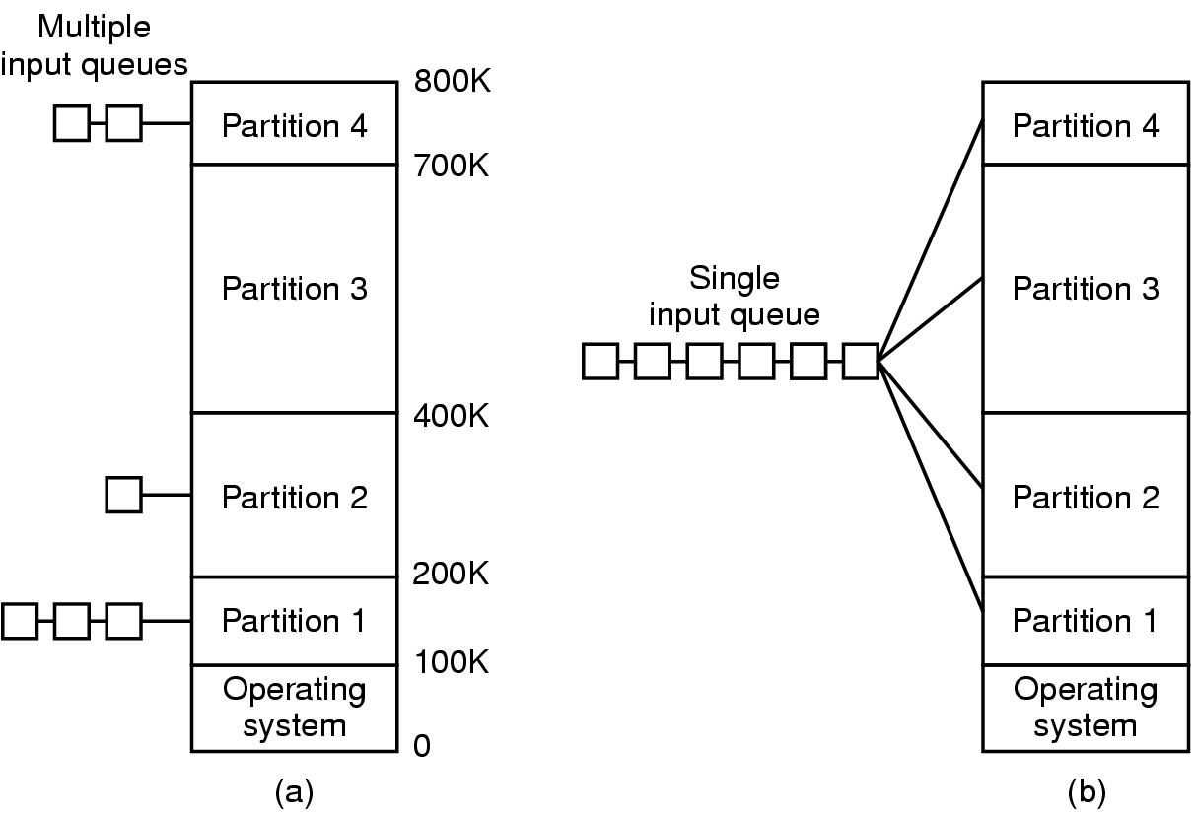
Multiprogramming with Fixed Partitions
Fixed memory partitions
  separate input queues for each partition
  single input queue

Slide 5
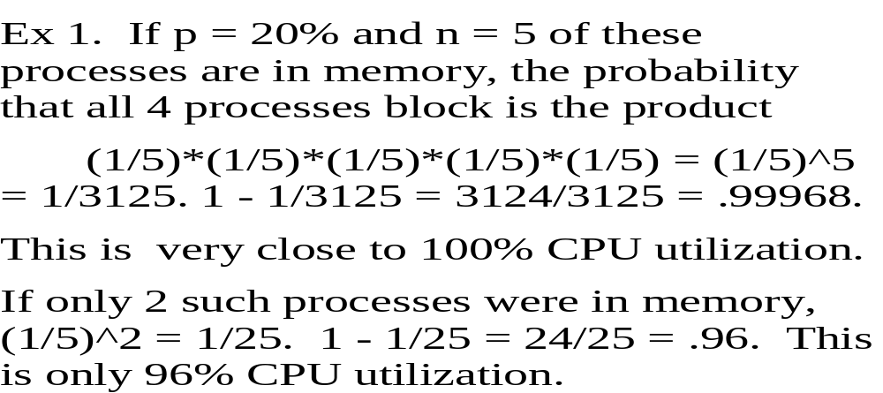
CPU UTILIZATION
Let ‘p’ be the fraction of time that a certain type process spends waiting for I/O. Let ‘n’ be the number of such processes in memory. The probability that all ‘n’ processes block for I/O is p^{n.} Therefore, CPU utilization is approximately: 1 - p^{n}

Slide 6
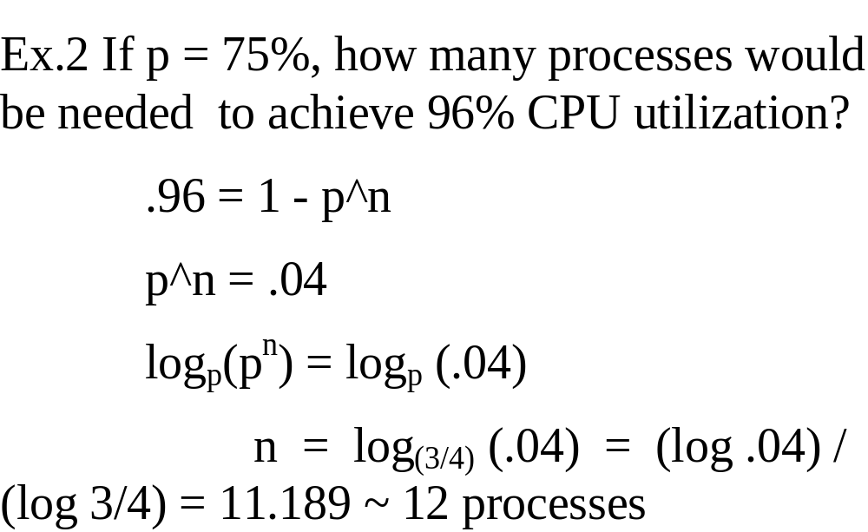

Slide 7
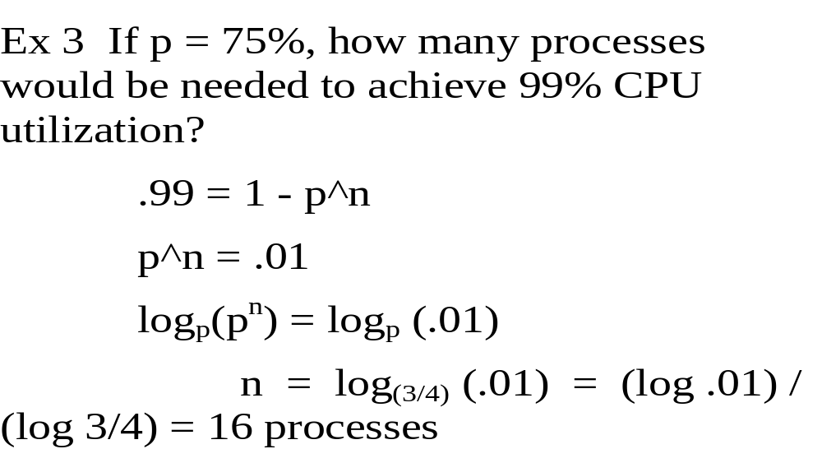

Slide 8
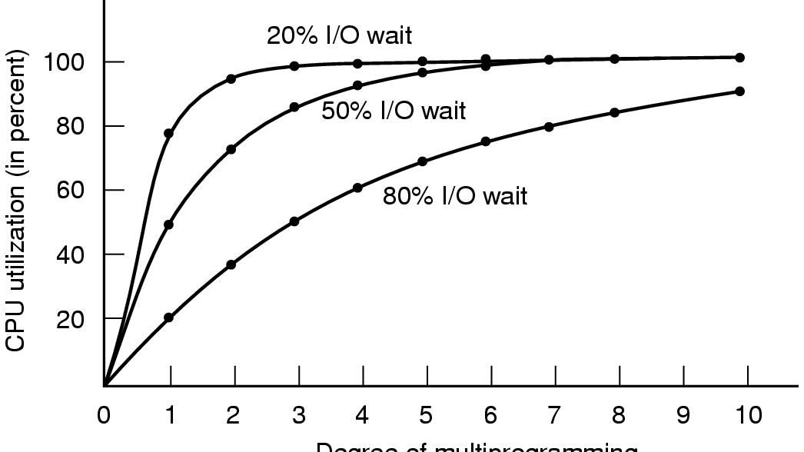
Modeling Multiprogramming
Degree of multiprogramming
CPU utilization as a function of number of processes in memory

Slide 9
Multilevel Page Tables

Slide 10
Relocation and Protection
Cannot be sure where program will be loaded in memory
  address locations of variables, code routines cannot be absolute
  must keep a program out of other processes’ partitions
Use base and limit values
  address locations added to base value to map to physical addr
  address locations larger than limit value is an error

Slide 11

Swapping
Memory allocation changes as
  processes come into memory
  leave memory
Shaded regions are unused memory

Slide 12

Allocating space for growing data segment
Allocating space for growing stack & data segment

Slide 13

Memory Management with Bit Maps
Part of memory with 5 processes, 3 holes
  tick marks show allocation units
  shaded regions are free
Corresponding bit map
Same information as a list

Slide 14
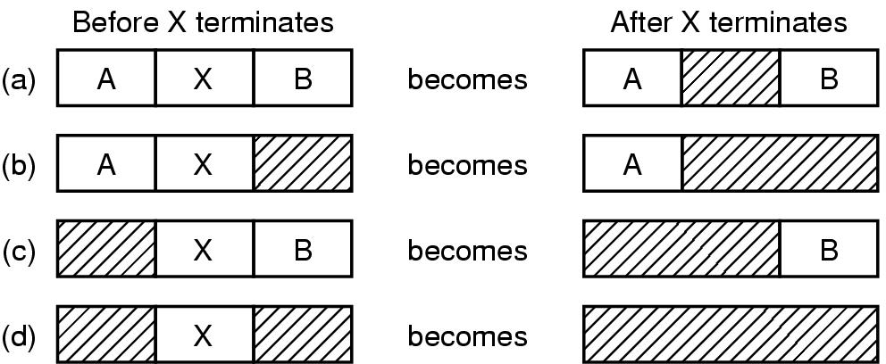
Memory Management with Linked Lists
Four neighbor combinations for the terminating process X

Slide 15
Algorithms for allocating memory when linked list management is used.
1. FIRST FIT - allocates the first hole found that is large enough - fast (as little searching as possible).
2. NEXT FIT - almost the same as First Fit except that it keeps track of where it last allocated space and starts from there instead of from the beginning - slightly better performance.
3. BEST FIT - searches the entire list looking for a hole that is closest to the size needed by the process - slow - also does not improve resource utilization because it tends to leave many very small ( and therefore useless) holes.
4. WORST FIT - the opposite of Best Fit - chooses the largest available hole and breaks off a hole that islarge enouggh to be useful (I.e. hold another process) - in practice has not been shown to work better than others.

Slide 16
FRAGMENTATION
All the preceding algorithms suffer from: External Fragmentation
As processes are loaded and removed from memory the free memory is broken into little pieces and enough total space exists to satisfy a request, but it is not contiguous.
Solutions:
Break memory into fixed-sized blocks and allocate in units of block sizes. Since the allocation will always be slightly larger than the process, some Internal Fragmentation still results.
Compaction: move all processes to one end of memory and holes to the other end. Expensive and can only be done when relocation is done at execution time, not at load time.

Slide 17
PAGING another solution to external fragmentation
Paging is a memory management scheme that permits the physical address space to be noncontiguous.
Used by most operating systems today in one of its various forms.
Traditionally handled by hardware, but recent designs implement paging by closely integrating the hardware and operating system.
Every address generated by the CPU is divided into two parts: the page number and the offset.
Addressing in a virtual address space of size: 2^{m}, with pages of size: 2^{n} , uses the high order m-n bits for the page number and the n low order bits for the offset.
A Page Table is used where the page number is the index and the table contains the base address of each page in physical memory.

Slide 18

Virtual Memory
The position and function of the MMU

Slide 19
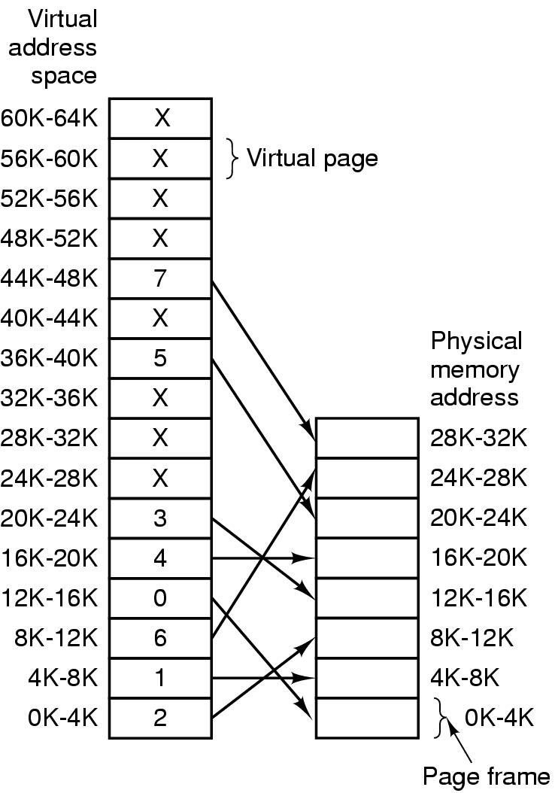
PAGING
The relation between
virtual addresses
and physical
memory addres-
ses given by
page table

Slide 20
An incoming virtual address is split into 2 parts:
A few high bits, on the left, for the page number.
The rest of the address for the offset (where the address actually lies within the page.
Ex: 16 bit addresses => the size of the virtual address space is 2¹⁶ , and if the page size is 2¹² (about 4k) the highest 4 bits of the address give the page number and lowest 12 bit give the offset.
Virtual Address: 8196(dec) = 2004(hex) = 0010000000000100(bin)
This address lies on page: ‘0010’ or 2 in the virtual address space, and
has offset ‘000000000100’ or 4,
that is the address is found 4 bytes from the beginning of the page.
****The physical address will have the same offset on the frame****

Slide 21

Internal Operation of MMU with 16 4 KB Pages*
16 bit addresses => address space size: 2¹⁶
Page size ~4K ~ 2¹² => 2¹⁶ / 2¹² = 2⁴ ⁼ 16 pages.

Slide 22
With Paging we have no external fragmentation: any free frame can be allocated to a process that needs it.
However, there will usually be internal fragmentation in the last frame allocated, on the average, half a page size.
Therefore, smaller pages would improve resource utilization BUT would increase the overhead involved.
Since disk I/O is more efficient when larger chunks of data are transferred (a page at a time is swapped out of memory), typically pages are between 4K and 8K in size.

Slide 23
Hardware Support
Most operating systems allocate a page table for each process.
A pointer to the page table is stored with the other register values (like the instruction counter) in the PCB (process control block).
When the dispatcher starts a process, it must reload all registers and copy the stored page table values into the hardware page table in the MMU.
This hardware “page table” may consist of dedicated registers with high-speed logic, but that design is only satisfactory if the page table is small, such as 256 entries - that is a physical address space of only 256 (2⁸) pages. If the page size is 4K ~ 2¹² , that is only 2¹² * 2⁸ = 2²⁰ ~1,000,000 bytes(virtual address space).
Today’s computers allow page tables with 1 million or more pages. Even very fast registers cannot handle this efficiently. With 4K pages each process may need 4 megabytes of physical address space its page table!!

Slide 24
Solutions to Large Page Table Problems
1. The MMU contains only a Page-Table Base Register which points to the page table. Changing page tables requires changing only this one register, substantially reducing context switch time. However this is very slow! The problem with the PTBR approach, where the page table is kept in memory, is that TWO memory accesses are needed to access one user memory location: one for the page-table entry and one for the byte. This is intolerably slow in most circumstances. Practically no better than swapping!

Slide 25
Solutions to Large Page Table Problems (cont.)
2. Multilevel page tables avoid keeping one huge page table in memory all the time: this works because most processes use only a few of its pages frequently and the rest, seldom if at all. Scheme: the page table itself is paged.
EX. Using 32 bit addressing:
The top-level table contains 1,024 pages (indices). The entry at each index contains the page frame number of a 2nd-level page table. This index (or page number) is found in the 10 highest (leftmost) bits in the virtual address generated by the CPU.
The next 10 bits in the address hold the index into the 2nd-level page table. This location holds the page frame number of the page itself.
The lowest 12 bits of the address is the offset, as usual.

Slide 26

Two-level Page Tables
32 bit address with 2 page table fields

Slide 27
Two-level Page Tables (cont.)
Ex. Given 32 bit virtual address 00403004 (hex) = 4,206,596 (dec)
converting to binary we have:
0000 0000 0100 0000 0011 0000 0000 0100
regrouping 10 highest bits, next 10 bits, remaining 12 bits:
0000 0000 01 00 0000 0011 0000 0000 0100
PT1 = 1 PT2 = 3 offset = 4
PT1 = 1 => go to index 1 in top-level page table. Entry here is the page frame number of the 2nd-level page table. (entry =1 in this ex.)
PT2 = 3 => go to index 3 of 2nd-level table 1. Entry here is the no. of the page frame that actually contains the address in physical memory. (entry=3 in this ex.) The address is found using the offset from the beginning of this page frame. (Remember each page frame corresponds to 4096 addresses of bytes of memory.)

Slide 28
Diagram of previous example:
Corresponds to all possible virtual addresses with 32bit addresses: 0 - 4,294,967,295(dec)
Top-level page table:
1023
.
.
.
1
0
1
2nd-level page table:
0 1 1023
0
1
2
3
1023
Each page ~ 4K
each chunk ~ 4M
(~4000*1000)
. . .
...
...
...
Corresponds to addresses 0 - 4, 194, 303
Corresponds to addresses 4, 194, 304 - 8,388,608
Corresponds to bytes 12,288 -
16,384 from beginning of page table 1
3
12,292
Offset 4 + 12,288 = 12,292 (corresponds to absolute address 4, 206, 596)

Slide 29
Two-level Page Tables (cont.)
Each page table entry contains bits used for special purposes besides the page frame number:
If a referenced page is not in memory, the present/absent bit will be zero, and a page fault occurs and the operating system will signal the process.
Memory protection in a paged environment is accomplished by protections for each frame, also kept in the page table. One bit can define a page as read-only.
The “dirty bit” is set when a page has been written to. In that case it has been modified. When the operating system decides to replace that page frame, if this bit (also called the modified or referenced bit) is set, the contents must be written back to disk. If not, that step is not needed: the disk already contains a copy of the page frame.

Slide 30
Solutions to Large Page Table Problems (cont.)
3. A small, fast lookup cache called the TRANSLATION LOOK-ASIDE BUFFER (TLB) or ASSOCIATIVE MEMORY.
The TLB is used along with page tables kept in memory. When a virtual address is generated by the CPU, its page number is presented to the TLB. If the page number is found, its frame is immediately available and used to access memory. If the page number is not in the TLB ( a miss) a memory reference to the page table must be made. This requires a trap to the operating system. When the frame number is obtained, it is used to access memory AND the page number and frame number are added to the TLB for quick access on the next reference. This procedure may be handled by the MMU, but today it is often handled by software; i.e. the operating system.

Slide 31
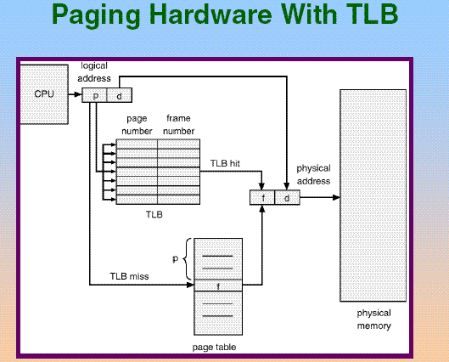

Slide 32
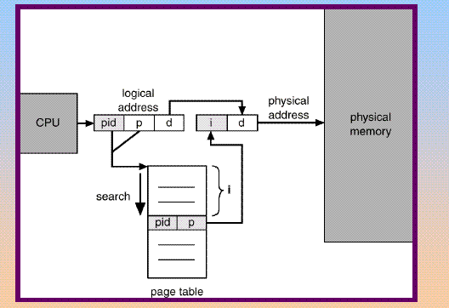
Solutions to Large Page Table Problems (cont.)
For larger addressing, such as 64 bits, even multi-level page tables are not satisfactory: just too much memory would be taken up by page tables and references would be too slow.
One solution is the Inverted Page Table. In this scheme there is not one page table for each process in the system, but only one page table for all processes in the system. This scheme would be very slow alone, but is workable along with a TLB and sometimes a hash table.

Slide 33
Page Replacement Algorithms
When a page fault occurs, the operating system must choose a page to remove from memory to make room for the page that has to be brought in.
On the second run of a program, if the operating system kept track of all page references, the “Optimal Page Replacement Algorithm” could be used:
replace the page that will not be used for the longest amount of time. This method is impossible on the first run and not used in practice. It is used in theory to evaluate other algorithms.

Slide 34
Page Replacement Algorithms (cont)
Not Recently Used Algorithm (NRU) is a practical algorithm that makes use of the bits ‘Referenced’ and ‘Modified’. These bits are updated on every memory reference and must be set by the hardware. On every clock cycle the operating system can clear the R bit. This distinguishes those pages that have been referenced most recently from those that have not been referenced during this clock cycle. The combinations are:
(0) not referenced and not modified
(1) not referenced, modified
(2) referenced, not modified
(3) referenced, modified
NRU randomly chooses a page from the lowest class to remove

Slide 35
Page Replacement Algorithms (cont)
First In First Out Algorithm: when a new page must be brought in, replace the page that has been in memory the longest. Seldom used: even though a page has been in memory a long time, it may still be needed frequently.
Second Chance Algorithm: this is a modification of FIFO. The Referenced bit of the page that has been in memory longest is checked before that page is automatically replaced. If the R bit has been set to 1, that page must have been referenced during the previous clock cycle. That page is placed at the rear of the list and its R bit is reset to zero. A variation of this algorithm, the ‘clock’ algorithm keeps a pointer to the oldest page using a circular list. This saves the time used in the Second Chance Algorithm moving pages in the list

Slide 36
Page Replacement Algorithms (cont)
Least Recently Used Algorithm (LRU) - keep track of each memory reference made to each page by some sort of counter or table. Choose a page that has been unused for a long time to be replaced. This requires a great deal of overhead and/or special hardware and is not used in practice. It is simulated by similar algorithms:
Not Frequently Used - keeps a counter for each page and at each clock interrupt, if the R bit for that page is 1, the counter is incremented. The page with the smallest counter is chosen for replacement. What is the problem with this?
A page with a high counter may have been referenced a lot in one phase of the process, but is no longer used. This page will be overlooked, while another page with a lower counter but still being used is replaced.

Slide 37
Page Replacement Algorithms (cont)
Aging -a modification of NFU that simulates LRU very well.
The counters are shifted right 1 bit before the R bit is added in.
Also, the R bit is added to the leftmost rather than the rightmost
bit. When a page fault occurs, the page with the lowest counter is
still the page chosen to be removed. However, a page that has not
been referenced for a while will not be chosen. It would have
many leading zeros, making its counter value smaller than a page
that was recently referenced.

Slide 38
Page Replacement Algorithms (cont)
‘Demand Paging’ : When a process is started, NONE of its pages are brought into memory. From the time the CPU tries to fetch the first instruction, a page fault occurs, and this continues until sufficient pages have been brought into memory for the process to run. During any phase of execution a process usually references only a small fraction of its pages. This property is called the ‘locality of reference’.
Demand paging should be transparent to the user, but if the user is aware of the principle, system performance can be improved.

Slide 39
Example of code that could reduce the number of page faults that result from demand paging:
Assume pages are of size 512 bytes. That is, 128 words where a word is 4 bytes. The following code fragment is from a Java program. The array is stored by rows and each page takes 1 row. The function is to initialize a matrix to zeros:
int a[] [] = new int[128][128];
for (int j=0; j<a.length; j++)
for (int i=0; i<a.length; i++)
a[i][j] = 0; //body of the loop
If the operating system allocates less than 128 frames to this program, how many page faults will occur? How can this be significantly reduced by changing the code?

Slide 40
Answers:
128 * 128 = 16, 384 maximum number of page faults that could occur.
The preceding code zeros 1 word in each row, which is an entire page. If there are only 127 frames allocated to the process, and the missing frame corresponds to the first row, another row (page) must be removed from memory to bring in the needed page. Suppose it is the 2nd row (page) that is replaced. Now a[0][0] can be accessed, but when the preceding code then tries to access a[1][0] a page fault! That row (page) is not in memory. Replace row 2 with row 1. Now a[1][0] can be accessed. Next an attempt will be made to write to a[2][0]. Page fault! Etc.

Slide 41
Changing the code to:
int a[][] = new int [128][128];
for (int i = 0; i< a.length; i++)
for (int j =0; j< a.length; j++)
a[i][j] = 0;
results in a maximum of 128 page faults.
If row 0 (page 0) is not in memory when the first attempt to access an element - a[0][0] - is made, a page fault occurs. When this page is brought in, all 128 accesses needed to fill the entire row are successful. If row 1 had been sacrificed to bring in row 0, a 2nd page fault occurs when the attempt is made to access a[1][0]. When this page is brought in, all 128 accesses needed to fill that row are successful before another page fault is possible.

Slide 42
Page Replacement Algorithms (cont)
The set of pages that a process is currently using is called its ‘working set’. If the entire working set is in memory, there will be no page faults.
If not, each read of a page from disk may take 10 milliseconds (.010 of a second). Compare this to the time it takes to execute an instruction: a few nanoseconds (.000000002 of a second). If a program has page faults every few instructions, it is said to be ‘thrashing’. Thrashing is happening when a process spends more time paging than executing.

Slide 43
Page Replacement Algorithms (cont)
The Working Set Algorithm keeps track of a process’ ‘working set’ and makes sure it is in memory before letting the process run. Since processes are frequently swapped to disk, to let other processes have CPU time, pure demand paging would cause so many page faults, the system would be too slow.
Ex. A program using a loop that occupies 2 pages and data from 4 pages, may reference all 6 pages every 1000 instructions. A reference to any other page may be a million instructions earlier.

Slide 44
Page Replacement Algorithms (cont)
The ‘working set’ is represented by w(k,t). This is the set of pages, where ‘t’ is any instant in time and ‘k’ is a number of recent memory references. The ‘working set’ set changes over time but slowly. When a process must be suspended ( due to an I/O wait or lack of free frames), the w(k, t) can be saved with the process. In this way, when the process is reloaded, its entire w(k,t) is reloaded, avoiding the initial large number of page faults. This is called ‘PrePaging’.
The operating system keeps track of the working set, and when a page fault occurs, chooses a page not in the working set for replacement. This requires a lot of work on the part of the operating system. A variation, called the ‘WSClock Algorithm’, similar to the ‘Clock Algorithm’, makes it more efficient.

Slide 45
How is a page fault actually handled?
1. Trap to the operating system ( also called page fault interrupt).
2. Save the user registers and process state; i.e. process goes into waiting state.
3. Determine that the interrupt was a page fault.
4. Check that the page reference was legal and, if so, determine the location of the page on the disk.
5. Issue a read from the disk to a free frame and wait in a queue for this device until the read request is serviced. After the device seek completes, the disk controller begins the transfer of the page to the frame.
6. While waiting, allocate the CPU to some other user.
7. Interrupt from the disk occurs when the I/O is complete. Must determine that the interrupt was from the disk.
8. Correct the page table /other tables to show that the desired page is now in memory.
9. Take process out of waiting queue and put in ready queue to wait for the CPU again.
10. Restore the user registers, process state and new page table, then resume the interrupted instruction.

Slide 46
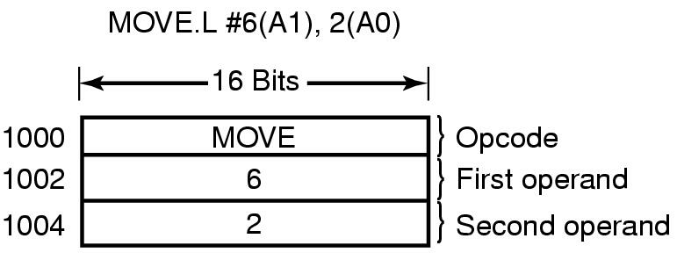
Instruction Back Up
Consider the instruction: MOV.L #6(a1), 2(a0)
(opcode) (operand) (operand)
Suppose this instruction caused a page fault.
The value of the program counter at the time of the page fault depends on which part of the instruction caused the fault.
How much memory does this instruction fill?
6 bytes

Slide 47
Suppose the PC = 1002 at the time of the fault. Does the O.S. know the information at that address is associated with the opcode at addresss 1000?
NO
Why would this be important?
The CPU will need to ‘undo’ the effect of the instruction so far, in order to restart the instruction after the needed page has been retrieved.
Solution (on some machines): an internal register exists that stores the PC just before an instruction executes.
Note: without this register, it is a large problem.

Slide 48
Backing Store
Once a page is selected to be replaced by a page replacement algorithm, a storage location on the disk must be found.
How did you partition the disk in lab1?
A swap area on the disk is used. This area is empty when the system is booted. When the first process is started a chuck of the swap area the size of the process is reserved. This is repeated for each process and the swap area is managed as a list of free chunks.
When a process finishes, its disk space is freed.

Slide 49
A process’ swap area address is kept in the process table (PCB)
How is a disk address found using this scheme, when a page is to be brought in or out of the backing store? ( The page offset (in the virtual address) is added to the start of the page - BUT only the disk address of the beginning of the swap area needs to be in memory: everything else can be calculated.)
Is the swap area initialized?
Sometimes.
When the method used to copy the entire process image to the swap area and pages (or segments) are brought in as needed.
Otherwise, the entire process is loaded into memory and paged out when needed.

Slide 50
Note: The scheme of saving the entire process image on the backing store has a problem:
SIZE.
Does a process always remain the same size?
NO.
What part of a process is always fixed?
CODE
What part of a process always changes in size?
STACK
What part of a process may change in size:
DATA

Slide 51
The alternative scheme of allocating no disk space to a process until it is needed, solves the size problem.
Alocation/deallocation of backing store space is done as pages are swapped in and out of memory.
Advantages: changing size of process is not a problem and disk space for pages in memory is not wasted.
Disadvantages: another table, besides the page table, must be kept in memory. In this table the disk address of each page in the backing store, but not in memory is kept.

Slide 52
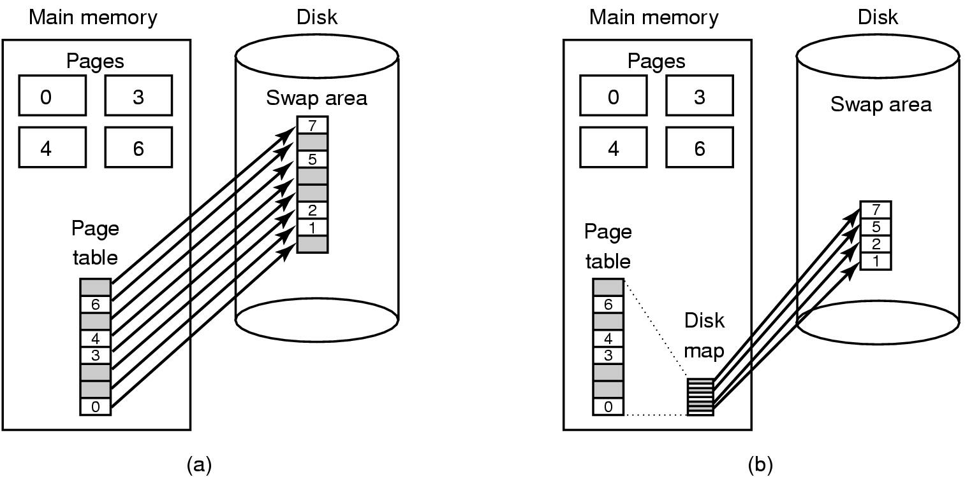

Slide 53
*Separation of ‘Mechanism’ and ‘Policy’
Think of Memory Management as having 3 parts:
(1) MMU (low level) - handler code is machine dependent.
(2) Page fault handler - part of the kernel, machine independent, contains most of the mechanism for paging.
(3) External pager - runs in user space, policy usually determined here.
* relating this to lab 3: drivers, in general, should be concerned with “what the device can do” (mechanism) not “how or who is allowed to use them” (policy)

Slide 54
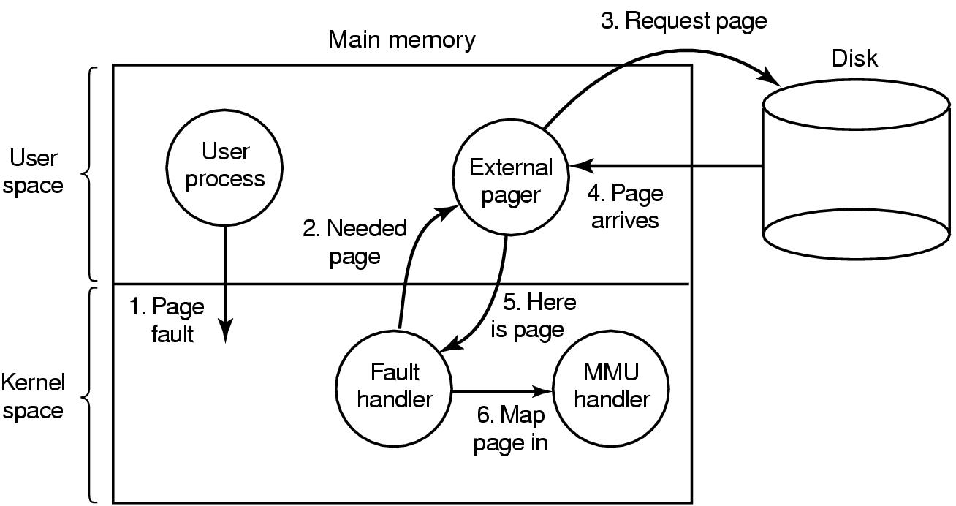

Slide 55
Where does the page replacement algorithm go?
(1) If in the external pager, a problem results:
Since this is in user space, it does not have access to the R and M bits. Therefore, a mechanism is needed to get this information.
(2) If the fault handler applies the algorithm and tells the externel pager what page was selected for replacement. In this case the externel pager just writes the data to disk.

Slide 56
Advantages of solution (2):
More modular code which offers more flexibility. (Think about lab3 where the driver was added as a module to the kernel. That way it could be removed and changed without rebooting.)
Disadvantages of solution (2):
Switching from user to kernel mode more often and additional overhead of message passing between parts of the ssytem.

Slide 57
SEGMENTATION
Where paging uses one continuous sequence of all virtual addresses from 0 to the maximum needed for the process.
Segmentation is an alternate scheme that uses multiple separate address spaces for various segments of a program.
A segment is a logical entity of which the programmer is aware. Examples include a procedure, an array, a stack, etc.
Segmentation allows each segment to have different lengths and to change during execution.

Slide 58

Without Segmentation a Problem May Develop

Slide 59
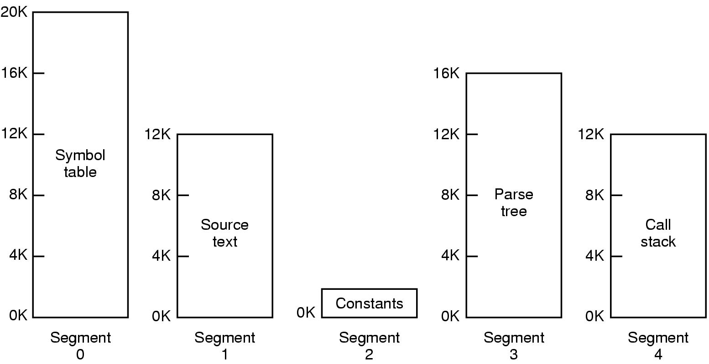
Segmentation
Allows each table to grow or shrink, independently
To specify an address in segmented memory, the program must supply a two-part address: (n,w) where n is the segment number and w is the address within the segment, starting at 0 in each segment.
Changing the size of 1 procedure, does not require changing the starting address of any other procedure - a great time saver.

Slide 60
Segmentation Permits Sharing Procedures or Data between Several Processes
A common example is the shared library, such as a large graphical library compiled into nearly every program on today’s modern workstations.
With segmentation, the library can be put in a segment and shared by multiple processes, avoiding the need to have the entire library in every process’s address space.
Since each segment contains a specific logical entity, the user can protect each appropriately (without concern for where boundaries are in the paging system): a procedure segment can be set execute but not read or write; an array can be specified read/write but not execute; etc. This is a great help in debugging.

Slide 61

Comparison of paging and segmentation

Slide 62
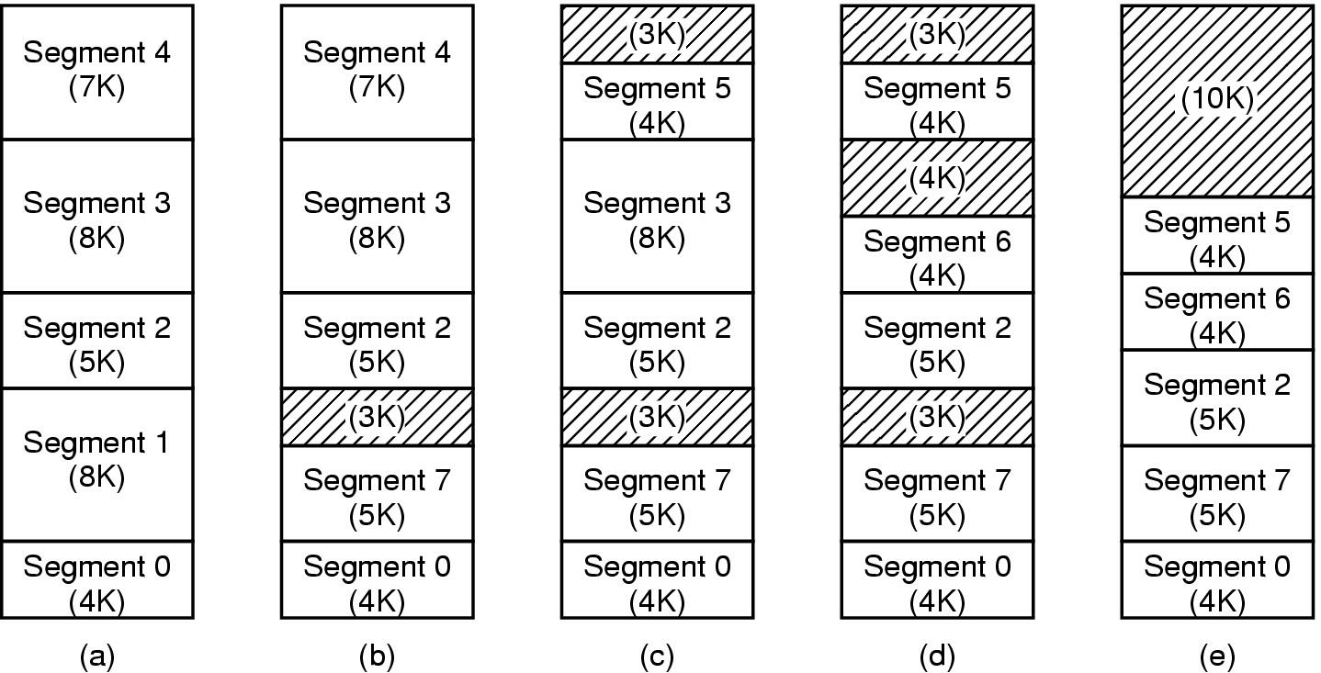
Pure Segmentation
(a) Memory initially containing 5 segments of various sizes.
(b)-(d) Memory after various replacements: external fragmentation (checkerboarding) develops.
(e) Removal of external fragmentation by compaction eliminates the wasted memory in holes.

Slide 63
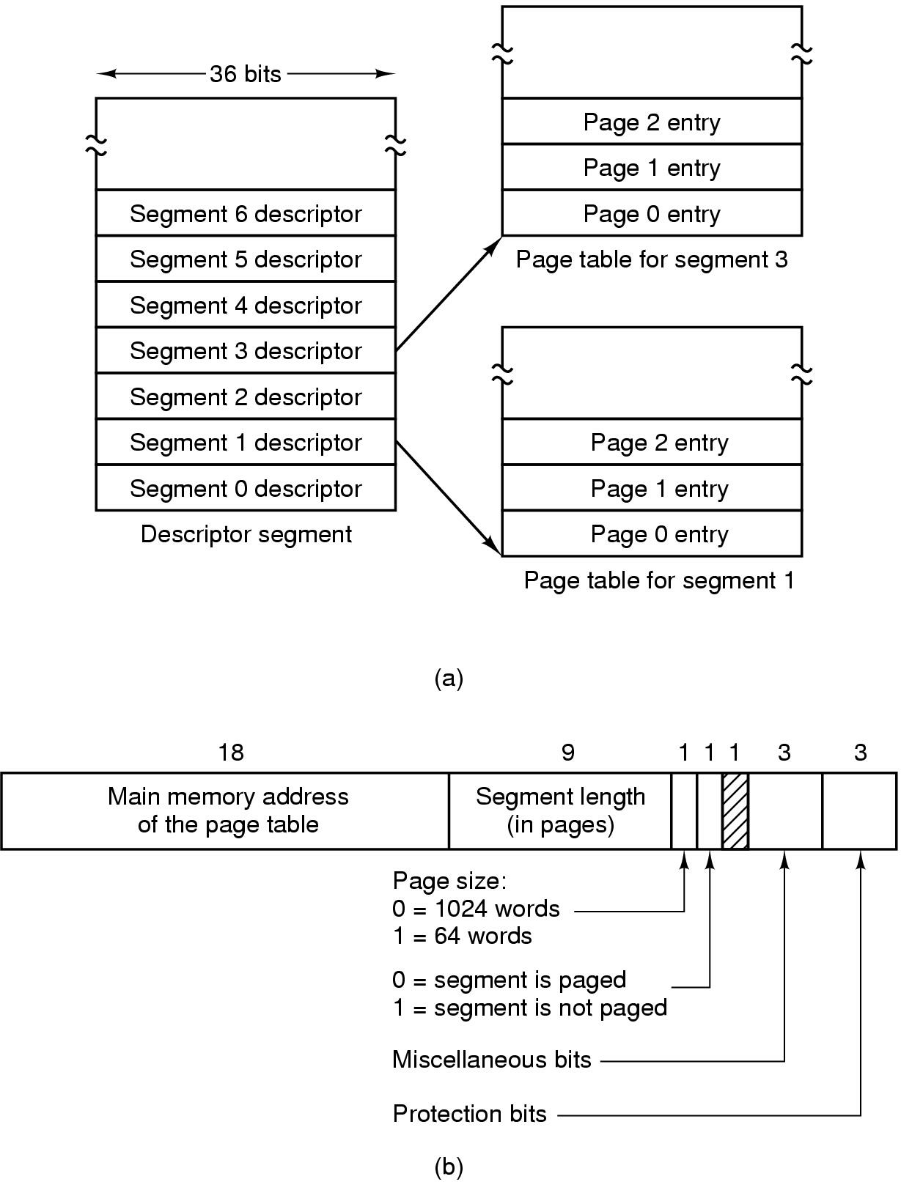
Segmentation with Paging: MULTICS (1)
Descriptor segment points to page tables
Segment descriptor – numbers are field lengths

Slide 64
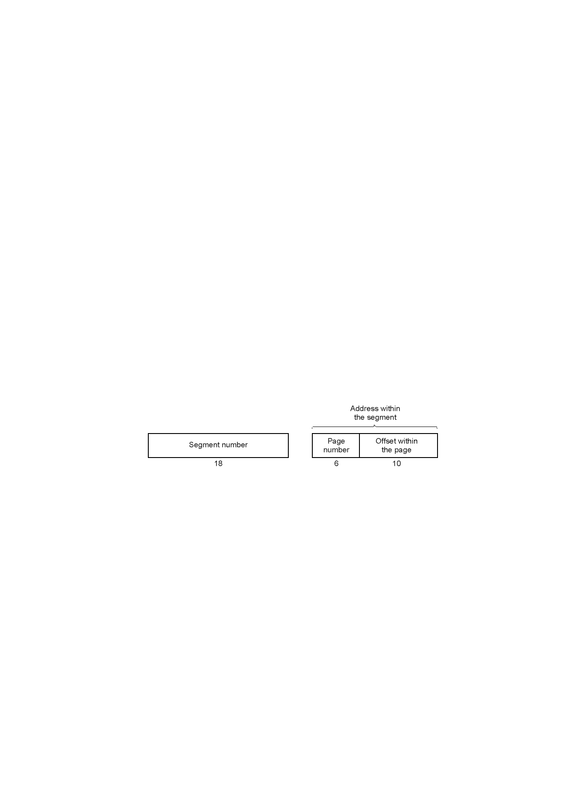
Segmentation with Paging: MULTICS (2)
A 34-bit MULTICS virtual address

Slide 65
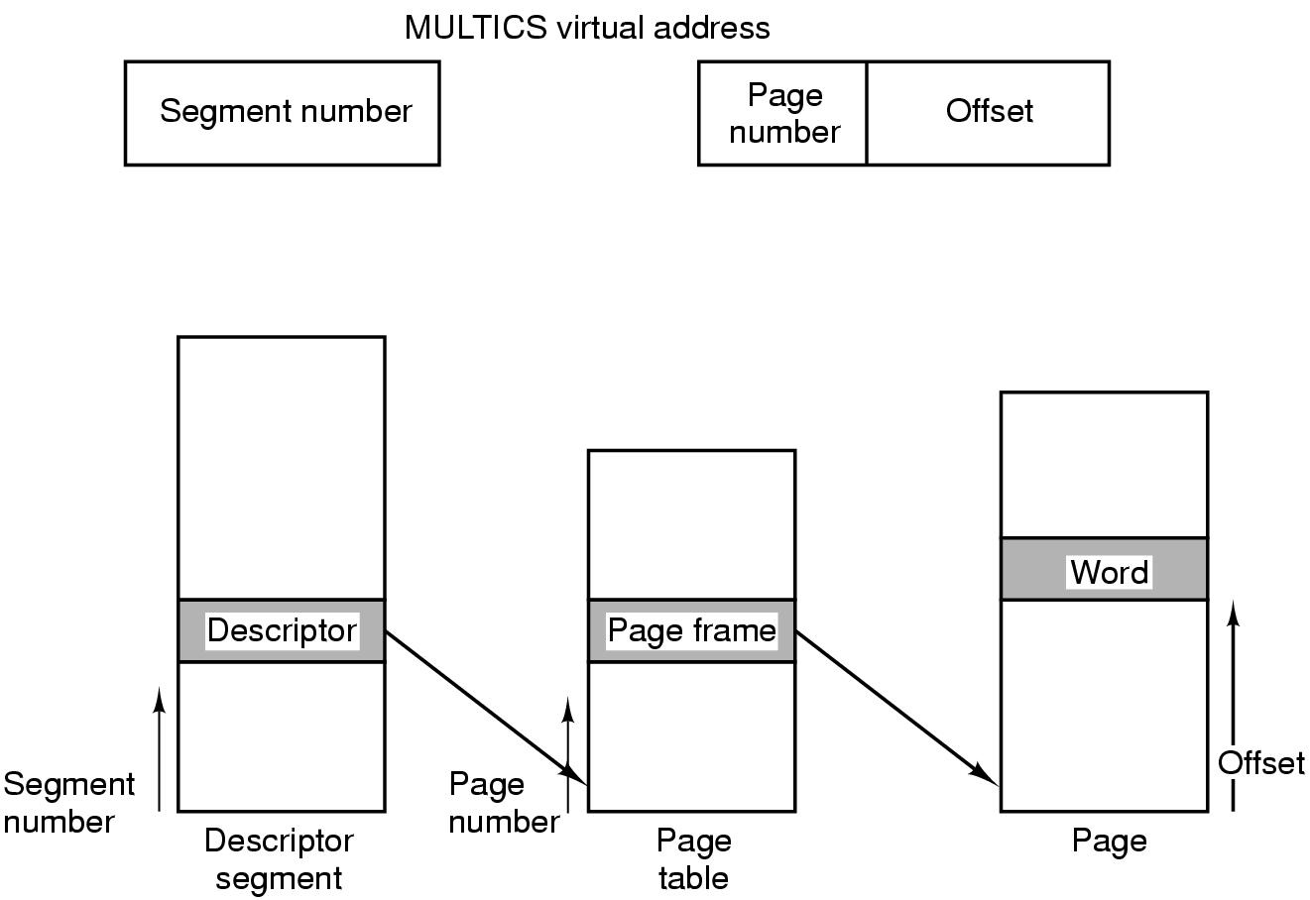
Segmentation with Paging: MULTICS (3)
Conversion of a 2-part MULTICS address into a main memory address

Slide 66
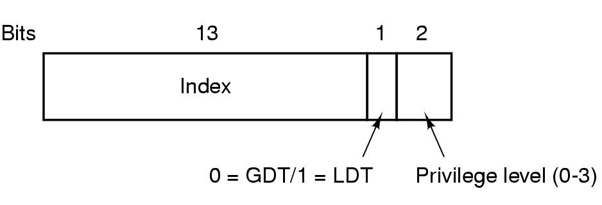
Segmentation with Paging: Pentium (1)
A Pentium selector

Slide 67
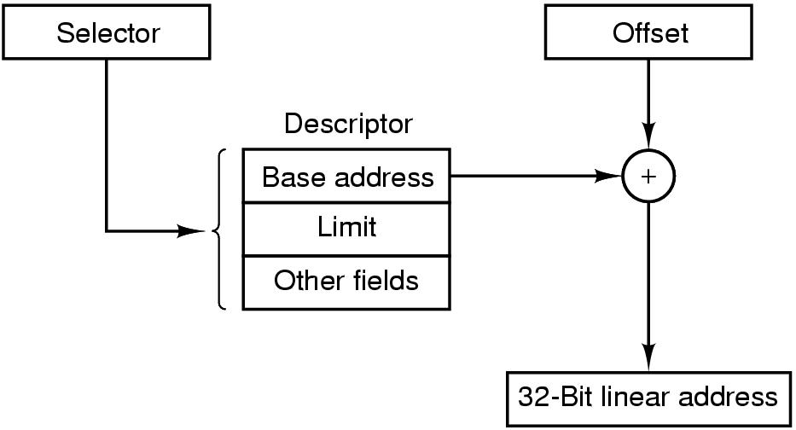
Segmentation with Paging: Pentium (3)
Conversion of a (selector, offset) pair to a linear address

Slide 68
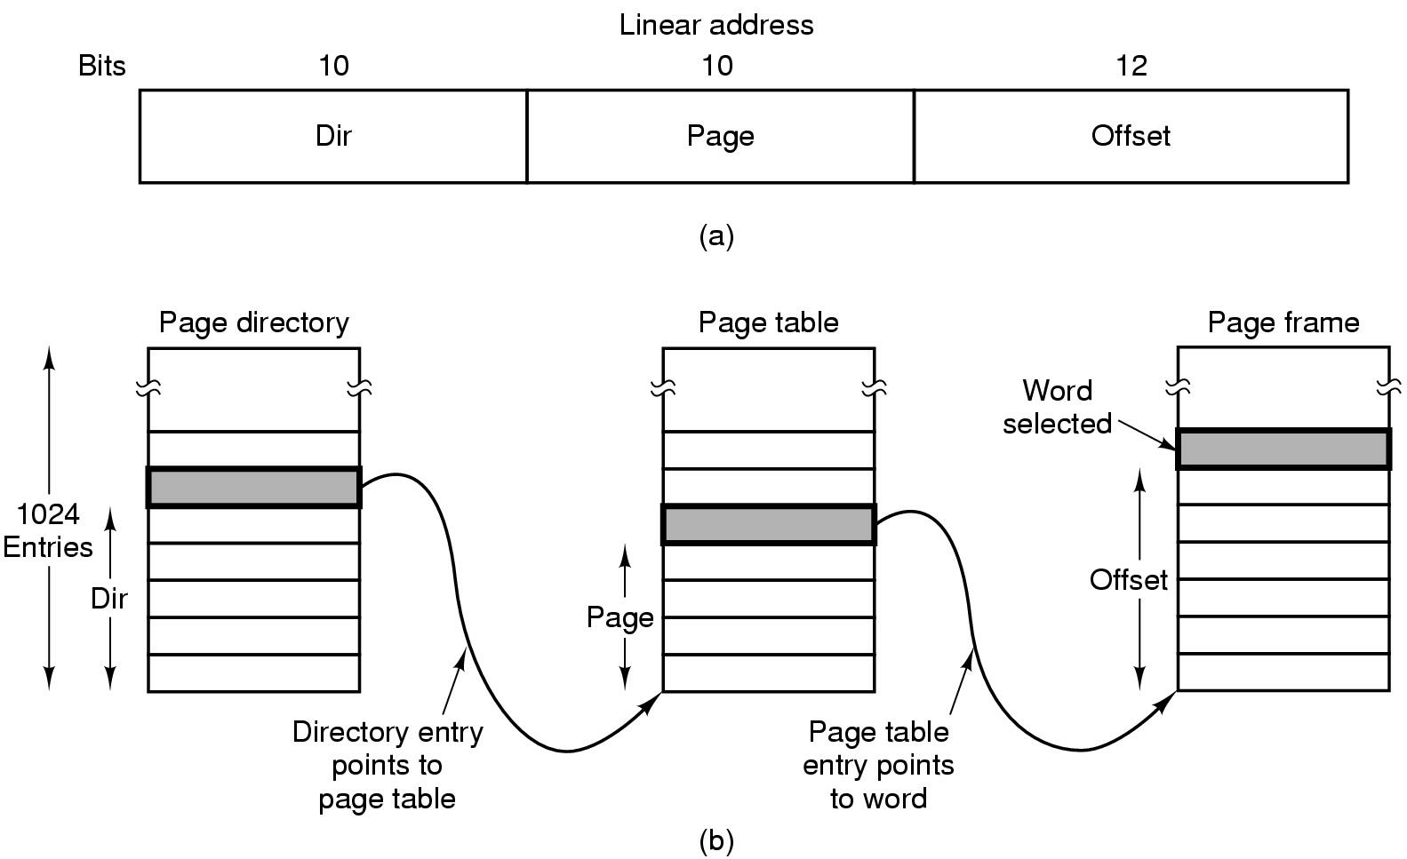
Segmentation with Paging: Pentium (4)
Mapping of a linear address onto a physical address

Slide 69
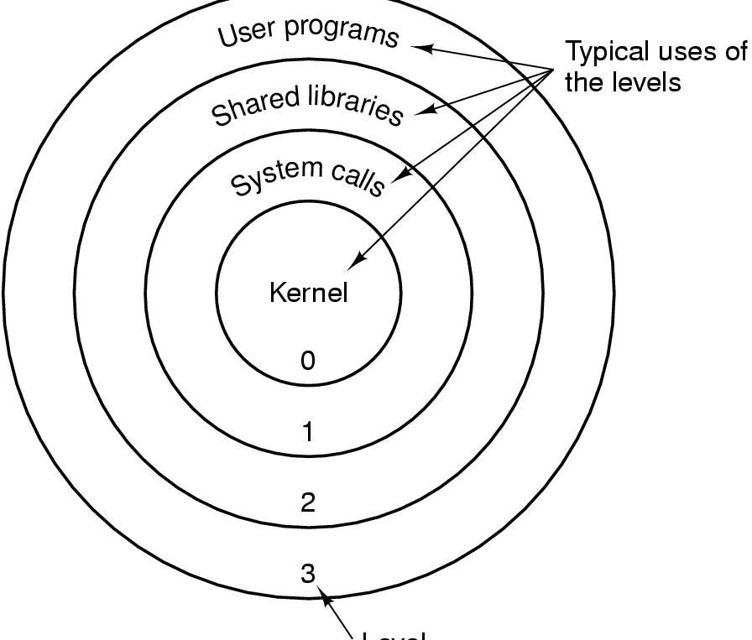
Segmentation with Paging: Pentium (5)
Level
Protection on the Pentium

