Slide 1
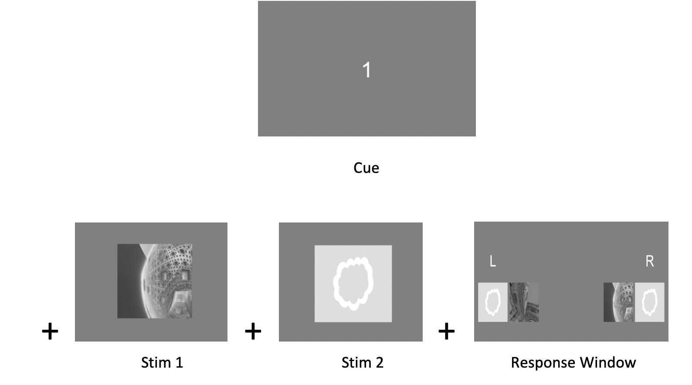
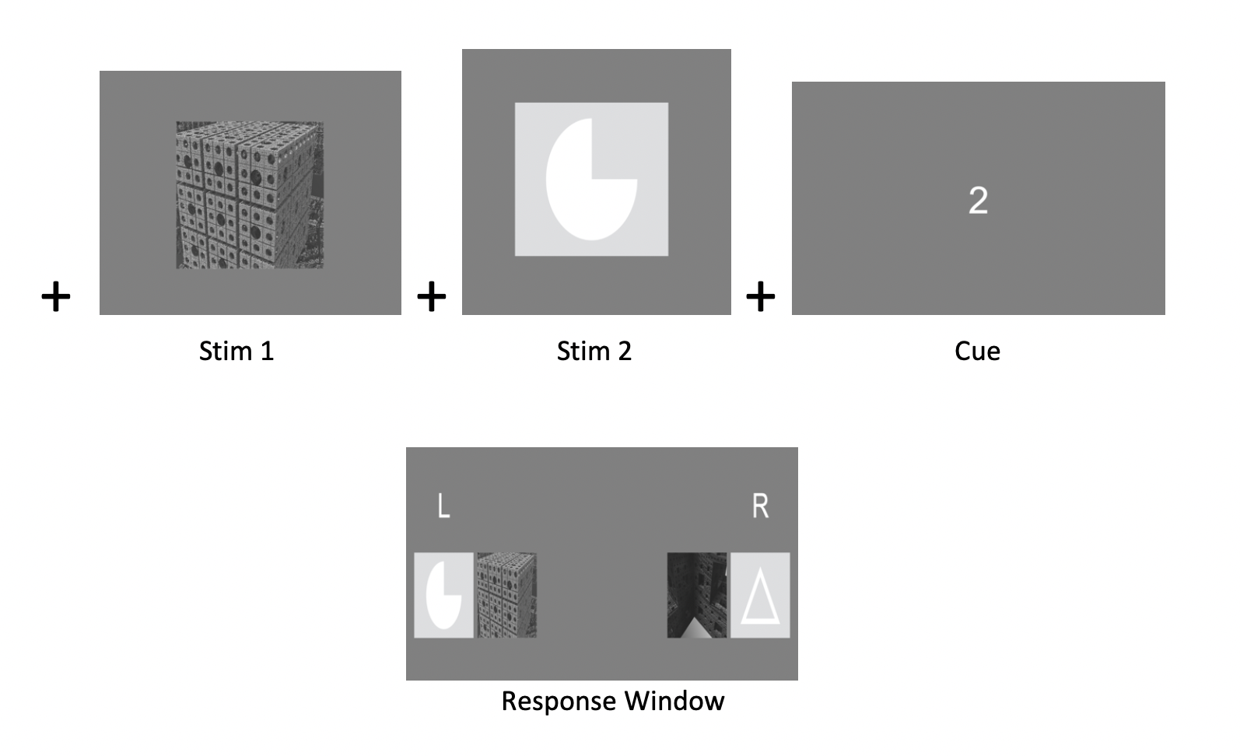


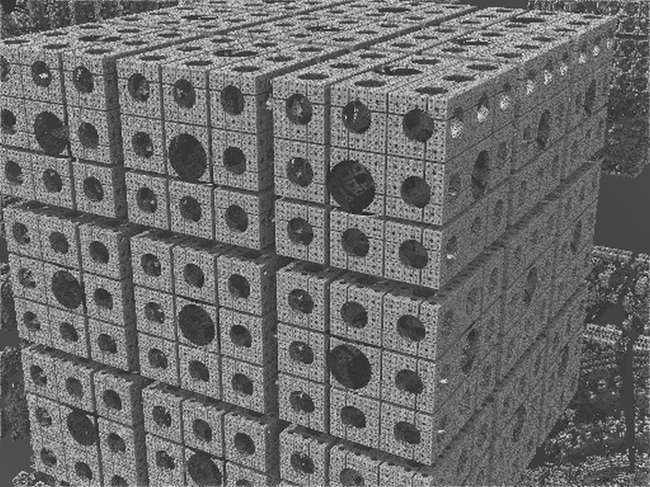

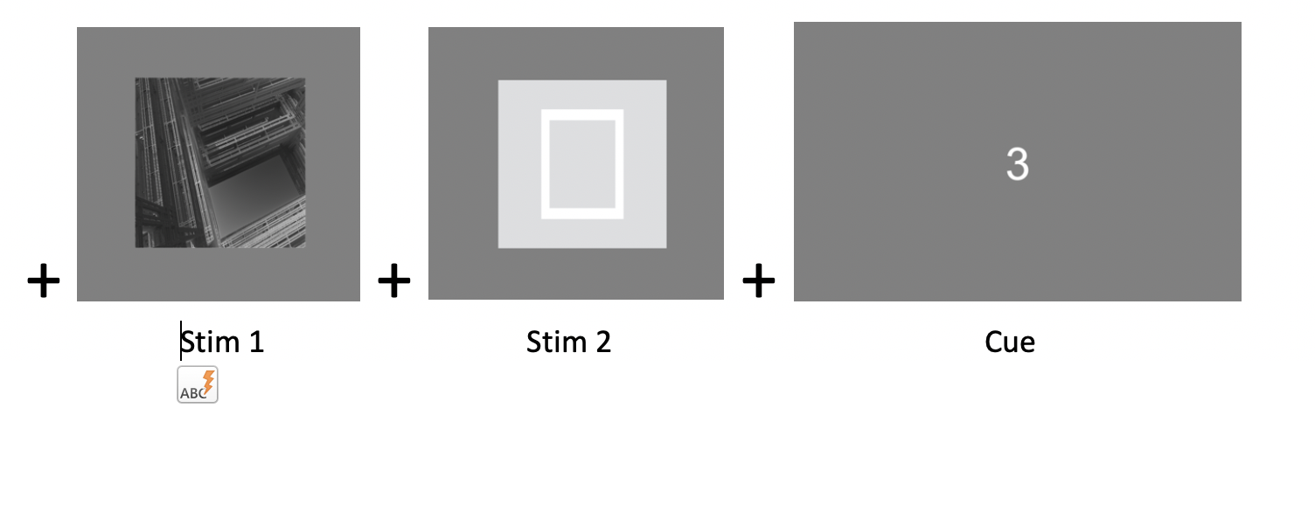
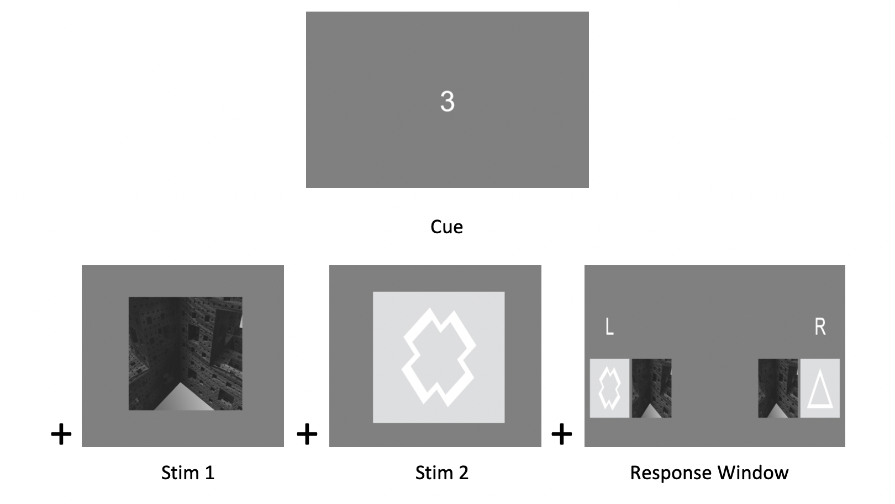
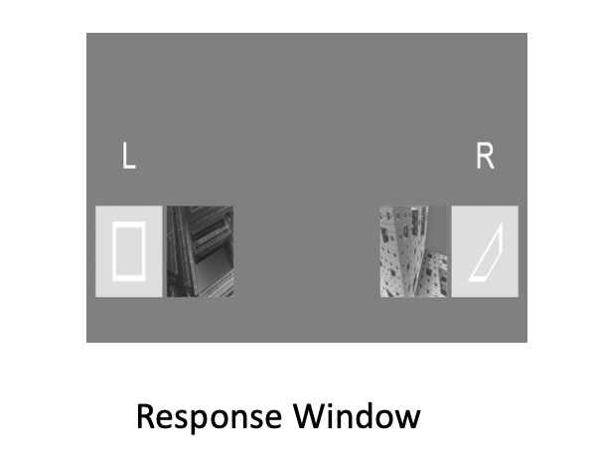







Regular single stim trial types (A,B)
1
A: Control First
A
B
B: Control Last
2
C: Global Control First
C
D
3
Global or ‘Dual’ stim trial types (C,D)
Figure1. The figure above shows the four possible trial type flows as they would appear during a task trial. The figure to the right describes the relevant stimuli options shown with each cue type, and the correct selected response as indicated by a left 1 button press or a right 0 button press. A) Describes a control first cue which appears first and is always associated with a fractal, B) Describes Control Last which appears after the stimuli and is associated with a shape, C) Global Control first indicates both stimuli shown after the cue will be the correct combination for response selection, D) Describes Global Control Last where the cue appears at the end of stimuli presentation and requires the correct combination of trial stimuli shown for response selection.
3
D: Global Control Last

Slide 2
Use Case for Function ITI Jitter: This accompanies Jupyter Notebook “Function_User_Cases.ipynb”
def make_ITI(num_trials):
if isinstance(num_trials, int) == True:
ITI=np.random.choice([1, 1.1, 1.2, 1.3, 1.4, 1.5, 1.6, 1.7, 1.8, 1.9, 2.0]) # numpy randomly grabs a value
# ITI refers to a "jitter" to prevent anticipatory effects
# The random value between 1-2 seconds is returned
return ITI
else:
print('Error: Input of Jitter is not integer')
Enter any integer
Check if integer
If, integer. Grab ITI
ITI is now returned
This will error if non-integer given
Good Input
Bad Input
num_trials = '4' # When it is a string
bad_output = make_ITI(num_trials) # We try running it in the function
print(type(num_trials)) # We see it is class string
print(isinstance(num_trials, int)) # We see it does not pass our test of 'Integer?'
num_trials=4 # integer (could be of any size: 8, 2, 23 etc..)
print(type(num_trials))
print(isinstance(num_trials, int))

Slide 3
User Case for function: getDuplicatesWithCount(listOfElems)
Input: list
Conditional: if input is list type
False: output error
True
Create empty dictionary
print('Error: did not feed in a list’)
Loop through list elements
Conditional: to create dictionary key and count
Filter key pairs and return dictionary: K = element type, value is count

