Slide 1

Android Auto
06.10.2017

Slide 2
Agenda
1
4
7
Debiscium ut ditio mintibus serem harciis dolorero
Debiscium ut ditio mintibus serem harciis dolorero
Debiscium ut ditio mintibus serem harciis dolorero
2
5
8
Si aborem eumque sam harchillis abore dolora
Si aborem eumque sam harchillis abore dolora
Si aborem eumque sam harchillis abore dolora
3
6
9
Idus non core amendunt es explistiam vellabo
Idus non core amendunt es explistiam vellabo
Idus non core amendunt es explistiam vellabo

Slide 3
1.
Overview- Android Auto

Slide 4
Overview- Android Auto
Release Date: March 19, 2015.
Android Application for smartphone that allows a connection with the car using a usb cable.
Android Auto connects via Bluetooth, in order to connect with the car sound system..
Simpler is safest
Only brings useful information
Organized into simple cards
Apps need to have consistent design
Large and round buttons, for easy touch points
Similar menu structures.

Slide 5
Comparison with Competitor Technologies
GPS Navigation
Google maps is the more precise and user friendly application for GPS Navigation.
Voice Control
Speech recognition from Google is more refined, and his able to interpret more commands.
Not compatible car
Android Auto has the ability to work in the phone.

Slide 6
2.
How it works?

Slide 7
How it works?
If connected to the car the phone stays unusable.
There are 5 panels available, if connected with the car dash screen.
If we use the phone there are 4 panels available
Home menu has information such as the weather, current song, current destination and upcoming appointments.
Only important information appear while driving
Notifications such as alerts from email, facebook or twitter, will not show in the notifications log.

Slide 8
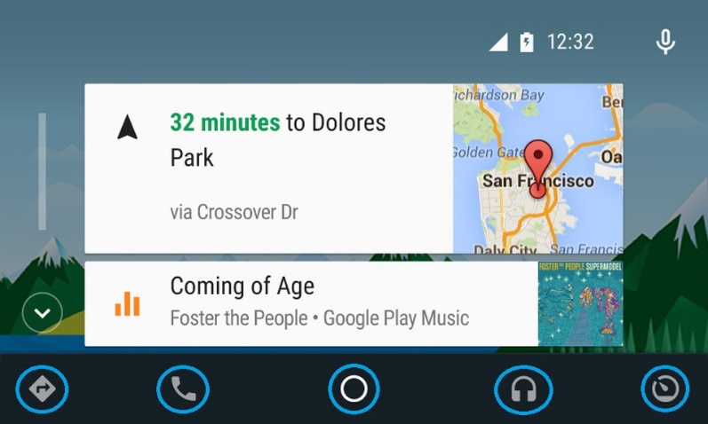
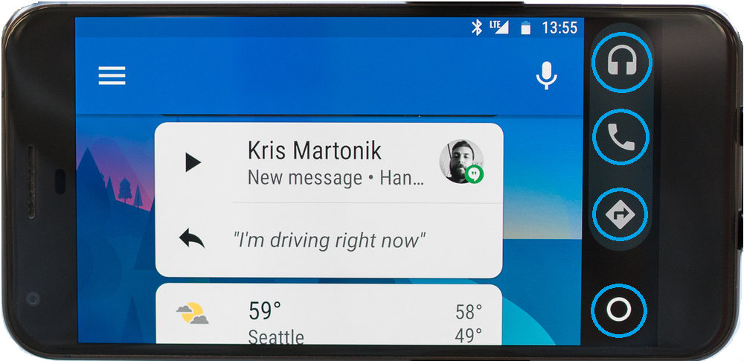
Android Auto - Panels
On phone Screen
On Car Dash Screen

Slide 9
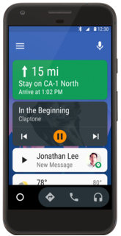
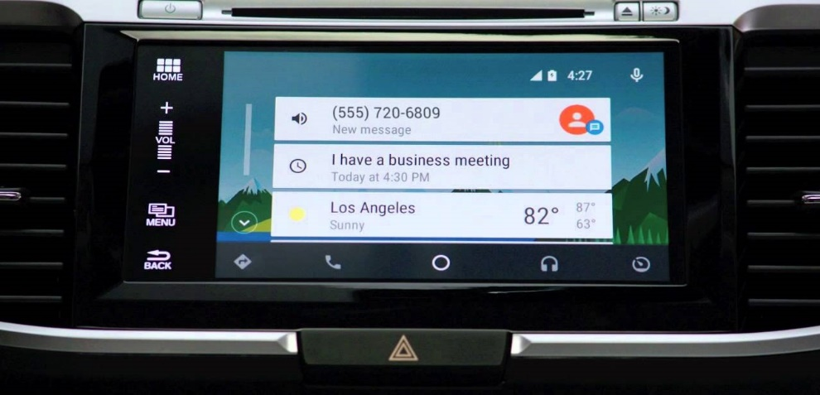
Android Auto - Home Menu
On phone Screen
On Car Dash Screen

Slide 10
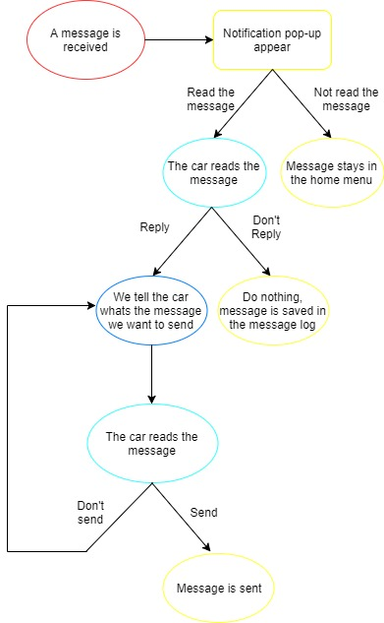
When a message is received

Slide 11
3.
Building Apps for Auto

Slide 12
Set up an Auto project
Auto supports two types of apps
Audio apps - allow users to browse and play music and spoken audio.
Messaging apps - receive incoming notifications, read message via text-to-speech, and send replies via voice input.
Prerequisites
Create or update your app project - target Android 5.0 (API level 21) or higher.
Install the support library- NotificationCompat.CarExtender class allows you to create notifications that are compatible with Auto devices.
Declare Auto capabilities
Define the Auto XML configuration- Specify the car capabilities that your app uses in an XML file.
Add a manifest entry - provide a reference to the Auto XML configuration file you created.
Add Auto features to your apps
Notes:
https://developer.android.com/training/auto/start/index.html#dev-project

Slide 13
Providing Audio Playback for Auto
Build a Browser Service
Media browser service extends MediaBrowserService class.
Android Auto includes a browsing capability that lets users select a letter from an on-screen keyboard
Building content hierarchy
Enable Playback Control
Register a media session - set a callback object that is used to handle playback control requests.
Implement play commands - your app must extend the abstract MediaSession.Callback class and implement the methods that your app supports
Support Voice Actions
Enable your audio app to launch with a voice command - "Play [search query] on [your app name]"
Parse the voice query to build the playback queue
Playback control actions - implement the callback methods with the playback controls that you support in your app.
Notes:
Android Auto can contact your service to do the following:

Slide 14
Providing Messaging for Auto
Define read and reply intent filters
Define the read action and reply action intent types for your app and the BroadcastReceiver classes.
Import Support Library for Messaging
Update the support libraries, building notifications requires classes from the v4 support library.
Notify Users of Messages
Create conversation read and reply intents - create a PendingIntent object for each of these actions,
Set up the conversation builder - Auto organize messages into conversations
Handle User Actions
Handling a message read action - Auto sends a read intent based on how your app defined the messaging notification
Handling a reply action - Auto sends a read intent based on how your app defined the messaging notification

Slide 15
Testing Apps for Auto
Android Auto is available for both car and phone screens
Car screen - Desktop Head Unit (DHU), a testing tool for Auto apps that lets you test pre-released versions of your Android Auto apps.
Phone screen - This option lets you display and test pre-released versions of your app on Android Auto for the phone screen.
Car screen
DHU enables your development machine to emulate an Android Auto head unit
The DHU runs on Windows, Mac, and Linux hosts.
After you’ve installed the DHU, you can test your Android Auto apps by connecting your phone and workstation via USB.
Phone screen
Install the Android Auto app, available on Google Play, on your handheld and enable unknown sources in developer mode
Enable USB debugging
Install your app onto the handheld and test

Slide 16
Auto App Quality
Need to meet all relevant core app quality criteria for the Android platform
Core app quality
Visual Design
Driver attention
Layout
Visual Contrast
Interaction
Auto app quality
General
Media
Notifications
Messaging
Functionality

Slide 17
Distribute to Android Auto
Understand the guidelines and requirements - read and understand the quality guidelines for Auto apps.
Develop a app for Auto - Android Auto is a part of a new or existing app for Android devices, using the same package name and store listing.
Test for Auto app quality - Apps should be designed to perform well, look great in the car, and offer the best user experience possible.
Agree to Android Auto terms and publish - Google Play submits your app for review against the Auto app quality criteria and notifies you of the result.
Track your review
App will be reviewed for compliance with driver distraction guidelines and the technical and quality criteria
After a successful review, your app will be published and made available on the Google Play Store
Notes:
https://developer.android.com/distribute/best-practices/launch/distribute-auto.html#how_to_participate

Slide 18
4.
Compatible with Android Auto

Slide 19
Compatible with Android Auto
There are 37 brands of cars that have already implemented Android auto in some models, such as: Audi, Chevrolet, Lamborghini and Volvo.
In the near future the Android Auto will be implemented in 16 more brands.
Android Auto is also implemented in 5 brands of aftermarket displays, such as: Kenwood,Panasonic and Sony.
In the near future Android Auto will be implemented in 4 more brands of aftermarket displays.
Android Auto is only avaible in 31 countries.
For Portugal, there isn’t a official release date that, however the apk can be downloaded, and use some functionalities.

Slide 20
5.
Embedded Android Auto

Slide 21
Overview – Embedded Android Auto
Release Date: No official release date, shown in May 17, 2017 in Google I/O
Android-based operating system designed for vehicles
Tightly-integrated with the features of the car
Can control various sensors and switches.
Gives the car OEMs more control over the UI
Full customization is important for adoption

Slide 22
How it works?
Similar to Android Auto.
UI elements and built-in apps differ from OEM to OEM.
Expect implementations from different automakers to look and feel unique
Different design elements
Different display types.

Slide 23
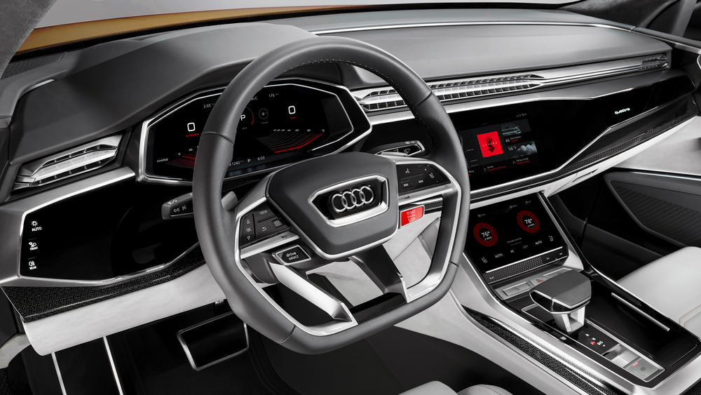
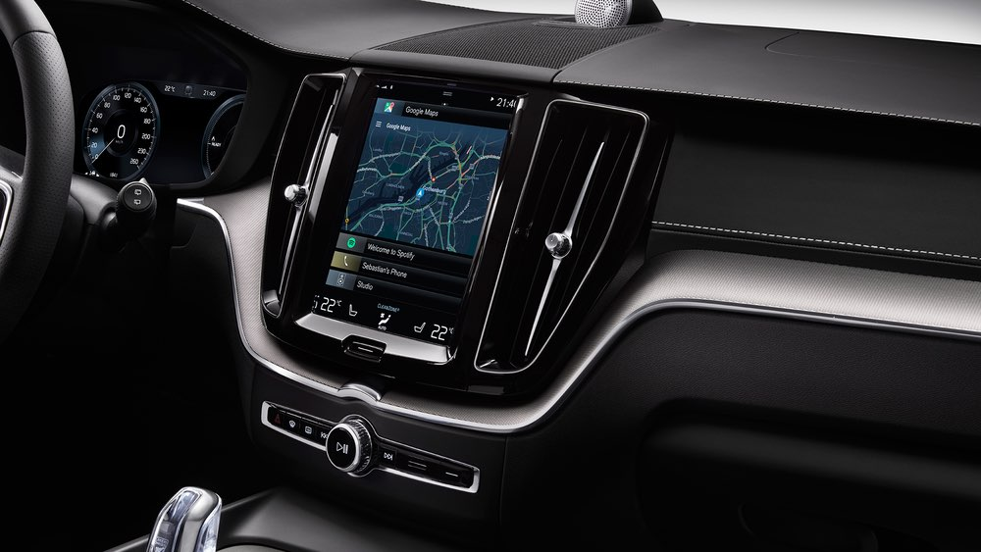
Car Models where it is available (Google I/O 2017)
Audi Q8
Volvo V90 SUVs

