Slide 1
Error Handler Rework
Fault Tolerance Working Group

Slide 2
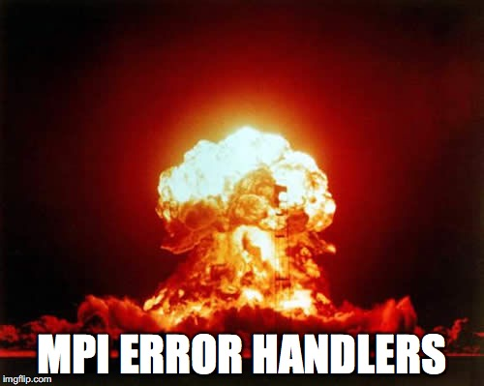
Motivation
In Portland (March 2015), Tony charged us with greenfielding Error Handlers and coming up with a wishlist of what we really want.
We’d figure out backward compatibility “later”.

Slide 3
Error Handler Rework Wish List
Clarify what you are allowed to do in an error handler
Return new error codes from an error handler
Handle with QMPI
Pick which error classes we handle in a single function
Be able to recreate operations if desired
Handle with QMPI
Combine the three error handler functions into a single one to be able to assign generically
Specify error handler inheritance

Slide 4
Clarify what you’re allowed to do in an errhandler
What are you allowed to do in an error handler?
MPI calls?
Communication?
Long jump?
Finalize?

Slide 5
Clarify what you’re allowed to do in an errhandler
What are you allowed to do in an error handler?
MPI calls?
Communication?
Long jump?
Finalize?
Probably want to allow everything, but point out that error handlers are local and the user is responsible for matching.
Some of these will be very tricky to implement correctly with threads but we think it might not be so bad given that error handling generally happens at the end.
Notes:
All of these are already used in fault tolerance libraries and they “work”. It may be an accident that they work though.

Slide 6
Pick Error Classes to Handle
Handler
Add array of error classes to the MPI_Errhandler_set function
Only call this error handler when an error class in the array is raised
Have ”generic” error handler for all other cases
Set a default and overwrite it for specific cases
Add a predefined value for MPI_ANY_ERROR
Helpful for FT libraries (e.g. Fenix)
MPI_ERR_PROC_FAILED
Error
MPI_ERR_MEM
Handler
MPI_ANY_ERROR
Handler

Slide 7
Multiple Error Handlers
Still only allow a single error handler for a particular error class
Specific error classes overwrite the general MPI_ANY_ERROR handler
Error
Handler
Other
Handler

Slide 8
Guarantee that MPI is long jump safe
Allow the error handler to long jump to a location after the function is completed
User’s responsibility to make sure that it doesn’t screw up its own threads
It might not currently be safe to long jump directly out of the error handler because you might be in MPI’s thread.
In practice, we don’t think implementations do this, but the Standard doesn’t prohibit it. We should clarify this.
This gives you Reinit/Fenix-like behavior
The implementation should be able to indicate whether or not it is long-jump safe.
Or we can off MPI_Jump() which lets the user specify a location to jump
Have to think about how to do this portably

Slide 9
One Errhandler to Rule Them All
Need a way to get a communicator from a request to be able to match up objects.
typedef void MPI_Errhandler_function(
(IN) void * handles, /* Request(s) if they exist,
otherwise comm/win/file/etc. */
(IN) int num_handles, /* Num handles in the previous array? */
(IN) int/enum * handle_types, /* req,comm,win,file */
(INOUT) int * errcode, /* Just one, maybe MPI_ERR_IN_STATUS */
(IN) void * context, /* User can log operations or something */
…); /* Implementation specific */
int MPI_Set_errhandler(
(IN) void * handle, /* Which handle does this apply to? */
(IN) int * error_classes, /* Which error classes to catch
Could be MPI_ANY_ERR_CLASS */
(IN) int num_error_classes, /* Num classes in the previous array */
(IN) void * context, /* User specific */
(IN) MPI_Errhandler errhandler);
Add parameter to specify errhandler inheritance

