Slide 1
MPI Errhandler Greenfield Result
December 2016 MPI Forum
Fault Tolerance Working Group

Slide 2
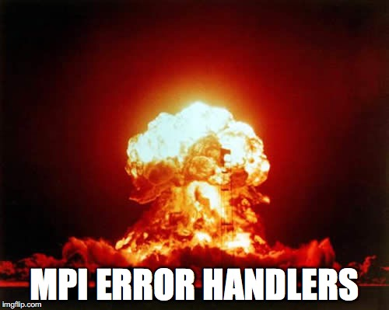
Motivation
In Portland (March 2015), Tony charged us with greenfielding Error Handlers and coming up with a wishlist of what we really want.
We’d figure out backward compatibility “later”.

Slide 3
Error Handler Rework Wish List
Clarify what you are allowed to do in an error handler
Return new error codes from an error handler
Handle with QMPI
Pick which error classes we handle in a single function
Be able to recreate operations if desired
Handle with QMPI
Combine the three error handler functions into a single one to be able to assign generically
Specify error handler inheritance
This is important for sessions in particular

Slide 4
Error Handler Rework Wish List
Clarify what you are allowed to do in an error handler
Return new error codes from an error handler
Handle with QMPI
Pick which error classes we handle in a single function
Be able to recreate operations if desired
Handle with QMPI
Combine the three error handler functions into a single one to be able to assign generically
Specify error handler inheritance
This is important for sessions in particular
Everything is permitted
Syntactic sugar
Very Hard

Slide 5
Why is combining the three hard?
Writing an error handler where the incoming handles are void * and could be any type of handle is if/switch hell.
Everything we tried ended up pointing back to something more like the existing error handler

Slide 6
We should still fix error handler inheritance
Non-Sessions (Do this now)
Sessions (Do this later)
Communicators inherit from each other (clean up definitions)
Windows inherit for MPI_WIN_NULL
Files inherit from MPI_FILE_NULL
(same as other issue we pursued)
Allow attaching a comm/win/file error handler to the session
These error handlers are inherited when a comm/win/file is created from a session
Create a new type of error handler for sessions
Would look the same as existing error handlers (s/Comm/Session/g)

Slide 7
Orthogonal Issue Is MPI_ERR_PENDING really necessary?
It’s only around to tell the user what happens when only some of the requests in an MPI_WAITALL are processed.
What if we just required that all requests got a “real” return code (some other error or MPI_SUCCESS)?
Can we just deprecate it?

