Slide 1
Fenix: An Online Failure Recovery Library for MPI applications on top of ULFM
Marc Gamell¹, Keita Teranishi²,
Rob Van Der Wijngaart³, Manish Parashar¹
¹ Rutgers Discovery Informatics Institute (RDI²), Rutgers University
² Sandia National Laboratories
³ Intel Corporation
Based on:
“Exploring Automatic, Online Failure Recovery for Scientific Applications at Extreme Scales”, SC14
Marc Gamell, Daniel S. Katz, Hemanth Kolla, Jacqueline Chen, Scott Klasky, Manish Parashar
“Practical Scalable Consensus for Pseudo-Synchronous Distributed Systems”, SC15
Thomas Herault, Aurelien Bouteiller, George Bosilca, Marc Gamell, Keita Teranishi, Manish Parashar, Jack Dongarra
SAND2016-1864 C
Notes:
1

Slide 2
Introduction / Goal
Fenix can be used effectively, efficiently, and productively to provide online fault tolerance to a major production code (S3D)
How can an application use Fenix?
How does Fenix use ULFM?

Slide 3
Key Contributions
Approach
Targets MPI-based parallel applications
Offers two disjoint interfaces
Fenix Interfaces:
1. Process/rank recovery
Online, semi-transparent recovery
from process, node, blade and cabinet failures
Tolerates a variety of MTBFs
even extreme MTBFs of <1 minute
2. Data recovery
Uses application-specific, double in-memory, implicitly coordinated checkpoints
Experimental Evaluation
Deployed Fenix on Titan Cray XK7 at ORNL
S3D combustion numerical simulation
Sustained performance with MTBF = 47 seconds
Experiments inject real process failures (SIGKILL)
App +
libraries
Fenix
MPI (+ULFM) runtime
O.S.
Implementation details
Built on top of ULFM
Tested up to
16384 cores w/ failures
250k cores w/o failures
Available for C and Fortran applications
Notes:
S3D has been highlighted by [22] as one of five promising applications on the path to exascale

Slide 4
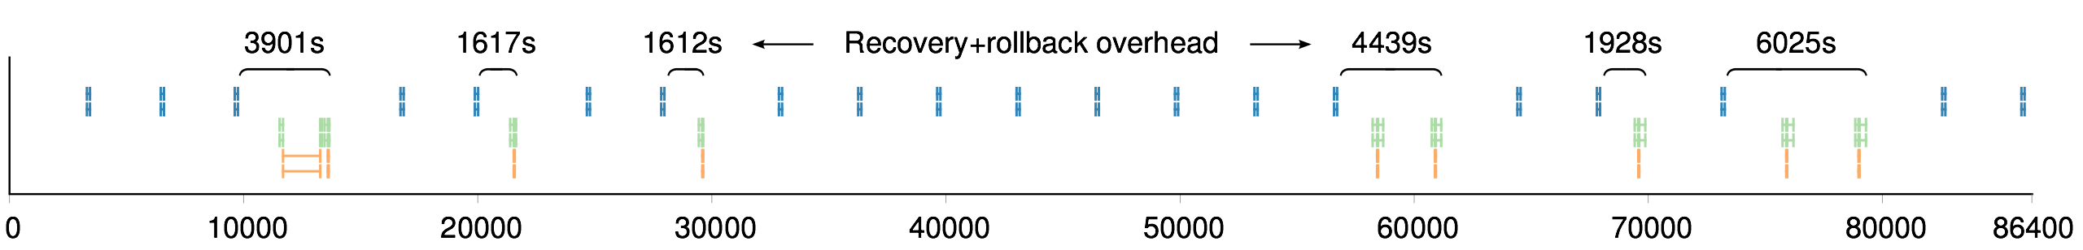

Motivating Use Case – S3D production runs
 | Total cost
Checkpoint (per timestep) | 55 s | 1.72 %
Restarting processes | 470 s | 5.67 %
Loading checkpoint | 44 s | 1.38 %
Rollback overhead | 1654 s | 22.63 %
Total overhead |  | 31.40 %
24-hour tests using Titan (125k cores)
9 process/node failures over 24 hours
Failures are promoted to job failures, causing all 125k processes to exit
Checkpoint (5.2 MB/core) has to be done to the PFS
Notes:
S3D production runs on (half of) Titan already have an overhead of 31.40% with C/R. This is a number we will use to compare with our result.

Slide 5
Motivating Use Case – Possible solution
Process failures cannot be promoted to job failures, to:
Reduce recovery cost
Keep process memory (contains checkpoints)
Online recovery
Checkpoint frequency has to be dramatically increased, e.g.
Checkpoint application-specific data
in process memory w/o coordination
Notes:
A possible solution to the previous problems is to use in-memory double checkpointing and local online recovery

Slide 6
ULFM – User Level Failure Mitigation
User Level Failure Mitigation is a set of MPI extensions to report errors, provide interfaces to stabilize the distributed state, and restore the communication capabilities in applications affected by process failures. Relevant communicators, RMA windows and I/O files can be reconstructed online, without restarting the application, as required by the user recovery strategy.
FLEXIBILITY
No particular recovery model is imposed or favored. Instead, a set of versatile APIs is included that provides support for different recovery styles (checkpoint, ABFT, iterative, Master-Worker, etc.).
Application directs the recovery, it pays only for the level of protection it needs.
Recovery can be restricted to a subgroup, preserving scalability and easing the composition of libraries.
PERFORMANCE
Protective actions are outside of critical MPI routines.
MPI implementors can uphold communication, collective, one-sided and I/O management algorithms unmodified.
Encourages programs to be reactive to failures, cost manifests only at recovery.
PRODUCTIVITY
Backward compatible with legacy, fragile applications.
Simple and familiar concepts to repair MPI.
Portability guaranteed by standardization.
Provides key MPI concepts to enable FT support from library, runtime and language extensions.
Fenix:
Provides semi-transparent online recovery to particular application types
Implements a particular recovery mode thanks to generic ideas behind ULFM
Excerpt of ULFM flyer at SC15 by ICL@UTK

Slide 7
Two Philosophy Changes for the Application
Application view:
Offer a single point in which all ranks will return upon failure has been recovered
longjump
Application should use Fenix’s resilient communicator instead of MPI_COMM_WORLD
Returned by Fenix_Init
All comms derived are safe ☺
What about other libraries?
If they do not use Fenix (and keep state): teardown and re-initialize
If they use Fenix themselves:
Not supported for the moment
Maybe recovery callbacks?

Slide 8
Fenix – Failure Recovery Interface
INITIAL_RANK
RECOVERED_RANK
SURVIVOR_RANK
void Fenix_Init ( int *status,
MPI_Comm comm,
MPI_Comm *newcomm,
int *argc, int ***argv,
int num_spare_ranks,
Fenix_Comm_repair_policy repair_policy,
int *error);
MPI_COMM_WORLD
App should use newcomm instead of MPI_COMM_WORLD
NO_SPAWN
SPAWN
comm
newcomm
spares
r
r
r
r
r
r
r
r
r
r
respawned
process
newcomm
sp.
newcomm
r
r
r
r
[SPAWN]
r
r
r
Initialize
newcomm
newcomm
Recovery from a process failure
r
r
r
[NO_SPAWN]
r
r

Slide 9
Fenix + ULFM – Recovery Stages
1. Failure detection
With ULFM, MPI communicating calls may return failure codes
Fenix captures them using MPI profiling interface
☹ For now, no other tools in conjunction with Fenix
☺ In the future, maybe MPI will replace PMPI with a method that allows attaching multiple tools (QMPI/MPI Extension Interface)?
Uses MPI_Comm_revoke to spread notification
2. Environment recovery
Repair only main communicator (newcomm)
Non-shrinking model:
Use spare process pool and
Re-spawn processes
Non-shrinking up to a certain number of failures
Use spare process pool
Shrinking model
Re-creation of user communicators: done by the user

Slide 10
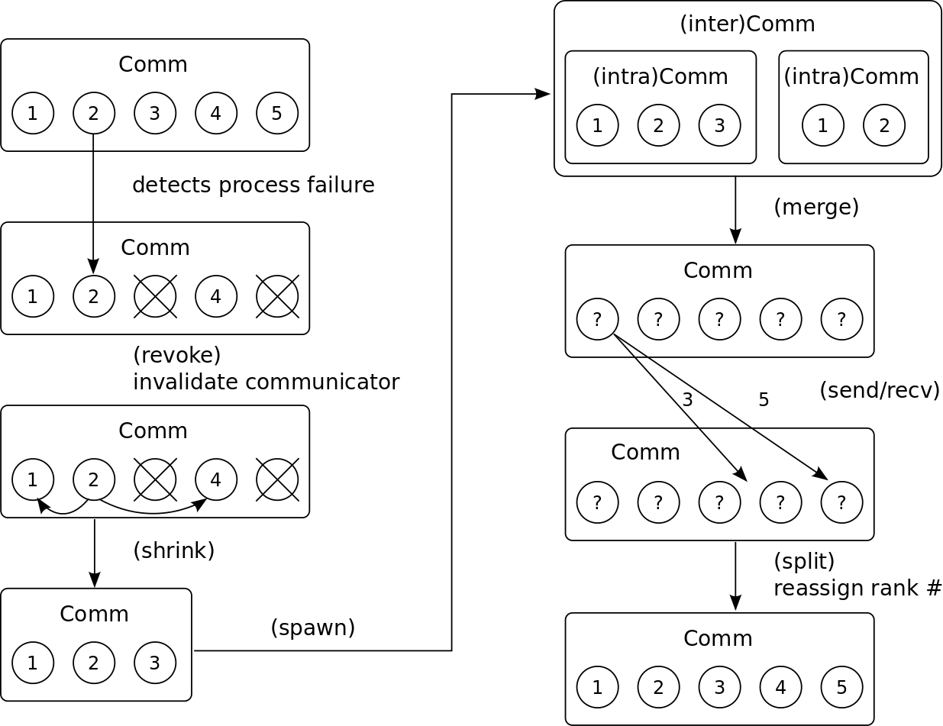
Fenix – Recovery Stages
1. Failure detection
Based on
ULFM return codes
MPI profiling interface
Comm revoke
2. Environment recovery
Spawn /
Spare process pool
Repair “newcomm” communicator
Delay re-creation of user comms
“Spawn” recovery mode depicted (similar for spare process pool)

Slide 11
Fenix + ULFM – Internal Initialization Pseudocode
Assume we have two communicators:
MPI_Comm comm (originally, a dup from Fenix_Init’s input comm)
MPI_Comm newcomm (repaired communicator to be used, returned as newcomm from Fenix_Init)
fenix_internal_init() {
MPI_Comm_set_errhandler(comm, MPI_ERRORS_RETURN);
MPI_Comm_rank(comm, &rank);
MPI_Comm_rank(comm, &size);
if(rank >= size – num_of_spare_ranks) { // SPARE RANK
PMPI_Comm_split(comm, MPI_UNDEFINED, rank, &newcomm);
for(;;) { // wait for failure to occur
ret = MPI_Recv(..., MPI_ANY_SOURCE, MPI_ANY_TAG, comm);
if(ret == MPI_SUCCESS)
MPI_Finalize(); exit();
}
} else { // NOT A SPARE RANK
PMPI_Comm_split(comm, 0, rank, &newcomm);
}
}

Slide 12
Fenix + ULFM – Failure Detection Pseudocode
Override MPI functions and use PMPI interface, e.g.
int MPI_Send(void *buf, int count, MPI_Datatype datatype,
int dest, int tag, MPI_Comm comm)
{
int ret;
ret = PMPI_Send(buf,count,datatype,dest,tag,comm);
fenix_internal_test_return_code(ret);
return ret;
}

Slide 13
Fenix + ULFM – Testing for Failures Pseudocode
void fenix_internal_test_return_code(int ret) {
switch(ret) {
case MPI_SUCCESS:
return;
case MPIX_ERR_PROC_FAILED:
MPIX_Comm_revoke(comm);
MPIX_Comm_revoke(newcomm);
fenix_internal_revoke_user_communicators();
case MPIX_ERR_REVOKED:
fenix_internal_communicator_repair();
break;
}
}

Slide 14
Fenix + ULFM – Recovery Pseudocode (1/2)
fenix_internal_communicator_repair() {
MPI_Comm comm_shrink;
MPIX_Comm_shrink(comm, &comm_shrink);
// Do we have enough spare ranks?
MPI_Comm_size(comm, &old_comm_size);
MPI_Comm_size(comm_shrink, &new_comm_size);
ranks_needed = old_comm_size - new_comm_size;
if(num_of_spare_ranks < ranks_needed)
// for today’s discussion, consider an error
// Which ranks failed?
MPI_Comm_rank(comm, &old_rank);
PMPI_Allgather(&old_rank, 1, MPI_INT,
survivor_ranks, 1, MPI_INT, comm_shrink);
// locally determine the failed ranks by using the survivor_ranks array
...

Slide 15
Fenix + ULFM – Recovery Pseudocode (2/2)
fenix_internal_communicator_repair() {
// Shrink the communicator
// Do we have enough spare ranks?
// Which ranks failed?
...
// Assign spare ranks to failed ranks
if(old_rank >= size_newcomm) // WAS A SPARE RANK
if((old_comm_size-1-old_rank) < procs_needed) // RECOVERED RANK
old_rank = // pick one of the failed ranks
else // WAS NOT A SPARE RANK
PMPI_Comm_free(&newcomm);
num_of_spare_ranks -= num_failed_ranks;
// Re-name the spare ranks in the new communicator
PMPI_Comm_free(&comm);
PMPI_Comm_split(comm_shrink, 0, old_rank, &comm);
PMPI_Comm_free(&comm_shrink);
fenix_internal_init();
// no matter who called fenix_internal_communicator_repair, return to Fenix_Init()
}

Slide 16
Which communicators does Fenix revoke?
All communicators derived from newcomm are revoked
The only communicators that the application should use with Fenix philosophy
Derived communicators detected by profiling interface
MPI_Comm_split, MPI_Comm_create, MPI_Comm_dup…
Captured by profiling interface when they are first derived
Upon failure, revoked

Slide 17
Core of Fenix Data Recovery Interface
Fenix_Checkpoint ( int member_id,
void *buffer,
int count,
MPI_Datatype datatype,
Fenix_Checkpoint_group group,
Fenix_Checkpoint_subset subset);
Fenix_Checkpoint_commit (
int *index,
Fenix_Checkpoint_group group);

Slide 18
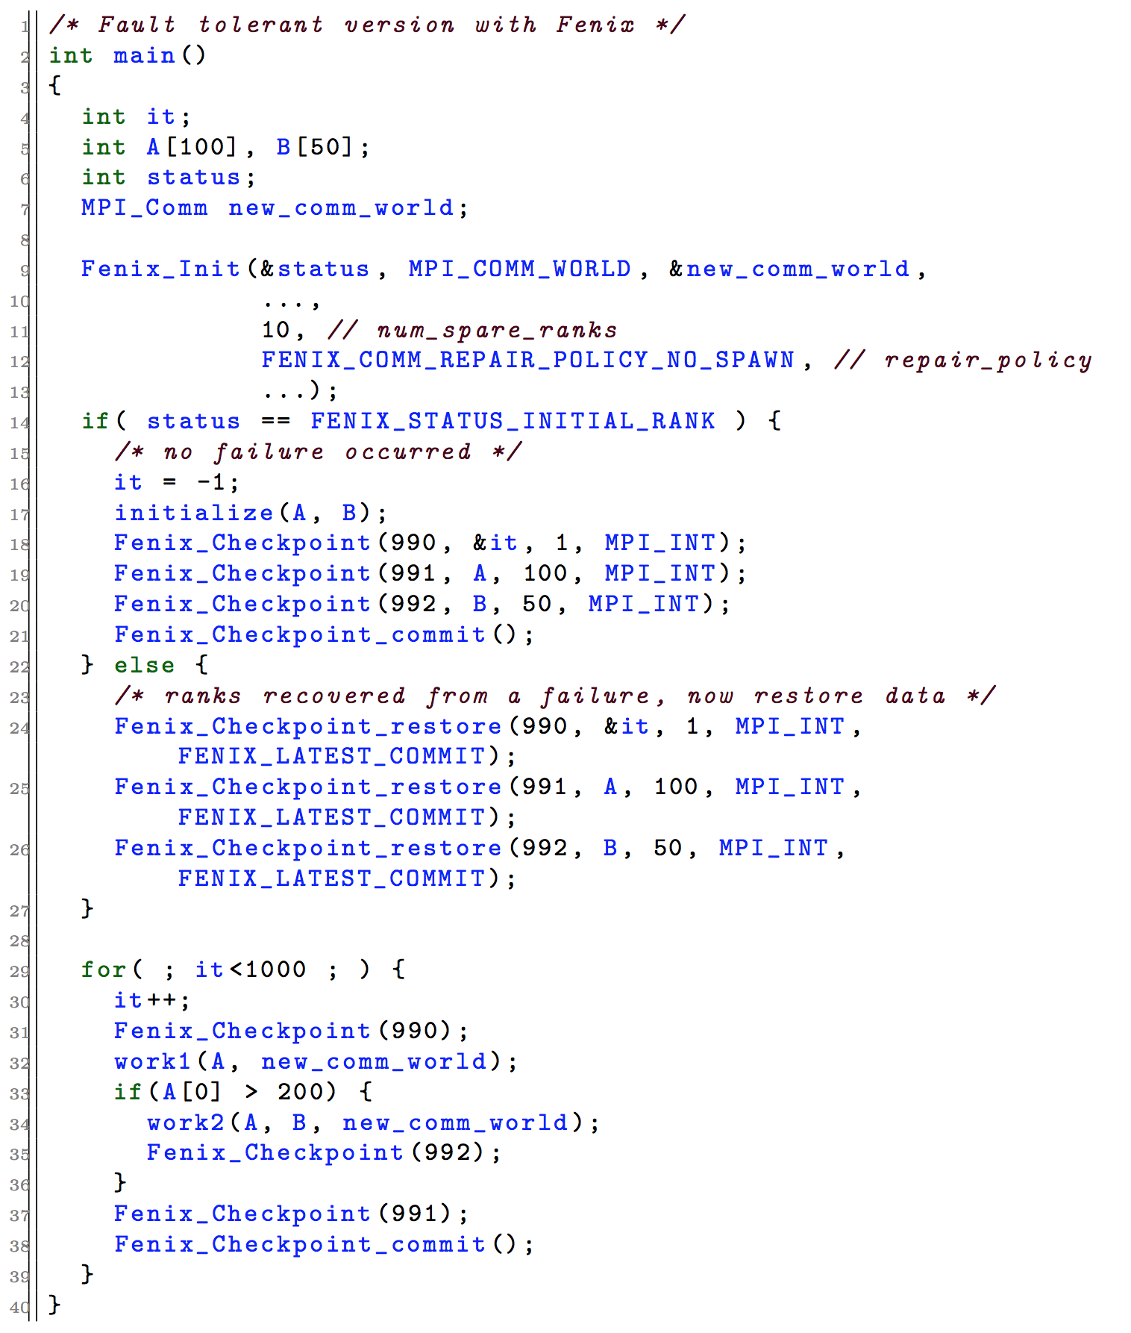
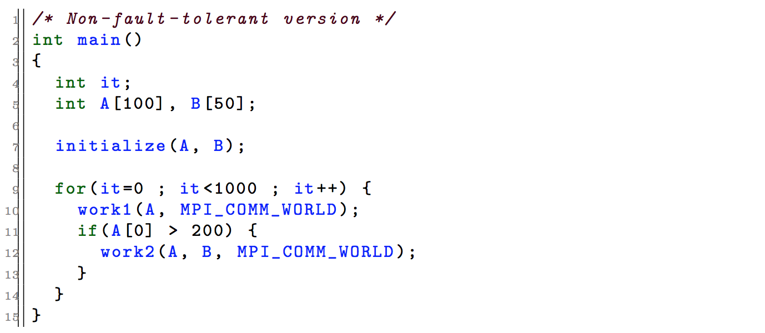
Fenix – Example
Assume work1() and work2() use an MPI communicator to communicate with other ranks
Rank failure line 34
(due to imbalance, some ranks are in it=102, the rest are in it=103 or it=104)
Fenix will resume the execution, returning from Fenix_Init()
This sets it=101, and A, B have the same values they had at iteration 101

Slide 19
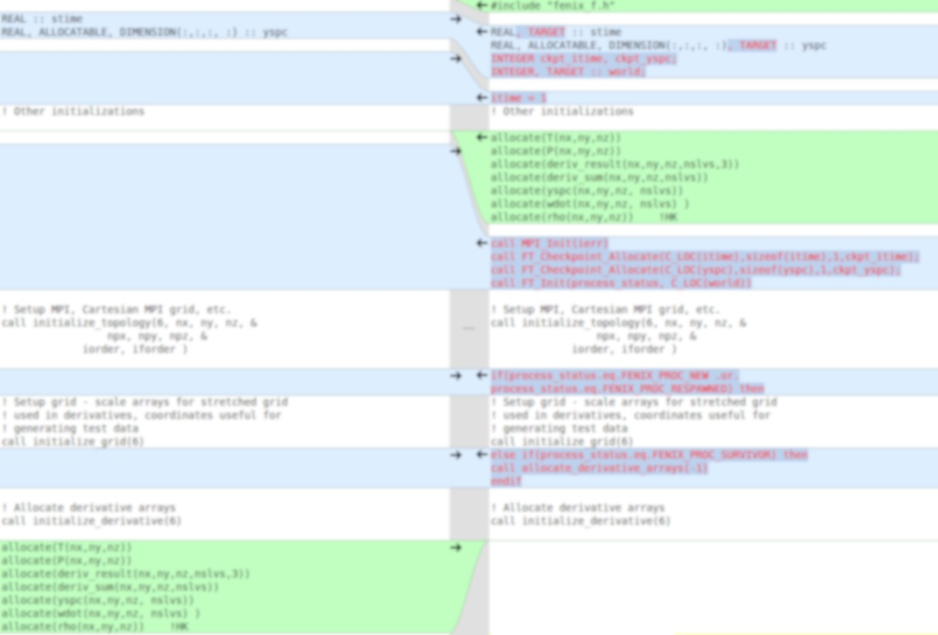
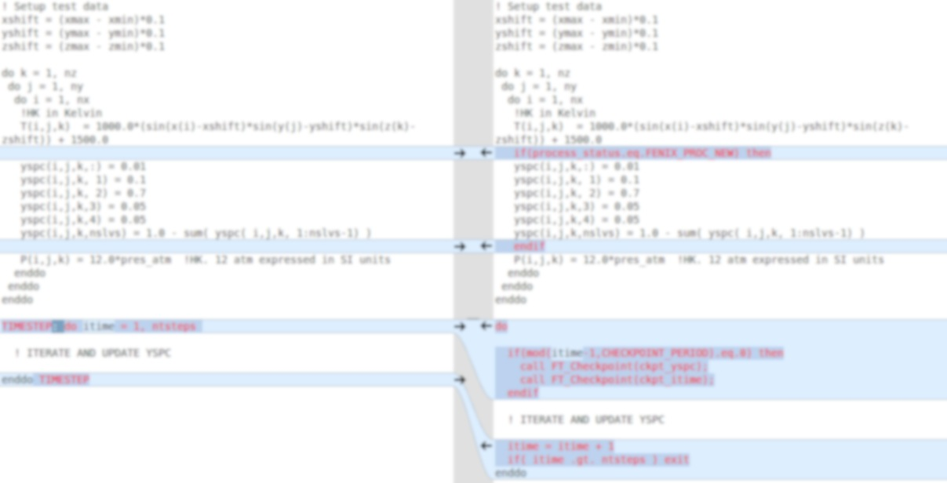
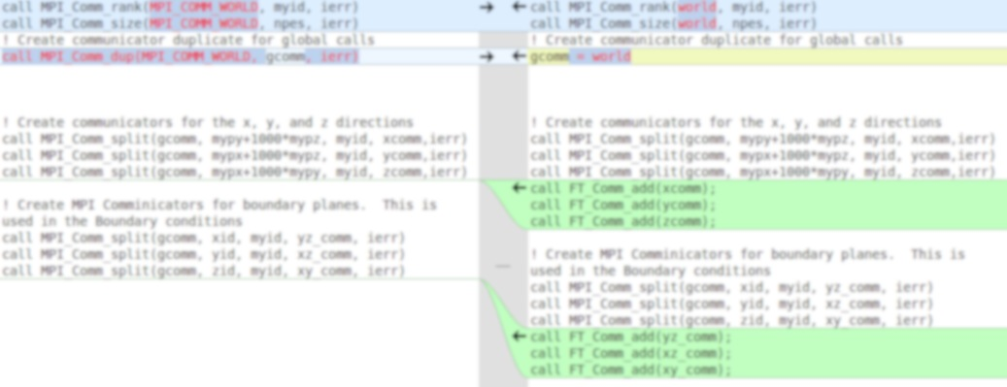
S3D Modifications
Original vs Fenix-enabled
Main function
Only 35 new, changed, or rearranged lines in S3D code
Topology module
Original vs Fenix-enabled

Slide 20
Goal and Methodology
Experiment:
S3D execution mimicking a future extreme-scale scenario
Injecting failures every (MTBF):
47 seconds
94 seconds
189 seconds
Checkpoint 8.58 MB/core
Procedure:
Evaluate checkpoint scalability
Calculate and validate optimal checkpoint interval
Evaluate recovery scalability
Run experiment
Evaluation on ORNL Titan - Cray XK7
Notes:
The goal of the experimental evaluation is to inject high frequency failures and evaluate its overhead over a failure-free checkpoint-free execution.
In order to do that, we first evaluate checkpoint scalability, optimal checkpoint interval and recovery scalability

Slide 21
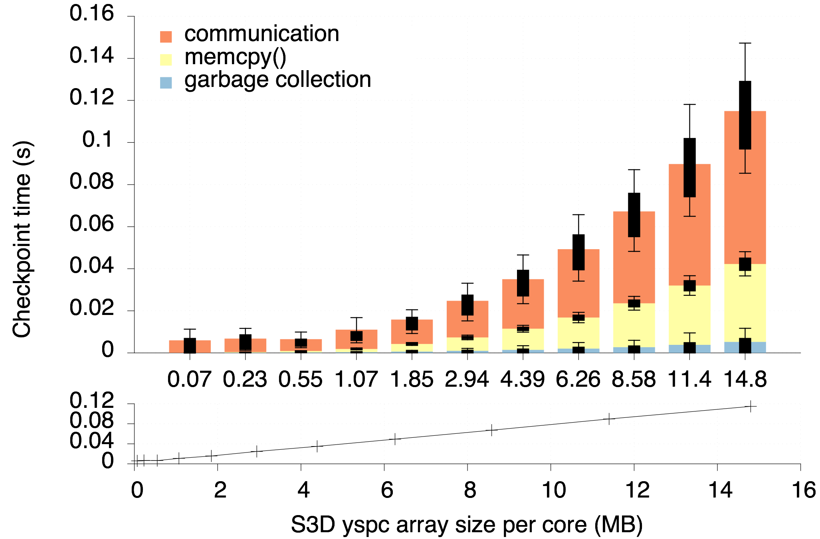
1. Failure-free checkpoint cost (data size)
Neighbor-based checkpointing
Conclusions:
Scales linearly with data size increase
Huge communication cost
Notes:
As expected, the checkpoint cost is linear to data size (lower figure)

Slide 22
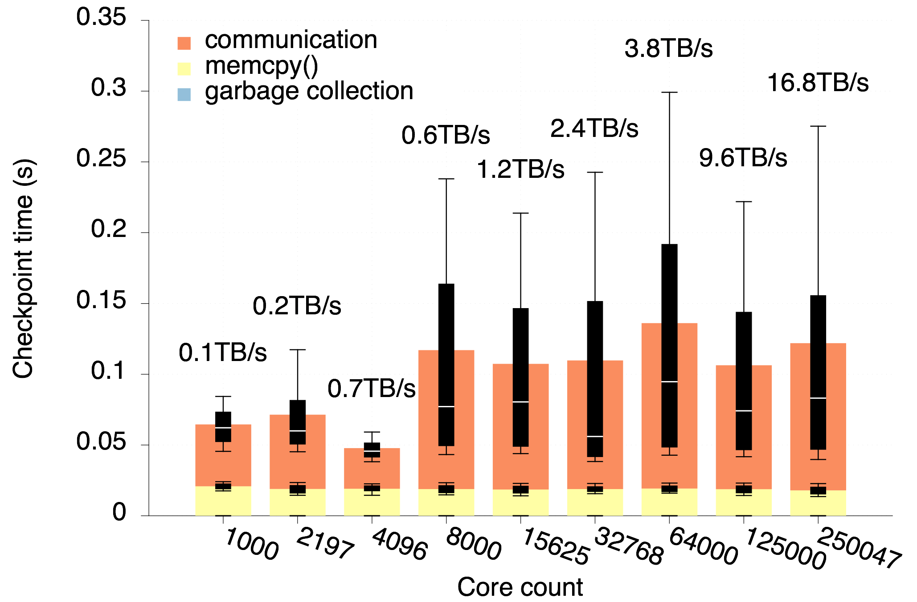
1. Failure-free checkpoint cost (core count)
Neighbor-based checkpointing
Conclusions:
Good scalability
Really small footprint: O(0.1s)
Notes:
It is NOT dependent to the number of cores. Perfect scalability.
If someone asks:
The difference between the first 3 bars (which are lower) and the remaining (6, which are a little higher) is due to the checkpoint destination. In the first 3 the checkpoints are copied to a different blade, while in the remaining the checkpoints are copied to a different cabinet

Slide 23
2. Optimal checkpoint rate
Calculated by Young’s formula:
= checkpoint time = 0.0748 s (with 2197 cores)
= system’s MTBF = {47, 94, 189} s (3 tests)
= {2, 3, 4} S3D iterations
Empirically validating the 94-second MTBF optimal rate:
Inject only one failure at a specific wall time within the first 94 seconds of a test
Repeat using:
Different checkpoint rates
Different failure injection timestamps
Optimal rate must offer smaller overall rollback cost!
Notes:
By the Young formula (we should have used Daly’s formula, which is newer), checkpoints have to be done every 2, 3 or 4 iterations, depending on the test (MTBF = 47, 94 or 189).
In the following slide we will show the evaluation of the 94-second MTBF case.

Slide 24
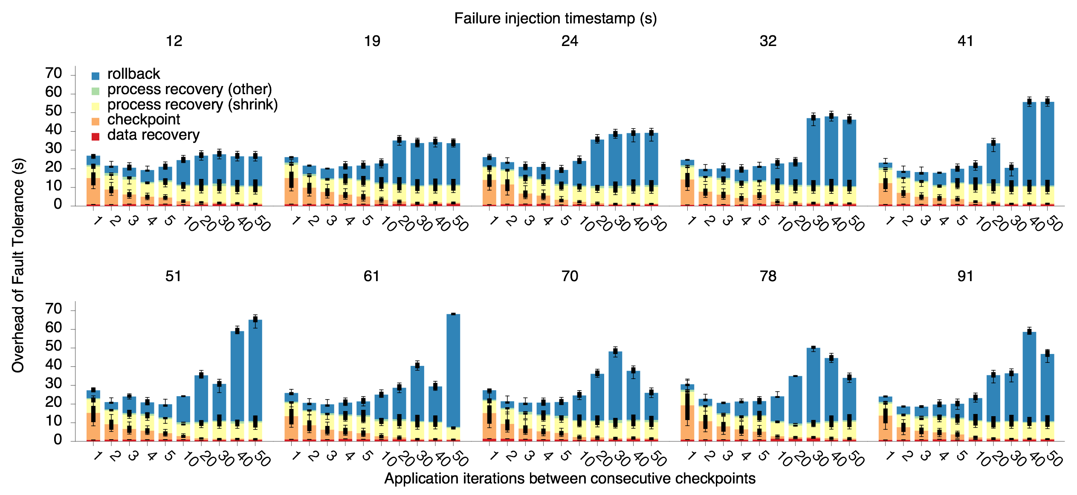
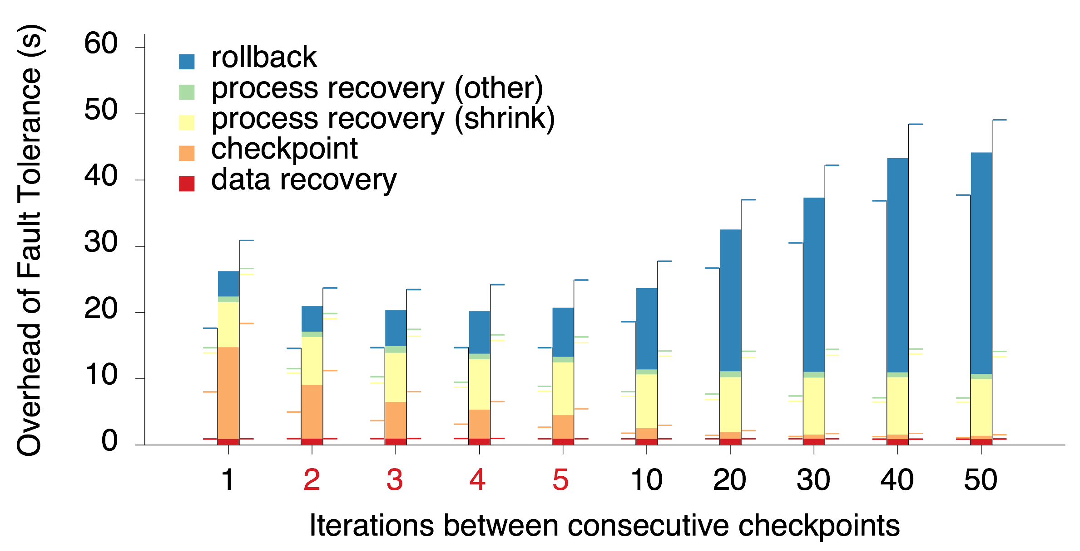
Average of all
failure injection
timestamps
2 to 5 iterations is the
optimal checkpoint
period, validating Young’s formula

Slide 25
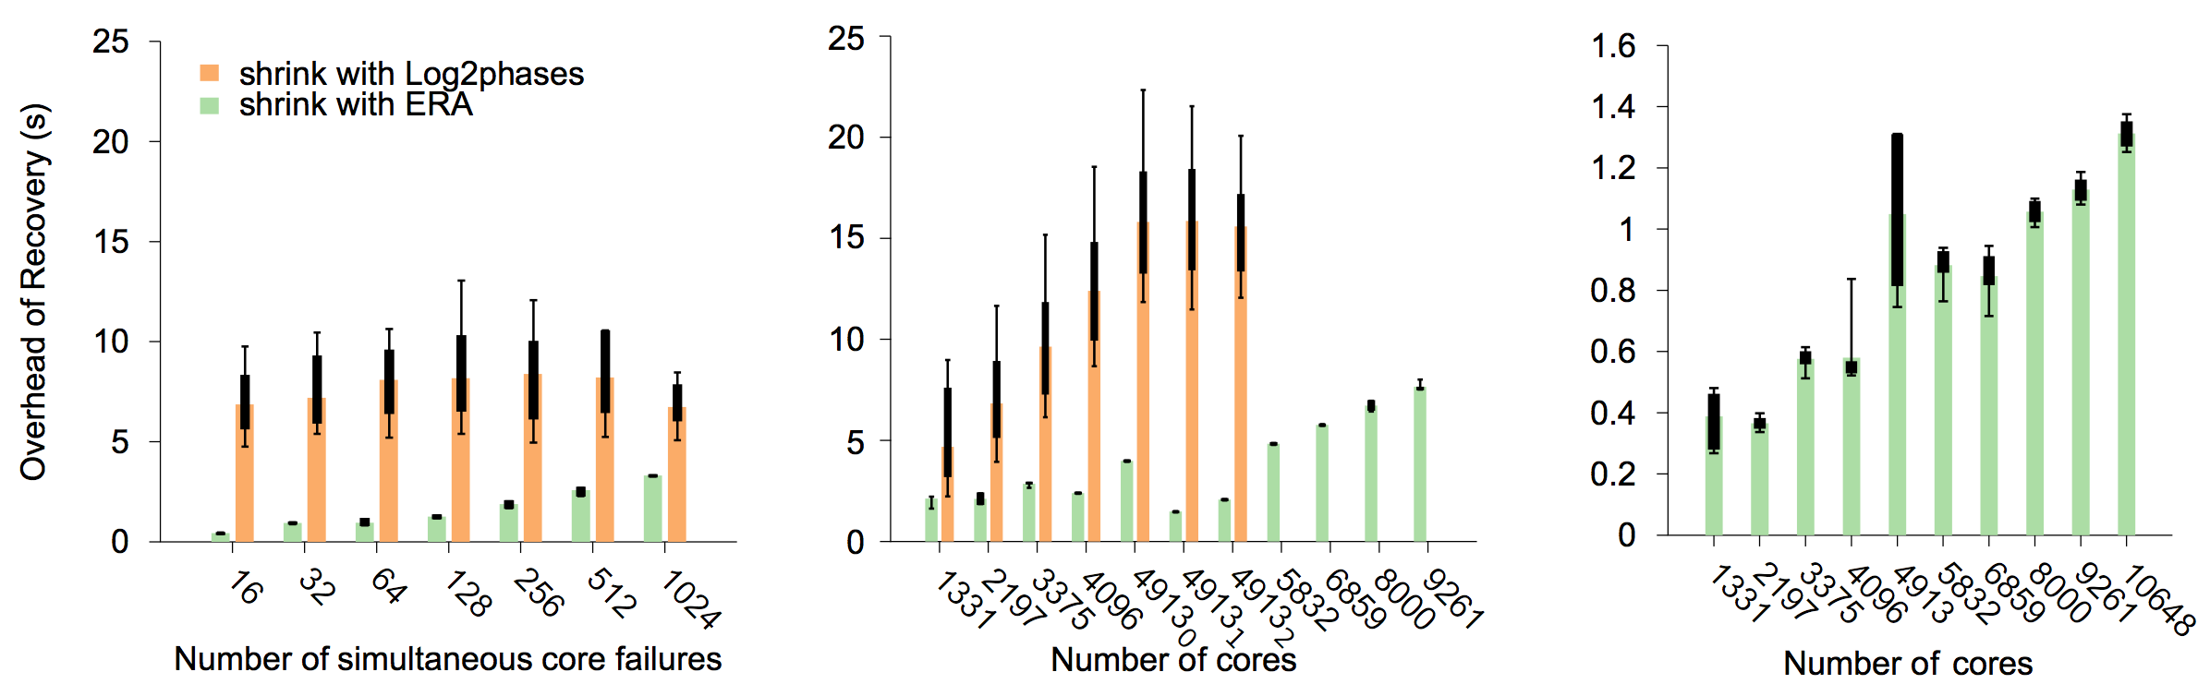
3. Recovery overhead
2197 cores
256-core failure (i.e. 16 nodes)
16-core failure (i.e. 1 nodes)

Slide 26
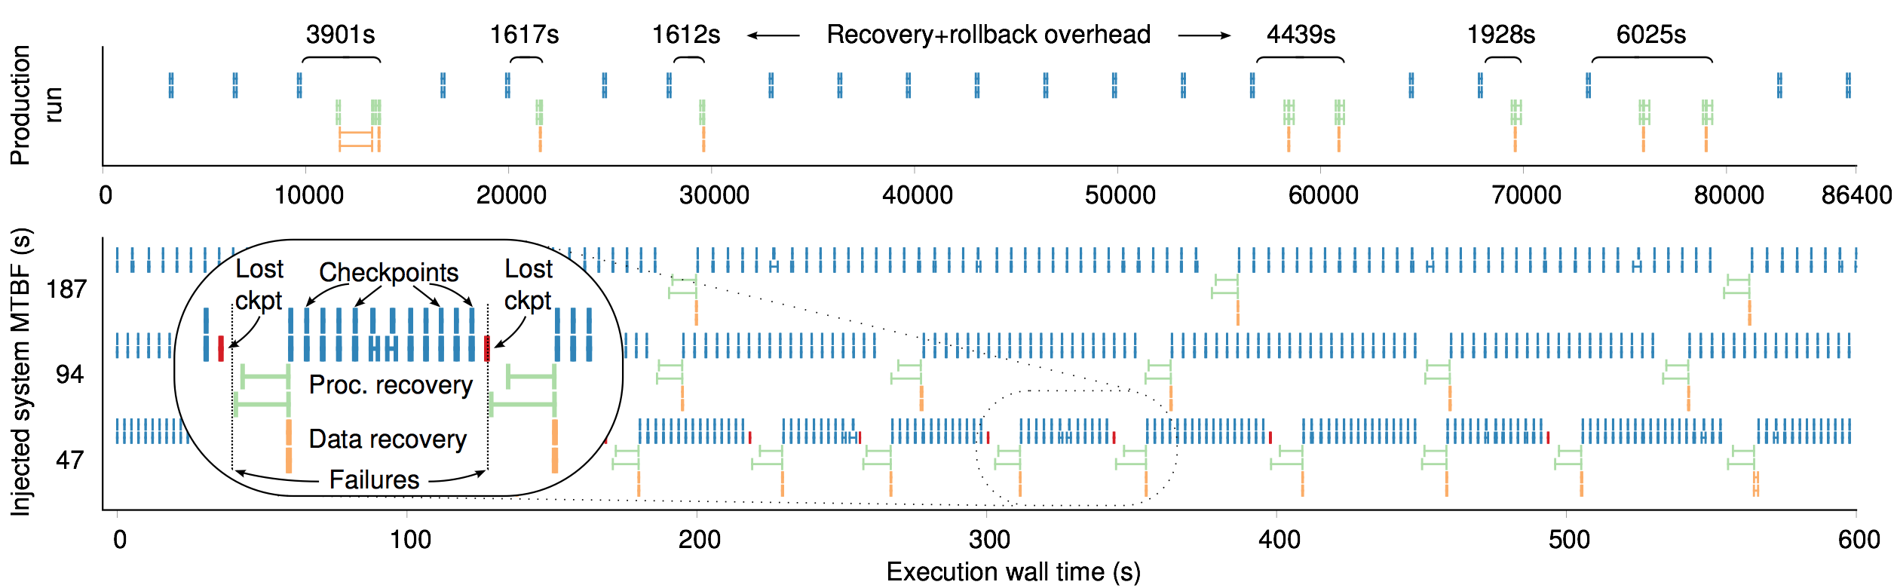
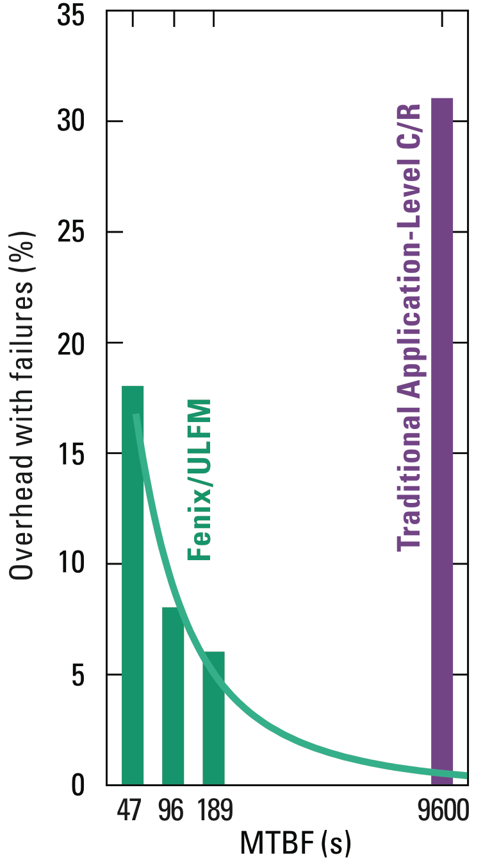
4. Recovering from high-frequency failures
Conclusions:
Online recovery allows the usage of in-memory checkpointing, O(0.1s)
Efficient recovery from high-frequency node failures, as exascale compels

Slide 27
4. Recovering from high-frequency failures
Conclusions:
Online recovery allows the usage of in-memory checkpointing, O(0.1s)
Efficient recovery from high-frequency node failures, as exascale compels
Figure extracted from ULFM flyer at SC15 by ICL@UTK

Slide 28
Conclusion
Application-awareness can help resilience at scale
Fenix provides
Online Failure Recovery (reducing failure overhead)
(uses in-memory, application-specific, high frequency checkpointing)
Simple API built on top of ULFM: only 35 new, changed, or rearranged lines in S3D code
Deployed and empirically tested on Titan Cray XK7
S3D+Fenix tolerate failure rates <1 min with lower overhead as coordinated CR with failure rates of ~2.5 hours
Since then, integrate it with other applications (SuperLU_DIST, SSEIG solver)
“Exploring Automatic, Online Failure Recovery for Scientific Applications at Extreme Scales”, SC14
Marc Gamell, Daniel S. Katz, Hemanth Kolla, Jacqueline Chen, Scott Klasky, Manish Parashar
“Practical Scalable Consensus for Pseudo-Synchronous Distributed Systems”, SC15
Thomas Herault, Aurelien Bouteiller, George Bosilca, Marc Gamell, Keita Teranishi, Manish Parashar, Jack Dongarra

Slide 29
Thank you

