Slide 1
ULFM + Automatic Recovery
FTWG Con Call
May 10, 2017

Slide 2
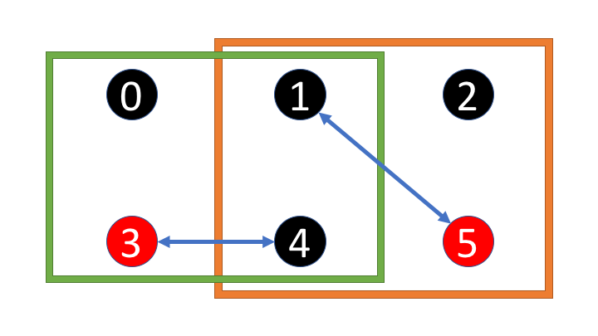
Motivation
During the ULFM discussion in December 2016, this example was presented.
If processes 3 & 5 fail simultaneously, recovery could deadlock as the green and orange communicators recover separately.

Slide 3
Solution: Make Recovery Internal
Bring the MPI_COMM_REVOKE and MPI_COMM_SHRINK operations into the MPI library
Give the user back the ”fixed” communicator.
When a failure is detected, do all of the recovery (failure discovery, agreement, and communicator repair) inside the MPI library.
MPI_REDUCE
Error = MPI_REDUCE

Slide 4
Don’t Throw Out the Baby with the Bathwater
Want to still have the old, broken comm and the new, fixed comm
Need to determine relationship between old rank and new rank
Might have an API to ask for either old or new communicator
Probably still want to have the revoke call to be able to interrupt non-dependent operations due to failure.
Would want to enable/disable automatic recovery for applications which can guarantee their own safety and/or don’t want automatic recovery (only care about point-to-point).

Slide 5
Fault Tolerance “Initialization”
The best solution would probably be to add FT to the initialization
Ask for ULFM / ULFM + autorecovery / Reinit, etc.
Could be an additional MPI_INIT function without sessions or part of the session creation function
Easy to see how this would interact with regular ULFM between different sessions
Could even live in the same session if we made it a property of the communicator
Reinit and ULFM(++) could probably work in the same app but in different sessions.
Would have to have sophisticated application-level recovery procedure for synchronizing application + library.

