Slide 1
FTWG Con Call Tuesday, May 24, 2016

Slide 2
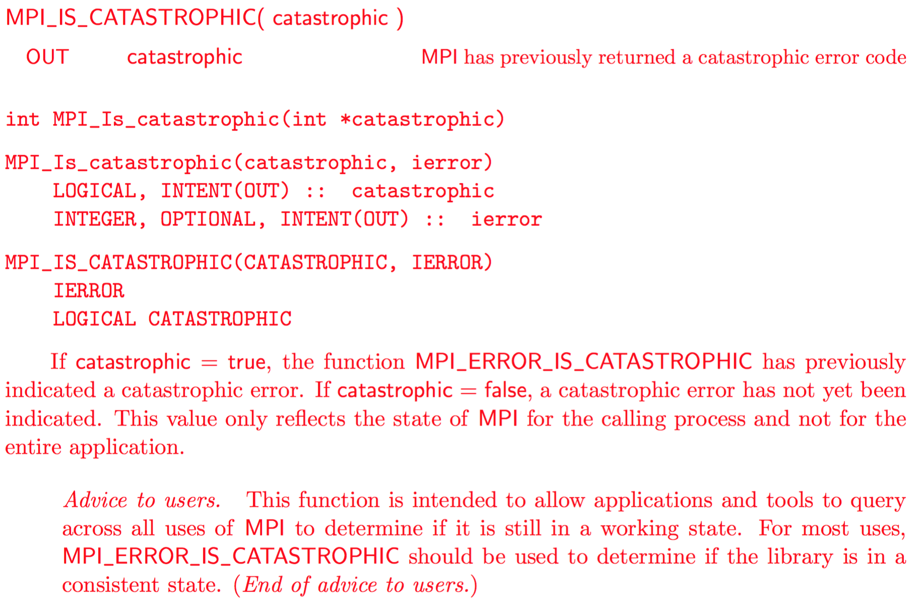
Catastrophic Errors
https://github.com/mpi-forum/mpi-standard/pull/9

Slide 3
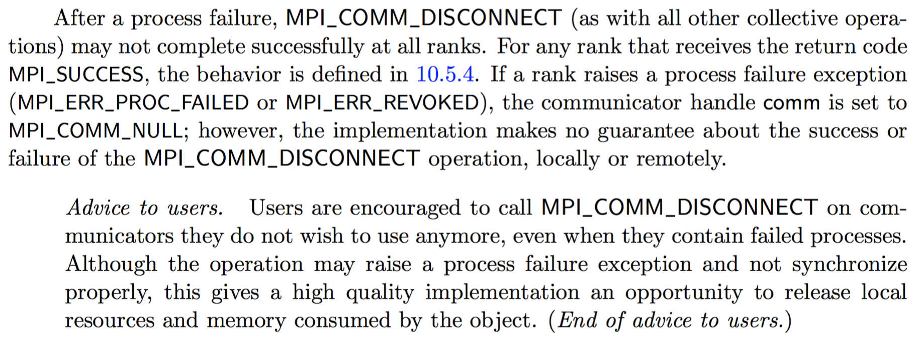
MPI_Disconnect with ULFM
https://github.com/mpiwg-ft/mpi-standard/pull/7

Slide 4
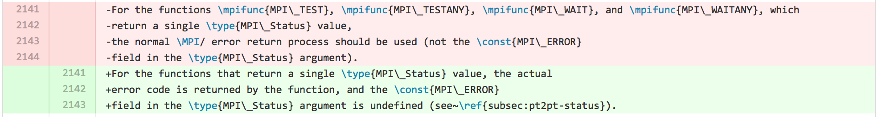
MPI_ERR_IN_STATUS
https://github.com/mpi-forum/mpi-standard/pull/19
Is this for consideration at this meeting?
Coordinate with Hybrid?

Slide 5
FTWG at the MPI Forum
Monday
FTWG F2F time: 2:00 PM – 5:30 PM
Wednesday
Wesley – Reading
#28: Add Catastrophic and Noncatastrophic Error Codes
#1: Clarify MPI_ERRORS_ARE_FATAL scope of abort
#3: Define new MPI Error handler for subcommunicator abort
Aurelien – Reading
#20: ULFM part 1
Thursday
Vote - #7: Cleanup Advice and Definition of MPI_COMM_FREE

